Slide 1
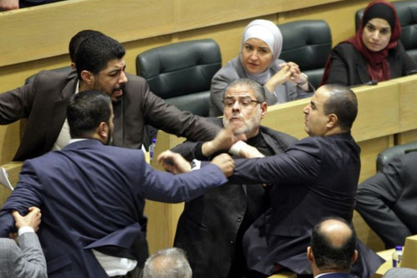
AutoAgg
Automatic detection and analysis of warnings and aggressiveness in Knesset committees

