Slide 1

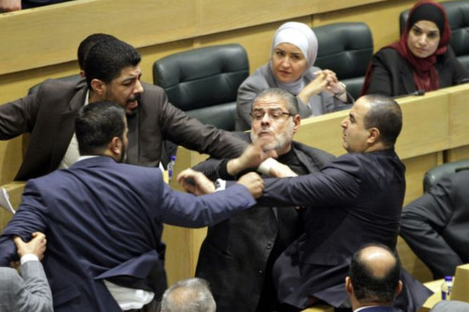
AutoAgg
Automatic detection and analysis of warnings and aggressiveness in Knesset committees
Presented by:
Ely Katz
Itai Tzruia
NLPSD 2023

Slide 2

Background
Israel got in complicated politic situation
There are complaints about:
Knesset members behavior
Deterioration from one election to another
Increase in politic polarization
Political disorder

Slide 3
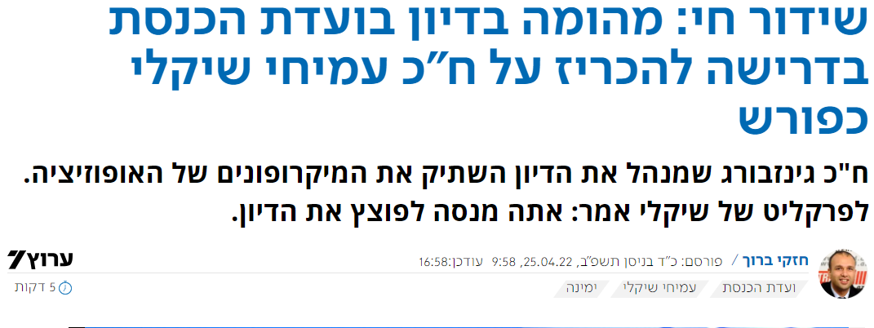
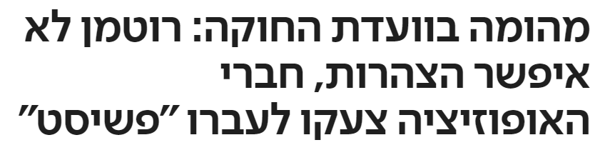
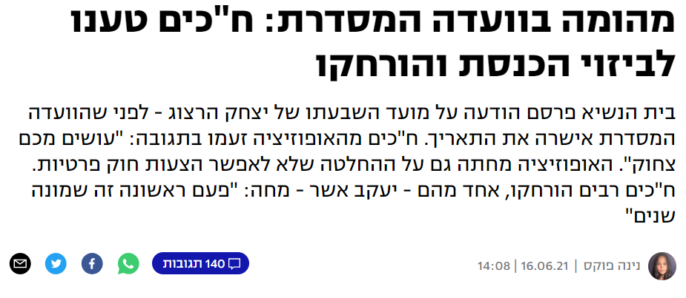
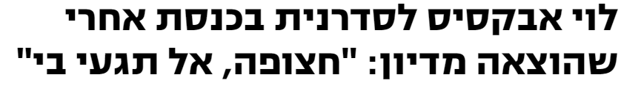
Some Examples

Slide 4
Research Goal
Quantify aggressive behavior in the Knesset
Detect and analyze warnings of Knesset members
Consequences of the political disorder

Slide 5
Our Data
Knesset numbers 20 to 25
5 committees:
Finances Committee (ועדת הכספים)
Defense Committee (ועדת חוץ וביטחון)
The Knesset Committee (ועדת הכנסת)
Regulatory Committee (הועדה המסדרת)
Law and Order Committee (ועדת חוק, חוקה ומשפט)
Using API of Open Knesset

Slide 6
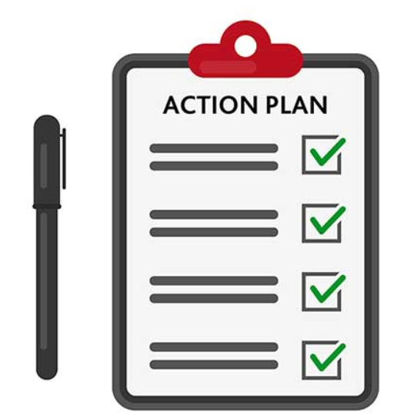
Our Work Plan
Initial data exploration
Warning detection
Aggressiveness rating
Experiments
Results

Slide 7
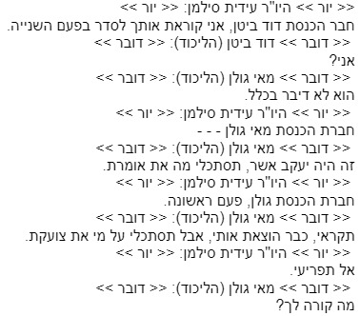
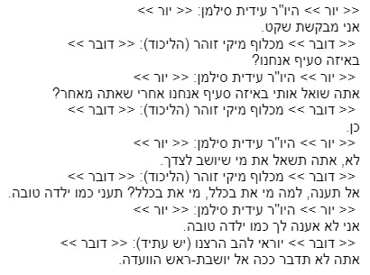
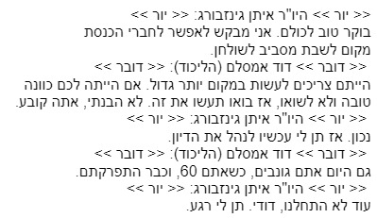



Initial Data Exploration

Slide 8
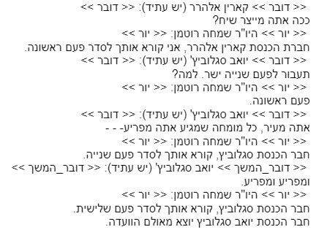
Warning Detection
Identifying patterns of warnings
Extract warned member and warning number
All using regex
Keep all members Nicknames to avoid duplicates
Save for every protocol:
Dict - {member: [# 1st_warning,
# 2nd_warning,
# 3rd_warning]}

Slide 9
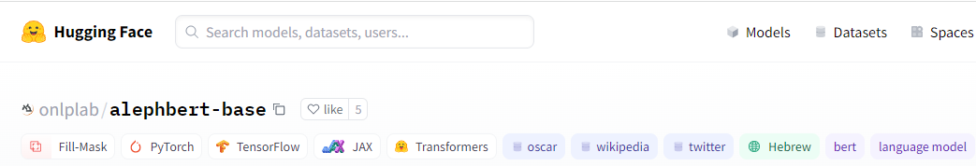
Aggressive Score Rating
Manually tagging ~1400 sentences (classification)
AlephBert binary classification
Fine-tune/transfer learning
Predict score for the whole session
Notes:
- Binary classification (aggressive or not).
- Fine-tune perform better (75% accuracy).
- For each protocol, split into sentences, for each sentence predict if aggressive, the ratio of aggressive sentence is the score.

Slide 10
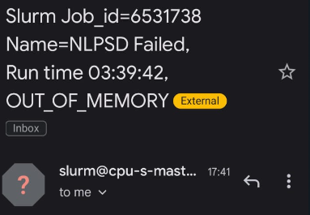
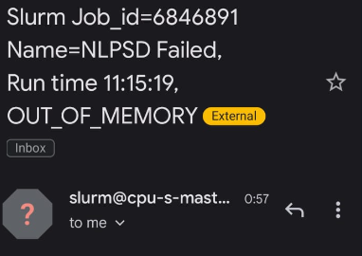
Experiments
Running a full pipeline on the BGU cluster
A lot of data – memory leaks :(

Slide 11
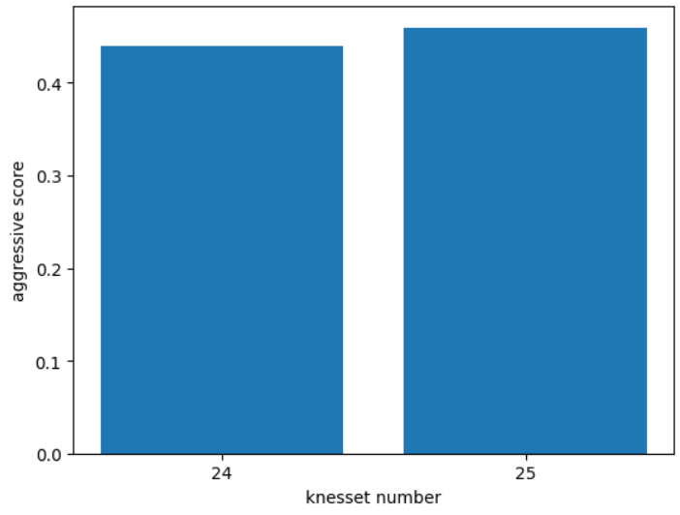
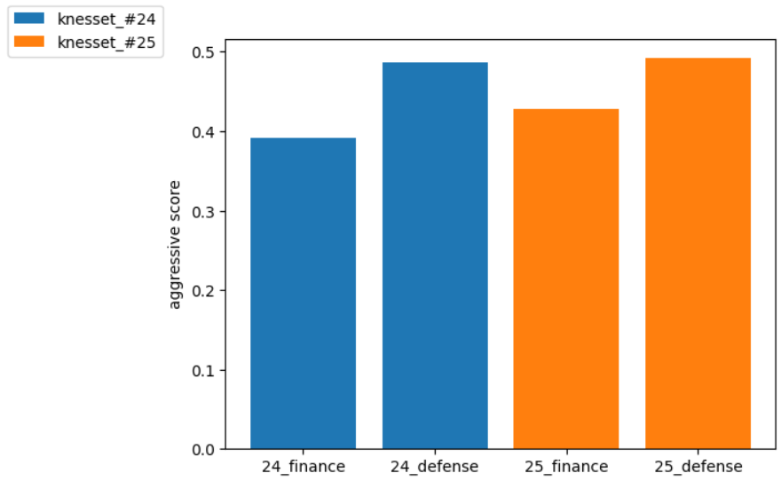
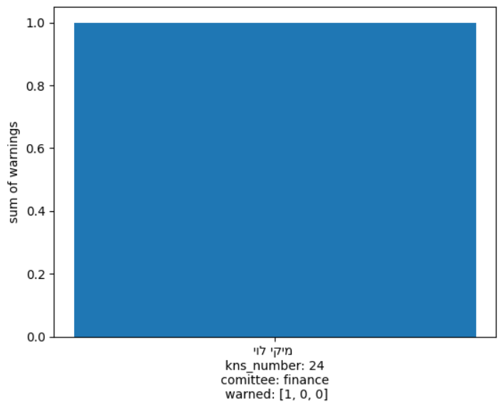
Initial Results

