Slide 1

סדנה גרסה 4
התאמת המערכת לשימוש בינלאומי
ראש גרסה – איתי צרויה
ראש גרסה חורג – ניר דניאל
חברי קבוצה יקרים – רון מיכל, איתי גיליוטין, תומר הלפרין, עומר פרסלר

Slide 2
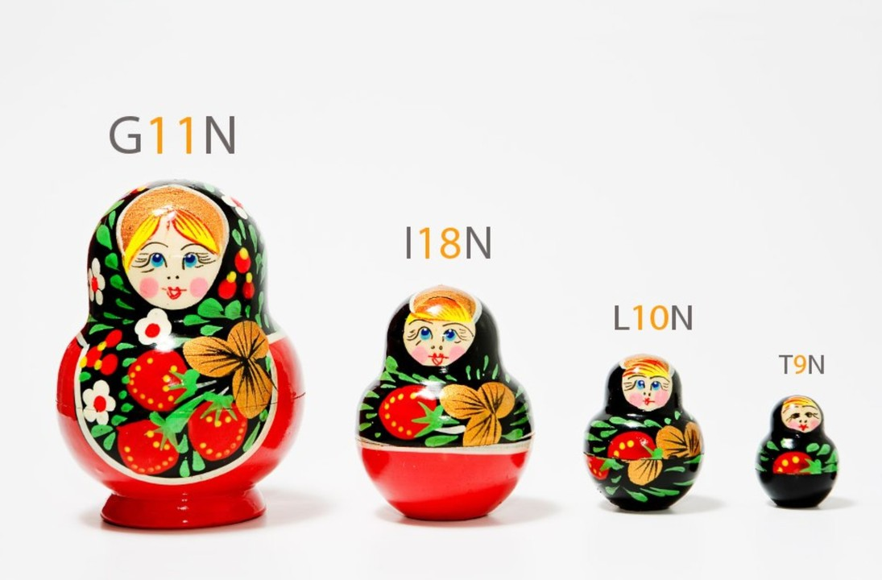
Globalization (G11N)
The process by which businesses or organizations develop international influence or operate on an international scale.
Used across many product-based companies to attract more customers.
Consists Internationalization (I18N), Localization (L10N) and Translation (T9N).

Slide 3

Internalization (I18N)
The process of developing our source code according to international formats.
For example – flexible currency sign, date format, credit card formats, time zones etc.
Should not be hard coded!
When developing our software system, we should keep in mind our product will not be used only in English, payment will not only be in dollars, etc.

Slide 4


Localization (L10N)
Adapting content to its destination country
For example, replacing polar bear icons with camels for Arab countries
Usually done for video games, movies, software and apps
Make the customers feel like the product was originally designed for their culture!

Slide 5

Changes Required to our System
Internalization
Including culture specific phrases in other languages (slang phrases etc.)
Supporting additional currencies besides dollars
Adapting messages to time zones (ex.- “Good morning/night” according to location)
Using location services to infer the client’s country and/or culture
Localization
Supporting different product types for various cultures
Personalizing logos and images for different population types

