Slide 1

סדנה גרסה 4
התאמת המערכת לשימוש בינלאומי
חברי קבוצה יקרים – איתי גיליוטין, ניר דניאל, עומר פרסלר, רון מיכל, תומר הלפרין
ראש גרסה – איתי צרויה

Slide 2
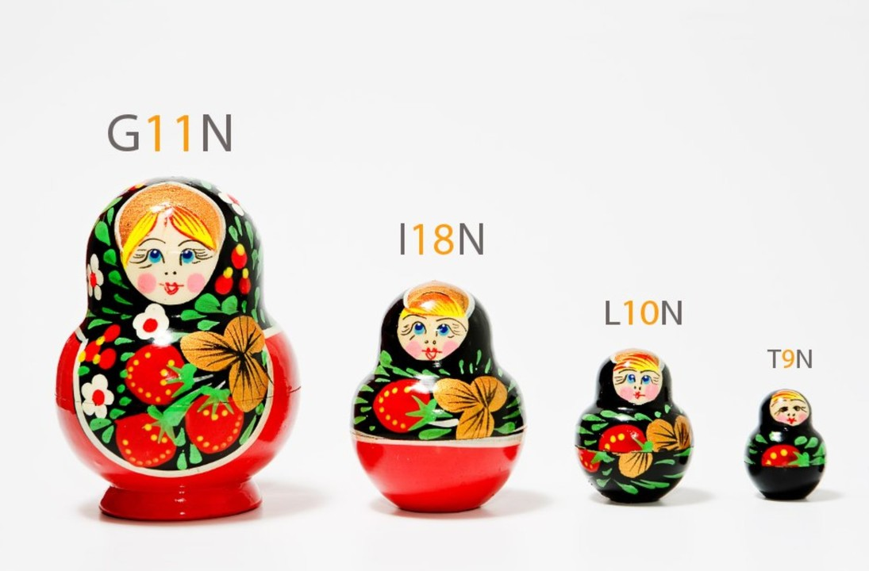
Globalization (G11N)
The process by which businesses or organizations develop international influence or operate on an international scale.
Used across many product-based companies to attract more customers.
Consists Internationalization (I18N), Localization (L10N) and Translation (T9N).

Slide 3

Internalization (I18N)
The process of developing our source code according to international formats.
For example – flexible currency sign, date format, credit card formats, time zones etc.
Should not be hard coded!
When developing our software system, we should keep in mind our product will not be used only in English, payment will not only be in dollars, etc.

Slide 4

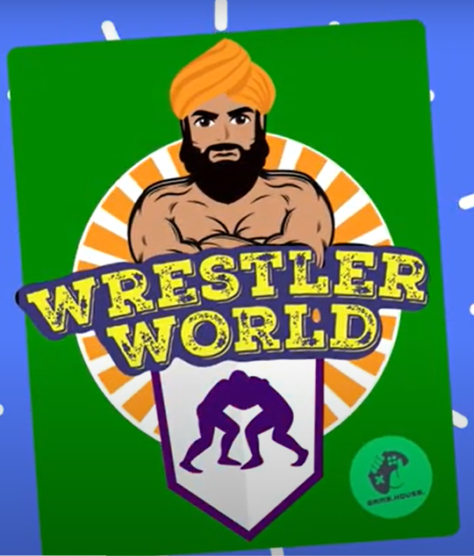
Localization (L10N)
Adapting content to its destination country
For example, replacing polar bear icons with camels for Arab countries
Usually done for video games, movies, software and apps
Make the customers feel like the product was originally designed for their culture!

Slide 5

Changes Required to our System
Internalization
Including culture specific phrases in other languages (slang phrases etc.)
Supporting additional currencies and measurement units (product size in cm/inches)
Adapting messages to time zones (ex.- “Good morning/night” according to location)
Using location services to infer the client’s country and/or culture
Localization
Supporting different product types for various cultures
Personalizing logos and images for different population types

Slide 6

Service Layer Requirements
User Experience (SLR 4)
Currently: Response time, Feedback, Comfortable and Personalized User Interface
In the future:
Globalization – UI contains familiar language and formats
Localization – UI contains familiar, culture-customized content
Result – a better user experience!

Slide 7
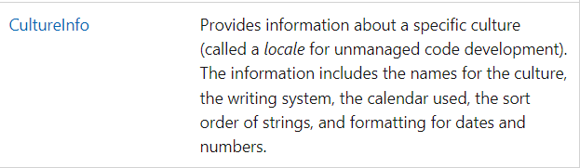
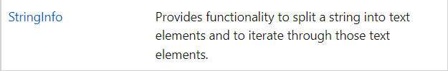


Available Frameworks
.NET contains the module System.Globalization
Some relevant classes (taken from System.Globalization API):

