Slide 1
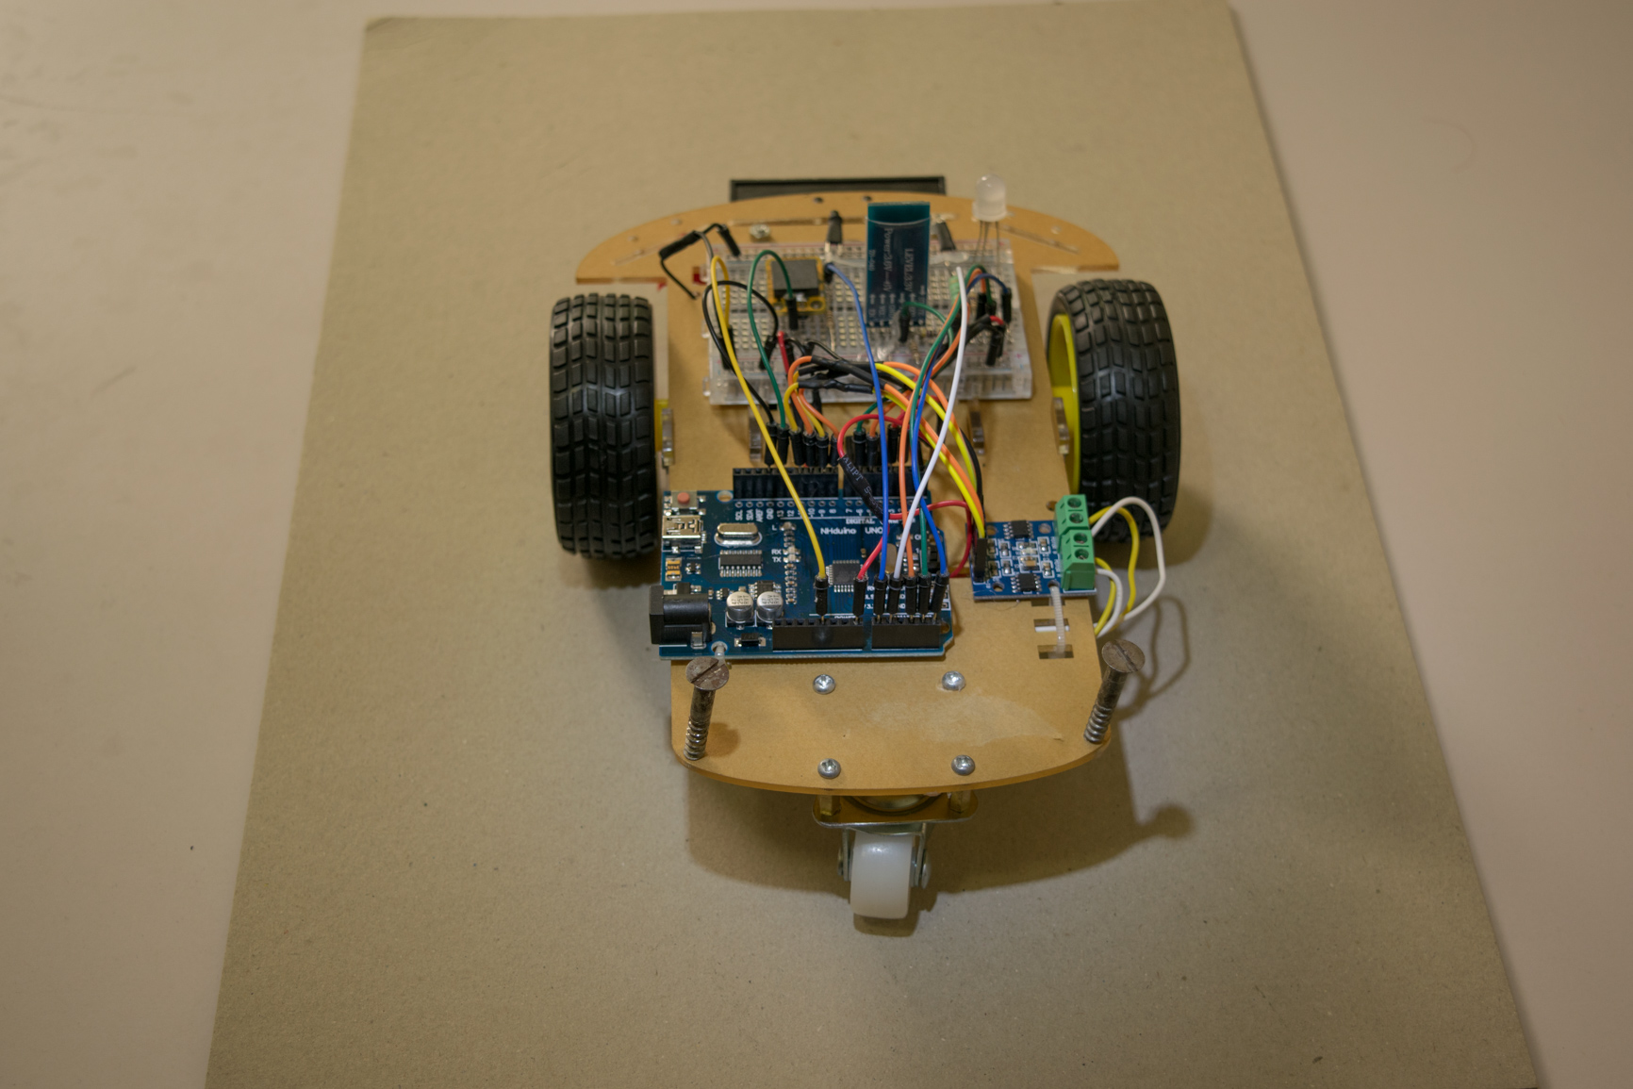
L9119S H-Bridge
Ardunio Uno
Payload Support :)

Slide 2
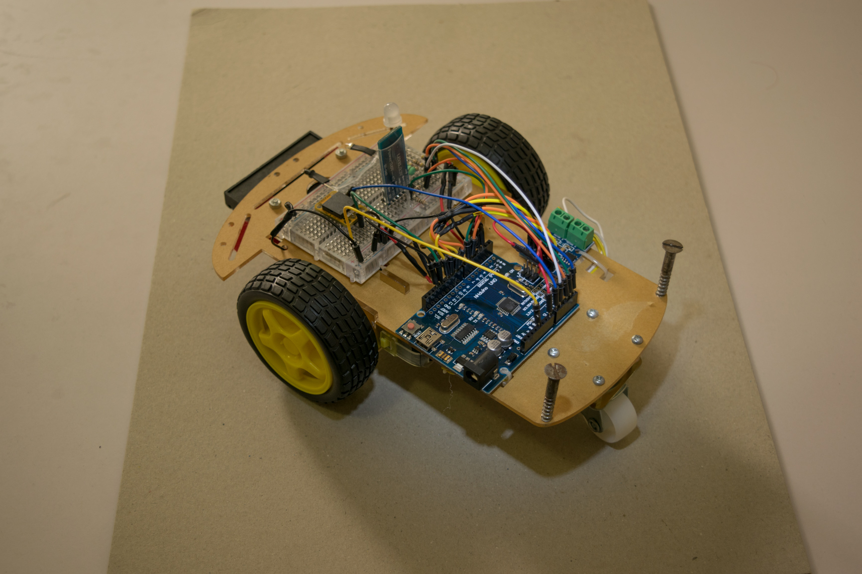
HC-05 Bluetooth
Hobby Wheels

Slide 3
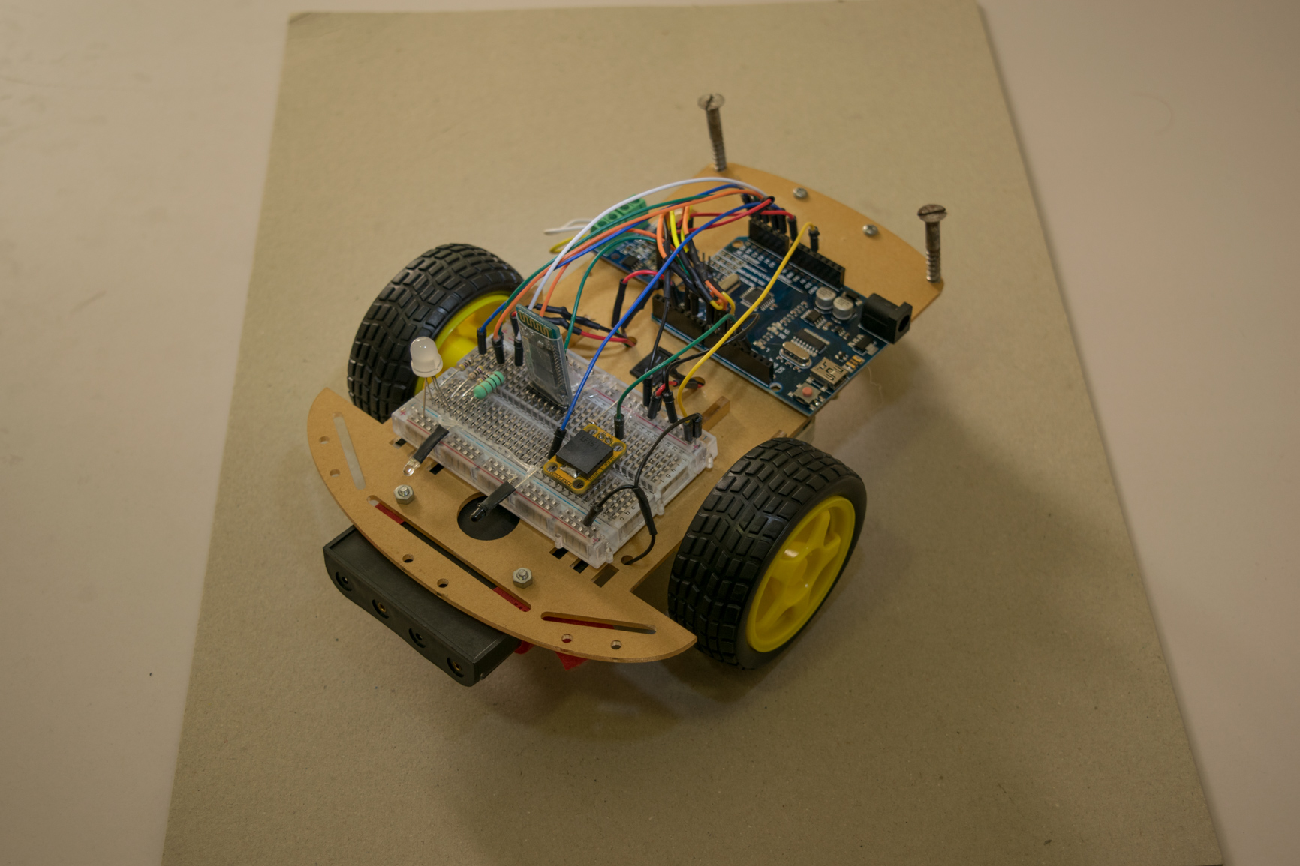
RGB LED
5mm IR LED
5V Piezo
5mm IR Photodiode

Slide 4
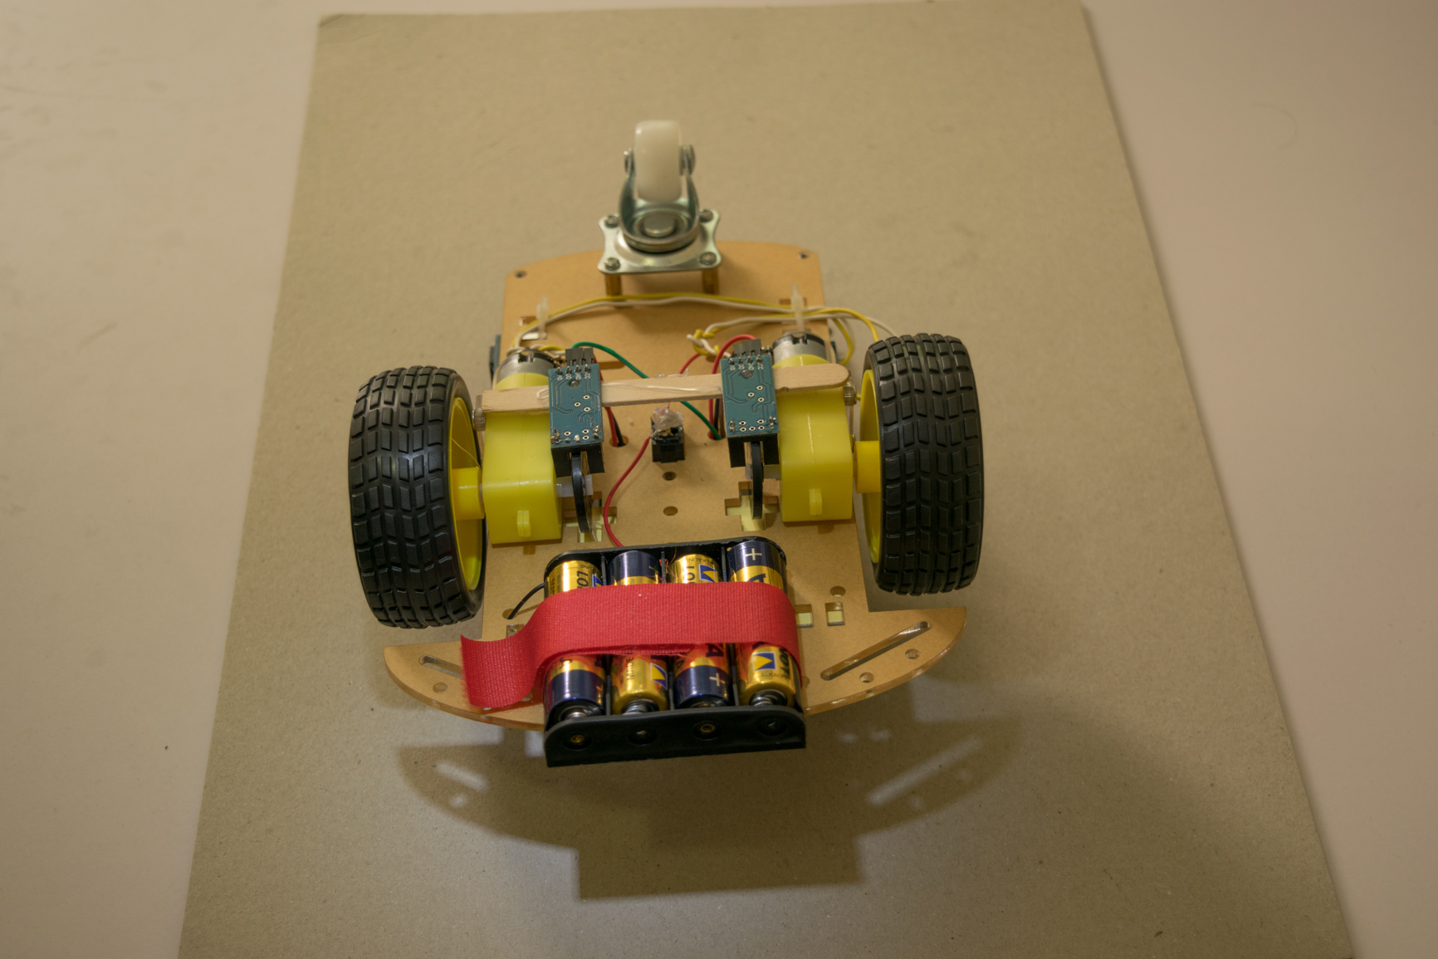
Caster Wheel
Optocoupler Speed
Sensor LM393
1:48 Gear Motor
4XAA Battery
Holder

Slide 5
