Slide 1


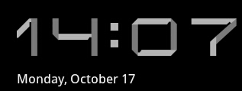



设计报告
决策树
082411 胡刘飞
Notes:
When Jobs returned to Apple in 1997 after a 12-year absence, Apple faced an uncertain future. Jobs closed his presentation that year at Macworld in Boston with an observation that set the tone for Apple’s resurgence: “I think you have to think differently to buy an Apple computer. A lot of times people think they’re crazy, but in that craziness we see genius.”

Slide 2




主页 | +
设计思想
四个模块
执行流程
总结
Notes:
When Jobs returned to Apple in 1997 after a 12-year absence, Apple faced an uncertain future. Jobs closed his presentation that year at Macworld in Boston with an observation that set the tone for Apple’s resurgence: “I think you have to think differently to buy an Apple computer. A lot of times people think they’re crazy, but in that craziness we see genius.”

Slide 3




设计思想
数据集
属性列表
测试属性
决策树
Notes:
When Jobs returned to Apple in 1997 after a 12-year absence, Apple faced an uncertain future. Jobs closed his presentation that year at Macworld in Boston with an observation that set the tone for Apple’s resurgence: “I think you have to think differently to buy an Apple computer. A lot of times people think they’re crazy, but in that craziness we see genius.”

Slide 4
主页 | +
设计思想
四个模块
执行流程
总结
Notes:
When Jobs returned to Apple in 1997 after a 12-year absence, Apple faced an uncertain future. Jobs closed his presentation that year at Macworld in Boston with an observation that set the tone for Apple’s resurgence: “I think you have to think differently to buy an Apple computer. A lot of times people think they’re crazy, but in that craziness we see genius.”

Slide 5

四个模块
1.训练集
2.属性列表
3.求测试属性
4.画决策树
Notes:
When Jobs returned to Apple in 1997 after a 12-year absence, Apple faced an uncertain future. Jobs closed his presentation that year at Macworld in Boston with an observation that set the tone for Apple’s resurgence: “I think you have to think differently to buy an Apple computer. A lot of times people think they’re crazy, but in that craziness we see genius.”

Slide 6

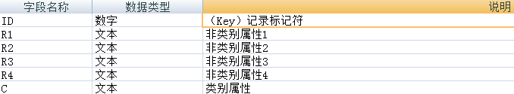
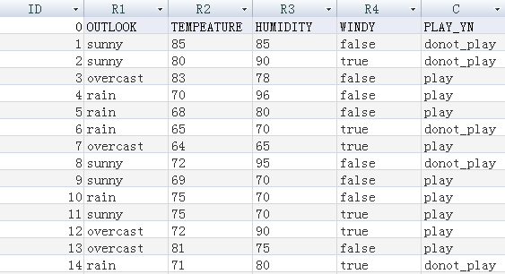
训练集
数据存储方式：Access数据库
数据库设计视图： ：
数据库样表：
Notes:
When Jobs returned to Apple in 1997 after a 12-year absence, Apple faced an uncertain future. Jobs closed his presentation that year at Macworld in Boston with an observation that set the tone for Apple’s resurgence: “I think you have to think differently to buy an Apple computer. A lot of times people think they’re crazy, but in that craziness we see genius.”

Slide 7

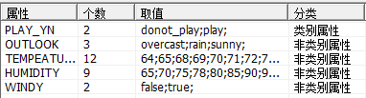
属性列表
数据库操作语言：SQL
数据库操作技术：ADO
属性列表：
样表：
Notes:
When Jobs returned to Apple in 1997 after a 12-year absence, Apple faced an uncertain future. Jobs closed his presentation that year at Macworld in Boston with an observation that set the tone for Apple’s resurgence: “I think you have to think differently to buy an Apple computer. A lot of times people think they’re crazy, but in that craziness we see genius.”

Slide 8
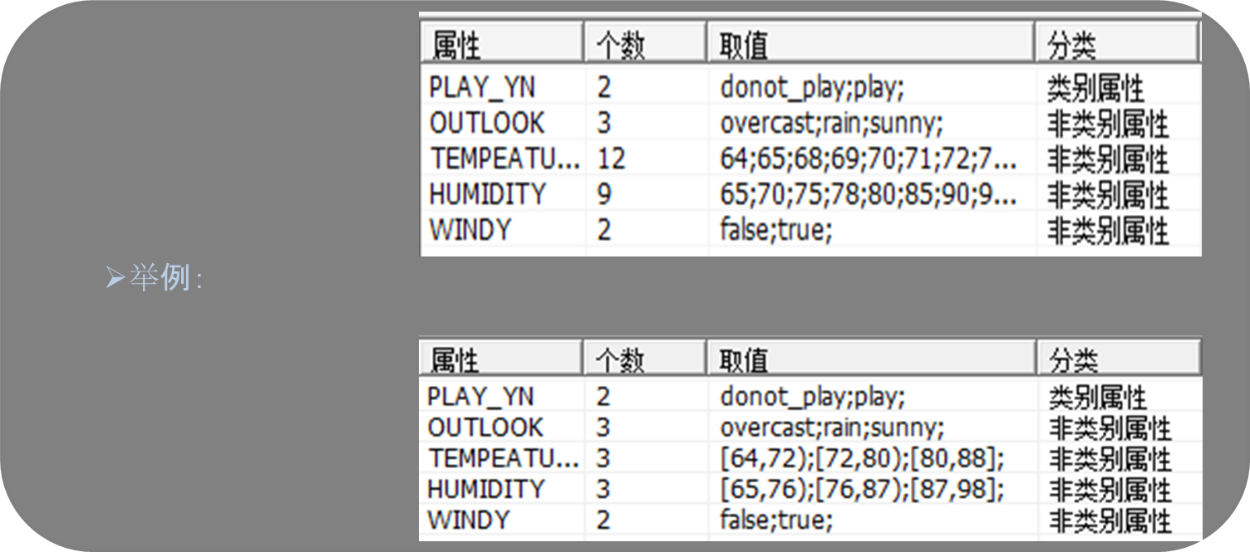

属性列表续
属性列表的优化
优化原则： 对于连续性属性（属性的值域为连续域时），取值用区间表示。
优化
Notes:
When Jobs returned to Apple in 1997 after a 12-year absence, Apple faced an uncertain future. Jobs closed his presentation that year at Macworld in Boston with an observation that set the tone for Apple’s resurgence: “I think you have to think differently to buy an Apple computer. A lot of times people think they’re crazy, but in that craziness we see genius.”

Slide 9
求测试属性
Info(T)
概念:若一个记录的集合T根据类别属性分为相互独立的类C1、C2、、、Ck，则识别一 个元素 属于哪个类别所需的信息量叫做Info（T）。
计算公式：Info（T）=I（P）；
P={|C1|/|T|,|C2|/|T|,…...,|Ck|/|T|};
Info(X,T)
计算公式：
Gain(X,T)
计算公式：
测试属性
具有最高信息增益（即Gain（X，T）最大）的属性为集合T的测试属性。
Notes:
When Jobs returned to Apple in 1997 after a 12-year absence, Apple faced an uncertain future. Jobs closed his presentation that year at Macworld in Boston with an observation that set the tone for Apple’s resurgence: “I think you have to think differently to buy an Apple computer. A lot of times people think they’re crazy, but in that craziness we see genius.”

Slide 10
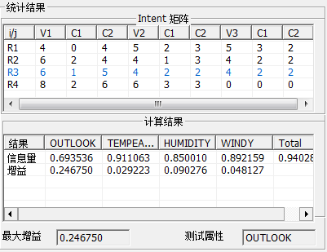
测试属性续
举例：
Notes:
When Jobs returned to Apple in 1997 after a 12-year absence, Apple faced an uncertain future. Jobs closed his presentation that year at Macworld in Boston with an observation that set the tone for Apple’s resurgence: “I think you have to think differently to buy an Apple computer. A lot of times people think they’re crazy, but in that craziness we see genius.”

Slide 11
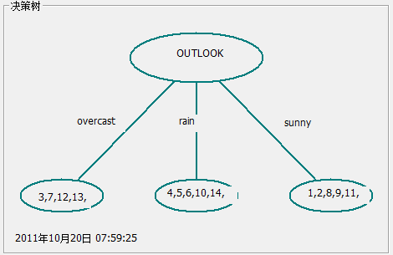
画决策树
原理：根据测试属性，创建一个节点，并以该属性为标记，对属性的每个值创建分 枝，并据此划分样本，显示样本集合。
举例：
Notes:
When Jobs returned to Apple in 1997 after a 12-year absence, Apple faced an uncertain future. Jobs closed his presentation that year at Macworld in Boston with an observation that set the tone for Apple’s resurgence: “I think you have to think differently to buy an Apple computer. A lot of times people think they’re crazy, but in that craziness we see genius.”

Slide 12
主页 | +
设计思想
四个模块
执行流程
总结
Notes:
When Jobs returned to Apple in 1997 after a 12-year absence, Apple faced an uncertain future. Jobs closed his presentation that year at Macworld in Boston with an observation that set the tone for Apple’s resurgence: “I think you have to think differently to buy an Apple computer. A lot of times people think they’re crazy, but in that craziness we see genius.”

Slide 13
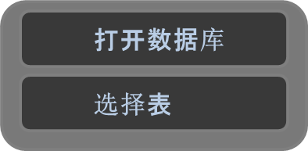
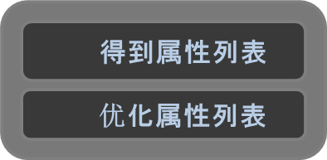
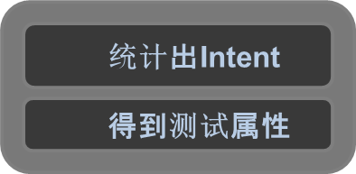

执行流程
OpenFile();
SelectTable();
CreateAttr();
ShowAttr();
ImproveAttr();
ShowNewAttr();
CreateIntent();
ShowIntent();
Inft();
Gain();
TestAttr();
ShowTreeView();
Notes:
When Jobs returned to Apple in 1997 after a 12-year absence, Apple faced an uncertain future. Jobs closed his presentation that year at Macworld in Boston with an observation that set the tone for Apple’s resurgence: “I think you have to think differently to buy an Apple computer. A lot of times people think they’re crazy, but in that craziness we see genius.”

Slide 14
主页 | +
设计思想
四个模块
执行流程
总结
Notes:
When Jobs returned to Apple in 1997 after a 12-year absence, Apple faced an uncertain future. Jobs closed his presentation that year at Macworld in Boston with an observation that set the tone for Apple’s resurgence: “I think you have to think differently to buy an Apple computer. A lot of times people think they’re crazy, but in that craziness we see genius.”

Slide 15
总结
不管项目有多小、多简单，在coding前有个设计框架，都会事半功倍。
不管是给别人提供接口还是去实现被人的接口。接口一定得明确、简洁，而且对双方都易于得到和利用。
项目周期较长或代码较长时，代码注释必不可少。
Notes:
When Jobs returned to Apple in 1997 after a 12-year absence, Apple faced an uncertain future. Jobs closed his presentation that year at Macworld in Boston with an observation that set the tone for Apple’s resurgence: “I think you have to think differently to buy an Apple computer. A lot of times people think they’re crazy, but in that craziness we see genius.”

Slide 16
End
THANK YOU !
Notes:
When Jobs returned to Apple in 1997 after a 12-year absence, Apple faced an uncertain future. Jobs closed his presentation that year at Macworld in Boston with an observation that set the tone for Apple’s resurgence: “I think you have to think differently to buy an Apple computer. A lot of times people think they’re crazy, but in that craziness we see genius.”

