Slide 1
Bag of Tricks

Slide 2
Activation Functions
CS231n: Convolutional Neural Networks for Visual Recognition

Slide 3
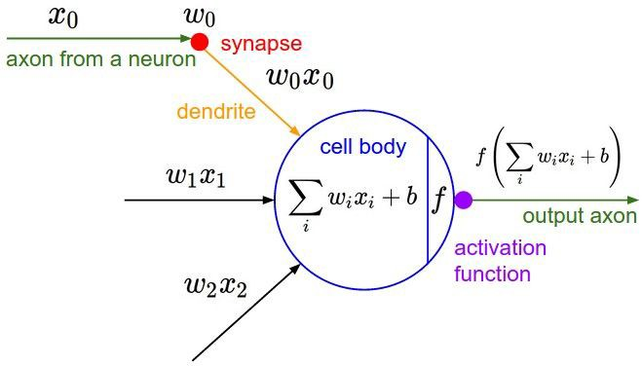
Activation Functions
Fei-Fei, Krishna, Xu

Slide 4
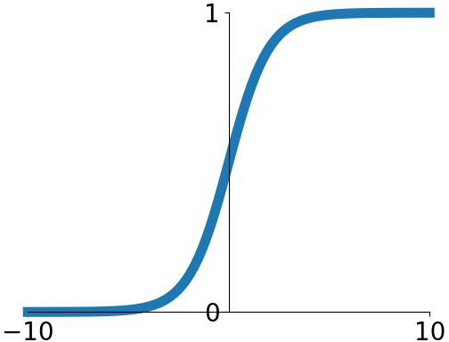
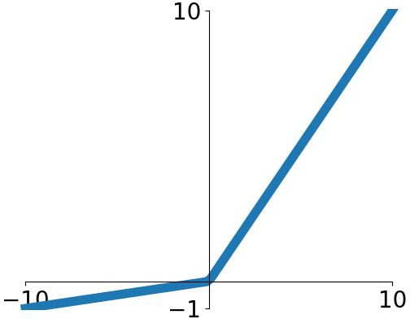


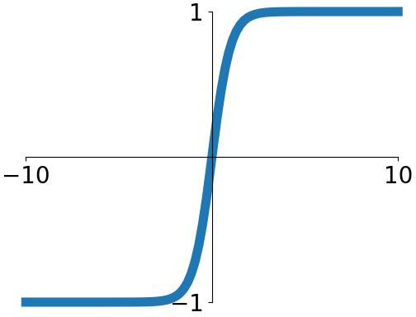


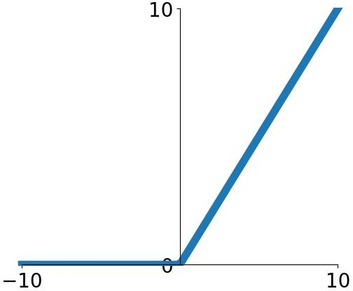
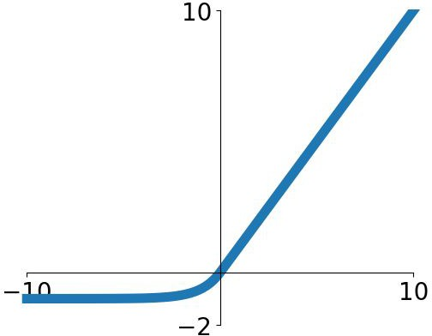
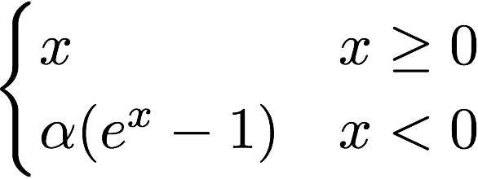

Activation Functions
Sigmoid
tanh
Leaky ReLU
Maxout
ReLU
ELU

Slide 5

Activation Functions
Squashes numbers to range [0,1]
Historically popular since they have nice interpretation as a saturating “firing rate” of a neuron
Sigmoid
Fei-Fei, Krishna, Xu

Slide 6
Activation Functions
Squashes numbers to range [0,1]
Historically popular since they have nice interpretation as a saturating “firing rate” of a neuron
3 problems:
1. Saturated neurons “kill” the gradients
Sigmoid
Fei-Fei, Krishna, Xu

Slide 7
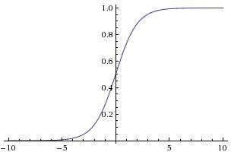




sigmoid gate
x
Fei-Fei, Krishna, Xu

Slide 8
x
sigmoid gate
What happens when x = -10?
Fei-Fei, Krishna, Xu

Slide 9
x
sigmoid gate
What happens when x = -10? What happens when x = 0?
Fei-Fei, Krishna, Xu

Slide 10
sigmoid gate
x
What happens when x = -10? What happens when x = 0?
What happens when x = 10?
Fei-Fei, Krishna, Xu

Slide 11
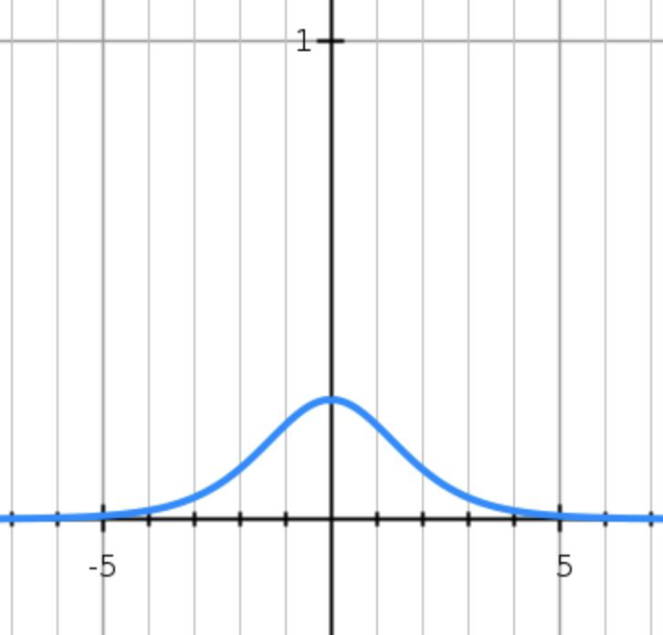
sigmoid gate
x
What happens when x = -10? What happens when x = 0?
What happens when x = 10?
Fei-Fei, Krishna, Xu

Slide 12
Activation Functions
Squashes numbers to range [0,1]
Historically popular since they have nice interpretation as a saturating “firing rate” of a neuron
3 problems:
1. Saturated neurons “kill” the gradients
2. Sigmoid outputs are not zero-centered
Sigmoid
Fei-Fei, Krishna, Xu

Slide 13
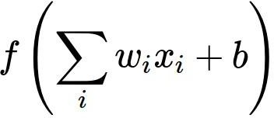
Consider what happens when the input to a neuron is always positive...
What can we say about the gradients on w?

Slide 14
Consider what happens when the input to a neuron is always positive...
What can we say about the gradients on w?

Slide 15
Consider what happens when the input to a neuron is always positive...
What can we say about the gradients on w?
We know that local gradient of sigmoid is always positive

Slide 16
Consider what happens when the input to a neuron is always positive...
What can we say about the gradients on w?
We know that local gradient of sigmoid is always positive
We are assuming x is always positive

Slide 17
Consider what happens when the input to a neuron is always positive...
What can we say about the gradients on w?
We know that local gradient of sigmoid is always positive
We are assuming x is always positive
So!! Sign of gradient for all w_{i} is the same as the sign of upstream scalar gradient!

Slide 18

Consider what happens when the input to a neuron is always positive...
 | allowed gradient update directions
allowed gradient update directions
Zigzag Path
What can we say about the gradients on w?
Always all positive or all negative :(
hypothetical optimal w vector

Slide 19
Consider what happens when the input to a neuron is always positive...
 | allowed gradient update directions
allowed gradient update directions
Zigzag Path
What can we say about the gradients on w?
Always all positive or all negative :(
(For a single element! Minibatches help)
hypothetical optimal w vector

Slide 20
Activation Functions
Squashes numbers to range [0,1]
Historically popular since they have nice interpretation as a saturating “firing rate” of a neuron
3 problems:
1. Saturated neurons “kill” the gradients
2. Sigmoid outputs are not zero-centered
3. exp() is a bit compute expensive
Sigmoid
Fei-Fei, Krishna, Xu

Slide 21
Activation Functions
Squashes numbers to range [-1,1]
zero centered (nice)
still kills gradients when saturated :(
tanh(x)
[LeCun et al., 1991]
Fei-Fei, Krishna, Xu

Slide 22
Activation Functions
Computes f(x) = max(0,x)
Does not saturate (in +region)
Very computationally efficient
Converges much faster than sigmoid/tanh in practice (e.g. 6x)
ReLU
(Rectified Linear Unit)
[Krizhevsky et al., 2012]
Fei-Fei, Krishna, Xu

Slide 23
Activation Functions
Computes f(x) = max(0,x)
Does not saturate (in +region)
Very computationally efficient
Converges much faster than sigmoid/tanh in practice (e.g. 6x)
Not zero-centered output
ReLU
(Rectified Linear Unit)
Fei-Fei, Krishna, Xu

Slide 24
Activation Functions
Computes f(x) = max(0,x)
Does not saturate (in +region)
Very computationally efficient
Converges much faster than sigmoid/tanh in practice (e.g. 6x)
Not zero-centered output
An annoyance:
ReLU
(Rectified Linear Unit)
Fei-Fei, Krishna, Xu

Slide 25
- Computes f(x) = max(0,x)
Activation Functions
Does not saturate (in +region)
Very computationally efficient
Converges much faster than sigmoid/tanh in practice (e.g. 6x)
Not zero-centered output
ReLU
(Rectified Linear Unit)
Fei-Fei, Krishna, Xu

Slide 26

x
ReLU
gate
What happens when x = -10? What happens when x = 0?
What happens when x = 10?
Fei-Fei, Krishna, Xu

Slide 27


active ReLU
DATA CLOUD
dead ReLU
will never activate
=> never update
Fei-Fei, Krishna, Xu

Slide 28
active ReLU
DATA CLOUD
=> people like to initialize ReLU neurons with slightly positive biases (e.g. 0.01)
dead ReLU
will never activate
=> never update
Fei-Fei, Krishna, Xu

Slide 29

Activation Functions
[Mass et al., 2013] [He et al., 2015]
Does not saturate
Computationally efficient
Converges much faster than sigmoid/tanh in practice! (e.g. 6x)
- will not “die”.
Leaky ReLU
Fei-Fei, Krishna, Xu

Slide 30

Activation Functions
[Mass et al., 2013] [He et al., 2015]
Does not saturate
Computationally efficient
Converges much faster than sigmoid/tanh in practice! (e.g. 6x)
- will not “die”.
Parametric Rectifier (PReLU)
Leaky ReLU
backprop into \alpha (parameter)
Fei-Fei, Krishna, Xu

Slide 31

Activation Functions
[Clevert et al., 2015]
- All benefits of ReLU
Closer to zero mean outputs
Negative saturation regime compared with Leaky ReLU adds some robustness to noise
Computation requires exp()
(Alpha default = 1)
Exponential Linear Units (ELU)
Fei-Fei, Krishna, Xu

Slide 32
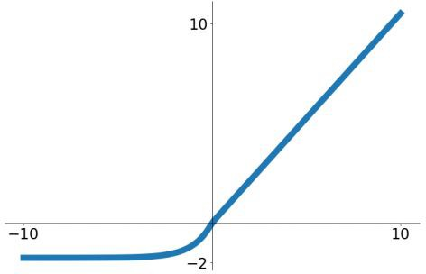
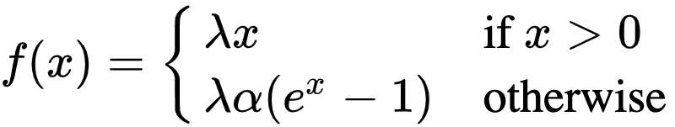
Activation Functions
[Klambauer et al. ICLR 2017]
Scaled Exponential Linear Units (SELU)
Scaled versionof ELU that works better for deep networks
“Self-normalizing” property;
- Can train deep SELU networks without BatchNorm
- (will discuss more later)
α = 1.6733, λ = 1.0507
Fei-Fei, Krishna, Xu

Slide 33

Maxout “Neuron”
[Goodfellow et al., 2013]
Does not have the basic form of dot product -> nonlinearity
Generalizes ReLU and Leaky ReLU
Linear Regime! Does not saturate! Does not die!
Problem: doubles the number of parameters/neuron :(
Fei-Fei, Krishna, Xu

Slide 34
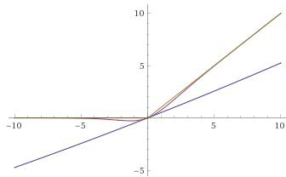
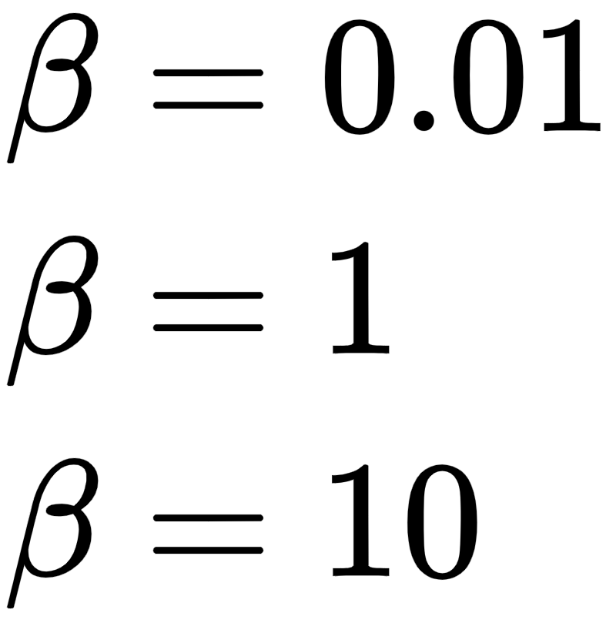
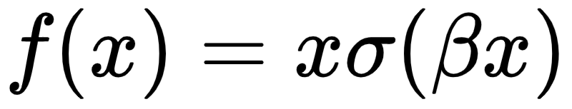
Activation Functions
[Ramachandran et al. 2018]
Swish
- They trained a neural network to generate and test out different non-linearities.
- Swish outperformed all other
options for CIFAR-10 accuracy
Fei-Fei, Krishna, Xu

Slide 35
In practice:
Use ReLU. Be careful with your learning rates
Try out Leaky ReLU / Maxout / ELU / SELU
- To squeeze out some marginal gains
Don’t use sigmoid or tanh

Slide 36
Data Preprocessing

Slide 37
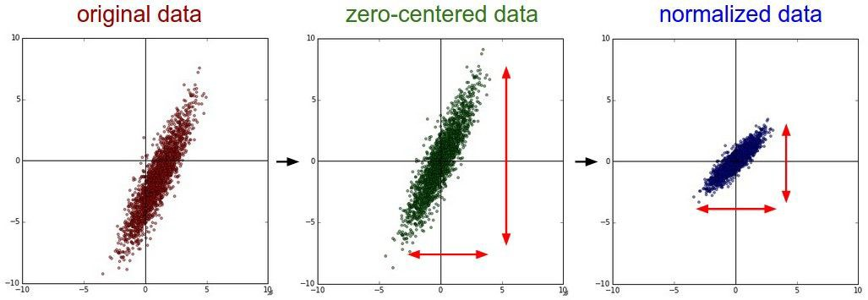


Data Preprocessing

Slide 38
Remember: Consider what happens when the input to a neuron is always positive...
 | allowed gradient update directions
allowed gradient update directions |  | zig zag pa
What can we say about the gradients on w? Always all positive or all negative :(
(this is also why you want zero-mean data!)

Slide 39
Data Preprocessing
Before normalization: classification loss very sensitive to changes in weight matrix; hard to optimize
After normalization: less sensitive to small changes in weights; easier to optimize

Slide 40
In practice for Images
e.g. consider CIFAR-10 example with [32,32,3] images
Subtract the mean image (e.g. AlexNet) (mean image = [32,32,3] array)
Subtract per-channel mean (e.g. VGGNet) (mean along each channel = 3 numbers)
Subtract per-channel mean and
Divide by per-channel std (e.g. ResNet)
(mean along each channel = 3 numbers)

Slide 41
Weight Initialization
CS231n: Convolutional Neural Networks for Visual Recognition

Slide 42
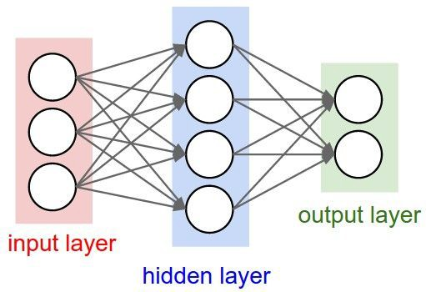
Q: what happens when W=constant init is used?

Slide 43
Weight Initialization: Gaussian Initialization
Small random numbers
Gaussian with zero mean and 1e-2 standard deviation

Slide 44
Weight Initialization: Gaussian Initialization
Small random numbers
Gaussian with zero mean and 1e-2 standard deviation
Works ~okay for small networks, but problems with deeper networks.

Slide 45
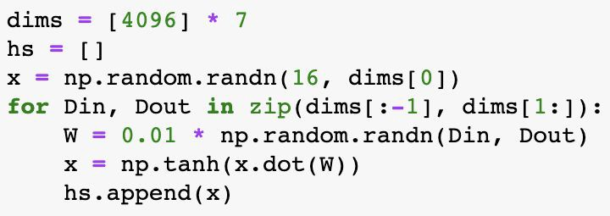
Weight Initialization: Activation statistics
Forward pass for a 6-layer net with hidden size 4096
What will happen to the activations for the last layer?

Slide 46
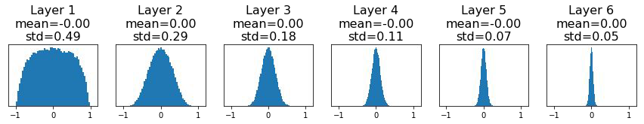
Weight Initialization: Activation statistics
Forward pass for a 6-layer net with hidden size 4096
All activations tend to zero for deeper network layers
Q: What do the gradients dL/dW look like?

Slide 47
Weight Initialization: Activation statistics
Forward pass for a 6-layer net with hidden size 4096
All activations tend to zero for deeper network layers
Q: What do the gradients dL/dW look like?
A: All zero, no learning :(

Slide 48
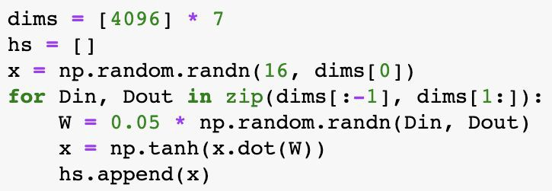
Weight Initialization: Activation statistics
Increase std of initial weights from 0.01 to 0.05
What will happen to the activations for the last layer?

Slide 49
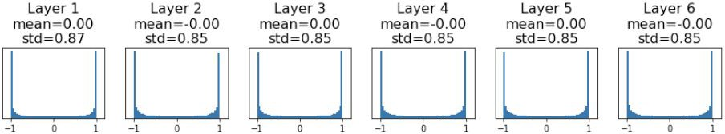
Weight Initialization: Activation statistics
Increase std of initial weights from 0.01 to 0.05
All activations saturate
Q: What do the gradients look like?

Slide 50
Weight Initialization: Activation statistics
Increase std of initial weights from 0.01 to 0.05
All activations saturate
Q: What do the gradients look like?
A: Local gradients all zero, no learning =(

Slide 51
How to find appropriate initialization values
The mean of the activations should be zero.
The variance of the activations should stay the same across every layer.

Slide 52
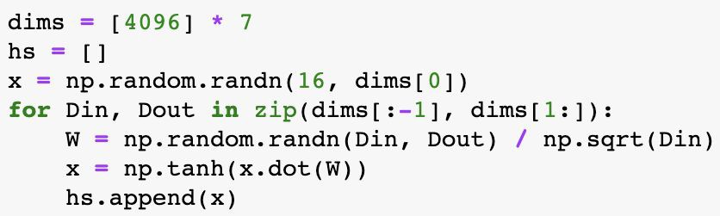
Weight Initialization: “Xavier” Initialization
“Xavier” initialization: std = 1/sqrt(Din)

Slide 53
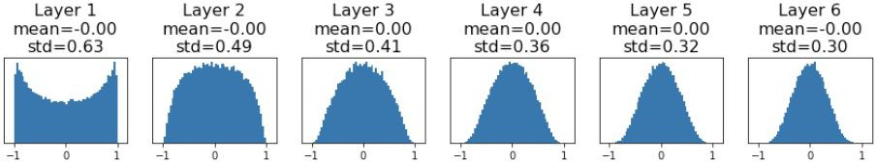
Weight Initialization: “Xavier” Initialization
“Xavier” initialization: std = 1/sqrt(Din)
“Just right”: Activations are nicely scaled for all layers!

Slide 54
Weight Initialization: “Xavier” Initialization
“Xavier” initialization: std = 1/sqrt(Din)
“Just right”: Activations are nicely scaled for all layers!
For conv layers, Din is
filter_size² * input_channels

Slide 55
Weight Initialization: “Xavier” Initialization
“Xavier” initialization: std = 1/sqrt(Din)
“Just right”: Activations are nicely scaled for all layers!
For conv layers, Din is
filter_size² * input_channels
Derivation:
Var(y_{i}) = Din * Var(x_{i}w_{i})
y = Wx h = f(y)
[Assume x, w are iid] [Assume x, w independant] [Assume x, w are zero-mean]
= Din * (E[x ²]E[w ²] - E[x ]² E[w ]²)
i i i i
= Din * Var(x_{i}) * Var(w_{i})
If Var(w_{i}) = 1/Din then Var(y_{i}) = Var(x_{i})

Slide 56
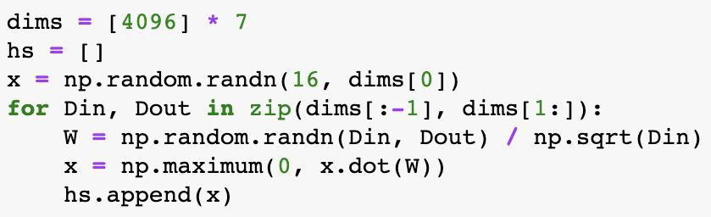
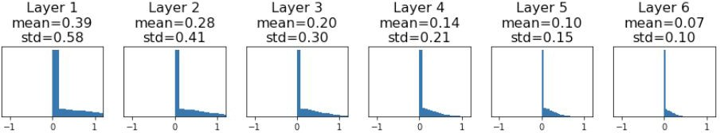
Weight Initialization: What about ReLU?
Change from tanh to ReLU
Xavier assumes zero centered activation function
Activations collapse to zero again, no learning :(

Slide 57
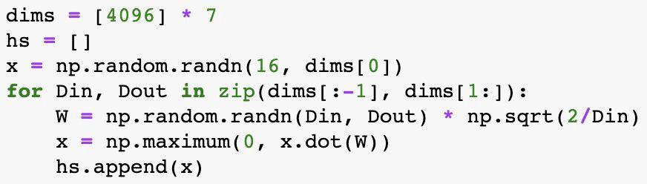
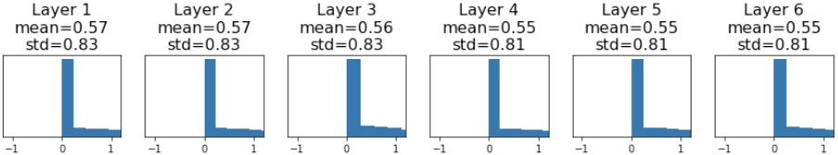
Weight Initialization: Kaiming / MSRA Initialization
ReLU correction: std = sqrt(2 / Din)
“Just right”: Activations are nicely scaled for all layers!

Slide 58
Visualization
https://www.deeplearning.ai/ai-notes/initialization/index.html

Slide 59
Batch Normalization

Slide 60
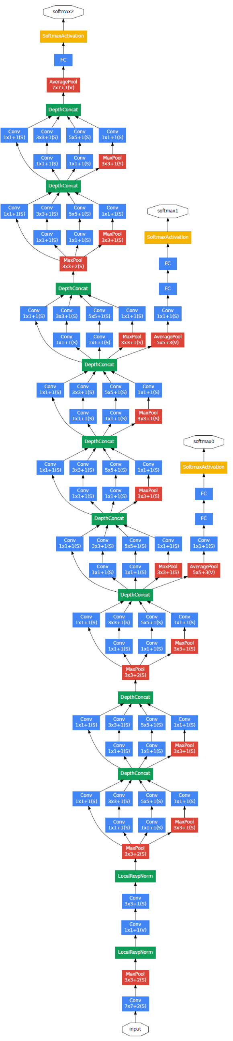
Batch Normalization
loss
Loss occurs at last layer
Last layers learn quickly
Data is inserted at bottom layer
Bottom layers change – everything changes
Last layers need to relearn many times
Slow convergence
This is like covariate shift
Can we avoid changing last layers while learning first layers
data

Slide 61
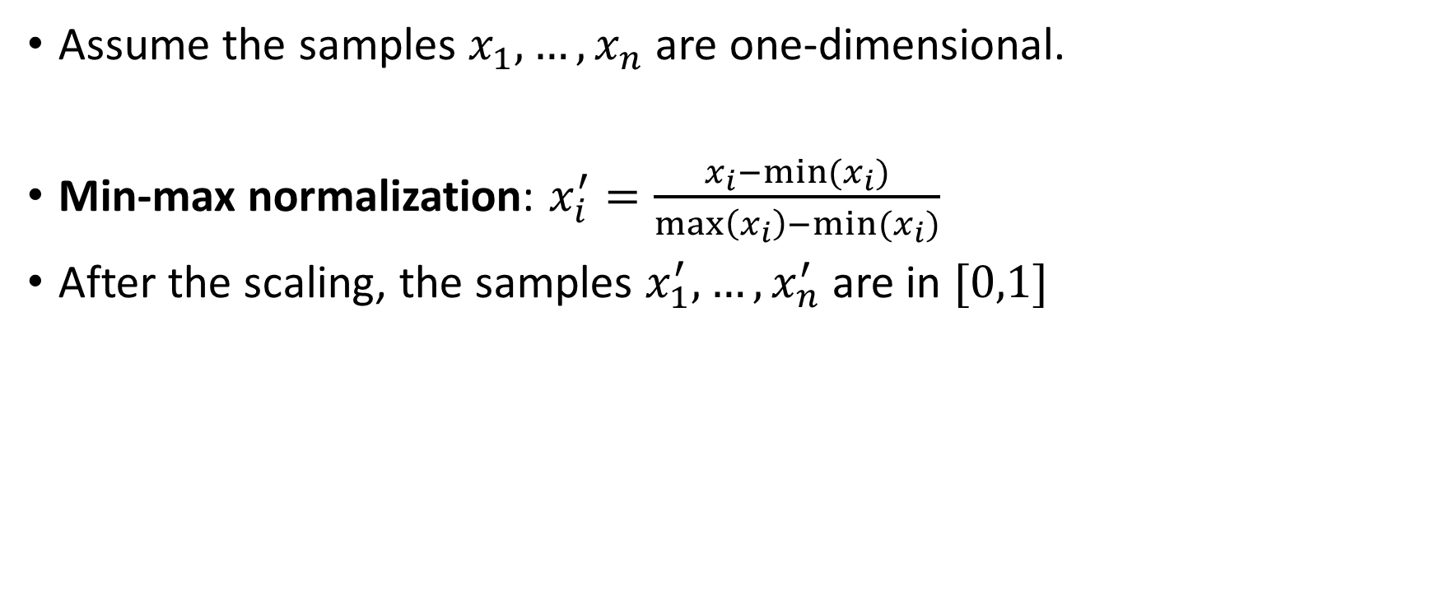
Feature Scaling for 1D data
Assume the samples $x_{1},…,x_{n}$ are one-dimensional.
Min-max normalization: $x_{i}^{′}=\frac{x_{i}−\min{(x_{i})}}{\max\left(x_{i}\right)−\min{(x_{i})}}$
After the scaling, the samples $x_{1}^{′},…,x_{n}^{′}$ are in $[0,1]$

Slide 62
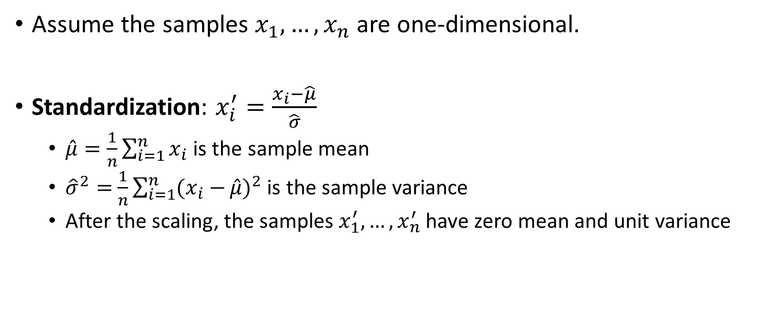
Feature Scaling for 1D data
Assume the samples $x_{1},…,x_{n}$ are one-dimensional.
Standardization: $x_{i}^{′}=\frac{x_{i}−\hat{μ}}{\hat{σ}}$
$\hat{μ}=\frac{1}{n}\sum_{i=1}^{n}{x_{i}}$ is the sample mean
${\hat{σ}}^{2}=$ $\frac{1}{n}\sum_{i=1}^{n}{(x_{i}−}\hat{μ})^{2}$ is the sample variance
After the scaling, the samples $x_{1}^{′},…,x_{n}^{′}$ have zero mean and unit variance

Slide 63
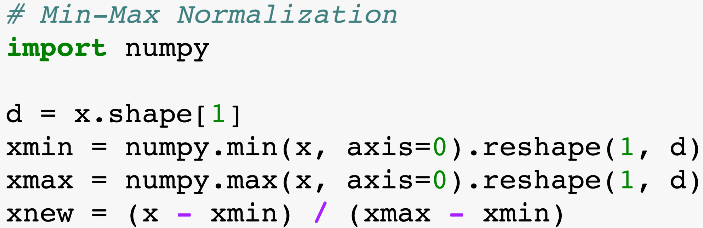
Feature Scaling for 1D data
Independently perform feature scaling for every feature.
E.g., when scaling the “height” feature, ignore the “income” feature.

Slide 64
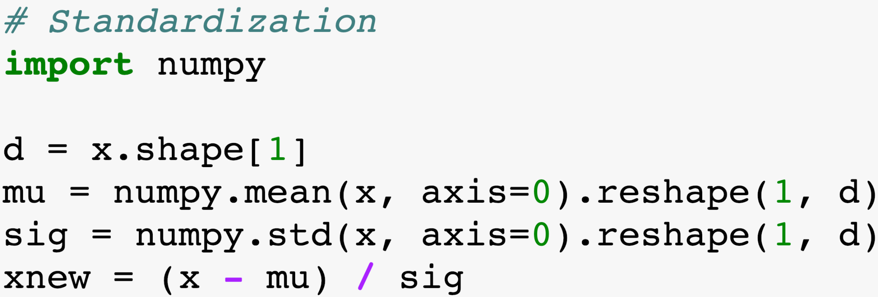
Feature Scaling for 1D data
Independently perform feature scaling for every feature.
E.g., when scaling the “height” feature, ignore the “income” feature.

Slide 65
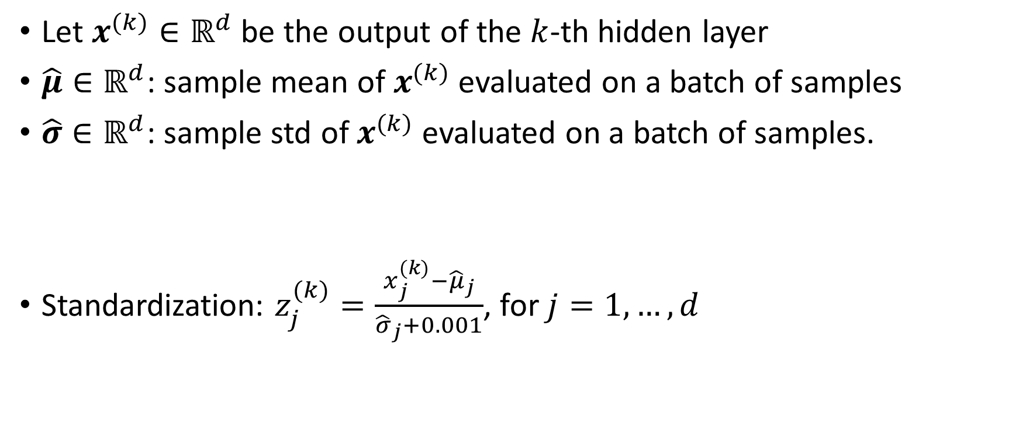
Batch Normalization: Standardization of Hidden Layers
Let $x^{(k)}∈ℝ^{d}$ be the output of the $k$-th hidden layer
$\hat{μ}∈ℝ^{d}$: sample mean of $x^{(k)}$ evaluated on a batch of samples
$\hat{σ}∈ℝ^{d}$: sample std of $x^{(k)}$ evaluated on a batch of samples.
Standardization: $z_{j}^{(k)}=\frac{x_{j}^{(k)}−{\hat{μ}}_{j}}{{\hat{σ}}_{j}+0.001}$, for $j=1,…,d$

Slide 66
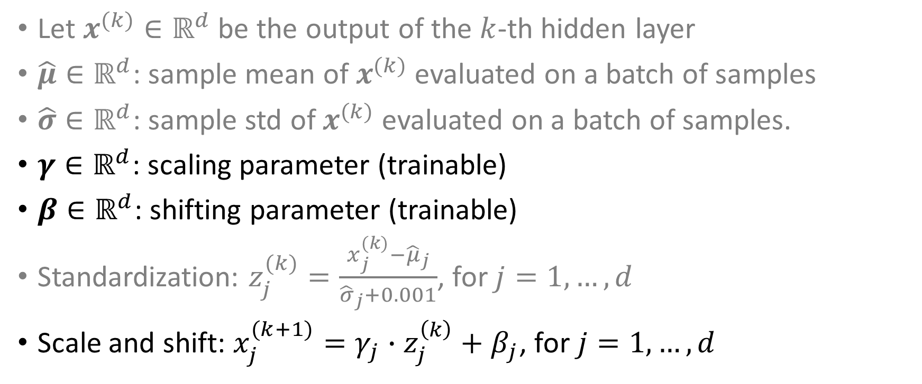
Batch Normalization: Standardization of Hidden Layers
Let $x^{(k)}∈ℝ^{d}$ be the output of the $k$-th hidden layer
$\hat{μ}∈ℝ^{d}$: sample mean of $x^{(k)}$ evaluated on a batch of samples
$\hat{σ}∈ℝ^{d}$: sample std of $x^{(k)}$ evaluated on a batch of samples.
$γ∈ℝ^{d}$: scaling parameter (trainable)
$β∈ℝ^{d}$: shifting parameter (trainable)
Standardization: $z_{j}^{(k)}=\frac{x_{j}^{(k)}−{\hat{μ}}_{j}}{{\hat{σ}}_{j}+0.001}$, for $j=1,…,d$
Scale and shift: $x_{j}^{(k+1)}=γ_{j}∙z_{j}^{\left(k\right)}+β_{j}$, for $j=1,…,d$

Slide 67
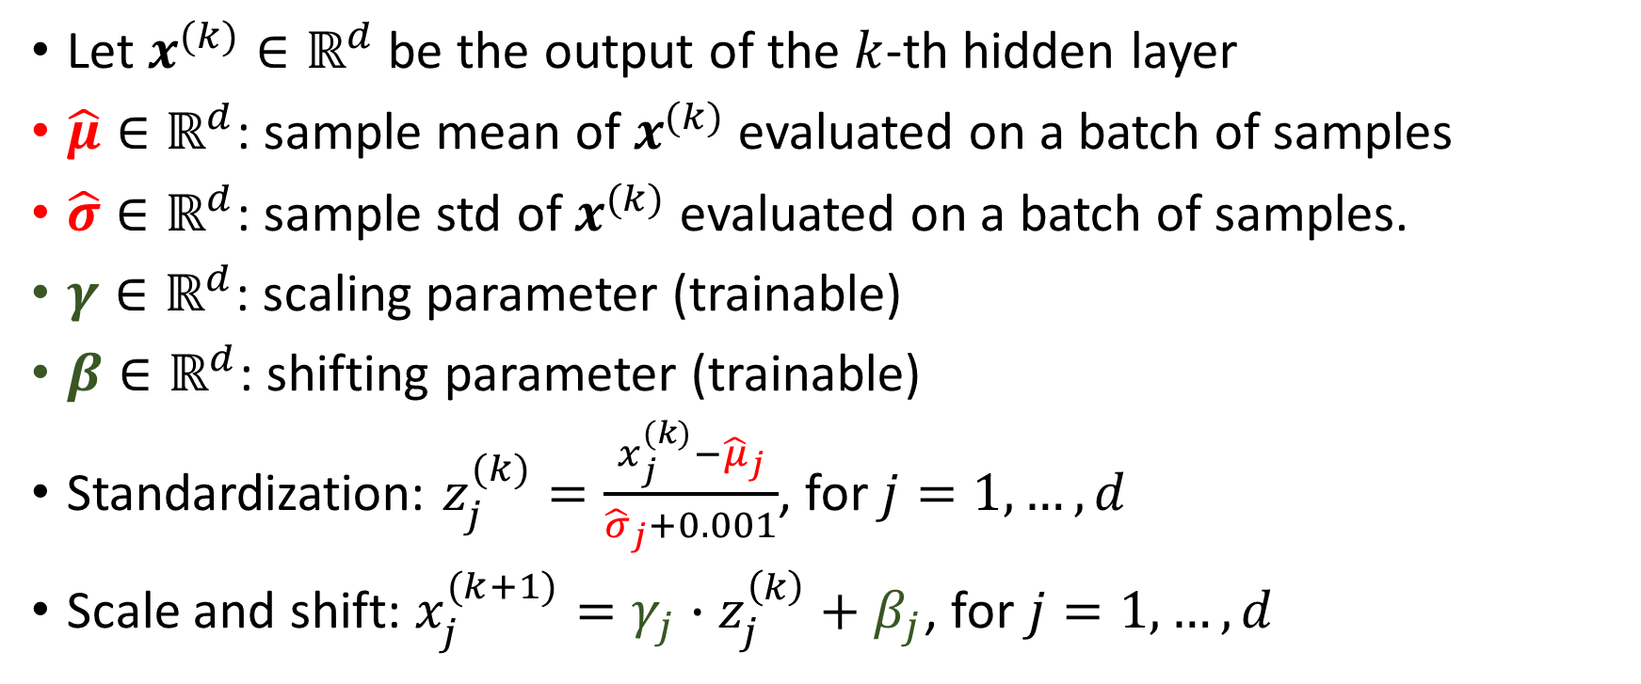
Batch Normalization: Standardization of Hidden Layers
Let $x^{(k)}∈ℝ^{d}$ be the output of the $k$-th hidden layer
$\hat{μ}∈ℝ^{d}$: sample mean of $x^{(k)}$ evaluated on a batch of samples
$\hat{σ}∈ℝ^{d}$: sample std of $x^{(k)}$ evaluated on a batch of samples.
$γ∈ℝ^{d}$: scaling parameter (trainable)
$β∈ℝ^{d}$: shifting parameter (trainable)
Standardization: $z_{j}^{(k)}=\frac{x_{j}^{(k)}−{\hat{μ}}_{j}}{{\hat{σ}}_{j}+0.001}$, for $j=1,…,d$
Scale and shift: $x_{j}^{(k+1)}=γ_{j}∙z_{j}^{\left(k\right)}+β_{j}$, for $j=1,…,d$
Non-trainable. Just record them in the forward pass; use them in the backpropagation.

Slide 68
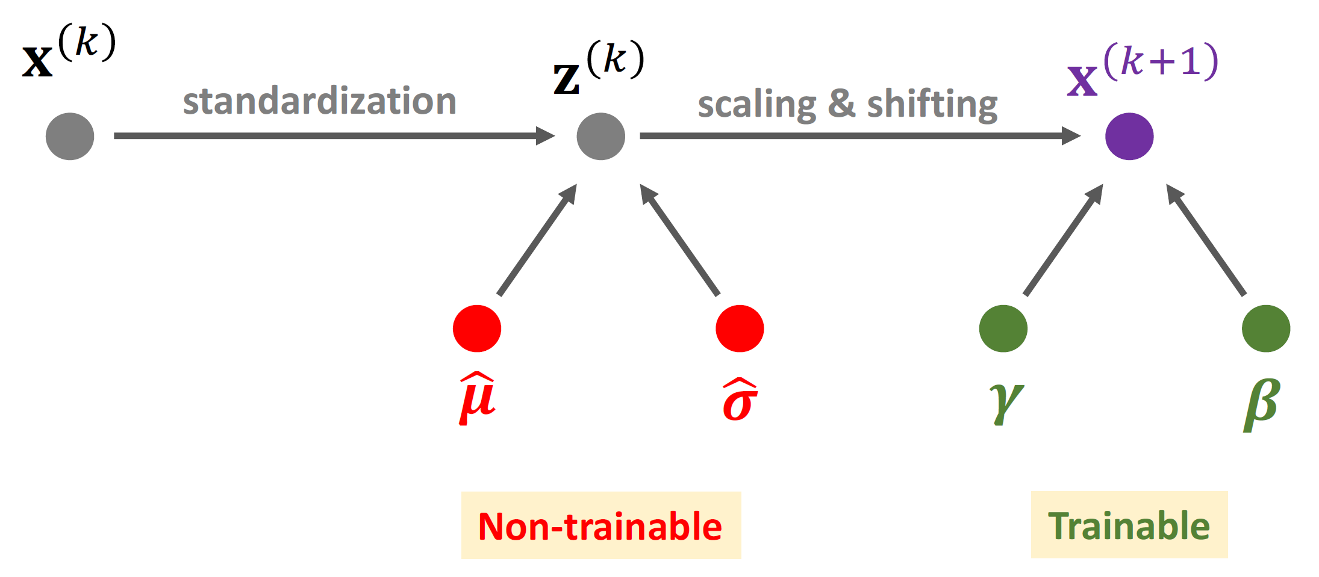

Backpropagation for Batch Normalization Layer
Standardization: $z_{j}^{(k)}=\frac{x_{j}^{(k)}−{\hat{μ}}_{j}}{{\hat{σ}}_{j}+0.001}$, for $j=1,…,d$
Scale and shift: $x_{j}^{(k+1)}=γ_{j}∙z_{j}^{\left(k\right)}+β_{j}$, for $j=1,…,d$

Slide 69
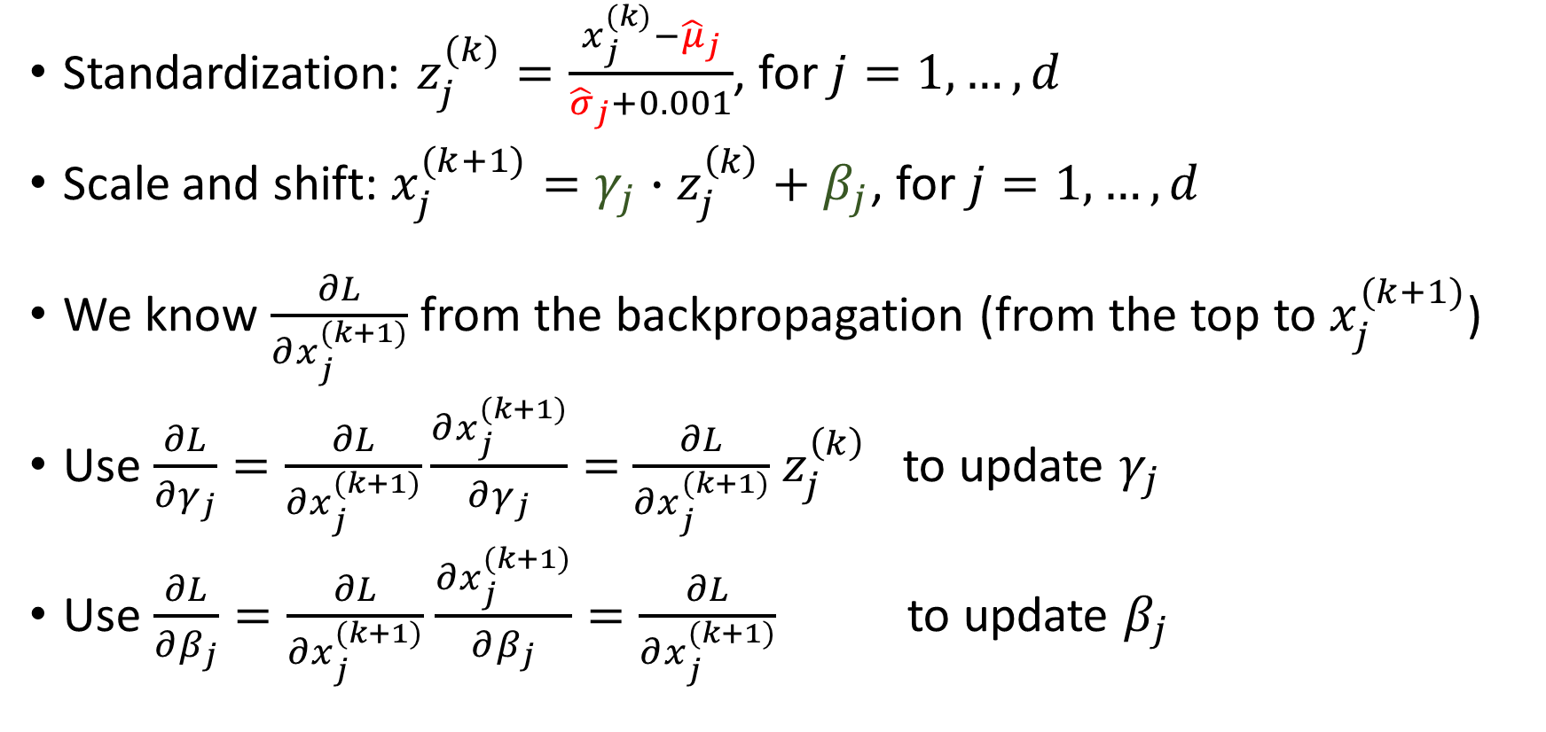
Backpropagation for Batch Normalization Layer
Standardization: $z_{j}^{(k)}=\frac{x_{j}^{(k)}−{\hat{μ}}_{j}}{{\hat{σ}}_{j}+0.001}$, for $j=1,…,d$
Scale and shift: $x_{j}^{(k+1)}=γ_{j}∙z_{j}^{\left(k\right)}+β_{j}$, for $j=1,…,d$
We know $\frac{∂L}{∂x_{j}^{(k+1)}}$ from the backpropagation (from the top to $x_{j}^{(k+1)}$)
Use $\frac{∂L}{∂γ_{j}}=\frac{∂L}{∂x_{j}^{(k+1)}}\frac{∂x_{j}^{(k+1)}}{∂γ_{j}}=$ $\frac{∂L}{∂x_{j}^{(k+1)}}$ $z_{j}^{\left(k\right)}$ to update $γ_{j}$
Use $\frac{∂L}{∂β_{j}}=\frac{∂L}{∂x_{j}^{(k+1)}}$ $\frac{∂x_{j}^{(k+1)}}{∂β_{j}}=\frac{∂L}{∂x_{j}^{(k+1)}}$ to update $β_{j}$

Slide 70
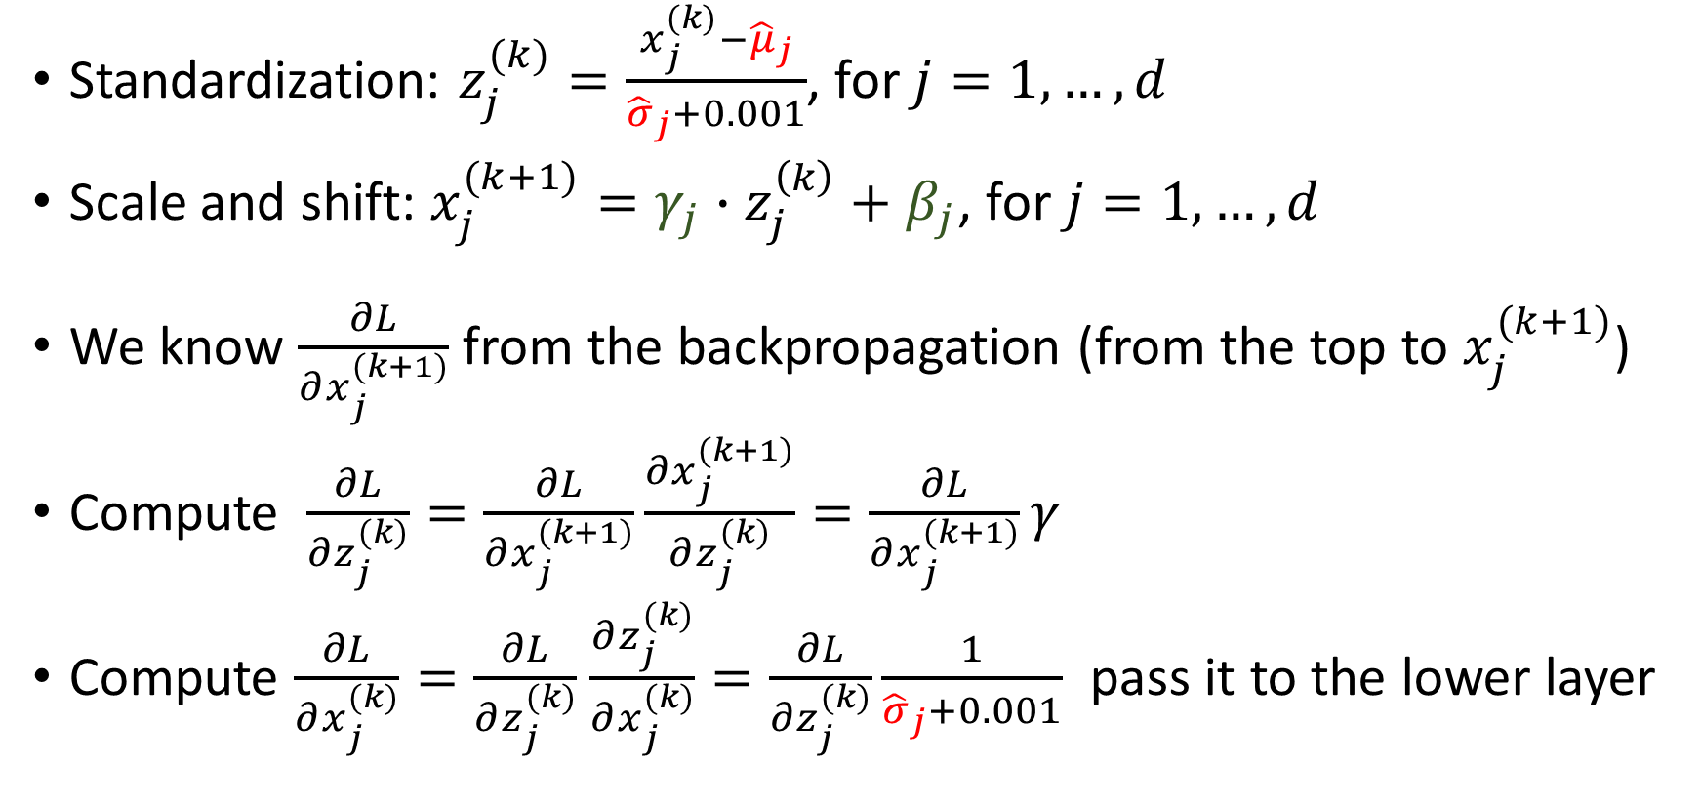
Backpropagation for Batch Normalization Layer
Standardization: $z_{j}^{(k)}=\frac{x_{j}^{(k)}−{\hat{μ}}_{j}}{{\hat{σ}}_{j}+0.001}$, for $j=1,…,d$
Scale and shift: $x_{j}^{(k+1)}=γ_{j}∙z_{j}^{\left(k\right)}+β_{j}$, for $j=1,…,d$
We know $\frac{∂L}{∂x_{j}^{(k+1)}}$ from the backpropagation (from the top to $x_{j}^{(k+1)}$)
Compute $\frac{∂L}{∂z_{j}^{(k)}}=\frac{∂L}{∂x_{j}^{(k+1)}}\frac{∂x_{j}^{(k+1)}}{∂z_{j}^{(k)}}=\frac{∂L}{∂x_{j}^{(k+1)}}γ$
Compute $\frac{∂L}{∂x_{j}^{(k)}}=\frac{∂L}{∂z_{j}^{(k)}}$ $\frac{∂z_{j}^{(k)}}{∂x_{j}^{(k)}}=\frac{∂L}{∂z_{j}^{(k)}}\frac{1}{{\hat{σ}}_{j}+0.001}$ pass it to the lower layer

Slide 71
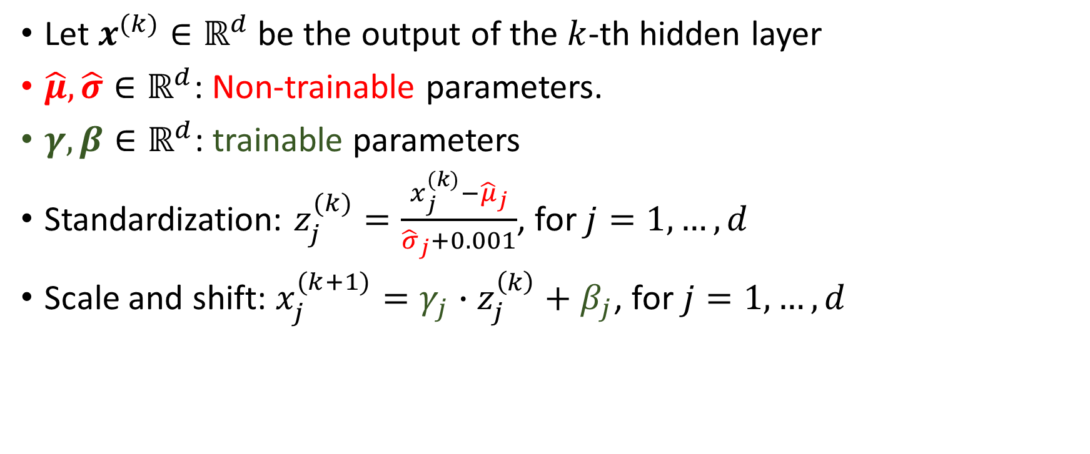
Batch Normalization Layer
Let $x^{(k)}∈ℝ^{d}$ be the output of the $k$-th hidden layer
$\hat{μ}, \hat{σ}∈ℝ^{d}$: Non-trainable parameters.
$γ,β∈ℝ^{d}$: trainable parameters
Standardization: $z_{j}^{(k)}=\frac{x_{j}^{(k)}−{\hat{μ}}_{j}}{{\hat{σ}}_{j}+0.001}$, for $j=1,…,d$
Scale and shift: $x_{j}^{(k+1)}=γ_{j}∙z_{j}^{\left(k\right)}+β_{j}$, for $j=1,…,d$

Slide 72
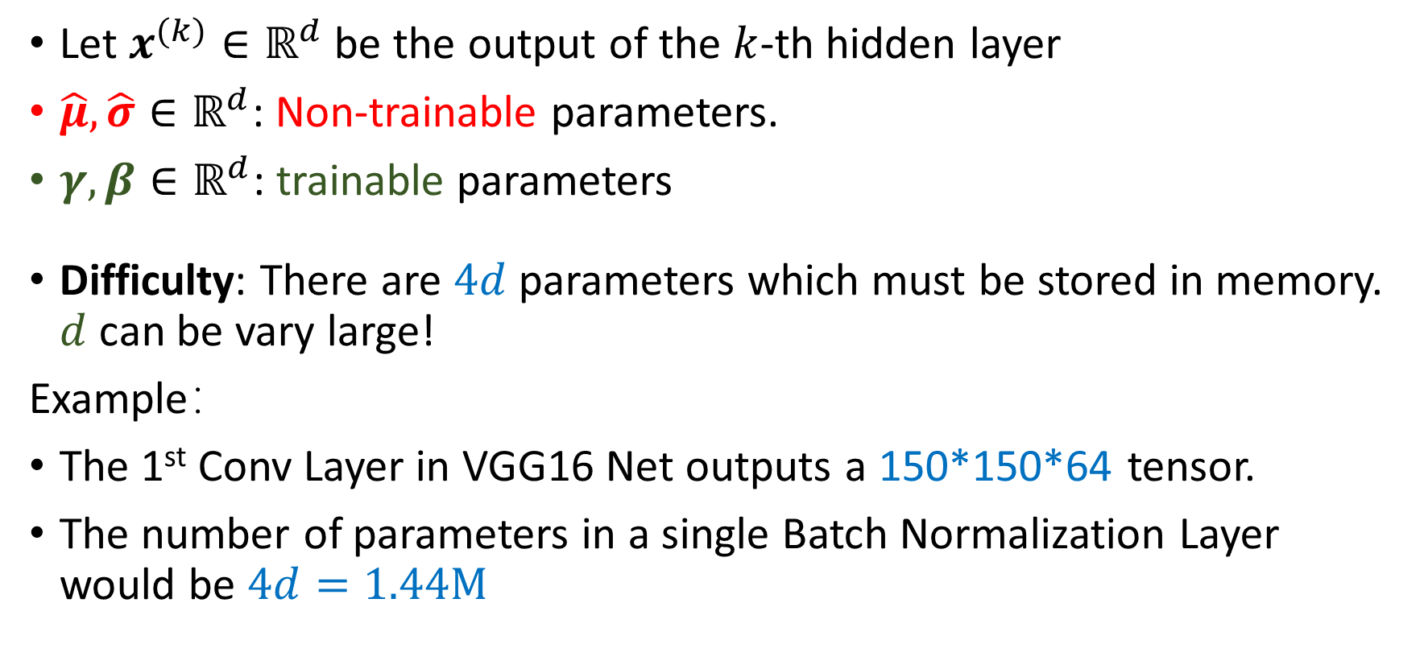
Batch Normalization Layer
Let $x^{(k)}∈ℝ^{d}$ be the output of the $k$-th hidden layer
$\hat{μ}, \hat{σ}∈ℝ^{d}$: Non-trainable parameters.
$γ,β∈ℝ^{d}$: trainable parameters
Difficulty: There are $4d$ parameters which must be stored in memory. $d$ can be vary large!
Example：
The 1st Conv Layer in VGG16 Net outputs a 150*150*64 tensor.
The number of parameters in a single Batch Normalization Layer would be $4d=1.44M$

Slide 73

Batch Normalization Layer
Let $x^{(k)}∈ℝ^{d}$ be the output of the $k$-th hidden layer
$\hat{μ}, \hat{σ}∈ℝ^{d}$: Non-trainable parameters.
$γ,β∈ℝ^{d}$: trainable parameters
Difficulty: There are $4d$ parameters which must be stored in memory. $d$ can be vary large!
Solution:
Make the 4 parameters 1*1*64, instead of 150*150*64

Slide 74
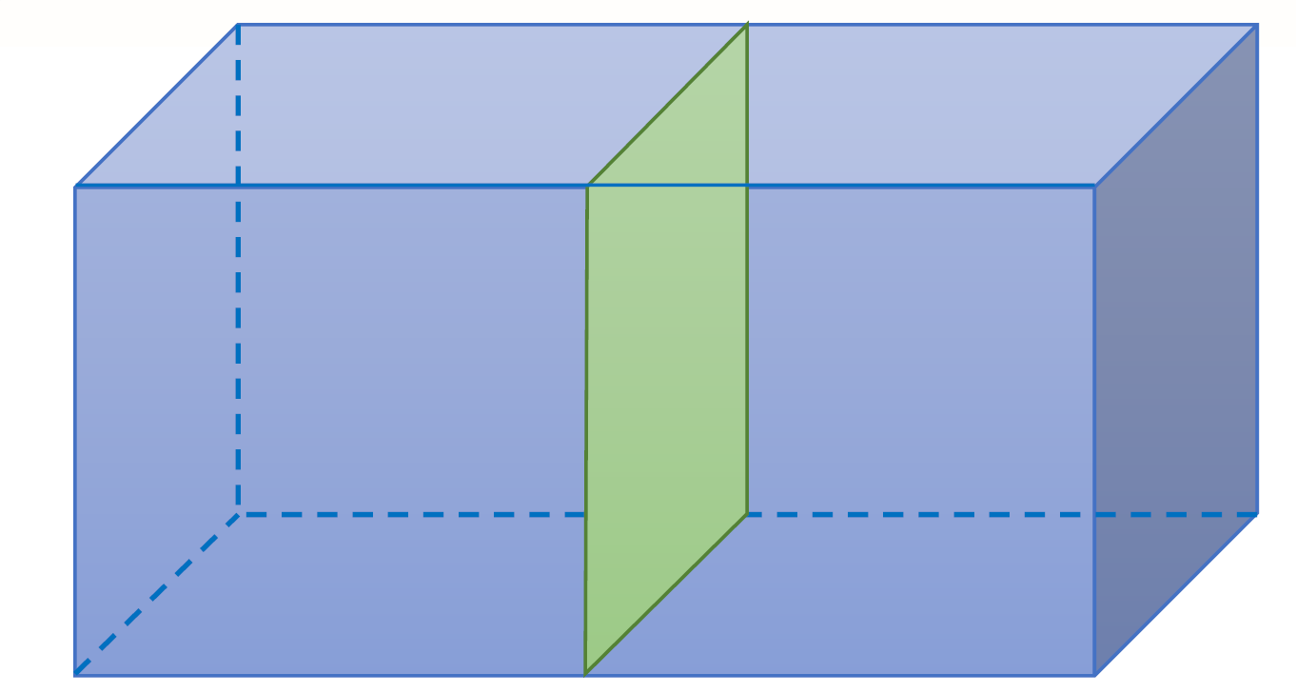
Batch Normalization Layer
Let $x^{(k)}∈ℝ^{d}$ be the output of the $k$-th hidden layer
$\hat{μ}, \hat{σ}∈ℝ^{d}$: Non-trainable parameters.
$γ,β∈ℝ^{d}$: trainable parameters
Difficulty: There are $4d$ parameters which must be stored in memory. $d$ can be vary large!
Solution:
Make the 4 parameters 1*1*64, instead of 150*150*64
How?
A scalar parameter for a slice (e.g., a 150*150 matrix) of the tensor

Slide 75
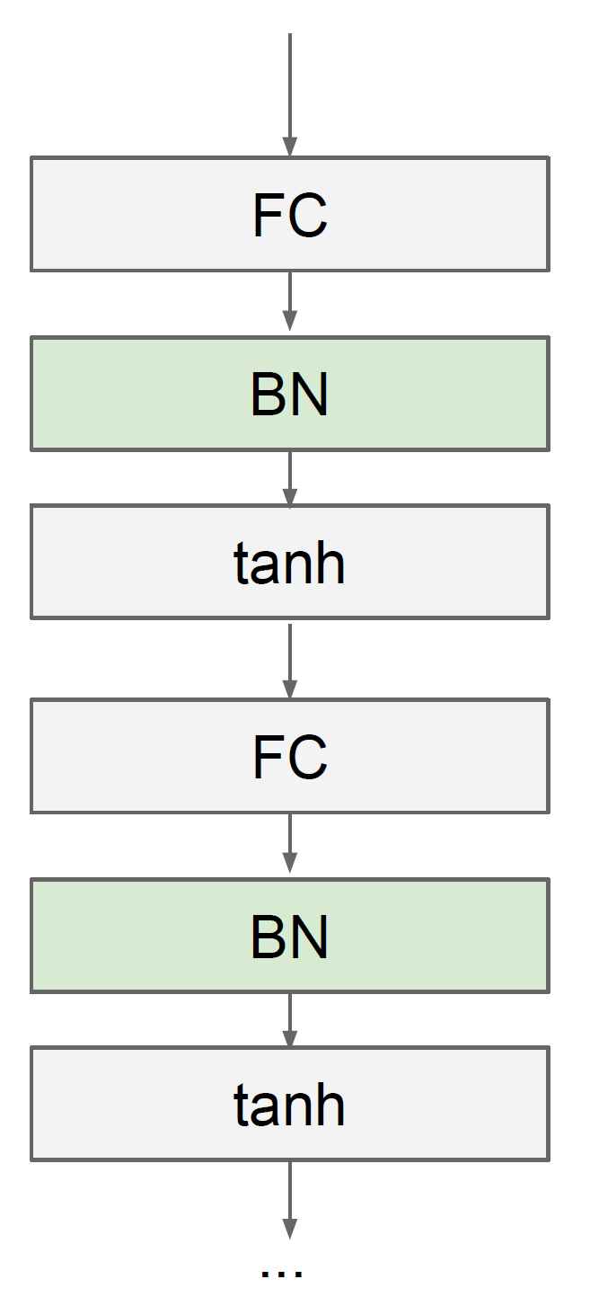
Batch Normalization Layer
Usually inserted after Fully Connected or Convolutional layers, and before nonlinearity.

Slide 76
Batch Normalization Layer
Makes deep networks much easier to train!
Improves gradient flow
Allows higher learning rates, faster convergence
Networks become more robust to initialization
Acts as regularization during training
Zero overhead at test-time: can be fused with conv
Behaves differently during training and testing: this is a very common source of bugs

Slide 77
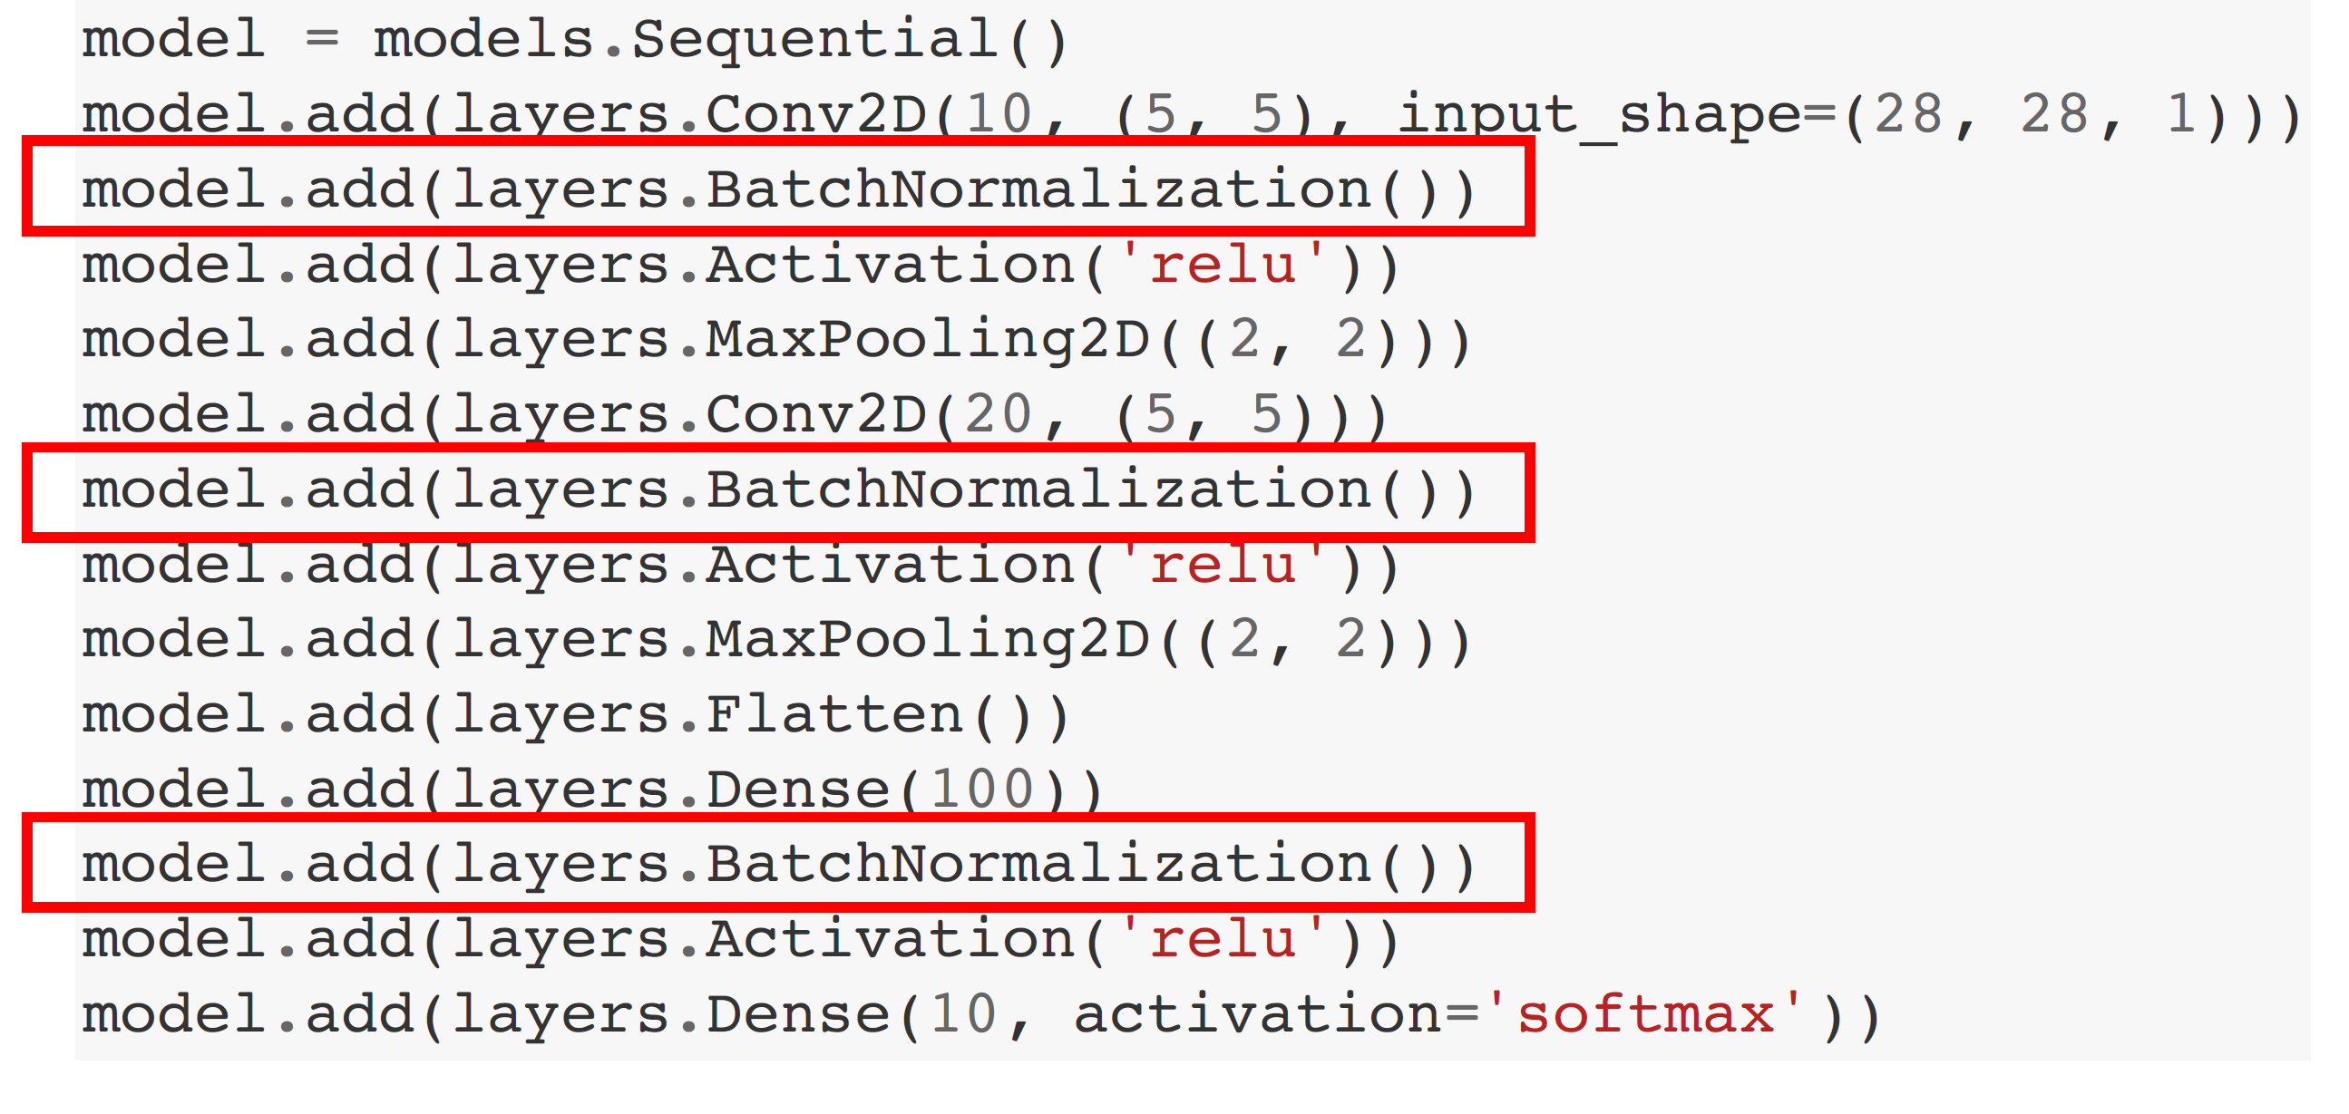
IPython Notebook

Slide 78
Feature Scaling
Make the scales of all the features comparable
Faster convergence
Methods:
Min-Max Normalization: scale the features to [0,1]
Standardization: every feature has zero mean and unit variance

Slide 79
Batch Normalization
Feature standardization for the hidden layers.
Why? Faster convergence
2 trainable parameters: shifting and scaling
2 non-trainable parameters: mean, variance
Put the BN layer after Conv and before Activation

Slide 80
Look at learning curves!
CS231n: Convolutional Neural Networks for Visual Recognition

Slide 81
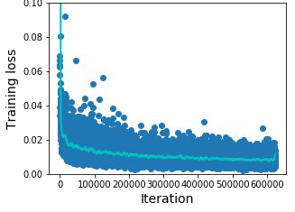
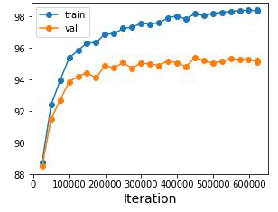
Look at learning curves!
Training Loss
Train / Val Accuracy
Losses may be noisy, use a scatter plot and also plot moving average to see trends better

Slide 82
Accuracy
Accuracy still going up, you need to train longer
Train
Val
time

Slide 83
Accuracy
Huge train / val gap means overfitting! Increase regularization, get more data
Train
Val
time

Slide 84
Accuracy
No gap between train / val means underfitting: train longer, use a bigger model
Train
Val
time

