Slide 1
Chromium as a framework
Raffaele Intorcia Tiziano Cappellari

Slide 2



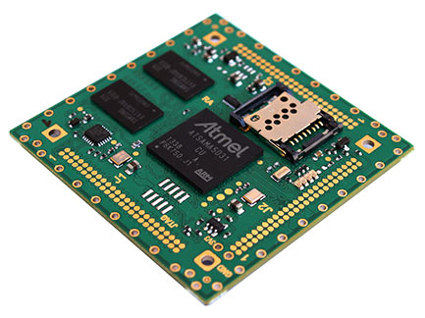



About us
Tiziano Cappellari
Raffaele Intorcia

Slide 3
Reasons
Develop a Web applications
Full access to peripherals and data on the host
C++ native libraries
Show UI as a desktop application

Slide 4
Browser customization
Plugins
access to system resources
Extensions
change browser user-interface and webpage content

Slide 5
Plugins
Extends browser capabilities at web-page level
Used by webpage when they explicit request it

Slide 6
Plugins
Plugin-browser communication is made with predefined API:
NPAPI: Firefox, Opera, Safari, Chrome
PPAPI: Opera, Chrome
WebKit Plugin: Safari
ActiveX: Internet Explorer

Slide 7
NPAPI
Netscape Plugin Application Program Interface
Plugin multiplatform framework
Supported by many browsers
Deprecation process started by Google
Unsecure

Slide 8
PPAPI
Pepper Plugin Application Program Interface
Use NPAPI as a starting point
More secure and more portable (cross-platform)
Limitation on functionalities if not trusted
Limited browser support (Chrome, Opera)

Slide 9
ActiveX
ActiveX controls
Supported only by MS IE
Opensource for some years ago
Enable to do some operation usually not permitted but custom authorization is mandatory

Slide 10
Plugin summary
Limitations
There is no common interface for all browsers
The access to the system resources is not always (or fully) allowed
Plugin are one of the first security problems for browsers

Slide 11
Extensions
Chrome: Apps and Extensions
Firefox: AddOn
Safari: Safari Extensions
Internet Explorer: Bho, AddOn

Slide 12
Summary
Plugins problems
browser dependent
deprecation
limited features
Extensions problems
browser dependent
limited features on UI or device access

Slide 13
What we really need?
A desktop application
for the access to the datas and peripherals
for the UI customization
That can do the rendering of web pages
maybe… i need my custom browser

Slide 14
My custom browser plus
Full UI customization
Provide fast access to my webapp internal services
Update browser render engine only when my webapp is ready to run on it

Slide 15
My custom browser plus
Can improve the standard browser security
only selected plugin and without extensions
only selected web resources
Full access to system resources
and only for my web application
Grant access to resources that normally cannot be used or accessible only with third-part tool

Slide 16
My custom browser opportunities
Build a persistent communication channel (using external libraries like xmpp)
Inform user about server operation
Enable client-to-client communcation (e.g. chat, file transfer and also co-browser, remote support...)

Slide 17
My custom browser cons
Limitations
webapp can only be used with my browser
provide services that can be accessed and used with common browser
custom browser is too complex to develop from scratch?

Slide 18
Chromium Project
Google Chrome browser is based on the Chromium Project
Cross-platform with more than 14 millions of SLOC, written mostly in C++
BSD-like License
We can use it as a starting point for our browser customization

Slide 19
Chromium Project
Framework for UI development (views)
Sandbox library
Network stack
and also:
Sqlite wrap
URL parsing library
XML and JSON parser
Image decoders and compression libraries

Slide 20
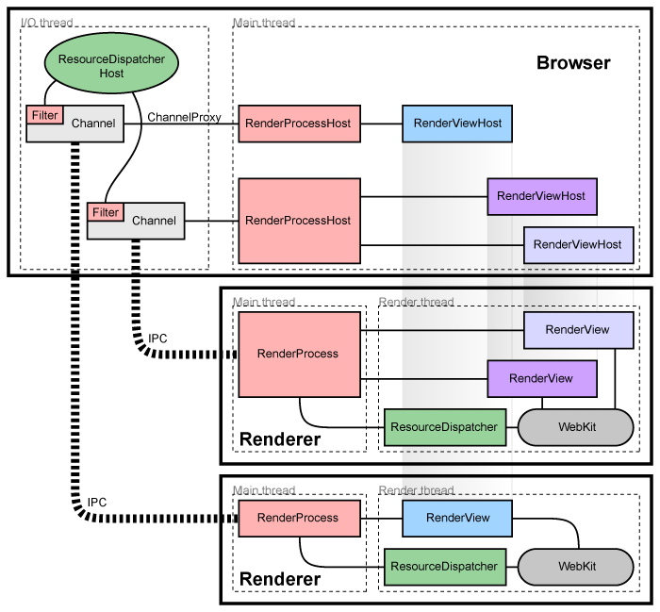
Multi-process Architecture

Slide 21
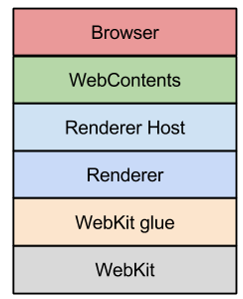
Application Layers

Slide 22
Get the code and build
Clone the Chromium GIT repository (use gclient from depot_tools)
Generate project files with gyp
Build with ninja and wait more than 2 hours on a 64 bit machine with 16 GB Ram, 4 cores
References
http://www.chromium.org/developers/how-tos/get-the-code

Slide 23
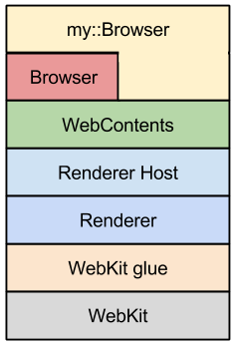
Example on extending browser module
Replace the chromium static method
::BrowserWindow*
BrowserWindow::CreateBrowserWindow(::Browser* chrome_browser)
with a factory static method
defined on our project

Slide 24
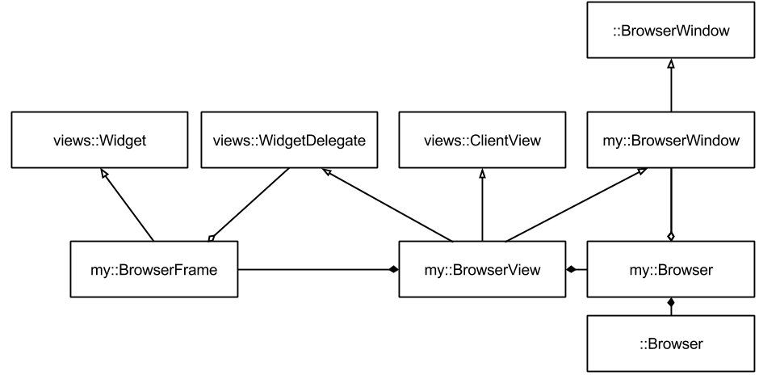
Show me the code!
::BrowserWindow* BrowserWindow::CreateBrowserWindow(::Browser* chrome_browser) {
my::BrowserView* view = new my::BrowserView();
scoped_ptr<my::Browser> browser(new my::Browser(view));
browser->set_chromium_browser(scoped_ptr<::Browser>(chrome_browser));
view->Init(browser.Pass());
scoper_ptr<my::BrowserFrame> frame(new my::BrowserFrame(view));
view->set_frame(frame.Pass());
frame->Show();
return view;
}

Slide 25
Conclusions
Generally speaking, browser customization is not a simple task, but
offers the opportunity to combine the strengths of the web application with those of the desktop application, to increase security and usability
avoid the browser compatibility problems or to accept passively the browser changes
we are not starting from scratch but we are using as a basis one of the most popular browsers

Slide 26
Contacts
Raffaele Intorcia
http://www.cgn.it - raffaele.intorcia@cgn.it
Tiziano Cappellari
http://www.nabertech.com - tcappellari@nabertech.com

