Slide 1


Storage Element with StoRM
Description, Installation and Configuration
Riccardo Zappi
INFN – CNAF
I° Corso di formazione INFN per amministratori di siti Grid
Martina Franca, November 5-7, 2007

Slide 2
Outline
About SRM
What StoRM is
StoRM components
Deployment schemas
StoRM concepts for StoRM administrator
Installing StoRM
How StoRM can be configured
  “storm.properties”
  “namespace.xml”
Command line tools
Log Files
References

Slide 3
Storage Resource Manager
(SRM) (1/2)
Storage Resource Managers are middleware services whose function is to provide dynamic space allocation and file management of shared storage components.
Files are no longer permanent entities on the storage, but dynamic ones that can appear or disappear according to the user's specification.
SRMs do not perform file transfers, but can invoke middleware components that perform this job (such as GridFTP).

Slide 4
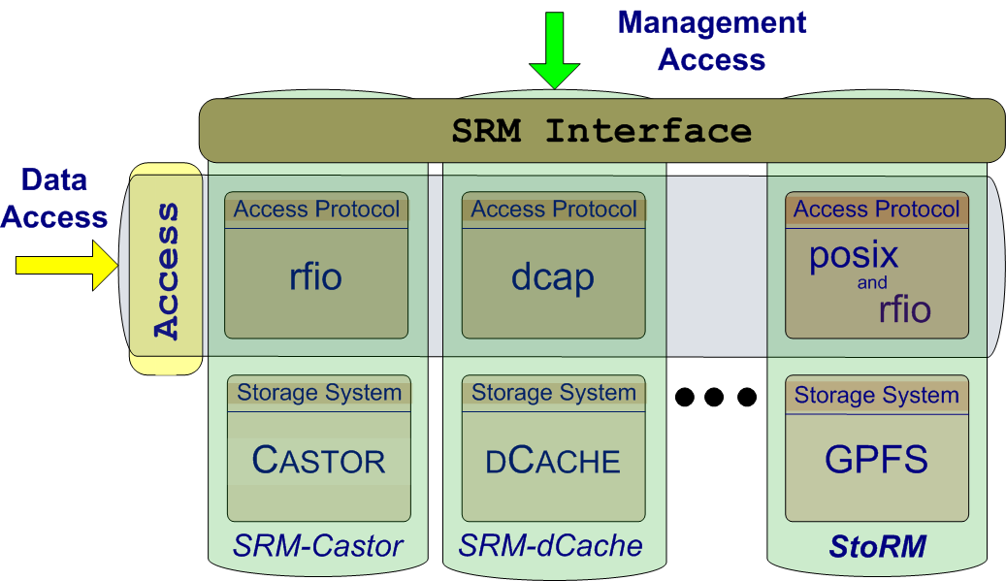
Storage Resource Manager
(SRM) (2/2)
SRM services agree on a standard interface to hide storage characteristics and to allow interoperability.
SRMs are implemented through the web service technology.

Slide 5
SRM v2.2
SRM v2.x is based on these concepts:
  lifetime of a file (volatile with a fixed lifetime, durable or permanent).
  file pinning (to ensure a file is not canceled during operation).
  space pre-allocation (to ensure the request space is available for the whole life of the application since the beginning).
  storage classes to identify different quality of storage resources.

Slide 6
Some DM Concepts:
Grid Files (1/2)
  Files in the Grid can be referred by different names:
    Logical File Name (LFN) : An alias created by a user to refer to some item of data
    Grid Unique IDentifier (GUID) : A non-human-readable unique identifier for an item of data
    Site URL (SURL) : The location of an actual piece of data on a storage system
    Transport URL (TURL) : Temporary locator of a replica + access protocol understood by a SE

Slide 7
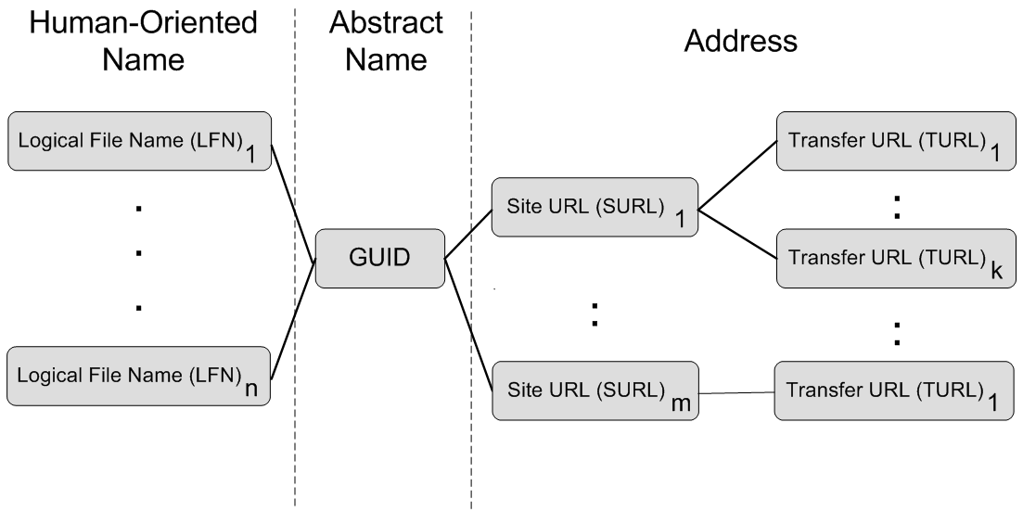
Some DM Concepts:
Grid Files (2/2)
  While the GUIDs and LFNs identify a file irrespective of its location, the SURLs and TURLs contain information about where a physical replica is located, and how it can be accessed.

Slide 8
Some DM Concepts:
SRM Naming Resolution
  SURL → TURL : This mapping is managed by Storage Resource Management (SRM) service.
Mapping made by the SRM Service

Slide 9
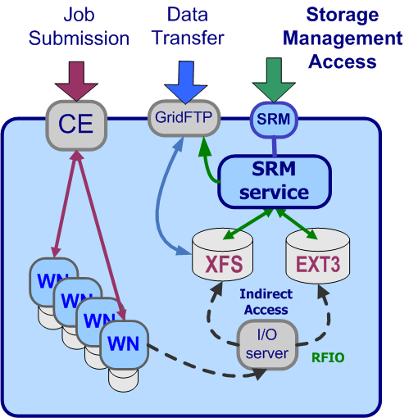
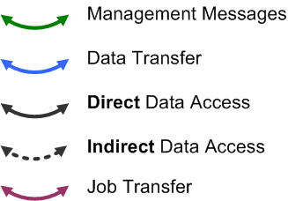
SRM role in a Site

Slide 10
What StoRM is
StoRM is a storage resource manager for disk based storage systems.
  It implements the SRM interface version 2.2.
  StoRM is designed to support guaranteed space reservation and direct access (native POSIX I/O call), as well as other standard libraries (like RFIO).
  StoRM takes advantage of high performance parallel file systems like GPFS (from IBM). Also standard POSIX file systems are supported (XFS from SGI and ext3).
  A modular architecture decouples StoRM logic from the supported file system (driver mechanism).

Slide 11
StoRM and cluster file systems
StoRM takes advantage of aggregation functionalities provided by dedicated systems, such as parallel and cluster file systems.
A cluster file system allows large numbers of disks attached to multiple storage servers to be configured as a single file system.
A cluster file system provides:
  Transparent parallel access to storage devices while maintaining standard UNIX file system semantics.
  High-speed file access to applications executing on multiple nodes of a cluster.
  High availability and fault tolerance.

Slide 12
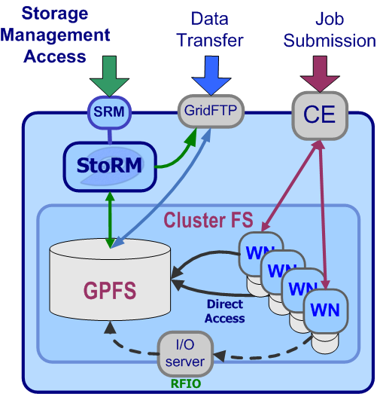
StoRM role in a site

Slide 13
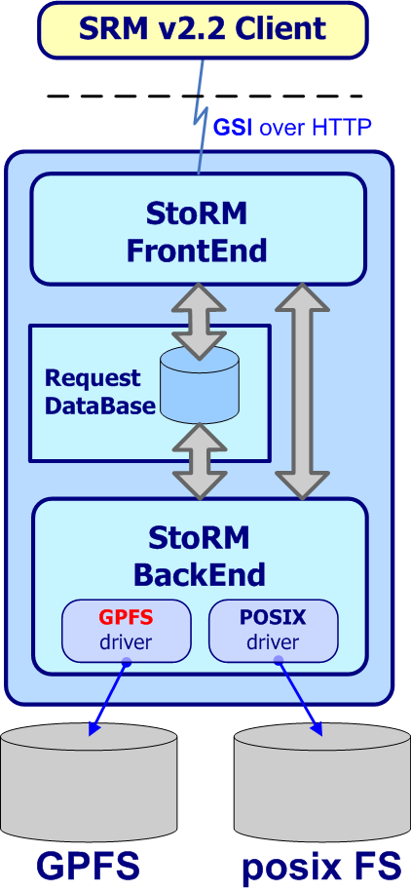
StoRM architecture (1/2)
Front end (FE) has responsibilities of:
expose a web service interface
manage connection with authorized clients
store asynchronous request into data base
retrieve asynchronous request status
co-operate with backend directly for synchronous call
manage user authentication
co-operate with external authorization service to enforce security policy on service
Notes:
In this slide you can see an artistic view of StoRM architecture.

Slide 14
StoRM architecture (2/2)
Data Base :
Store SRM request and status
Store application data
Back end (BE) has responsibilities of:
execute all synchronous (active) action
get asynchronous request from data base
execute all asynchronous action
bind with underlying file systems
enforce authorization policy on files
manage SRM file and space metadata
Notes:
In this slide you can see an artistic view of StoRM architecture.

Slide 15
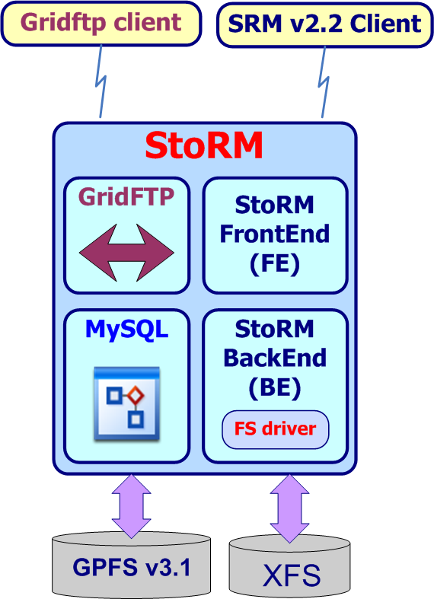
Deployment Schema (1/2)
Simplest
Simplest installation
  One single Front-End
  One single Back-End
  One single GridFTP deamon
  MySQL server
All the components in the same host
Adapt for small SE
  Low transfer traffic (not means with small space size..)
  Few requests for second

Slide 16
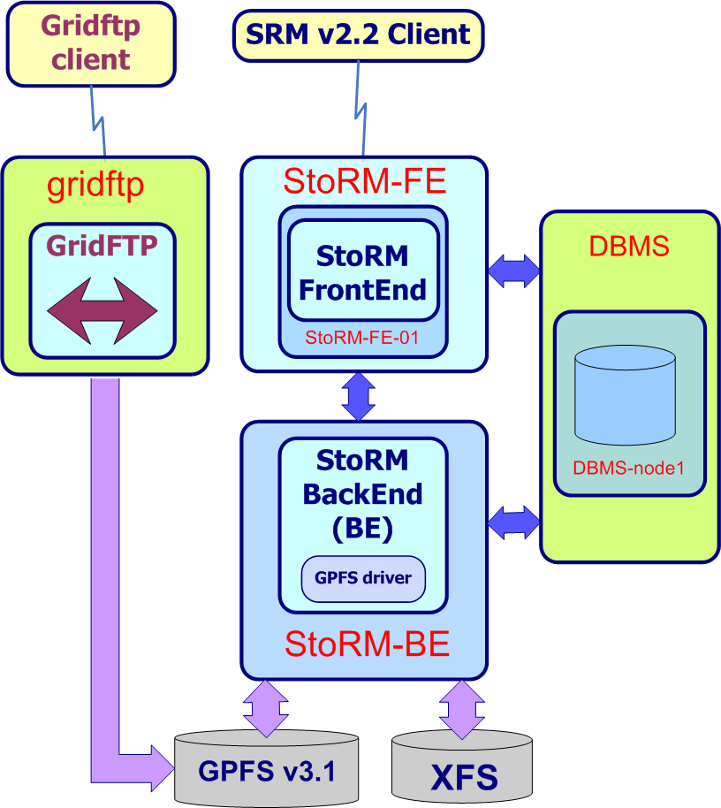
Deployment Schema (2/2)
Distributed
Distributed installation
  One single Front-End
  One single Back-End
  One single GridFTP deamon
  MySQL server
All the components could live in different host
Adapt for a scalable SE
  Medium transfer traffic
  Medium load (requests for second)

Slide 17
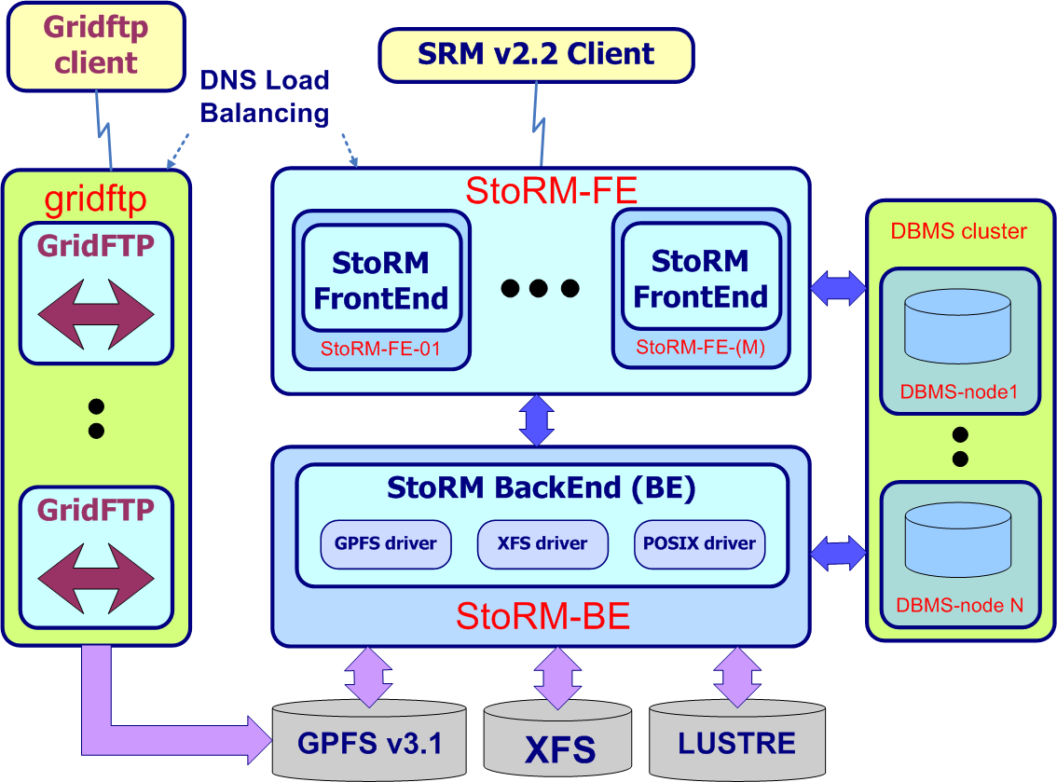
Deployment Schema (2/2)
Cluster
Critical components could be installed in cluster arrangement
Many FEs
Adapt for a scalable SE
High transfer traffic (able to saturate bandwidth)
High load (requests for second )

Slide 18
Installing StoRM (1/3)
  Please, follow the installation instruction available in StoRM site
  and send feedback to us ;)
  Web Site : http://storm.forge.cnaf.infn.it , Follow documentation link!
Prerequisites
  Scientific Linux CERN (SLC) Edition 3.0.x
  Host certificates (hostcert.pem and hostkey.pem)
  Local accounts and Pool account configured for the VOs you want support
  LCAS/LCMAPS (with VOMS support) configured on the BE host
  MySQL server 4.1.11 (or greater) on host dedicated to DBMS
  Java 5 on the BE host
  ACL enabled on underlying file system

Slide 19
Installing StoRM (2/3)
Installing via YAIM
  Installing YAIM
  Setting StoRM variables
    General parameters
    StoRM repository
    StoRM specific parameters
    Managed VO parameters
  Installing StoRM
  LINK :
  http://storm.forge.cnaf.infn.it/doku.php?id=documentation:installation_guides:yaim

Slide 20
StoRM Configuration (1/7)
Configure the Front-End component
The frontend binary is installed in the following directory:
/opt/srmv2storm
StoRM FE configuration file is:
/etc/sysconfig/srmv2storm.nsconfig
It contains only the connection parameter to the DB
<db_user>/<db_password>@<frontend_host>
… Simple! ;)

Slide 21
StoRM Configuration (2/7)
Configure the Back-End component
The backend binary is installed in the following directory:
/opt/storm
StoRM BE configuration is based on two files:
  storm.properties
  namespace.xml
The storm.properties configuration file is a common java .properties. It’s placed in the StoRM home directory:
/opt/storm/etc/storm.properties
The namespace.xml configuration file is a structured and complex configuration file based on a XML Schema.
/opt/storm/etc/namespace.xml

Slide 22
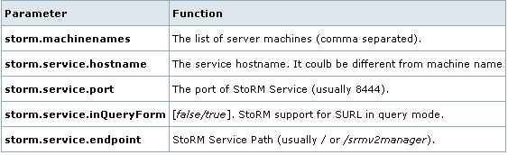
StoRM Configuration (3/7)
Some properties in storm.properties

Slide 23
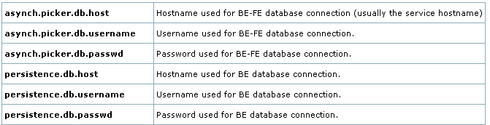
StoRM Configuration (4/7)
Other properties in storm.properties
There are many other parameters, but only a few are mandatory.
Please, see the guide:
LINK : http://storm.forge.cnaf.infn.it/doku.php?id=documentation:configuration_be_base

Slide 24
StoRM Configuration (5/7)
Some concepts about namespace.xml (1/3)
StoRM makes the mapping between SURL and TURLs without the use of a database (like the component DPNS of DPM)
  Performance and Stateless
StoRM adopts a configuration file containing the rules to perform the mapping:
The rules are based on:
  SURL (only the Storage File Name (StFN), part of SURL)
  Grid user Identity
  Grid user permissions

Slide 25
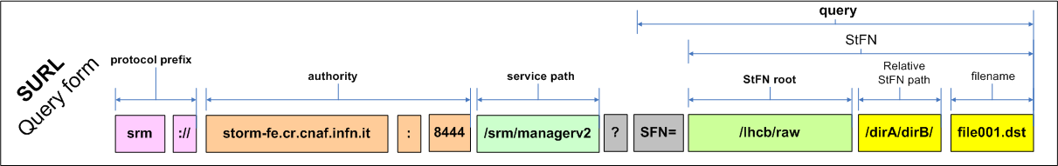
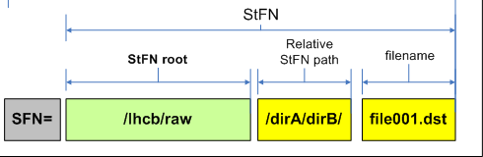
StoRM Configuration (6/7)
Some concepts about namespace.xml (2/3)
SURL format and StFN part
srm://school18.gs.ba.infn.it:8444/srm/managerv2?SFN=/infngrid/test_file.txt

Slide 26
StoRM Configuration (7/7)
Some concepts about namespace.xml (3/3)
Grid Identity
  Attribute used within StoRM: VOMS FQAN and DN
Storage Area
  Storage Space (SA) defined within a Storage Element
    Within namespace we identify SA-VOview with (virtual) file sysytem
  assigned to a VOs (VOView)
Permissions
  StoRM service is shared between all the VO (one installation per site!!)
  VO members can approach their storage area (SA) only
    Approachable rule in namespace.xml
  VO can view many SA within the same Storage Element
    Mapping rule in namespace.xml

Slide 27
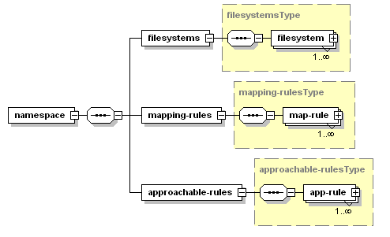

Namespace.xml (1/7)
Some concepts about namespace schema

Slide 28
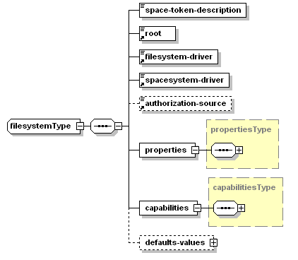
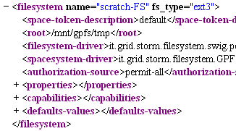
Namespace.xml (2/7)
Filesystem Type

Slide 29
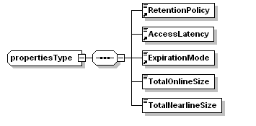
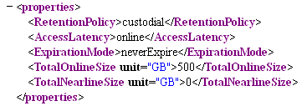
Namespace.xml (3/7)
File system Properties type

Slide 30
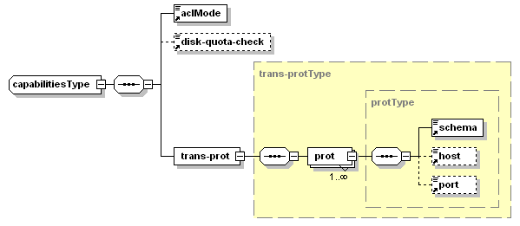
Namespace.xml (4/7)
File system capabilities Type

Slide 31
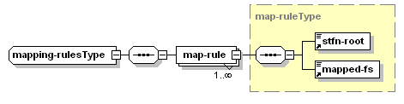
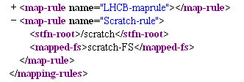
Namespace.xml (5/7)
Mapping Rule type

Slide 32
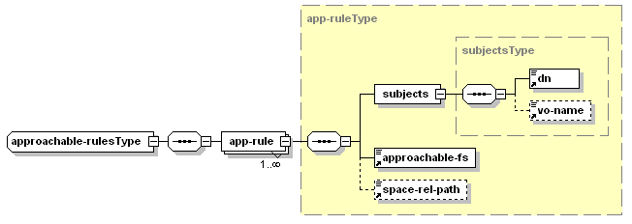
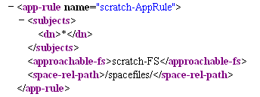
Namespace.xml (6/7)
Approachable rule type

Slide 33
Namespace.xml (7/7)
The Namespace algorithm
Select the set of filesystem that the requestor can approach (app-rules)
Select the set of filesystem compatible with StFN (mapping rules)
Intersection between the two above sets
Select the best compatible filesystem (similarity (distance) of StFN-root)
Build the TURL with Filesystem properties and Capabilities

Slide 34
Command Line tools
StoRM is distributed with SRMv2.2 command line clients
  Please, refers to the documentation at
http://storm.forge.cnaf.infn.it/doku.php?id=documentation:client_examples
The frontend binary is installed in the following directory:
/opt/srmv2storm/bin/clientSRM
You can use this client to play with any SRMv2.2
Useful to validate the installation of StoRM
  How? See the documentation.

Slide 35
Log Files
StoRM holds some log files:
For the Front-End component refers to:
/opt/srmv2storm/var/log/srmv2storm.log
For the Back-End component refers to:
/opt/storm/var/log/storm-backend.stderr
/opt/storm/var/log/storm-backend.stdout
/opt/storm/var/log/storm-backend.log
Log files of BE are based on log4j, so it is possible change log level from debug, info, warn, error and fatal.

Slide 36
References
Web Site: http://storm.forge.cnaf.infn.it
  Papers published, Documentation, Slides, …
Mailing list: storm-users@cnaf.infn.it
  For subscription: https://iris.cnaf.infn.it/mailman/listinfo/storm-users
Send private mail to:
  Riccardo.Zappi<at>cnaf.infn.it
  Luca.Magnoni<at>cnaf.infn.it
  Alberto.Forti<at>cnaf.infn.it

Slide 37
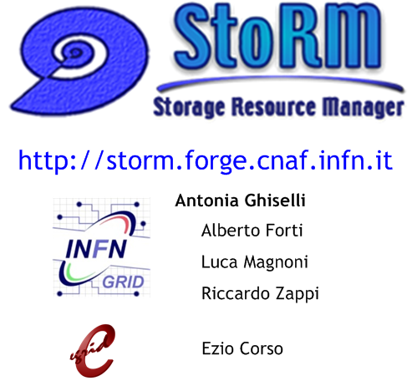
StoRM team

Slide 38


