Slide 1
Experience with GPFS and StoRM at the INFN Tier-1
Luca dell’Agnello
INFN-CNAF
Hepix, Roma 6th April 2006

Slide 2
Parallel File Systems at the INFN Tier-1: early studies in 2005
Evaluation of GPFS for the implementation of a powerful disk I/O infrastructure for the TIER-1 at CNAF.
  A moderately high-end testbed used for this study:
    6 IBM xseries 346 file servers connected via FC SAN to 3 IBM FAStT 900 (DS4500) controllers providing a total of 24 TB.
    500 CPU slots (temporarily allocated) acting as clients
    Maximum available throughput from server to client nodes using 6 Gb Ethernet cards in this study: 6 Gb/s
PHASE 1: Generic tests.
  Comparison with Lustre
PHASE 2: Realistic physics analysis jobs reading data from (not locally mounted) Parallel File System.
Dedicated tools for test (PHASE 1) and monitoring have been developed:
  The benchmarking tools allows the user to start, stop and monitor the test on all the clients from a single user interface
  It implements network bandwith measurements by means of the netperf suite and sequential read/write with dd
  The monitoring tools allow to measure the time dependence of the raw network traffic of each server with a granularity of one second

Slide 3
Early Parallel File System Test-bed
4 TB, 2 LUN
17x250 GB
Raid-5 array
IBM xseries 346
dual Xeon, 2 GB RAM
client node
dual Xeon, 2 GB RAM
IBM
FastT 900
(DS 4500)
client node
dual Xeon, 2 GB RAM
4 TB, 2 LUN
17x250 GB
Raid-5 array
IBM xseries 346
dual Xeon, 2 GB RAM
client node
dual Xeon, 2 GB RAM
500 client nodes
client node
dual Xeon, 2 GB RAM
4 TB, 2 LUN
17x250 GB
Raid-5 array
IBM xseries 346
dual Xeon, 2 GB RAM
Brocade
Fiber
Channel
Switch
Gigabit
Ethernet
Switch
client node
dual Xeon, 2 GB RAM
IBM
FastT 900
(DS 4500)
4 TB, 2 LUN
17x250 GB
Raid-5 array
client node
dual Xeon, 2 GB RAM
IBM xseries 346
dual Xeon, 2 GB RAM
client node
dual Xeon, 2 GB RAM
4 TB, 2 LUN
17x250 GB
Raid-5 array
client node
dual Xeon, 2 GB RAM
IBM xseries 346
dual Xeon, 2 GB RAM
IBM
FastT 900
(DS 4500)
4 TB, 2 LUN
17x250 GB
Raid-5 array
IBM xseries 346
dual Xeon, 2 GB RAM
client node
dual Xeon, 2 GB RAM
3 disk storage
24 TB, 12 LUN
6 file system server

Slide 4
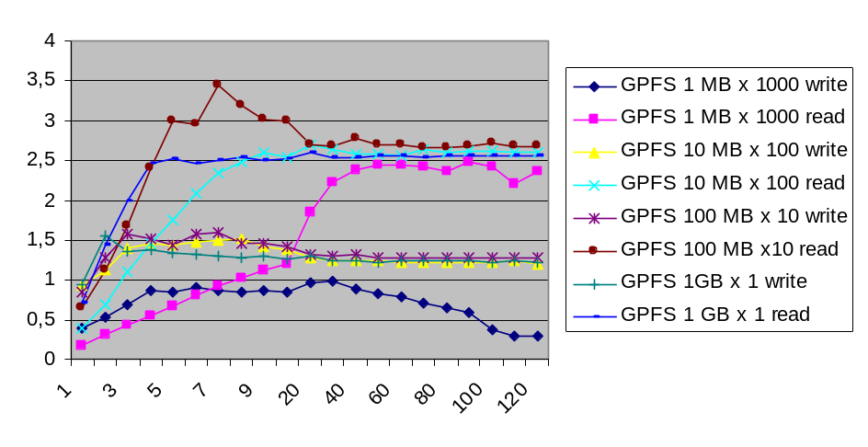
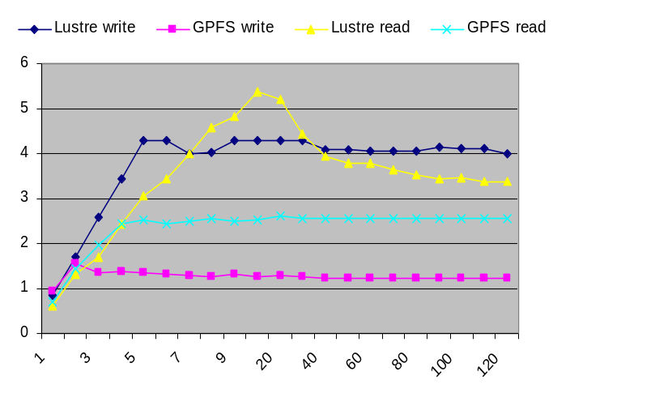
Test results
Network tests (bidirectional saturation of 6 Gbps aggregate bandwidth to disk servers)
GPFS robustness test
  Done just with GPFS 2.2
  2.000.000 files written in 1 directory (for a total of 20 TB) by 100 processes simultaneously with native GPFS and then read back, run continuously for 3 days
  No failures!
Phase 1 – sequential r/w from several clients simultaneously performing I/O with different protocols (native GPFS/Lustre, RFIO over GPFS/Lustre, NFS over GPFS).
  1 to 30 GigaEthernet clients, 1 to 4 processes per client.
  File sizes ranging from 1 MB to 1 GB.
Results of read/write
(1GB different files)
Native GPFS with different file sizes
Effective average throughput (Gb/s)
Effective average throughput (Gb/s)
# of simultaneous read/writes
# of simultaneous read/writes

Slide 5
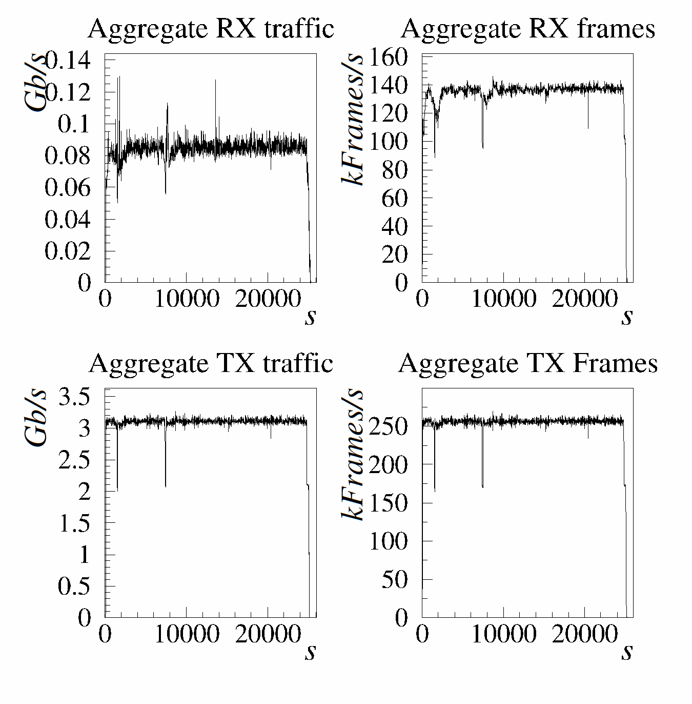
Test results : a realistic scenario
Test with a realistic LHCb analysis algorithm
  Analysis Jobs are generally the most I/O bound processes of the experiment activity.
  The analysis algorithm reads sequentially input data files containing simulated events and produces n-tuples files in output
Analysis jobs submitted to the production LSF batch system
  14000 jobs submitted to the queue, 500 jobs in simultaneous RUN state
8.1 TB of data served by RFIO daemons running on GPFS parallel file system servers (LUSTRE not tested for lack of time)
  RFIO-copy to the local wn disk the file to be processed;
  Analyze the data;
  RFIO-copy back the output of the algorithm;
  Cleanup files from the local disk.
All 8.1 TB of data processed in 7 hours, all 14000 jobs completed successfully.
  >3 Gbit/s raw sustained read throughput from the file servers with GPFS (about 320MByte/s effective I/O throughput).
  Write throughput of output data negligible (1 MB/job).
Copying input files to the local disk is not the best approach (no guarantee for disk space availability)
More cleaver approach (which requires SRM v2.1 and a reliable filesystem that allows to keep a file open for a while) would be to open remotely input and output file
  SRM 2.1 functionalities needed to pin the input files and reserve space for the output files on the SE

Slide 6








More recent studies with GPFS
In 2006 new tests with local GPFS mount on WNs (no RFIO)
  GPFS version 2.3.0-10
Installation of GPFS RPMs completely “quattorized”
  Minimal work required to adapt IBM RPM packages to become quattor compliant
GPFS mounted on 500 boxes (most of the production farm)
Why we (temporarily) dropped LUSTRE ?
  Commercial product: it seems very promising and scalable (10000+ nodes) ☺
  Stable and reliable ☺
  Easy to install, but rather invasive ☹
    Requires own Lustre patches to standard kernels either on server and client side
  No support for ACL and space reservation ☹
  GPFS already in production at Tier1……
Worker Nodes
mounting GPFS
Ethernet
Storage servers GPFS
and GridFTPd
4
x Sun
Microsystem
S
SunFire V
20
Z
Qlogic
F
2340
HBA
8
x
2
Gb
/
s FC
P
SAN Fabric
G
r
4
x
2
Gb
/
s FC
e
t
s
u
22
TB
l
C
StorageTEK
FLexLine
FLX
680

Slide 7
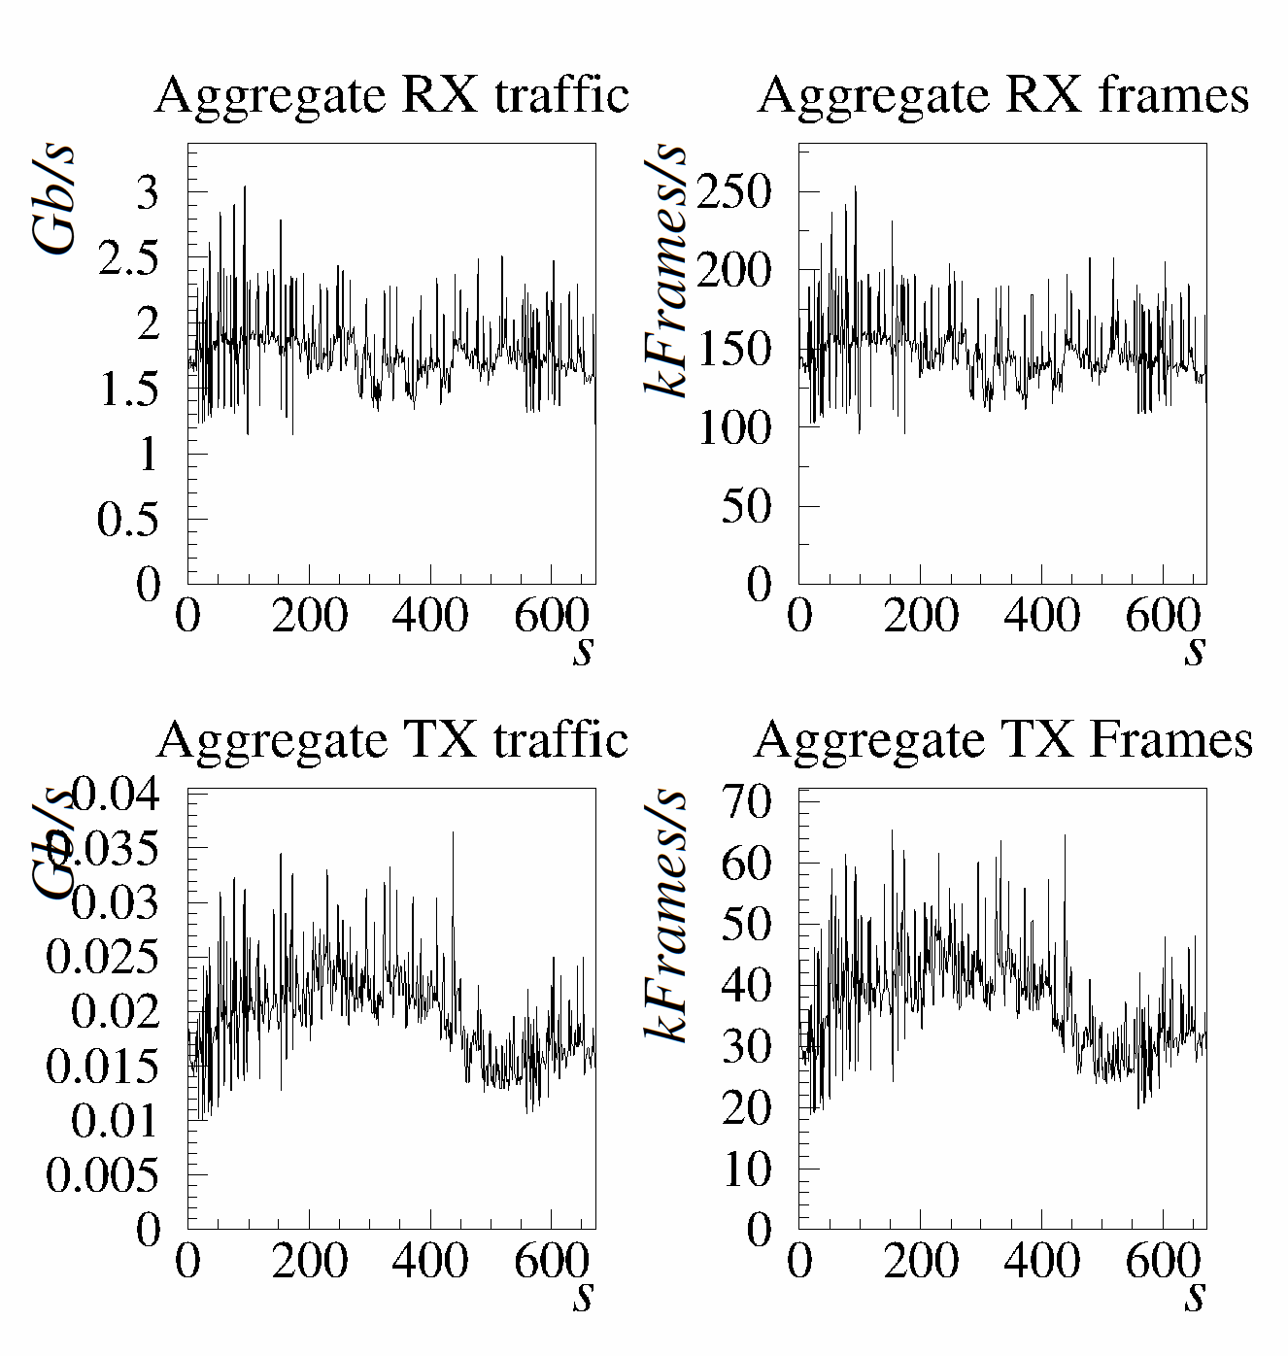
WAN data transfers
Data transfers of pre-staged stripped LHCb data files from CERN (castorgridsc data exchanger pools) to the 4 GPFS servers via third party globus-url-copy
40 simultaneous transfers, dynamically balanced by the DNS, 5 streams per transfer
  Typical file size 500 MB
About 2 Gb/s of sustained throughput with this relatively simple testbed
CPU load of servers: 35%
  Including I/O wait: 15%

Slide 8
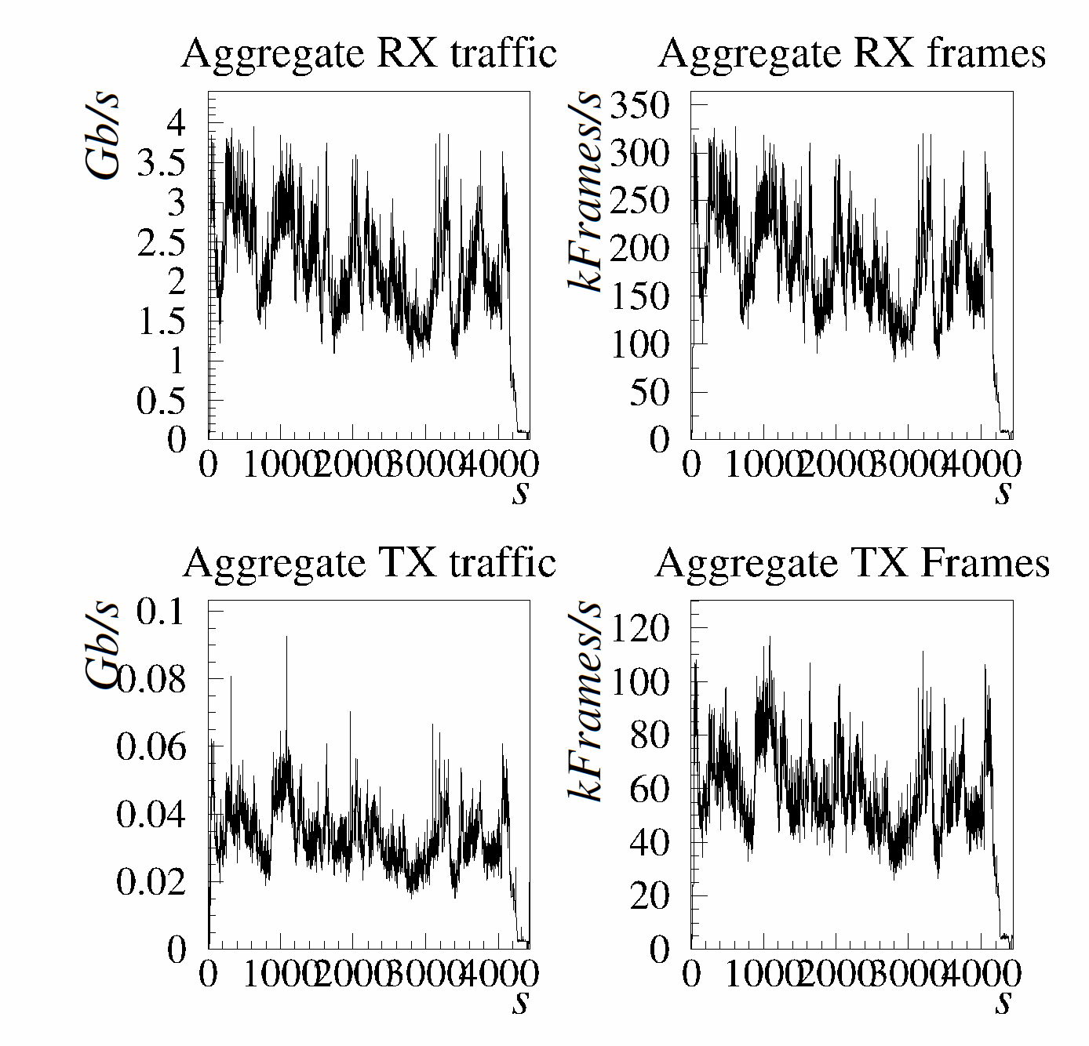
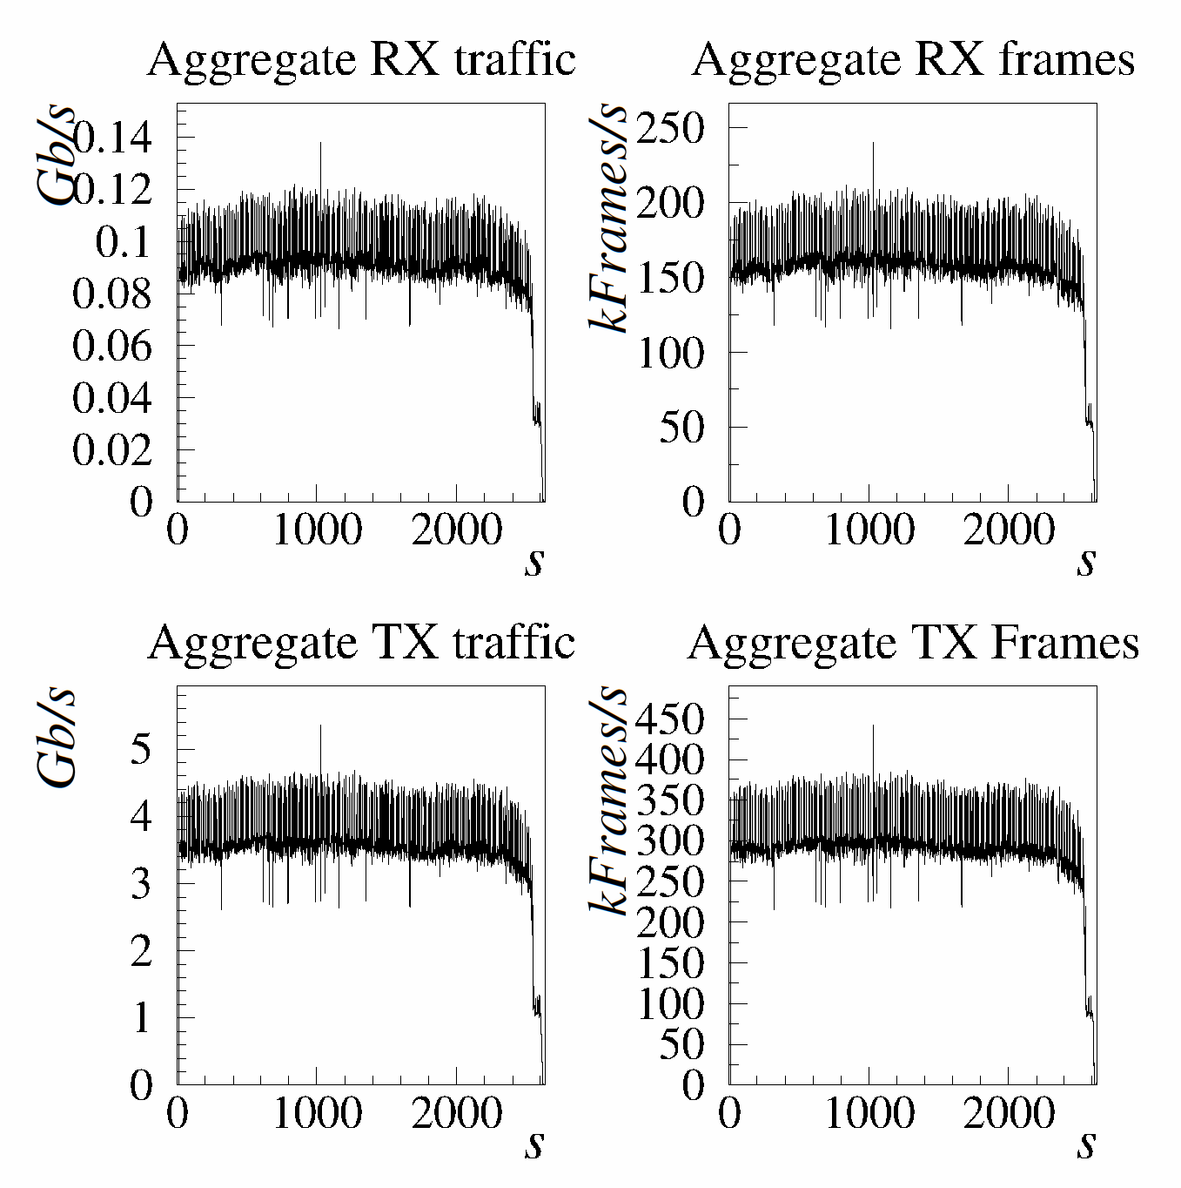
Sustained read & writes on LAN from production worker nodes
1000 jobs submitted to the LSF production batch
  400 jobs in simultaneous running state
  1 GB file written from each job at full available throughput
About 2.5 Gb/s
CPU load of servers: 70%
  including I/O wait: 20
  negligible on client side
Sustained writes on LAN from production WNs
1000 jobs submitted to the LSF production batch
  300 jobs in simultaneous running state
  1 GB file read from each job at full available throughput
4 Gb/s
  Maximum available bandwidth used
CPU load of servers: 85%
  including I/O wait: 50%
  negligible on client side
Sustained read on LAN from production WNs

Slide 9
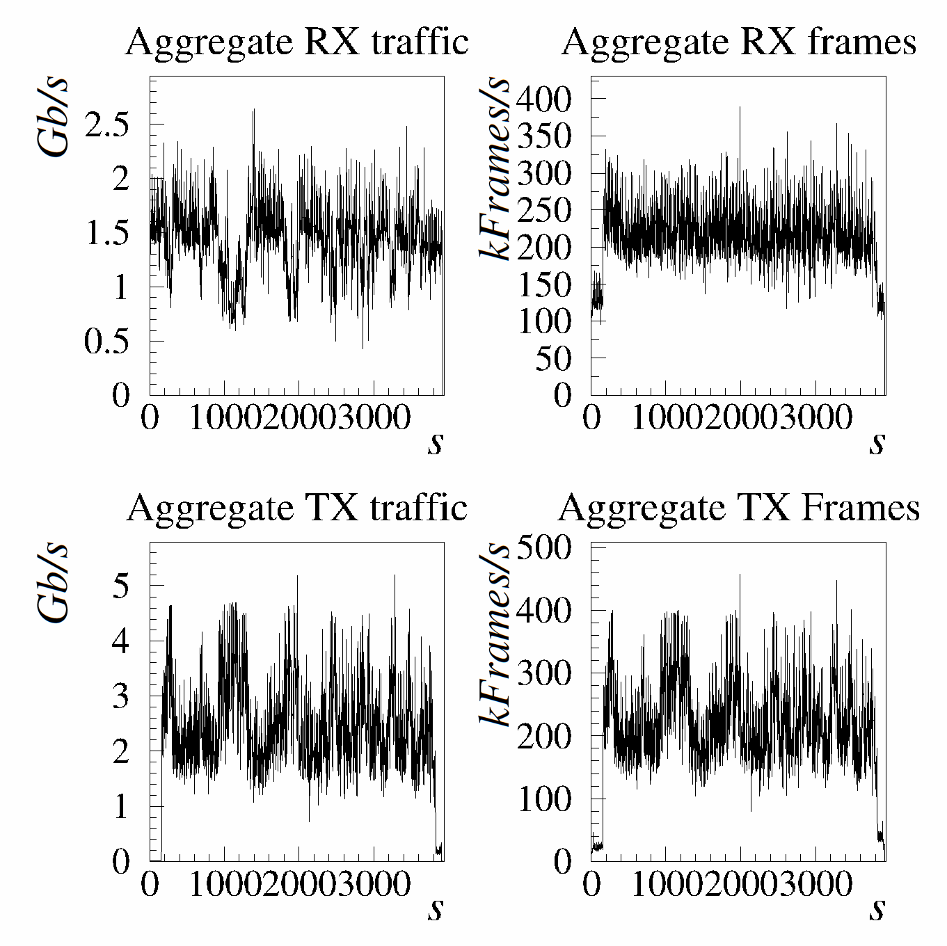
A more realistic scenario: sustained WAN data transfers and local LAN read from worker nodes at the same time
40x5 streams from CERN to CNAF
1000 jobs submitted to the LSF production batch
  550 jobs in simultaneous running state
  1 GB file read from each job at full available throughput
About 1.7 Gb/s from CERN and 2.5 Gb/s to worker nodes
CPU load of servers: 100%
  including I/O wait: 60%
  negligible on client side

Slide 10
GPFS summary (1)
Commercial product, initially developed by IBM for the SP systems and then ported to Linux
  Free for academic use, but very difficult to have support from IBM (even paying…)
Stable, reliable, fault tolerant, indicated for storage of critical data
  Possibility to have data and metadata redundancy
    Expensive solution, as it requires the replication of the whole files, indicated for storage of critical data
  Data and metadata striping
  Data recovery for filesystem corruption available, fsck
  Fault tolerant features oriented to SAN and internal health monitoring through network heartbeat
  Interesting performance figures, already at the scale of what required “one day” (not so far actually...)
Easy to install, not invasive
  Distributed as binaries or sources in RPM packages (smart repackaging needed for easy installation)
  No patches to standard kernels are required (apart for small bug fixes on the server side already included in newer kernels), just a few kernel modules for POSIX I/O to be compiled for the running kernel
POSIX I/O access, every existing application can use these filesystems as they are without any adaptation

Slide 11
GPFS summary (2)
In principle requires every machine in the cluster (clients and servers) to have each-other root authentication without password (with rsh or ssh)
  In case one gets root privileges on one machine, all machines can be hacked
  This is not a nice feature for security and seems like a quick and dirty way adopted when porting the software to Linux
  We implemented a workaround restricting the access of the clients to the servers by means of ssh forced-command wrappers
Advanced command line interface for configuration and management but…
… the configuration of the cluster (tuning parameters, topology of the cluster, address of servers nodes, disks, etc.) has to be replicated on each node by means of ssh via a push mechanism
  Pull mechanism however foreseen, e.g. in case the configuration has changed while a node was down, then the node can pull the new configuration when it comes up
  Lustre solves the problem of deploying the cluster configuration by using an LDAP-based centralized information service
For advanced storage management they require a dedicated SRM (see StoRM below), then naturally become fully GRID-compliant disk-based storage solutions, and can be solid building blocks toward GRID standardization in the I/O sector

Slide 12
SRM and StoRM
StoRM is a disk based Storage Resource Manager which:
  implements SRM specification version 2.1.1
    WS-I compliant version, named “2.1.1_modified”.
  is designed to support guaranteed space reservation.
  supports direct access (native posix I/O calls).
    Other access protocols remain available (e.g., rfio).
  takes advantage of high performance Cluster File System with ACL support, such as GPFS.
    Other posix file systems are supported (e.g., ext3)
  Authentication and Authorization are based on VOMS certificates.
Current release (1.1.0) provides these functionalities:
  Data transfer : srmCopy, srmPtG, srmPtP, srmStatus<XXX>
  Space Management : srmReserveSpace, srmGetSpaceMetadata
  Directory : srmLs, srmRm, srmMkDir, srmRmdir.
Production release ready next May

Slide 13
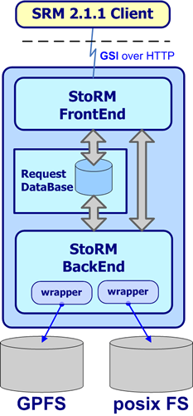
StoRM architecture
Front end (FE) has responsibilities of :
  expose a web service interface
  manage connection with authorized clients
  store asynchronous request into data base.
  retrieve asynchronous request status.
  co-operate with backend directly for synchronous call.
  co-operate with external authorization service to enforce security policy on service.
  manage user authentication
Data Base :
  Store SRM request and status
  Store application data
Back end (BE) has responsibilities of :
  accomplish all synchronous (active) action.
  get asynchronous request from data base.
  accomplish all asynchronous action.
  bind with underlying file system.
  enforce authorization policy on files
  manage SRM file and space metadata.

Slide 14
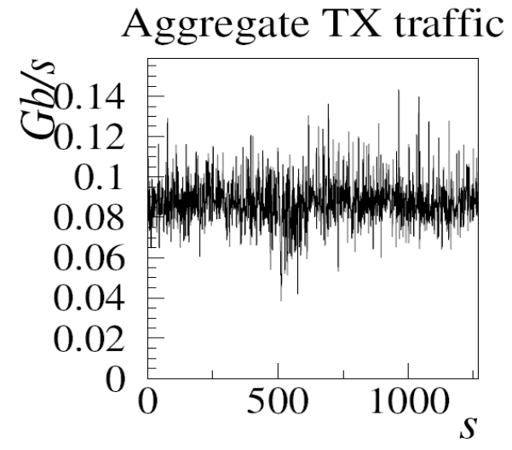
Preliminary tests
Tests with 1.1.0
4 sites involved
  Tier1 (22T) – Stress test and transfer test
  Bari (2TB) – Transfer test
  ICTP-Trieste (30GB) - Functionality tests
  CNAF-Cert-SE (50GB) - Functionality tests
50 parallel srmCopy with:
From SURL at CNAF
To SURL at BARI
1GB file size, everyone
Only 100 Mb/s access bandwidth to BARI
Next planned transfertest with larger access bandwidth
Data transfer T1 to/from Bari via srmCopy v.2.1.1

Slide 15
People involved
A lot of people contributed to these test activities:
INFN Tier1 staff (INFN–CNAF)
StoRM development team (INFN-CNAF, ICTP)
LHCb Bologna group

