Slide 1

StoRM a Grid Storage Resource Manager
  Luca Magnoni
  INFN-CNAF, Bologna

Slide 2
Outline
StoRM Team
Storage Resource Managers
StoRM
    Features
    StoRM in a Grid usage scenario
    Security Framework
  Conclusions
  StoRM References

Slide 3
StoRM Team
StoRM is a result from collaboration between:
INFN – CNAF within the High Energy Physics community
and
ICTP – EGRID Grid infrastructure for Economics and Finance research.
CNAF team:
    Coordinator: A.Ghiselli.
    Members: A.Forti, L.Magnoni and R.Zappi.
  EGRID team:
    Coordinators: A.Nobile and S.Cozzini.
    Members: E.Corso, A.Messina and A.Terpin.

Slide 4
Storage Resources
Heterogeneous storage resources co-exists in a Grid environment.
Basically, storage resources can be composed by disks, tapes or a combination of the two.
The main logical entities of a storage resource are space and file.
Most Grid applications involve the generation of large datasets, the consumption of large datasets , or both.
There is the need to deal with reservation and scheduling of storage resources.

Slide 5
Storage Resource Manager (SRM) 1/2
Storage Resource Managers are middleware services whose function is to provide space allocation and file management of shared storage components.
Files are no longer permanent entities on the storage, but dynamical ones that can appear or disappear according to the user's specification.
SRMs do not perform file transfers, but can invoke middleware components that perform this job (such as GridFTP).

Slide 6
Storage Resource Manager (SRM) 2/2
SRM services agree on a standard interface to hide storage characteristics and to allow interoperability.
SRMs are implemented through the web service technology.
SRM v2.x is based on these concepts:
    lifetime of a file (volatile with a fix amount of life-time, durable or permanent).
    file pinning (to ensure a file is not canceled during operation).
    space pre-allocation (to ensure the request space is available for the whole life of the application since the beginning).
    storage classes to identify different quality of storage resources.

Slide 7
StoRM
StoRM is a storage resource manager for disk based storage systems.
It implements the SRM interface version 2.x.
StoRM is designed to support guaranteed space reservation and direct access (native POSIX I/O call), as well as other standard libraries (like RFIO).
StoRM take advantage from high performance parallel file systems like GPFS (from IBM). Also standard POSIX file systems are supported (XFS from SGI and ext3).
A modular architecture decouples StoRM logic from the supported file system.

Slide 8
StoRM and cluster file systems
StoRM takes advantage from aggregation functionalities provided by dedicated systems, such as parallel and cluster file systems.
A cluster file system allows large numbers of disks attached to multiple storage servers to be configured as a single file system.
A cluster file system provides:
  Transparent parallel access to storage devices while maintaining standard UNIX file system semantics.
  High-speed file access to applications executing on multiple nodes of a cluster.
  High availability and fault tolerance.

Slide 9
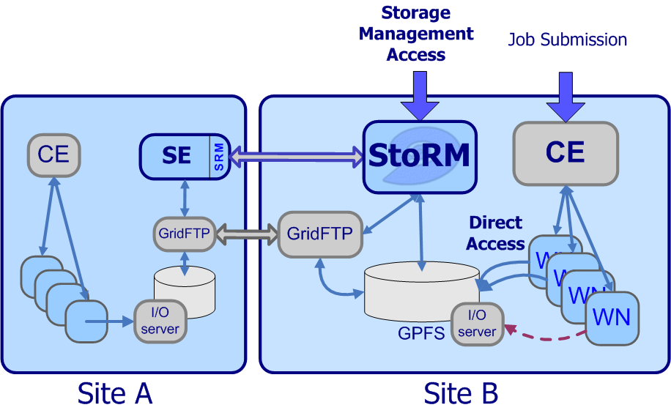
StoRM Grid usage scenario
StoRM dynamically manages files and space in the storage system.
Applications can directly access the Storage Element (SE) during the computational process.

Slide 10
Examples of SRM operation
PrepareToGet: the requested files are pinned, the lifetime is extended and the permission on the file are enforced.
PrepareToPut: a guaranteed space reservation is performed and the permission are enforced.
SrmCopy: the srm contact the remote srm and interact with the transfer service (e.g.gridftp) to transfer the file.

Slide 11
StoRM security framework
Security is a driving feature in StoRM design.
Security is based on:
    VOMS certificates.
    File system ACLs to enforce permissions on data.
Plug-in to external Authorization sources.
StoRM requires ACL capable file systems.
StoRM is able to manage different security approach coming from HEP and Economic and Finance Grid requirements.

Slide 12
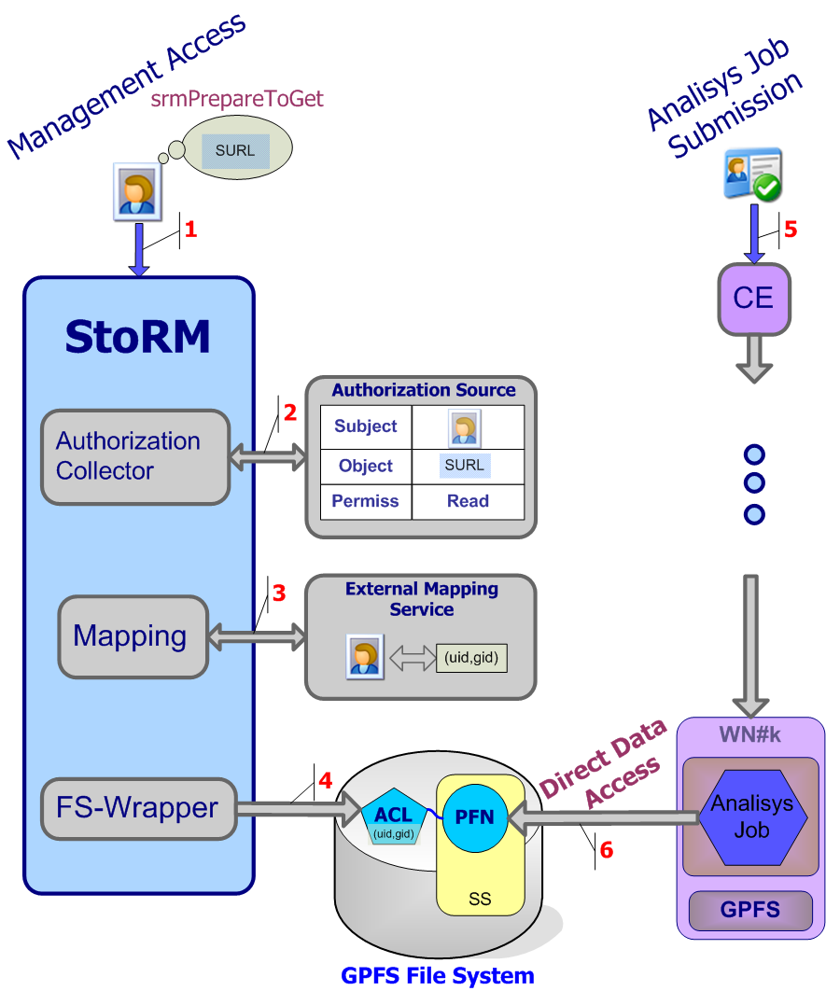
StoRM security framework
User wants to access a file.
StoRM verifies if the principal holds a valid proxy certificate and delegates the external policy decision point to validate the request.
StoRM then queries the Authorization Sources to verify if the user can perform the specified operation on the file.
StoRM queries the Mapping Service to obtain the local user account corresponding to the grid identity of the requester.
The file system wrapper enforces permissions by setting a new ACL on the physical file.
The user job can be executed into the worker node.
The application can perform a standard POSIX call to access the file from the storage system.

Slide 13
Conclusions
We presented StoRM, a SRM solution for disk based storage systems.
    It leverages parallel file systems advantages in a Grid scenario.
    It is a lightweight SRM implementation for standard POSIX file systems.
    It provides a strong security framework .
StoRM is involved in the WLCG-DM working group for interoperability tests on SRM v.2.2 services.

Slide 14
StoRM References
Futher information can by found at:
http://storm.forge.cnaf.infn.it
Questions?

