Slide 1
StoRM disk management middleware
CHEP 2004, Interlaken
27th September 2004
Flavia Donno, INFN
Antonia Ghiselli, CNAF-INFN
Luca Magnoni, CNAF-INFN
Riccardo Zappi, CNAF-INFN

Slide 2
Problem statement (1/3)
Storage System
For applications that are disk-intensive, particular attention should be paid to storage resources, such as those providing higher capacity, redundancy, scalability, etc..
More than decent performance are required to access your data.

Slide 3
Problem statement (2/3)
Space Reservation
In a storage system, we can identify two kinds of resources : file and space.
It often authorized users on storage acts as concurrent consumer of storage resources.
Concurrent consuming of storage resources may cause jobs failure, specially if there is no certainty of space availability.

Slide 4
Problem statement (3/3)
Direct access
Data-intensive jobs want direct access on reserved space with good I/O performance.
Some data-intensive job might not be able to be adapted to use reserved space through an “external” space management application (backward compatibility).

Slide 5
Requirements (1/2)
Storage
  Efficient I/O
  Capacity, Fault-tolerance
Space Management
  Space reservation
  Direct access to reserved space
  Management policies

Slide 6
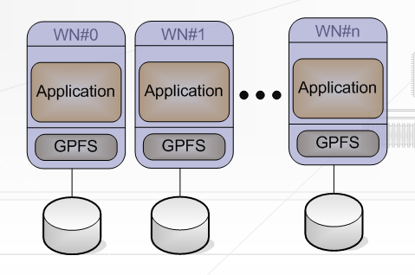
Storage : Efficient I/O
Solution: Parallel File System
An example of Parallel FS.
POSIX I/O
read() write()
open() close()
…
Logical File

Slide 7
Storage : Scalability, Fault recovery, ..
Solution: GPFS
The following requirements:
  Scalability
  Large files/file-systems
  Security
  Failure Recovery
are satisfied by modern parallel file system as GPFS.

Slide 8
Requirements (2/2)
Storage
  Efficient I/O
  Capacity, Fault-tolerance
Space Management
  Space reservation
  Direct access to reserved space
  Management policies

Slide 9
Space Management : Interface
In SRM v2.1 advanced specification there are some new functionalities regarding space management :
srmReserveSpace()
srmReleaseSpace()
srmUpdateSpace()
srmCompactSpace()
...
we have adopted SRM definitions to preserve compatibility with any Space Management Client that is SRM-compliant.

Slide 10
Space Management : Direct access
In order to enable applications for posix access to the reserved space in a storage, we consider a <path>/<file-name> as a part of spaceToken.
  path ::= [root] [relative-path]
  root ::= [root-directory]
  root-directory ::= "/"
  relative-path ::= path-element { "/" path-element } ["/"]
  path-element ::= name | parent-directory | directory-placeholder
  name ::= char { char }
  directory-placeholder ::= "."
  parent-directory ::= "..“

Slide 11
Assembling all the pieces: StoRM
Storage Resource Manager
StoRM goal is to create a container for storage management functionalities as:
  Space reservation (SRM-compliant)
  Other SRM functionalities.
  Management policy enforcement on storage (G-Pbox provided by INFN).

Slide 12
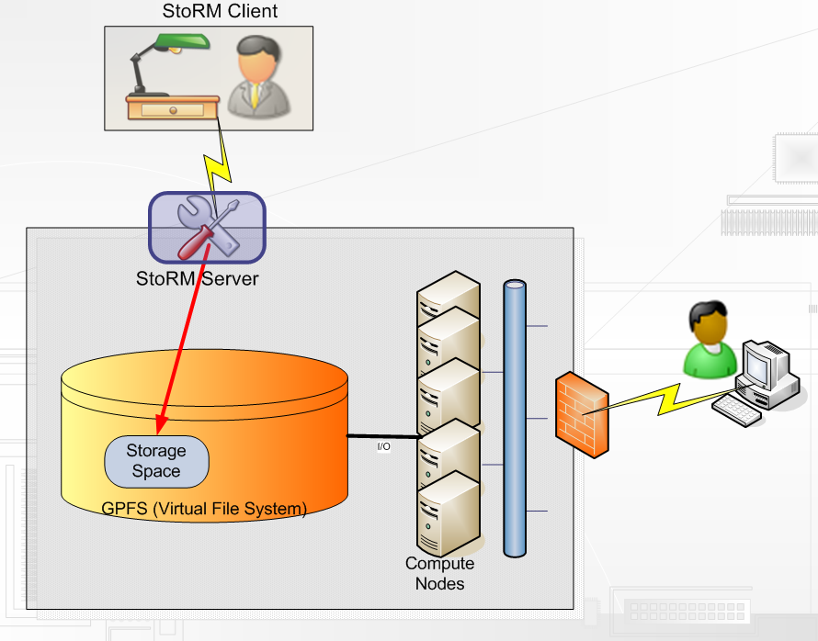
Architecture : access to StoRM.

Slide 13
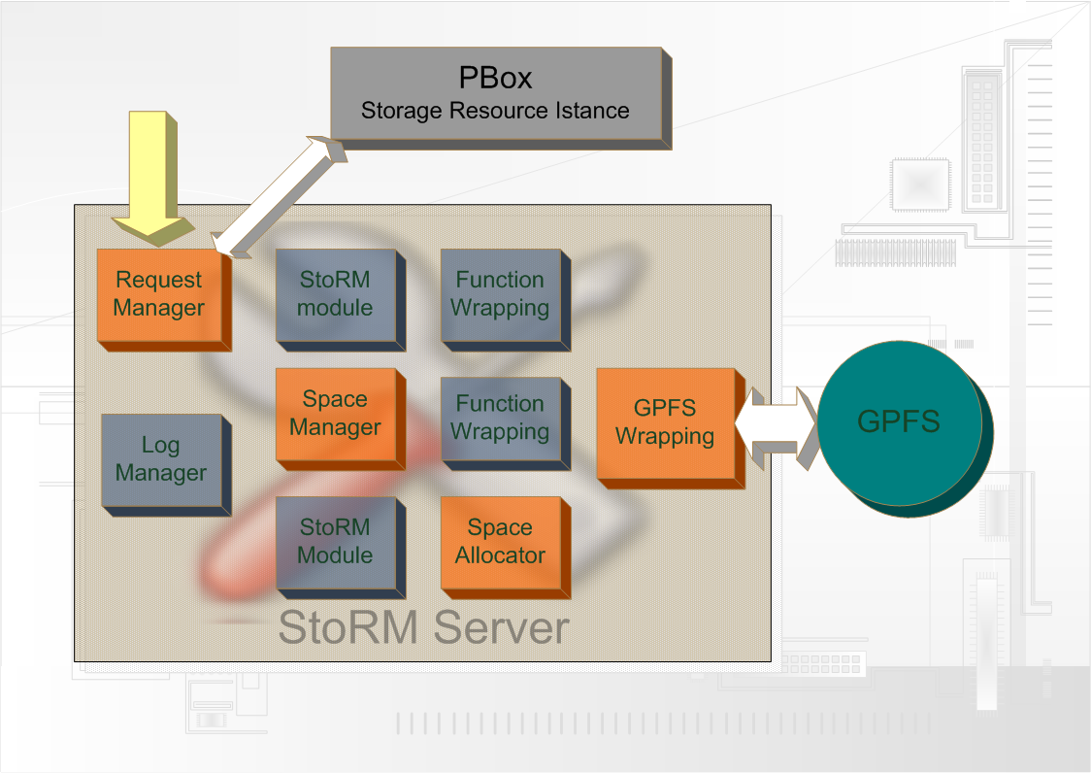

Architecture : StoRM Server
Management
Request

Slide 14













Use scenario : Use of reserved space

Slide 15
Prototype status and future plan
Prototype of StoRM implementing reserve-space functionality exists.
Next steps :
  Testing of all functionalities defined in SRM advanced involving Space Management.
  Integration with other Storage Management Client SRM-Compliant (SRM File Transfer functionalities).

Slide 16
Conclusion
We have presented StoRM, a solution that fulfils the requirements about space management and I/O performance in disk-intensive Grid applications.
StoRM prototype have shown how to create and use reserved space in efficient mode.
There is a lot of work to do, but we are confident in a success.

Slide 17
End
Project references can be found at INFNForge :
http://infnforge.cnaf.infn.it

