Slide 1




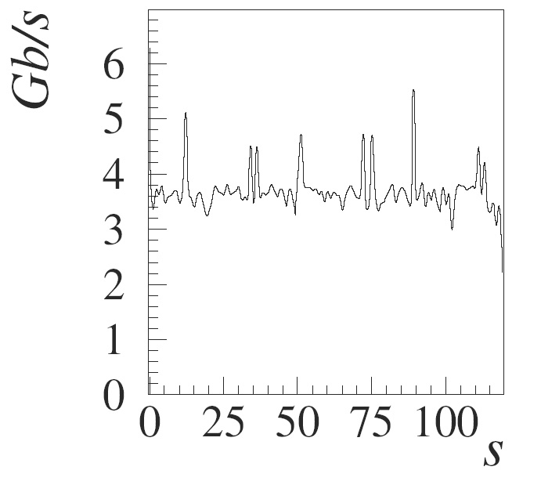
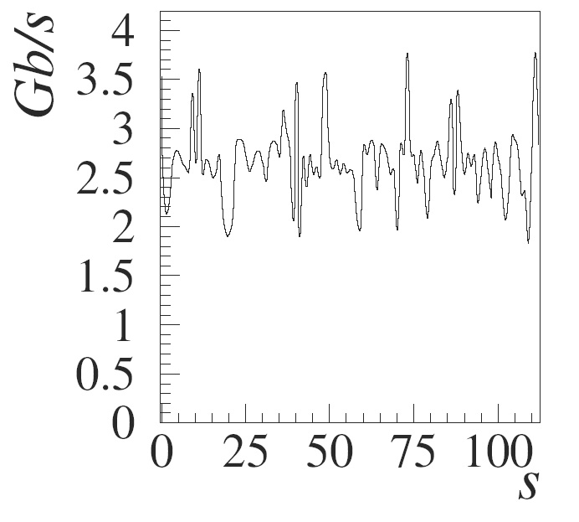
StoRM
An SRM Implementation for LHC Farms
E.Corso¹, S.Cozzini¹, F. Donno², A.Ghiselli³, L.Magnoni³, M.Mazzucato³, R.Murri¹, H.Stockinger⁴, A.Terpin¹, P.Ricci³, V.Vagnoni⁵, R.Zappi³,
1) ICTP, Trieste, I 2) INFN, Pisa and CERN, CH 3) INFN-CNAF, Bologna, I 4) University of Vienna, Vienna, A 5) INFN, Bologna, I
Introduction
Architecture
Security Aspects
High energy physics data-intensive applications demand large storage systems capable of serving hundreds of terabytes of storage space in a fast and reliable way, with high throughput and easy management. Nowadays, Storage Area Network (SAN) solutions are commonly deployed at LHC centres, and parallel file systems such as GPFS and Lustre allow for reliable, high-speed native POSIX I/O operations.
StoRM is a Storage Resource Manager (implementing version 2.1.1 of the SRM standard) that relies on a parallel file system or a standard Posix file system backend. It allows direct POSIX access (“file:///” transfer protocol support) from applications to file and space. Data access is performed without interacting with an external service, with great performance improvement.
StoRM has a multi-tier architecture. There are two main levels named Front-End (FE) and Back-End (BE).
There are several storage security issues: data integrity, confidentiality, authentication, non-repudiation and authorization are only some examples. Every aspect must be taken into account at different levels (site and virtual organization). StoRM manages some important security aspects at site level, in particular regarding authorization to a specific resource (StoRM service, file and space). Authorization is based on subject authentication. StoRM uses the Grid Security Infrastructure (GSI) for authentications. Some FQANs (short form for Fully Qualified Attribute Name) could be present within X.509 proxy certificates, as defined by the Virtual Organization Membership Service (VOMS). The first step is the authorization for using the StoRM service. StoRM verifies if an authenticated user is authorized to perform the request, delegating to external authorization services, like G-PBox, the validation of the StoRM usage. Storage resources with authorization requirements are file and space. Authorization policies on file and space live on external catalogs, like the LHC File Catalog (LFC) or others. Authorization policies are expressed in terms of grid identities and SURLs, typically. StoRM collects these security information from authorization sources (LFC or other). StoRM takes advantages of the security mechanism provided by the underlying file system to enforce permissions. StoRM sets up ACLs on the physical file to allow direct access from a worker node.
The FE exposes the service interface. It receives the requests, manages the client communications, and forwards a processed structure to the server.
The BE is the core of StoRM. It processes the requests, executes necessary tasks to perform operations like security, metadata, space and file management and returns the result to the client.
The wrappers to different file system types (at the moment GPFS from IBM and the standard Posix FS) provides a common interface, hiding file system peculiarities. StoRM takes also advantage of special features provided by the underlying file system, like ACL support and file system block pre-allocation (feature available with GPFS).
The current release of StoRM provides the following functionalities of the SRM v2.1.1 interface:
StoRM interacts with grid services concerning security (such as G-PBox), mapping services (through the LCMAPS interface), external file authorization catalogs and file system security mechanisms to provide a strong security model. The emphasis on security was also driven by the needs of Economics and Finance as represented by the EGRID project, which makes StoRM suitable for applications in such fields.
Data Transfer: SrmPrepareToPut(), SrmPrepareToPut() SmrCopy() SrmStatus[*](), SrmPutDone().
Space Management: SrmReserveSpace(), SrmGetMetaDataSpace().
Directory Functions: SrmLs() with recursive option, SrmRm(), SrmRmdir(), SrmRm().
Use case: srmPrepareToGet
Test bed architecture
at the INFN-CNAF Tier-1
Results
Write test: SrmPrepareToPut() with implicit reserveSpace of 1GB files. globus-url-copy from local source to the returned TURL. 80 simoultaneous client processes.
Read test: SrmPrepareToGet() followed by globus-url-copy from the returned TURL to a local file (1 GB files). 80 simultaneous client processes.
The two tests allow to validate the SrmPrepareToPut() and SrmPrepareToGet() functionality and robustness provided by StoRM, as well the read and write throughput of underlying GPFS file system. The sustained throughputs obtained on our testbed have been about 3 Gb/s (Write) and 4 Gb/s (Read), respectively
The GPFS cluster employed as storage testbed is realized with the architecture described below. The disk storage (lower part of the figure) is composed by roughly 40 TB. It is provided by 20 logical partitions of one dedicated StorageTEK FLexLine FLX680 disk array storage, aggregated by GPFS (version 2.3.0-10).
Read throughput
Write throughput
Conclusions
StoRM is designed with the aim of answering to a set of requests coming from various applications to allow direct POSIX file system access to files in a local environment, while allowing access to high-performance, modern parallel file systems like GPFS (IBM) and Lustre (CFS). The StoRM server runs on top of any POSIX file system on Linux, but can take advantage of the special features of the underlying file system (e.g. GPFS add-ons). StoRM allows data transfer functions, directory management functions and explicit space reservation with native POSIX access to files. The StoRM security model allows either grid access and local access according to a principle of least privileges
The figure above shows a typical data access scenario in a site with StoRM as SRM and with a storage system based on disks. The user requests SrmPrepareToGet to a SURL to obtain a file pinned and ready to be accessed. See callout named ‘1’. StoRM verifies if the principal holds a valid proxy certificate and delegates the external policy decision point to validate the request. See ‘2’. StoRM then queries the Authorization Sources to verify if the user can perform the specified operation on the SURL. See ‘3’. StoRM queries LCMAPS to obtain local user account corresponding to the grid identity of the requester See ‘4’. Physical file name derives by SURL and user attributes (Virtual organization name space). See ‘5’. The file system wrapper enforces permissions by setting a new ACL on the physical file. See ‘6’. The user Job ( see ‘7’) can be executed into the worker node. The application can perform a standard Posix call to access the file into/from the storage system (see ‘8’).
The FLX680 contains 96 blade units composed of 2 interconnected 250GB drives. The 2 Fibre Channel (FC) redundant controllers are connected using four 2Gb/s links to our central Fabric Director FC Switch Brocade 24000 on 4 different hot-swappable switching modules for the best availability. The GPFS disk-servers are 4 high performance Sun Microsystem SUnFire V20Z servers with dual Opteron 2.6 GHz and 4 GB of RAM, connected to the FC Switch through 2 Qlogic 2340 2Gb/s FC Host Bus Adapter (HBA) on 2 different switching modules. The disk servers run GridFTP daemons as well to provide an external access to the file system.
References
[1] ISO/IEC 9945-1:1996 (IEEE Std 1003.1, 1996 Edition), Information technology—Portable Operating System Interface (POSIX®).
[2] The Storage Resource Management Working Group: http://sdm.lbl.gov/srm-wg, 2004
[3] F.Schmuck, R.Haskin, “GPFS: A Shared-Disk File System For Large Computing Clusters”, FAST’02, 28-30 January 2002, Monterey, CA.
[4] F. Donno, A. Ghiselli, L. Magnoni, R. Zappi “StoRM: Grid Middleware for Disk Resource Management”, Chep 2004, 26 Sept – 1 Oct 2004, Interlaken, Switzerland.

