Slide 1

Status Report
Riccardo Zappi
INFN-CNAF, Bologna

Slide 2
Outline
StoRM
  Origin and StoRM team
  Quick overview of architecture
Current Status
  Functionalities developed
Timeline expected
  Functionalities incoming

Slide 3
StoRM Origin
Result of collaboration between:
INFN - Grid.IT Project : to build a disk-based SRM service on top of high performance parallel file systems.
+
ICTP - EGRID Project : to build a pilot national grid facility for research in Economics and Finance (www.egrid.it)

Slide 4
StoRM Development Team
INFN – CNAF
project coordinator : A.Ghiselli
developers : A.Forti, L.Magnoni, R.Zappi
eGRID - ICTP
coordinator :A.Nobile, S.Cozzini
developers : E.Corso, A.Messina, A.Terpin
INFN-Bo
tester : V.Vagnoni (LHCb)

Slide 5
StoRM : General Features
StoRM is a disk based Storage Resource Manager which:
  Production release implements SRM specification version 2.1.1
  is migrating to the SRM version 2.2
  is designed to support guaranteed space reservation.
  supports direct access (native posix I/O calls).
    Other access protocols remain available (e.g., rfio).
  takes advantage of high performance Cluster File System with ACL support, such as GPFS.
    Other posix file systems are supported (e.g., ext3)
  Authentication and Authorization are based on VOMS certificates (LCMAPS).

Slide 6
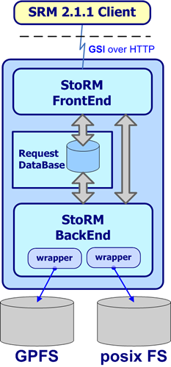
StoRM architecture
Front end (FE) has responsibilities of:
expose a web service interface
manage connection with authorized clients
store asynchronous request into data base
retrieve asynchronous request status
co-operate with backend directly for synchronous call
manage user authentication
co-operate with external authorization service to enforce security policy on service
Notes:
In this slide you can see an artistic view of StoRM architecture.

Slide 7
StoRM architecture
Data Base :
Store SRM request and status
Store application data
Back end (BE) has responsibilities of:
execute all synchronous (active) action
get asynchronous request from data base
execute all asynchronous action
bind with underlying file systems
enforce authorization policy on files
manage SRM file and space metadata
Notes:
In this slide you can see an artistic view of StoRM architecture.

Slide 8
Migration Status to SRM v2.2 of StoRM
We started the migration from the released version of StoRM implementing SRM 2.1.1_modified (begin of July).
The followed strategy is based on adapting the 2.1.1 functions already developed.

Slide 9
Status Summary
Status | Functionality
Currently available | srmPing, srmGetProtocols srmMkdir, srmRmdir, srmRm, srmLs srmReserveSpace, srmGetSpaceMetadata srmStatusOf[*]
available in the next week / mid September | srmPrepareToGet, srmPrepareToPut, srmPutDone, srmCopy (push mode)
available by mid September | srmBringOnLine, srmReleaseFile, srmMv
Available in near future | srmReleaseSpace, srmChangeSpaceForFile, srmPurgeFromSpace

Slide 10
Status details (1/4)
  Directory functionality
srmMkdir : Done.
srmRmDir : Done.
srmRm : Done.
srmLs : Done.
  Only synchronous version is provided
  Limit on returned entries configurable (admin. config)
srmMv : Not provided yet (available by the end of Sept. or before)

Slide 11
Status details (2/4)
  Data Transfer functionality
srmPrepareToGet: Almost done. (by mid Sept or before).
srmPrepareToPut: Almost done. (by mid Sept or before).
srmPutDone : Almost done. (by mid Sept or before).
srmCopy : Almost done. (by mid Sept or before).
  Push mode only.
  The management of SRM_BUSY is not completely tested.
srmBringOnLine : Not provided yet (available by the end of Sept.)
  We need more analysis for disk only solution ( no “state” or “copies” of SURL within StoRM…)
“Other asynch func.” : Not provided yet (no schedule)

Slide 12
Status details (3/4)
  Status functionality
srmStatusOf [PtP/PtG/Copy/Bol] : Done.
  Discovery functionality
srmPing: Done.
  otherInfo[] : ? … some example could be useful.
srmGetProtocols: Done.
  Return all protocols managed by StoRM instance (admin. config)
  Protocol ‘file://’ is supported

Slide 13
Status details (4/4)
Space Management functionality
srmReserveSpace: Done.
  Guaranteed space is managed only for GPFS through space allocation mechanism.
srmGetSpaceMetadata: Done.
srmReleaseSpace : Not provided yet (no scheduled)
srmChangeSpaceForFiles : Not provided yet (no scheduled)
srmPurgeFromSpace : Not provided yet (no scheduled)

Slide 14
Timeline summary
  As soon as possible (by second week of Sept):
  StoRM with v2.2 endpoint available for interoperability tests.
  By mid of September or before:
  All functionalities tagged as “almost done” will be provided. (PtG, PtP, Copy, PutDone).
  By the end of September or before:
  BringOnLine and ReleaseFiles
  Other functionalities:
  The schedule will follow the agreement …

Slide 15
Last minute issues
retentionPolicyInfo for srmReserveSpace:
  is mandatory in SRM v2.2 spec. but
  it is optional in WLCG usage agreement and within S-2 test suite.
Concurrent PrepareToPut on the same SURL:
  SRM V2.2 spec. not mentioned
  WLCG agreement introduce SRM_FILE_BUSY for such use case
  Which is the right interpretation?

Slide 16

Questions
?!

Slide 17
Links
  Hepix Spring meeting 2006 (3-7 April 2006) : Slides
  CHEP’06 (13-17 February 2006) : Poster and Paper
  Fourth EGEE Conference (23-28 October 2005) : Slides
  StoRM web sites :
    http://grid-it.cnaf.infn.it/storm
    http://www.egrid.it/sw/storm/
    http://forge.cnaf.infn.it/projects/storm/
  Source code
    http://www.egrid.it/cvs/storm?root=cvs

Slide 18
Backup slides

Slide 19
Characteristics of Space Reservation in StoRM
Space guarantee is performed through a Space allocation (feature available only in StoRM on GPFS)
spaceToken
spaceToken
spaceToken
spaceToken
Storage
Space
Storage
Space
Storage
Space
Storage
Space
File
silhouette
Storage
Space
File
resize
It is not an atomic operation.. but it’s very fast. Inverse operation is possible..

Slide 20
Space Allocation in GPFS
GPFS exposes a programming interface.
gpfs_prealloc( ) subroutine for storage space allocation
  The gpfs_prealloc( ) function is used to preallocate disk storage for a file that has already been opened, prior to writing data to the file.
  It assigns a number of empty block to I-Node pointed by a parameter.
  The preallocation of disk space for a file provides an efficient method for allocating storage without having to write any data.
  This can result in faster I/O compared to a file which gains disk space incrementally as it grows.
  Existing data in the file will not be modified. Reading any of the preallocated blocks will return zeroes.

Slide 21
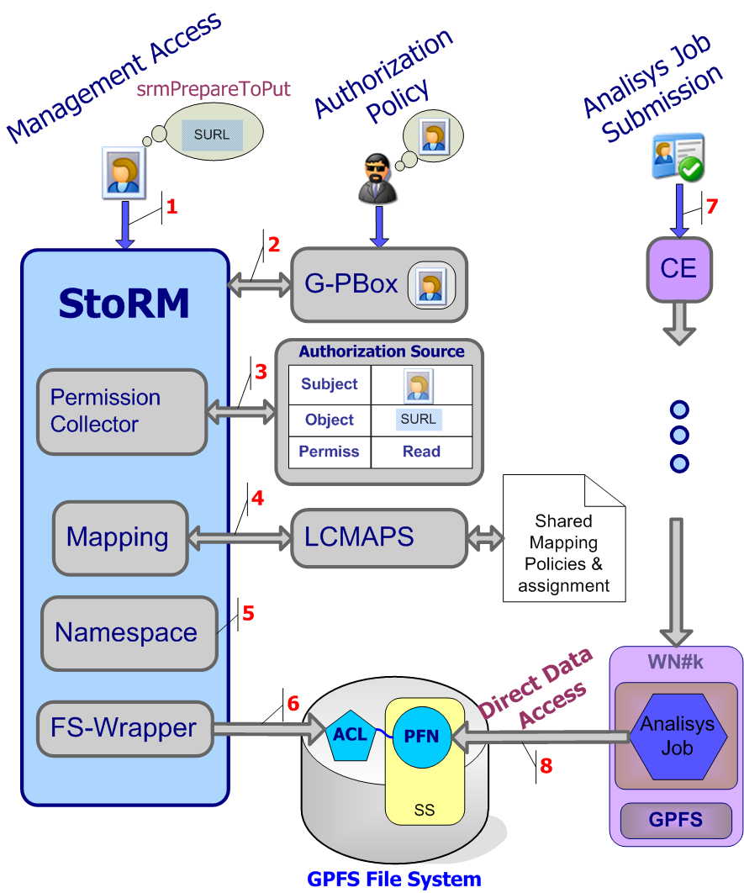
Security aspects
User perform srmPrepareToPut
StoRM verifies if the principal holds a valid proxy certificate and delegates the external policy decision point to validate the request.
StoRM then queries the Authorization Sources to verify if the user can perform the specified operation on the SURL
StoRM queries LCMAPS to obtain local user account corresponding to the grid identity of the requestor
Physical file name derives by SURL and user attributes (Virtual organization name space)
The file system wrapper enforces permissions by setting a new ACL on the physical file.
The user job can be executed into the worker node
The application can perform a standard POSIX call to access the file into/from the storage system.

Slide 22
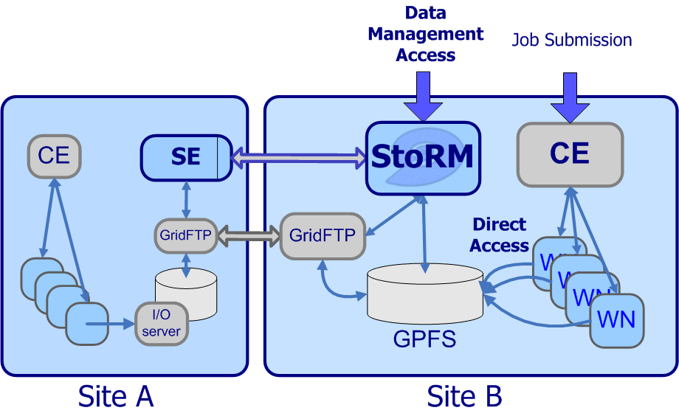
StoRM: SE model
File metadata are managed (and stored) in underlying file system. No replica of metadata at application level.. That is a filesystem job! In this way StoRM gain in performance.
Data access is performed without interacting with an external service, with great performance improvemnet. ( by POSIX call) . Moreover, in case of Parallel File System, StoRM permits to make the most of the provided performance!!

Slide 23
StoRM configurability
Service configuration ( XML based )
  Per VO configuration
  Default values (Space size, lifetime, …)
  Namespace (relative path names)
  Protocols allowed (and other capabilities)
  Authorization model adopted
  Drivers for wrapping underlying Filesystem
Service customization (Property file)
  Service properties (port, tuning parameters, …)
    Properties file that overwrite default service configuration
Notes:
In this slide you can see an artistic view of StoRM architecture.

