Slide 1





VOMS attribute use in StoRM

Slide 2
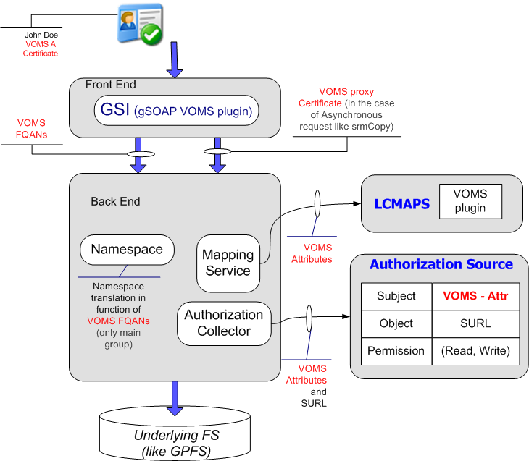
StoRM
VOMS Attribute
Utilization
Description
The web service StoRM uses httpg protocol.
StoRM front-end is written in C and C++. It is based on gSOAP with GSI plugin (with VOMS support). [gLite distribution]

Slide 3
StoRM
VOMS Attribute
Utilization
Description
StoRM front-end parses the proxy certificate to extract DN and FQANs.
FQAN and DN are passed to back end as request parameter.
In the case of srmCopy request entire proxy is passed to backend. (It is used to open a GSI connection to the remote SRM).

Slide 4
StoRM
VOMS Attribute
Utilization
Description
StoRM back-end uses the subject’s attribute to identify the right namespace. Every VO holds one’s namespaces. Every namespace could be based on different quality of storage (underlying filesystem, access protocols, performance, etc.)
E.g. ‘lhcb users’ → ‘/mnt/gpfs/lhcb/’

Slide 5
StoRM
VOMS Attribute
Utilization
Description
Mapping service uses LCMAPS with VOMS plugin.

Slide 6
StoRM
VOMS Attribute
Utilization
Description
Authorization in StoRM is based on external AuthZ sources combination (made by AuthZ collector).
AuthZ source can be LFC, but other sources are also accepted

Slide 7
Further information:
http://storm.forge.cnaf.infn.it

