Slide 1

Version control with Github Desktop
Shuai Wei
IS&T Research Computing Services
Boston University

Slide 2
Setting up GitHub Desktop
Installing GitHub Desktop
https://desktop.github.com/
Authenticating to GitHub
Add your GitHub.com account information to GitHub Desktop
Configuring Git for GitHub Desktop
If you don’t have Git installed, you must configure it before using GitHub Desktop.

Slide 3
Git: main features
Track all your changes
Work along with others
Share work with others
With Git

Slide 4
Git Workflow
Local
computer
Github.com

Slide 5
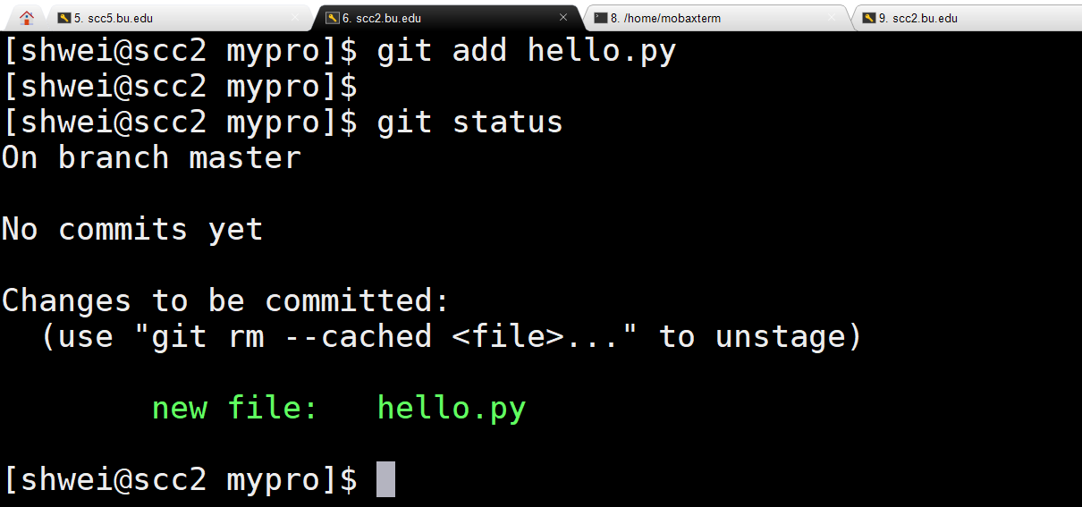
Git: command lines in a terminal window

Slide 6
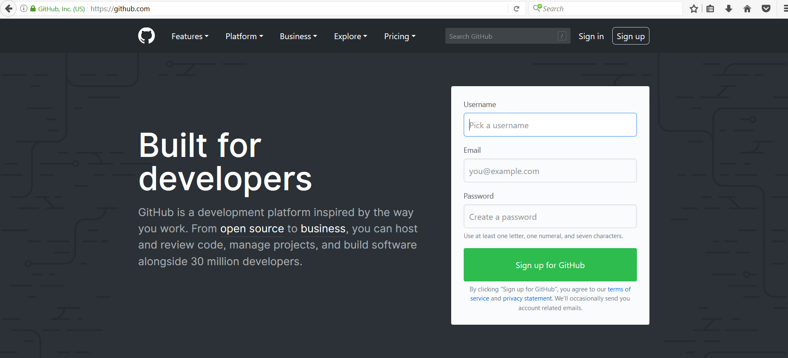
Github.com
A web-server that allows you to save/access your repository remotely.
Easy to share with collaborators.

Slide 7
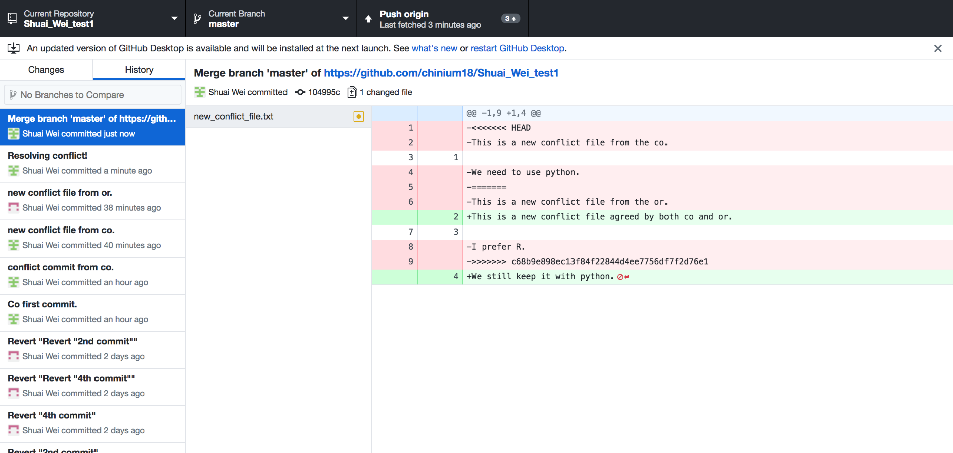
GitHub desktop
It’s a fast, easy way to contribute to projects from OS X and Windows.
GitHub workflow and replace GitHub for Mac and Windows with a unified experience across both platforms.

Slide 8
Setting up GitHub Desktop
Installing GitHub Desktop
https://desktop.github.com/
Authenticating to GitHub
Add your GitHub.com account information to GitHub Desktop
Configuring Git for GitHub Desktop
If you don’t have Git installed, you must configure it before using GitHub Desktop.

Slide 9
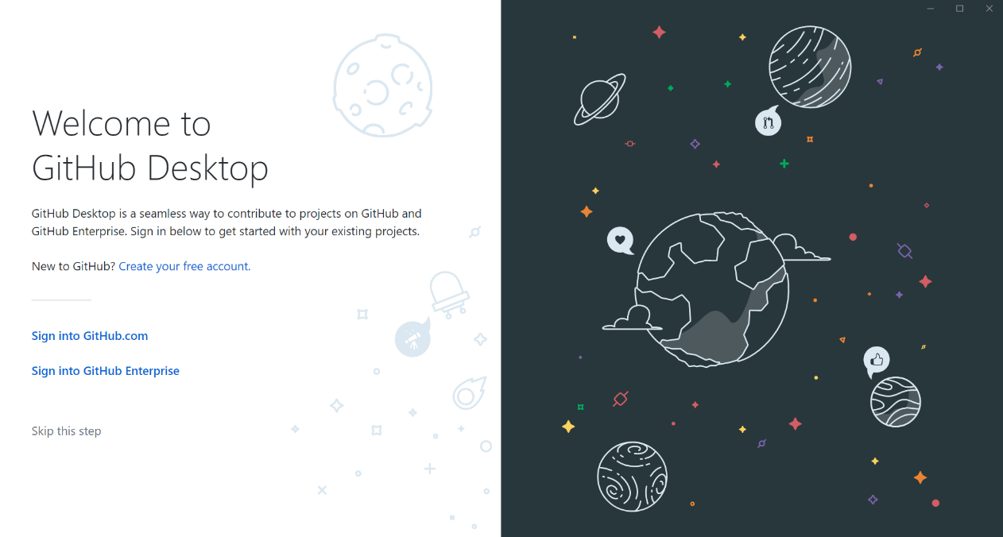
Authenticating to GitHub
or

Slide 10
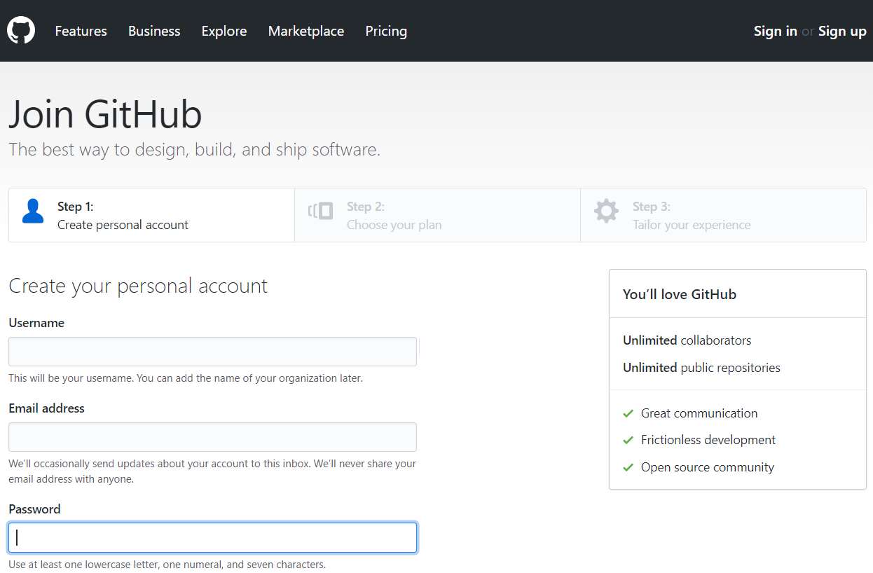
Creating GitHub account if you don’t have an account already

Slide 11
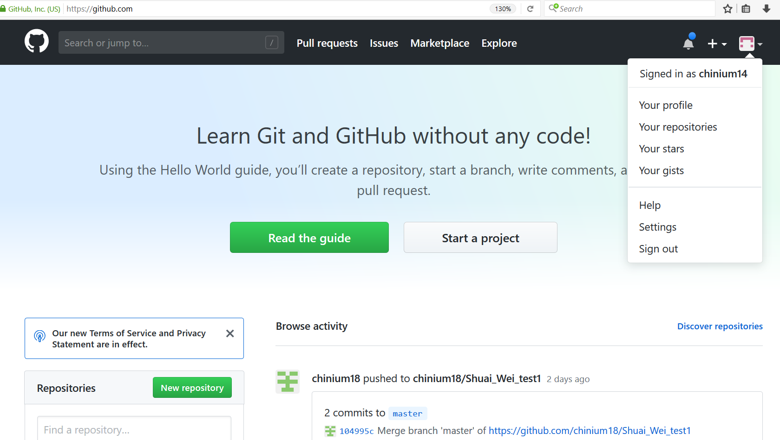
Configuring GitHub account

Slide 12
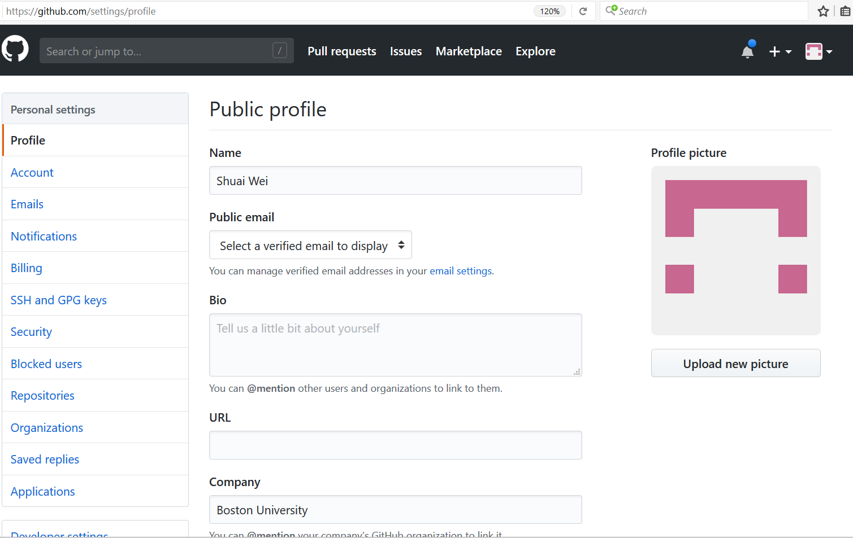
Configuring GitHub account

Slide 13
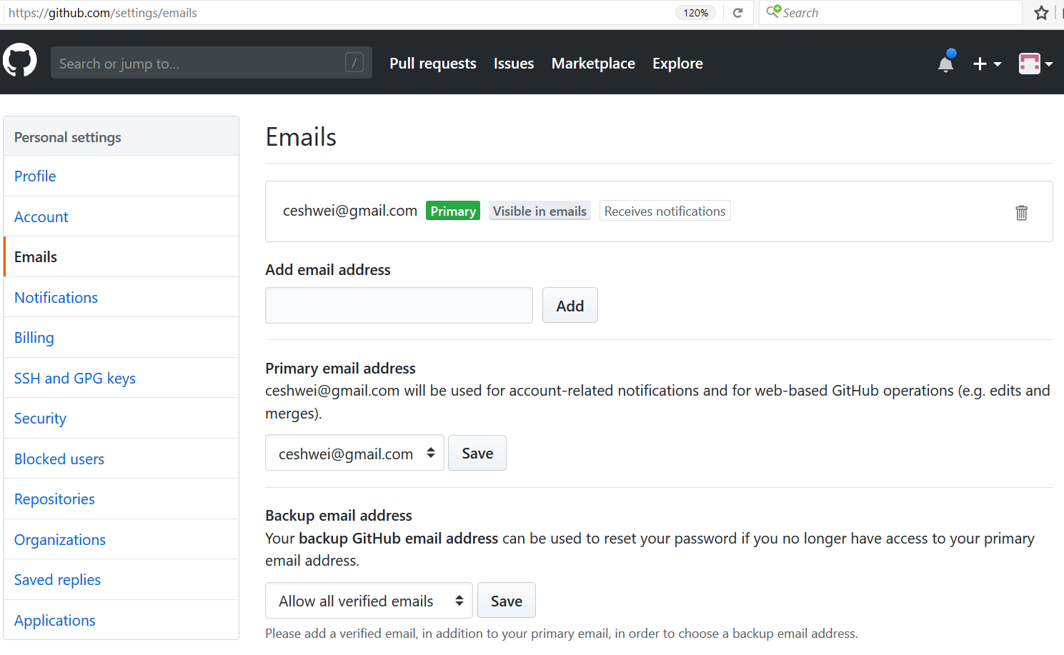
Configuring GitHub account

Slide 14
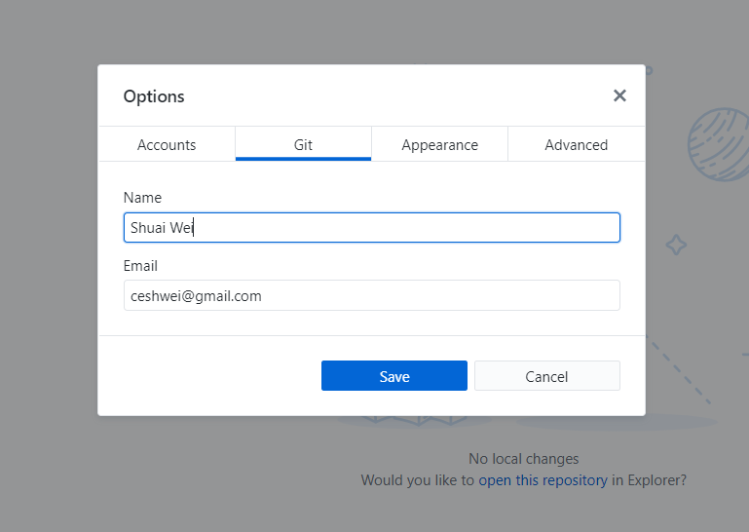
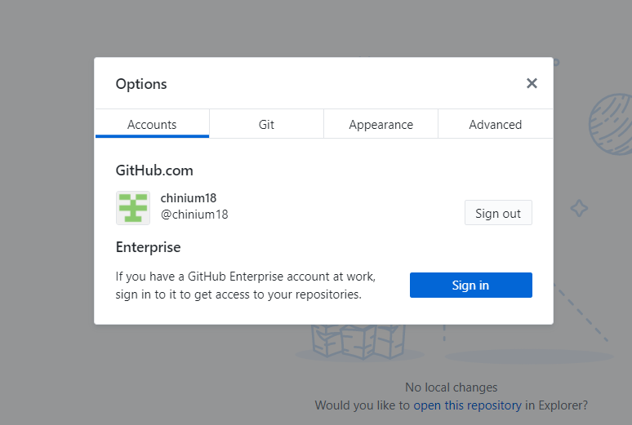
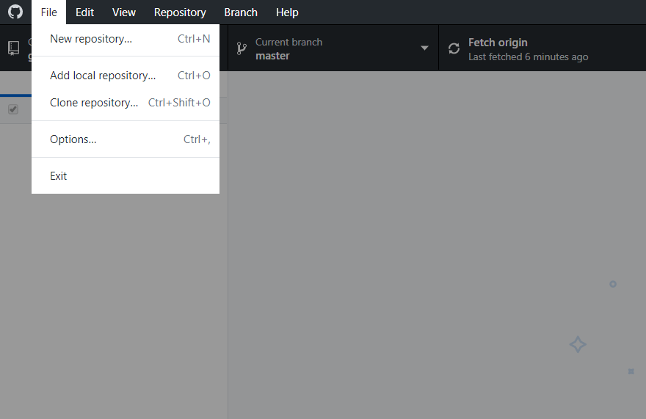
GitHub Desktop Setup

Slide 15
Using Github desktop for version control
Track and visualize each update of your code.
Revert a previous version/commit.
Branch out for large project development.
Now let’s start a new project (repository) with Github desktop.

Slide 16
We use the following set up.
Repository name: BI594
File:
hello.txt, class.txt
First line:
Hello World!
More lines:
Chapter 1:
Chapter 2:

Slide 17
Other resources to learn Git:
https://help.github.com/desktop/
http://try.github.io/
https://www.atlassian.com/git/tutorials
https://github.com/chinium18/github_desktop_tutorial

Slide 18
Topics for hand-on practice in class
Create a new repository
New file
Commit
Publish
Edit, commit, and push
Add new file, commit, and push
Revert a commit
Revert a reverted commit
Add collaborators
Accept collaboration
Clone a repository from collaborator
Edit files in the same directory
Resolve conflicts in code development

Slide 19
help@scc.bu.edu

