Slide 1
Radio Link and Coding Modulation Modeling
Scott Mansfield (Ericsson)

Slide 2
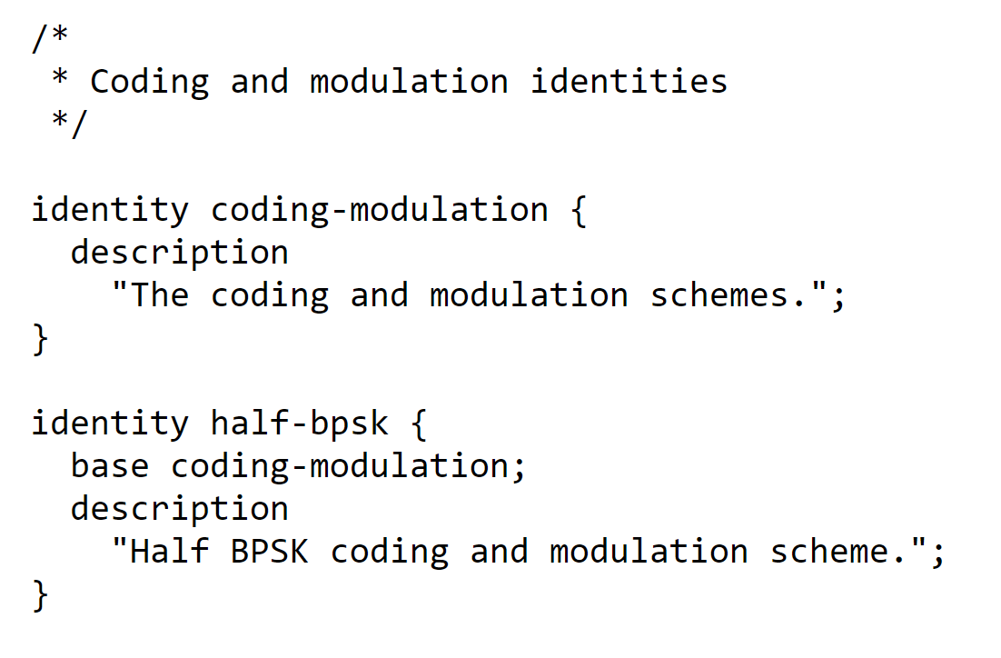
Existing RFC 8561
RFC 8561 contains three modules
ietf-microwave-radio.link.yang
ietf-microwave-types.yang
ietf-interface-protection.yang
Since the ietf-microwave-types.yang module is in RFC 8561, the only way to add new standardized coding-modulations to the list is to create a revision of RFC 8561.
…

Slide 3
Alternative
Split take the identities related to coding-modulation out of RFC 8561 and put them in their own yang module
A registration for new identities process could be created and the yang file could be auto generated from the registry database like the IANA process for interface types
Positives
The microwave radio link RFC does not have to change when new standardized coding-modulations are needed.
Lightweight process for adding new identities

Slide 4
Examples
iana-if-type.yang
This one has a registration database (spreadsheet) that includes all the approved interface types
A tool is run periodically to create a new version of the yang file if there are new/modified entries in the registration database
So the process for adding new if-types is a much less arduous process than reving an RFC
(soon to be) ieee802-ethertype.yang (IEEE P802f)
This one uses enumeration rather than identity, which makes it harder to extend without modifying/updating the standard that includes the yang module.

Slide 5
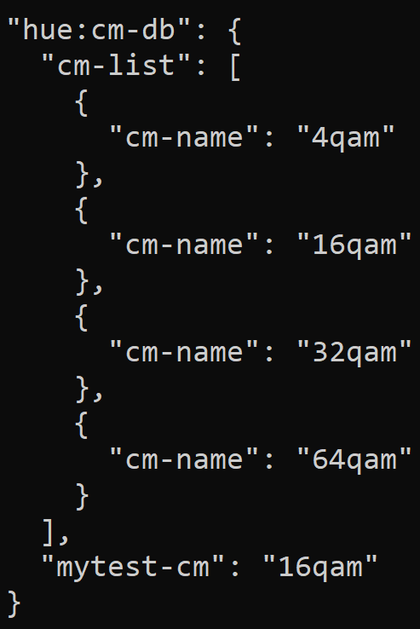
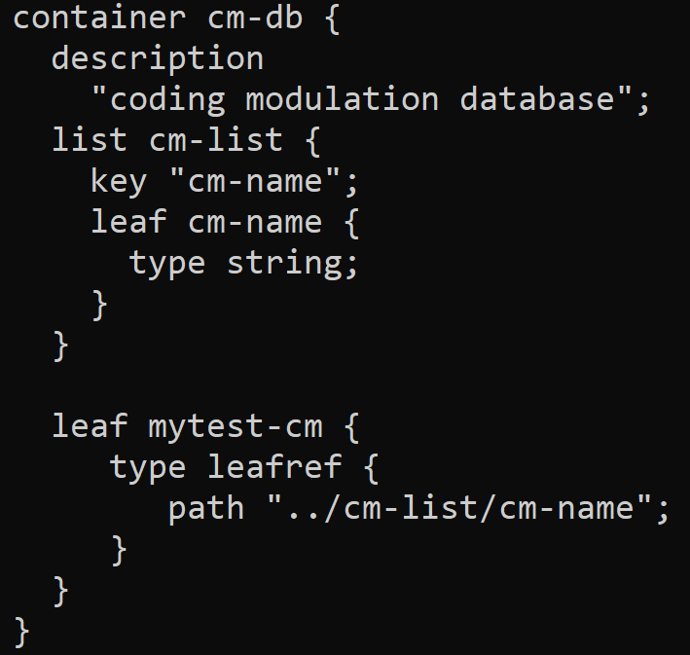
Another Alternative (Option 2)
Create a Container that has a list that contains a string
Then instances for each supported modulation would have to be created at run time and populate the list
Instead of identity refs there would be a leafref to an instance of the list
No validation until runtime

