Slide 1

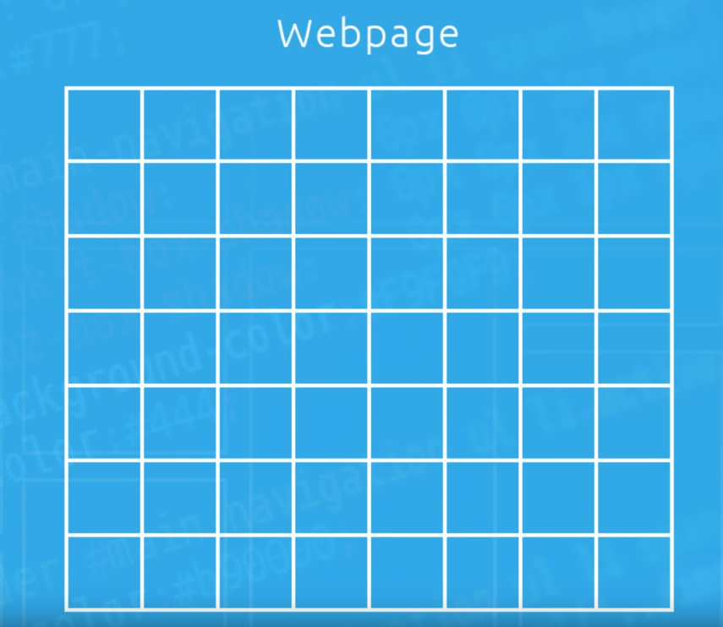
CSS grid
by: Itamar Mizrahi

Slide 2

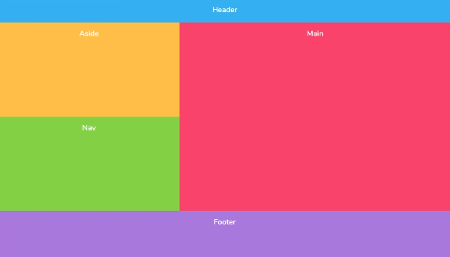



What is CSS grid?
Its about making a layout (like this background), modify it in verity ways,
and in the most useful ones.

Slide 3
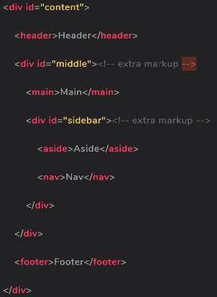
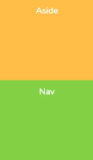
But why CSS grid? Why not Flexbox?
Flexbox is only good in one direction, we can not use them in the same direction at once .
We have to use extra markup, if we want to nest the flex items.

Slide 4
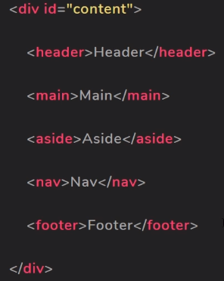
CSS grid to the rescue!

Slide 5
CSS grid
The content div acts as the grid wrapper
Then we put the elements we want to include in the div
That’s it for the html markups!
Now we can focus on the fun part- CSS!

Slide 6
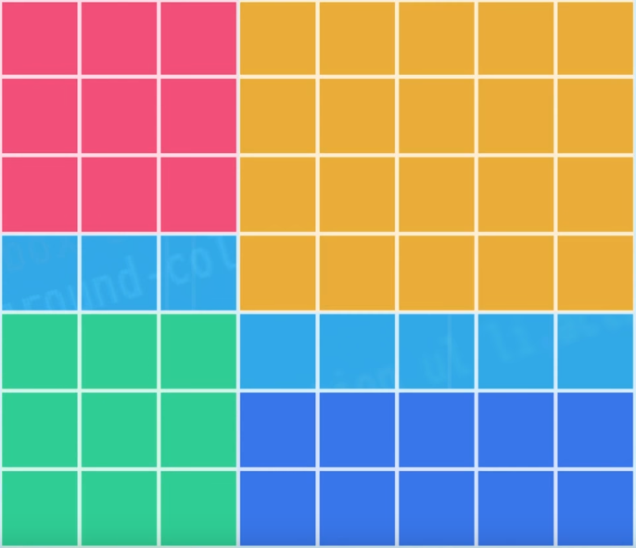
but why grid?
CSS grid threats the page just as a grid, that’s all it is! A box of rows an columns
We can put the elements where we want , in any order we want!

Slide 7
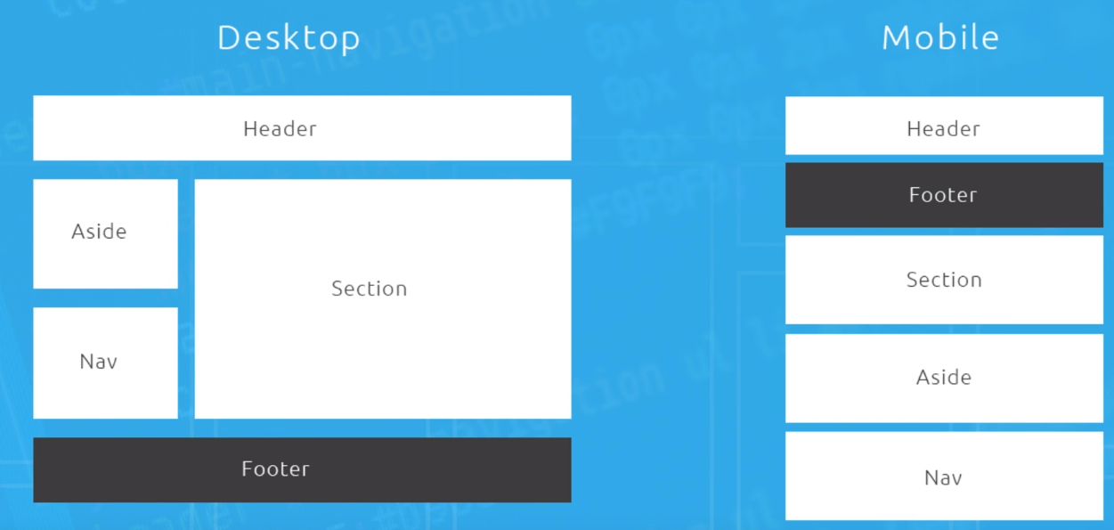
CSS grid on mobile
We can rearrange the content depending on the screen size

Slide 8
Unlimited options
Enough talking, lets see CSS grid on action.

