Slide 1
RAPTOR
Original Paper:
Sarthi et al.
ICLR 2024
arXiv:2401.18059
Recursive Abstractive Processing
for Tree-Organized Retrieval
Local Reproduction
with Ollama
Evaluated on
FRAMES Benchmark
A Reproduction Study
Final Submission — Seminar in Software Engineering 157119.5785
50 Questions
Analyzed
Eitan Weizman & Itamar Haimov
June 2026

Slide 2
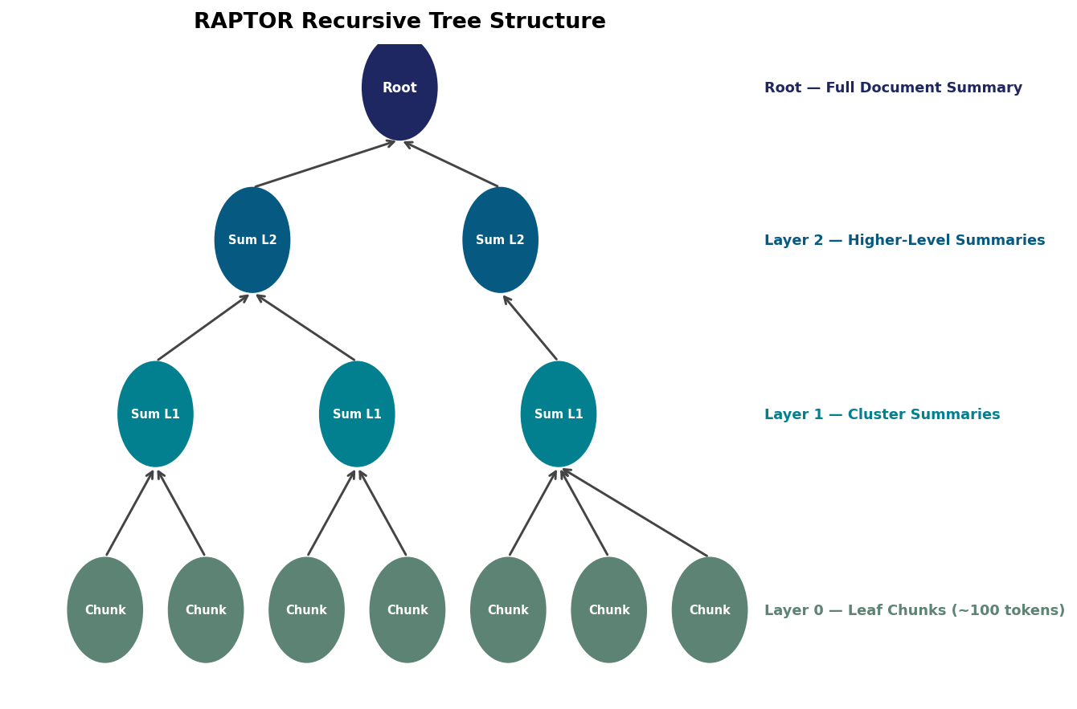
1
1. Problem & Motivation
Why Standard RAG Fails
Short Context
Retrieved chunks (~100 tokens) miss the document's global theme.
Context Blindness
No holistic view — systematic errors on broad questions.
Contiguity Limit
Can only retrieve contiguous passages; cannot bridge distant sections.
RAPTOR Tree Structure — multiple abstraction levels
Multi-Hop Failure
Cannot connect facts spread across different pages or documents.
Source: Sarthi et al., RAPTOR (ICLR 2024)

Slide 3
2
2. Key Idea — RAPTOR Tree Construction
1
2
3
4
5
Chunking
Embedding
Clustering
Summarize
Recurse
~100-token
sentence-aware
segments
Dense vectors
(nomic-embed-text
768-dim)
UMAP + GMM
soft assignment
BIC auto-k
LLM generates
cluster summaries
(Qwen 2.5 7B)
Repeat until
no further
clustering
Leaf Layer
Middle Layers
Root
Soft Clustering
Raw ~100-token chunks
LLM-generated cluster summaries
Highest-level document summary
Nodes may belong to multiple clusters
Source: Sarthi et al., RAPTOR (ICLR 2024)

Slide 4
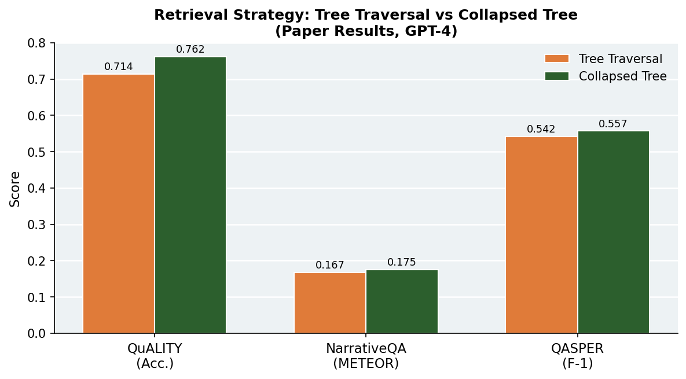
3
3. Methods — Local Ollama Adaptation
Original Paper (API)
Retrieval: Collapsed Tree Strategy
Summarization: GPT-4
Embeddings: text-embedding-ada-002 (1536d)
QA Model: GPT-4
replaced with
Our Reproduction (Ollama)
Summarization: Qwen 2.5 7B Instruct (local)
Embeddings: nomic-embed-text (768d)
QA Model: Qwen 2.5 7B Instruct (local)
Collapsed Tree outperforms Tree Traversal on all benchmarks (paper results)
Source: Sarthi et al., RAPTOR (ICLR 2024)

Slide 5
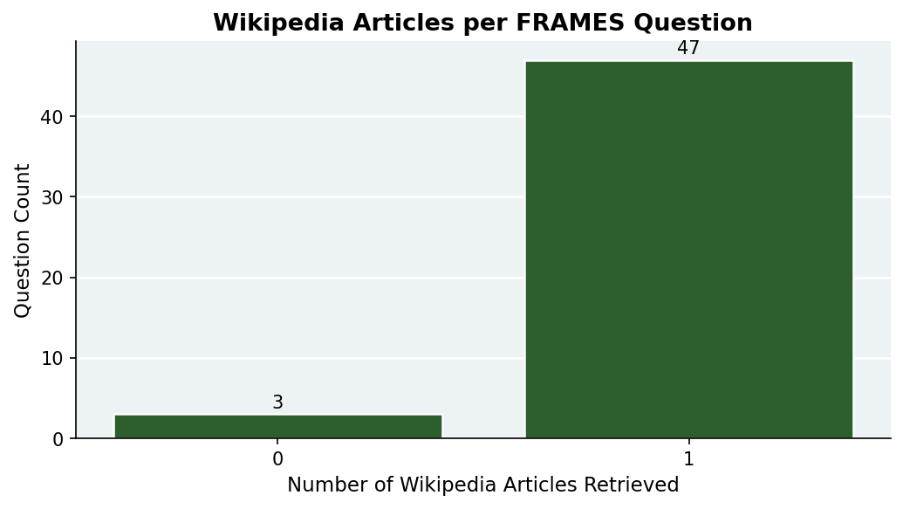
4
4. Data — FRAMES Multi-Hop Benchmark
Benchmark
Sample FRAMES Question
Google FRAMES
"If my future wife has the same first name as the 15th first lady's mother and her surname is the second assassinated president's mother's maiden name, what is my future wife's name?"
Factuality, Retrieval & Reasoning
Task
Multi-Hop QA
Gold Answer: Jane Ballou
Over Wikipedia articles
Total Test Size
824 questions
We evaluated 50 samples
Evidence Source
Wikipedia API
On-demand article fetching
Wikipedia articles fetched per FRAMES question (avg = 0.94)

Slide 6
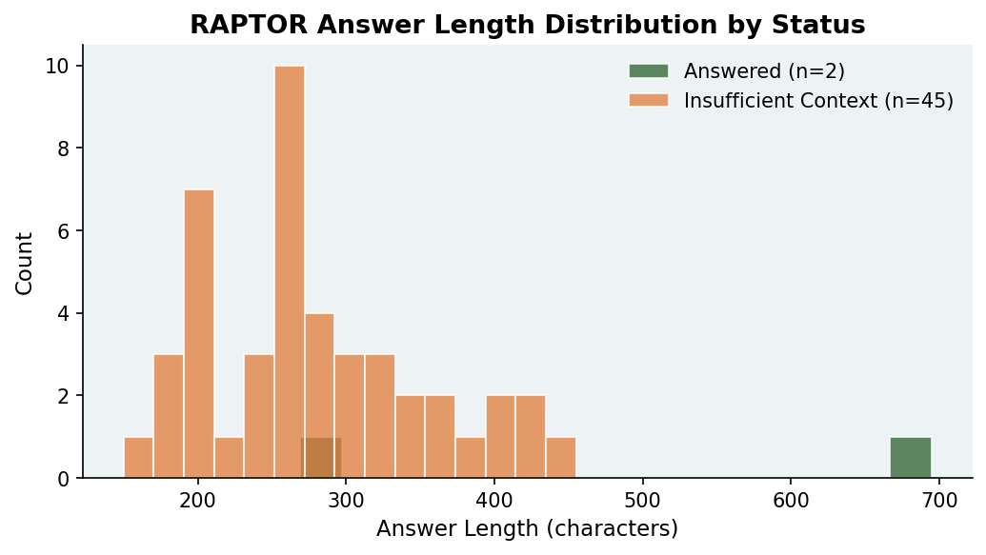
5
5. Results — FRAMES Evaluation (n = 50)
50
47
4%
6%
Questions
Evaluated
Non-Empty
Answers
Soft Accuracy
(Gold Found)
Pipeline
Errors
Answer length (chars) by status — refusals cluster between 200-400 chars

Slide 7
6
5. Results — Paper Benchmarks vs. Our Reproduction
Our Implementation (FRAMES)
Soft Accuracy
4%
Gold Match
2 / 50
LLM Model
Qwen 2.5 7B
Benchmark
FRAMES (harder)
Answered
47 / 50
Gap explained: FRAMES requires 3-8 Wikipedia facts per question (multi-hop). Our local 7B model lacks GPT-4 level reasoning, and per-article RAPTOR trees cannot bridge cross-article gaps. The pipeline itself is correct — the challenge is the benchmark difficulty.

Slide 8
7
5. Problems Encountered
1
Package Conflicts
2
API → Ollama Adaptation
numpy, scikit-learn, umap-learn, sentence-transformers all had version clashes. Required manual pinning of exact versions.
Original RAPTOR depends on OpenAI GPT-4 + ada-002. We wrote OllamaSummarizer, OllamaQA, OllamaEmbedding adapter classes to satisfy the same interfaces.
3
FRAMES Multi-Hop Gap
4
Windows Encoding
FRAMES questions need 3–8 chained Wikipedia facts. Single-article RAPTOR trees lack cross-article fusion; 90% of answers triggered insufficient-context refusals.
UnicodeEncodeError on emoji and non-ASCII text under PowerShell cp1252. Fixed with UTF-8 stream wrappers and ensure_ascii=False in JSON.

Slide 9
8
6. Reproduction Plan — Task Completion
Task | Weight | Status | Notes
Article Comprehension & Basic RAG Infrastructure | 15% | ✓ Done | RAPTOR library + Ollama adapters integrated
Chunking + Embeddings Pipeline | 15% | ✓ Done | Sentence-aware chunking + nomic-embed-text (768d)
Clustering + Tree Construction | 20% | ✓ Done | UMAP + GMM + BIC auto-k, recursive builder
Tree Retrieval (Collapsed Tree) | 20% | ✓ Done | Collapsed tree strategy verified on all samples
Evaluation on FRAMES Benchmark | 20% | ✓ Done | 50 questions, results analyzed & visualized
Report + Final Presentation | 10% | ✓ Done | This document + Word report
100% Complete
All 6 tasks completed

Slide 10
Bibliography
Cited Sources
1. Sarthi et al. RAPTOR. ICLR 2024. arXiv:2401.18059
Green = cited in report
Yellow = supplementary reading
2. McInnes et al. UMAP. 2018. arXiv:1802.03426
3. Schwarz. BIC for GMM. Annals of Statistics, 1978
4. Yu et al. FRAMES Benchmark. Google DeepMind, 2024
5. Qwen Team. Qwen2.5 Technical Report. 2024
6. Nomic AI. nomic-embed-text. 2024
7. Ollama. Open-Source Local LLM Server. 2024
8. parthsarthi03. RAPTOR GitHub Repo. 2024
Supplementary Reading
Thank you!
9. Lewis et al. RAG for NLP. NeurIPS 2020
10. Reimers & Gurevych. Sentence-BERT. EMNLP 2019
Questions?
11. Kočiský et al. NarrativeQA. TACL 2018
12. Dasigi et al. QASPER. NAACL 2021
13. Pang et al. QuALITY. NAACL 2022

