Slide 1
Classification of objects at a very low resolution
Project number: s-2026-045 / p-2026-061 Students: Dotan Ann Hanna 211542311, Bahat Itamar 205805856
Emails: anndo@post.bgu.ac.il, bahit@post.bgu.ac.il Supervisors: Yitzhaky Yitzhak, Lerner Rinat Progress Presentation March 2026

Slide 2
Motivation
Image Classification under Severe Image Degradation
Modern image classification systems assume high-quality images
However, many real-world sensors produce degraded images:
• Low resolution
• High noise
• Blurring and loss of details
This significantly reduces classification accuracy

Slide 3
Research Problem
Standard CNN classifiers rely on high-frequency visual details
When images are heavily degraded:
• textures and edges are lost
• spatial information is reduced
As a result, classification accuracy drops significantly
Research Question:
How robust are modern deep learning models
to severe image degradation?

Slide 4
Project Goals
Evaluate the robustness of deep learning models
under severe image degradation
Compare different model architectures:
• ResNet
• DenseNet
• TransNeXt
Study the effect of degradation on classification accuracy
Achieve high classification performance
even with degraded inputs

Slide 5
Dataset
Primary dataset used in the current experiments: CIFAR-10
• 60,000 labeled images
• 10 object classes
• Image resolution: 32 × 32 pixels
Dataset split:
• 50,000 training images
• 10,000 test images
Chosen due to its small resolution
which fits low-resolution classification research
Future work:
• Additional experiments on MNIST

Slide 6
THz-Like Image Degradation Simulation
To simulate THz imaging conditions,
we apply controlled degradation to the images.
Degradation operations include:
• Resolution reduction (downsampling)
• Gaussian blur
• Noise injection
• Color information removal
[Images showing degradation pipeline]
לשים תרשים: Original Image
↓
Downsample (Low Resolution)
↓
Blurred
↓
Noisy

Slide 7
System Pipeline
במצגת עדיף תרשים אופקי. Original Image ↓ Image Degradation (simulated THz conditions) ↓ Upsampling ↓ ImageNet Normalization ↓ Deep Learning Model (ResNet / DenseNet / TransNeXt) ↓ Classification Output
ב-PowerPoint כדאי להציג את זה כ-boxes מחוברים בחצים.
גרסה ויזואלית מומלצת לשקופית
Original Image ↓ Degradation ↓ resolution + noise + blur ↓ Upsample to network input size ↓ ImageNet Normalization ↓ Model ResNet / DenseNet / TransNeXt ↓ Predicted Class
טיפ חשוב למצגת
אם יש מקום — שים אייקון קטן או תמונה קטנה בכל שלב:
תמונה → image icon
degradation → blur/noise image
model → neural network icon
output → label
זה גורם לשקופית להיראות הרבה יותר מקצועית.
משהו קטן שכדאי להוסיף מתחת לתרשים
שורה קצרה:
Pipeline used in all experiments

Slide 8
Models Evaluated
Baseline CNN architectures:
• ResNet
• DenseNet
Advanced architecture:
• TransNeXt (Vision Transformer based)
All models use ImageNet pretrained weights
ResNet block
DenseNet connections
Transformer attention
Training framework: PyTorch

Slide 9
Experimental Setup
Dataset: CIFAR-10
Training Framework: PyTorch
Models initialized with ImageNet pretrained weights
Experiment parameters:
• degradation level
• learning rate
• batch size
• backbone freezing (linear probe) Experiments are tracked and logged automatically
(metrics.csv, logs, checkpoints)

Slide 10
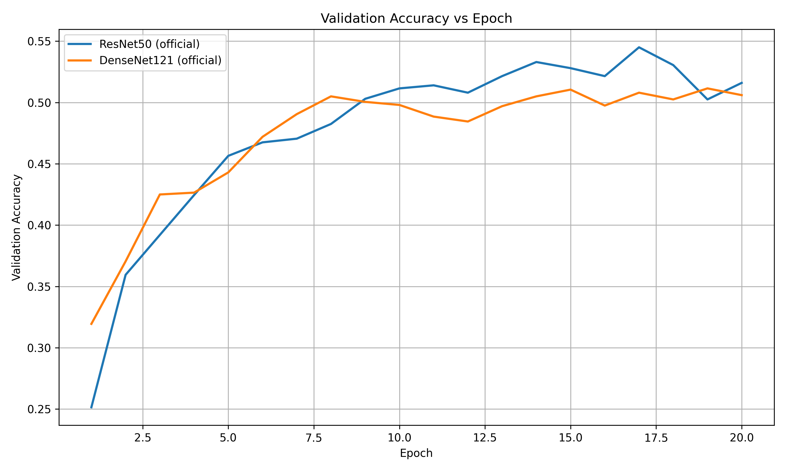
Initial Experimental Results
Validation accuracy during training for ResNet50 and DenseNet121 under degradation level 16

Slide 11
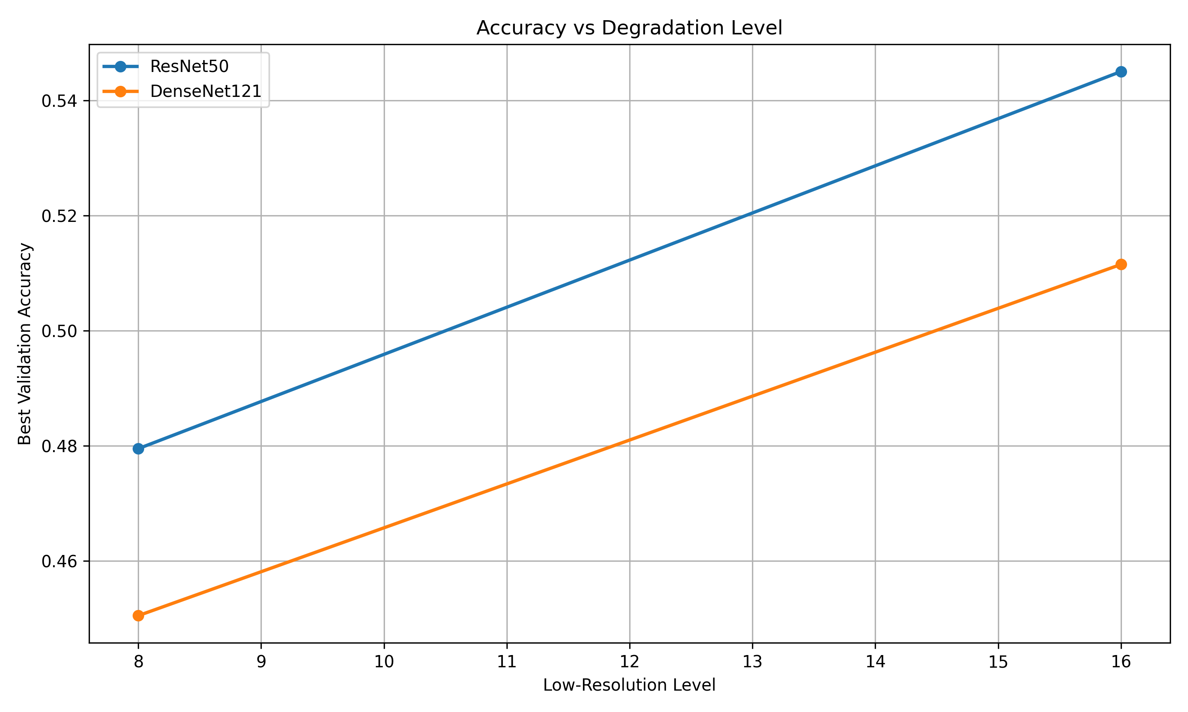
Effect of Image Degradation on Classification Accuracy
Classification accuracy decreases as image resolution becomes lower

Slide 12
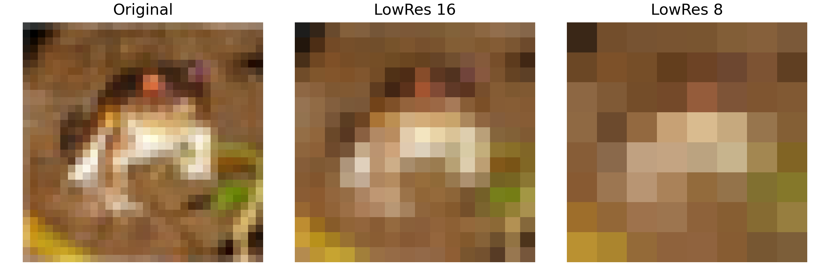
Example of Simulated THz Degradation

Slide 13
Discussion and Preliminary Insights
• Deep CNN models can still classify degraded images
• Performance decreases as degradation becomes stronger
• ResNet50 slightly outperforms DenseNet121
• Image degradation significantly reduces visual information

Slide 14
Current Project Progress
• CIFAR-10 dataset integrated into the pipeline
• Image degradation simulation implemented
• Training framework implemented in PyTorch
• Experiments conducted with ResNet50 and DenseNet121
• Automatic experiment logging and result tracking

Slide 15
Future Work
• Additional experiments with the TransNeXt architecture
• Training with additional degradation levels
• Experiments on additional datasets (e.g., MNIST)
• Hyperparameter tuning and model optimization

