Slide 1
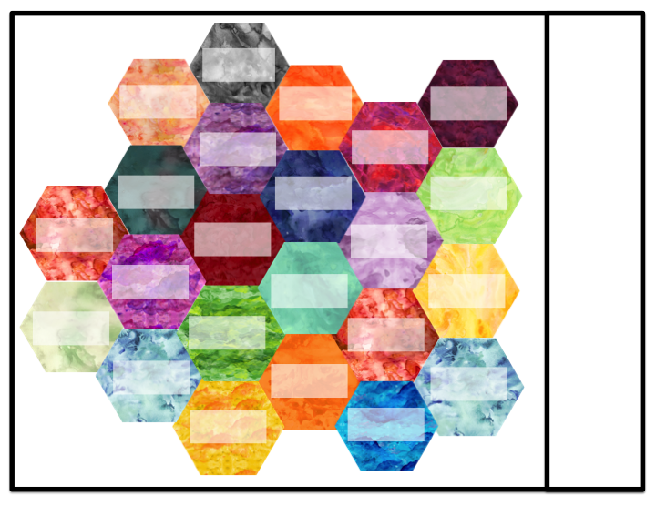
Name:
Terms
Root
Hierarchical structure
Morphology
Derivation
Historical linguistics
Syntax or phonology?
Predictability
Spell-out
Allomorphy
Social factors
Features
Scope
Late Insertion
Voice
Phonology
Inflection
TERM
TERM
TERM

Slide 2
Name:
Terms
Predictability
Voice
Allomorphy
Vocabulary Insertion
Nodes
Social factors
Semantics
Root
Hierarchical structure
Morphology or syntax?
*ABA
Derivation
Late Insertion
Inflection
Features
Morphology or phonology?
TERM
TERM
TERM

Slide 3
Name:
Terms
Categorizer (a, v, n)
Late Insertion
Spell-out
Language evolution
Morphology or syntax?
Allomorphy
Nodes
Semantics
Historical linguistics
Hierarchical structure
Root
Vocabulary Insertion
Ambiguity
Prefix/suffix
Inflection
Voice
TERM
TERM
TERM

