Slide 1
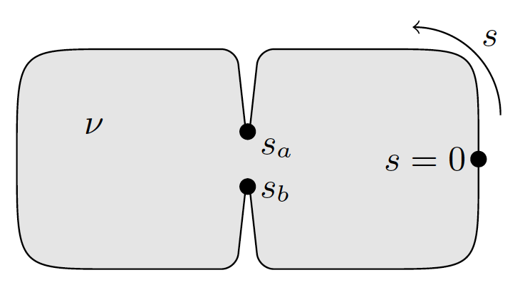
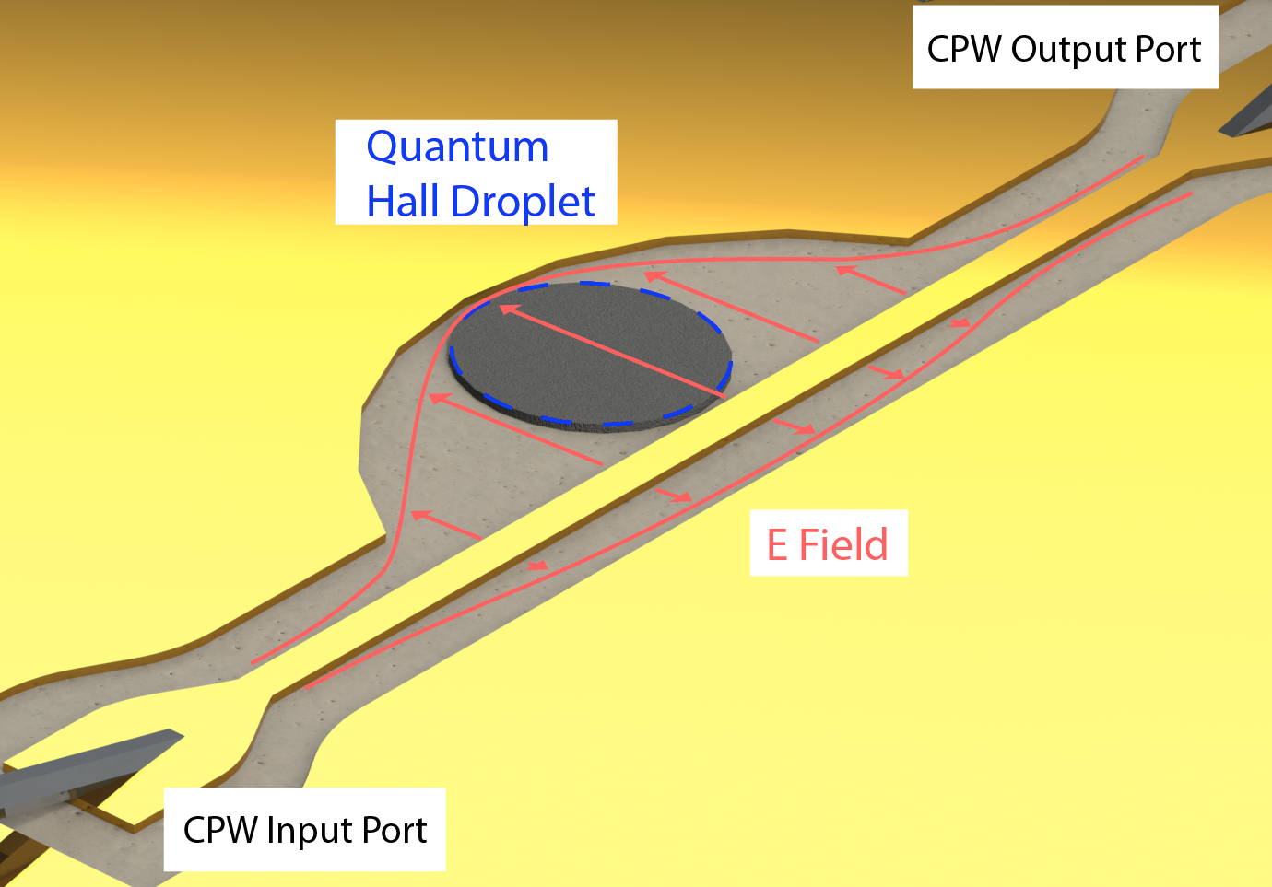




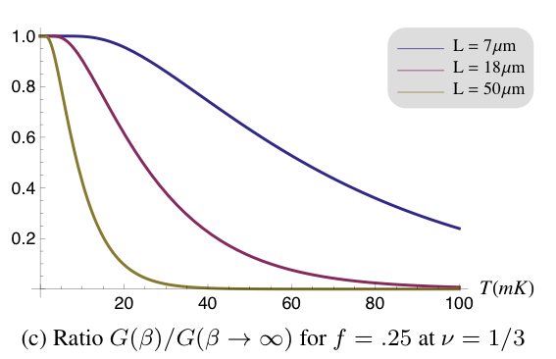

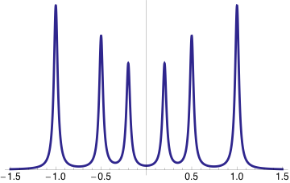


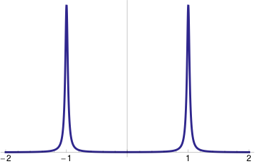




Microwave absorption by a mesoscopic quantum Hall droplet
Jennifer Cano, Andrew Doherty, Chetan Nayak, and David Reilly
UC Santa Barbara, University of Sydney and Microsoft Station Q
Compute spectrum of a circular droplet at ν = 1/m
Why microwave absorption?
Interferometry with a quantum point contact
Chiral Luttinger liquid action:
Coupling to electric field:
Fermi’s Golden Rule yields the absorption/emission spectrum
Considerable simplification for a circular droplet:
Counts number of charged edge modes and measures velocities
Measurement is through a contact-free device!
- different edge equilibration regimes and different sized droplets probed in same device
- smaller droplets measured
- do not need to consider details of Ohmic contact
Interferometry can be measured to first order in the tunneling amplitude across a QPC
Height of absorption peaks change as a function of magnetic field with period proportional to quasiparticle charge
where
and parameterizes the y-component of the droplet circumference
Device schematic
R(ω)
Microwave absorption probes the edge in a way that is different from and complementary to transport measurements
Tunneling at QPC modeled by perturbation to Lagrangian
We compute the change in R(ω) to order λ – an improvement over Fabry-Perot interferometry schemes, which show effects to order λ²:
-2πv/L
2πv/L
ω
Experiment at University of Sydney
Peak location yields velocity of edge mode
Peak width from waveguide losses, finite longitudinal resistance, phonon coupling, ...
Two peaks characteristic of circular droplet: irregular shapes yield a series of evenly spaced peaks
At finite temperature, prefactor
The shape of the droplet determines the geometrical factor:
Electric field spatially constant over length
scale of droplet
Filling fraction confirmed by comparison
to transport measurement on adjacent
Hall bar
Preliminary data (not shown) for droplet
with diameter 50μm, scanned in
frequencies 0-4 GHz
We recommend experimenting with different shaped droplets to determine which shows the largest effect
The temperature dependence is given by:
Probe edges with multiple edge modes
Clean limit
Disordered limit
At experimental temps:
Ratio G(β)/G(∞)
General edge theory:
Always can be written as:
Generalizing the single-mode case, we find the absorption/emission spectrum
Length scales
Varying the magnetic field leads to oscillations, the period of which depend on quasiparticle charge and shape of the droplet
A droplet with circumference L = 10 - 100μm and edge velocity v = 10⁴ -10⁶ m/s will have peaks in its absorption spectrum at frequencies v/L = 1-100 GHz
There is a finite bulk gap Δ_{bulk} = 1-10K =20-200 GHz for fractions, where the lower limit is for ν = 5/2. We require v/L < Δ_{bulk} , which favors smaller velocities and larger devices
On the other hand, interferometry requires L < L_{T} ∝ βv = 1-30μm, favoring smaller devices and larger velocities.
For temperatures T = 25-100 mK, there is a sweet spot at v/L ≈ 5GHz. For an intermediate velocity of v = 10⁵m/s this requires L = 20μm. These scales are experimentally accessible!
R(ω)
where diagonalizes and
We also expect to see interesting interferometry effects at ν = 5/2, similar to existing experiments but perhaps easier to observe because there should be a signal to first order in the tunneling amplitude
Multiple peaks count number of edge modes
-ω₃
-ω₂
-ω₁
ω₁
ω₂
ω₃
ω
Scattering off random impurities can drive the system to a random fixed point with a different edge structure (usually only one charged mode)
In the clean limit, where the droplet size is less than the length scale of equilibration, the spectrum should be distinct from that of the disordered limit
Changing the size of the droplet should tune between these regimes and reveal the equilibration length
Such tuning would answer open questions about fractions with counter- propagating edge modes (such as ν = 2/3)
References
C. L. Kane and M.P.A. Fisher, Phys. Rev. B 51, 13449 (1995)
X. G. Wen, Phys. Rev. B 41, 12838 (1990)
C. de C. Chamon, D. E. Freed and X. G. Wen, Phys. Rev. B 51, 2363 (1995)
C. de C. Chamon, D. E. Freed and X. G. Wen, Phys. Rev. B 53, 4034 (1996)
J. S. J. Allen, H. L. Störmer and J. C. M. Hwang, Phys. Rev. B 28, 4875 (1983)
V. I. Talyanskii, et al, JETP Letters 50, 221 (1989)
V. I. Talyanskii, et al, Surface Science 229, 40 (1989)
M. Wassermeier, et al, Phys. Rev. B. 41, 10287 (1990)
E. Y. Andrei, D. C. Glattli, F.I.B. Williams and M. Heiblum, Surface Science 196, 501 (1988)
I. Grodnensky, D. Heitmann, and K. von Klitzing, Phys. Rev. Lett. 67, 1019 (1991)
V. I. Talyanskii, et al, Phys. Rev. B 50, 1582 (1994) and references therein
Contact: Jennifer Cano jcano@physics.ucsb.edu
This project was supported by the NSF Grant No. DGE1144085

