Slide 1


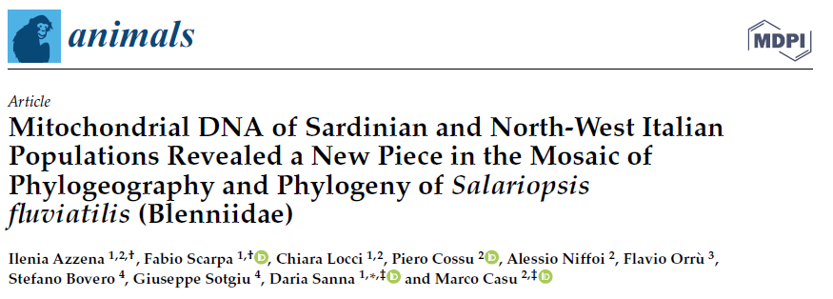
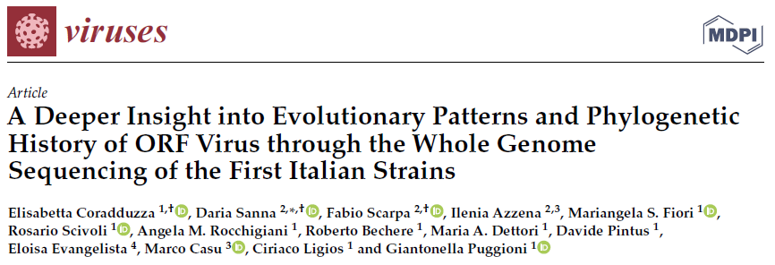
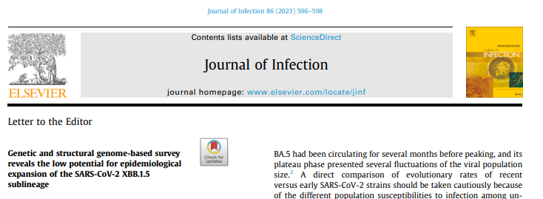
Ilenia Azzena
Current position: PhD student at the University of Sassari
Project: “From individuals to populations: molecular analyses, population genetics and modern phylogenetic approach (MPA) applied to different aquatic organisms”
Improve my skills in the field of bioinformatics in order to be able to apply it in my future studies and be as independent as possible;
Understanding the correct approach to whole genomes studies
IMPLICATIONS
Molecular dating studies

