Slide 1

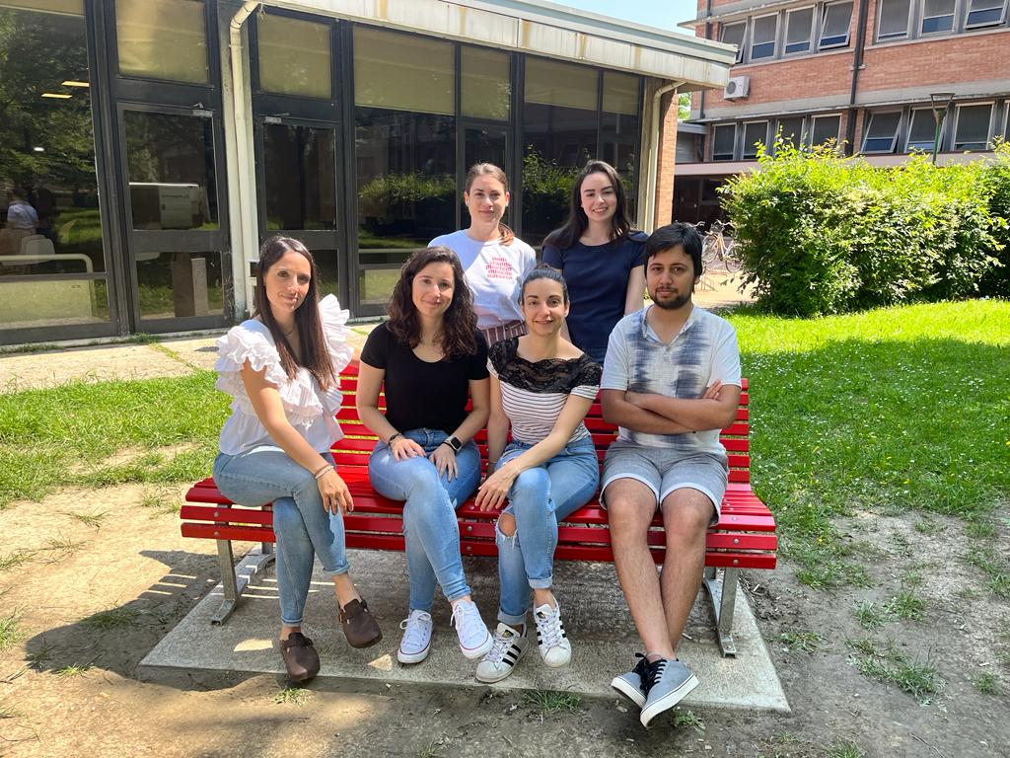

Rajiv Boscolo Agostini
PhD student in Evolutionary Biology and Ecology
Curriculum in Genetics and Evolution
XXXVII Cycle
My research focuses mainly on demographic modeling, reconstruction of evolutionary dynamics. I am interested in Population Genetics, Evolutionary Biology and Bioinformatics.
I am currently working on:
Past human population dynamics in Italy.
Invasion history of Halyomorpha halys.
Helicobacter pylori Genome Project.
Better understanding the genetic relationship between different individuals through phylogenetic analyses could be beneficial to my projects, improving my understanding of complex evolutionary processes.
Ghirotto Lab

