Slide 1

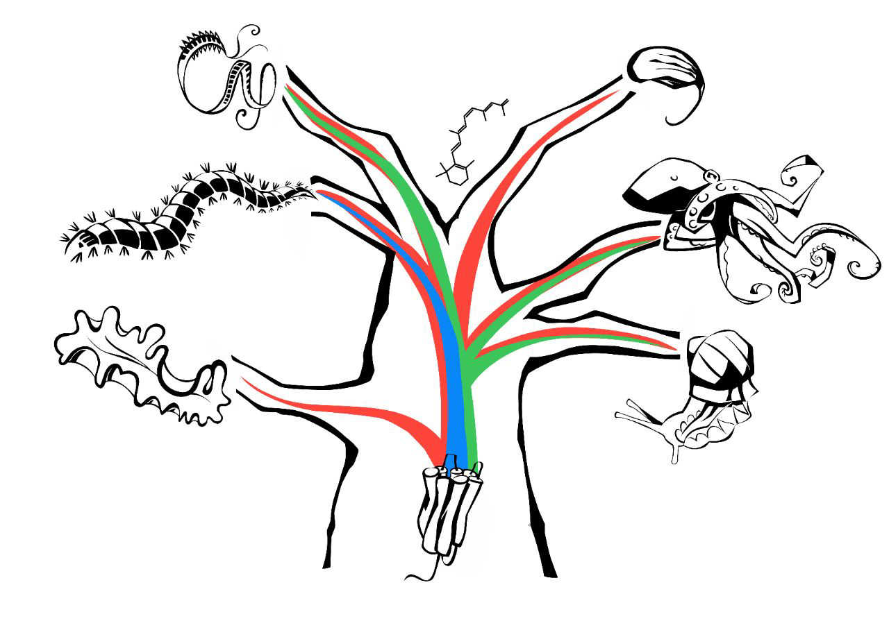

GIACINTO DE VIVO
PhD student at STAZIONE ZOOLOGICA ANTON DOHRN
Project on OPSIN EVOLUTION in CEPHALOPODA
Interests: molecular and morphological phylogenetic analysis, gene evolution, integration of fossil and molecular data

