Slide 1






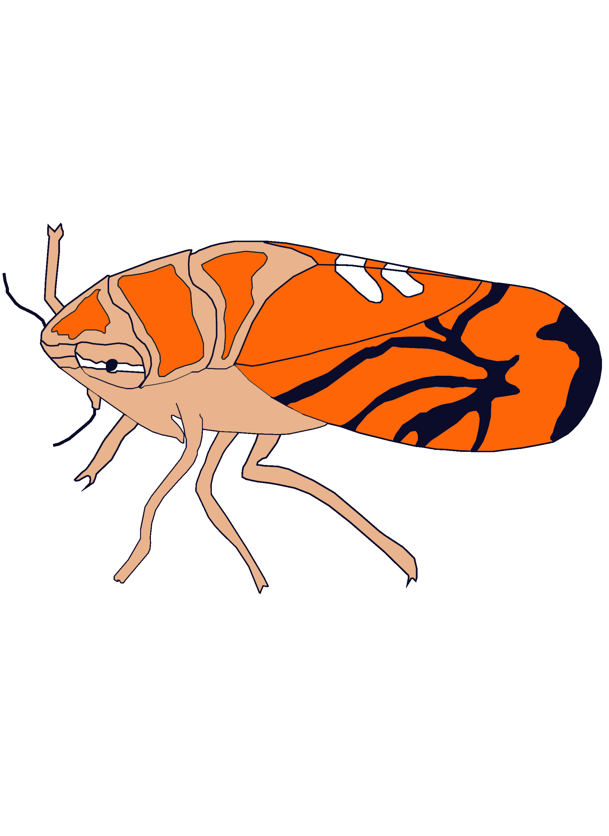

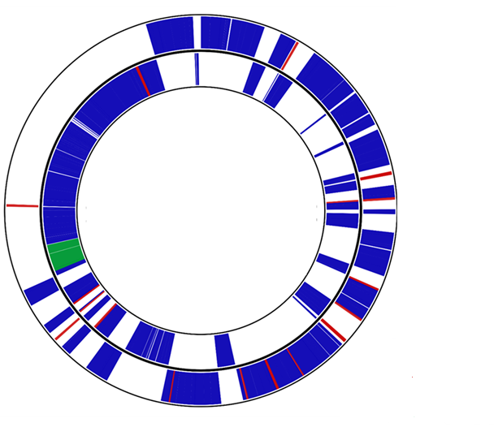
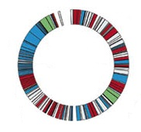


Juan Sebastian Enciso
PhD Candidate
Notes:
My name is Juan Sebastian Enciso, I PhD candidate at the Free University of Bolzano-Bozen, Italy. My core interests are the understanding of the interplays between microorganisms and their insect hosts concerning both the evolutionary mechanisms and history of these interactions. The focus of my PhD project consists in the genomics of the symbionts associated with Scaphoideus titanus (Hemiptera: Cicadellidae). S. titanus has a broad distribution in the Nearctic and the Palearctic region and is an important agricultural vector of one of the most devasting diseases of grapevines, Flavescence doree caused by ‘Candidatus Phytoplasma vitis’.
the evolutionary history of S. titanus and its symbionts is still not fully explored and thus remains an intriguing topic. In my project, I am applying a metagenomic sequencing approach, in order to sequence and assembly the genomes of the symbionts (bacteria, fungi) as well as the host mitochondrial genome. Therefore, this workshop is a great opportunity to gain knowledge and implement tools that will help me to foster my research goals.
1 Juan Sebastian Enciso
2 interests
3 focus
4 S.titanus-fd
5Metagenomic sequencing approach
6 workshop

