Slide 1

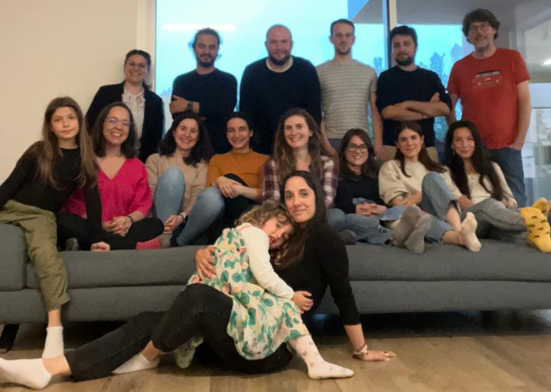
Ferraresi Debora
phD student in Life Sciences and Biotechnology
University of Ferrara
Curriculum Genetics and Evolution
XXXVIII cycle
Population Genomics Group
My research focuses on Population Genetics, Evolutionary Biology and Bioinformatics related to aDNA.
I’m currently working on a research project which aims to characterize ancient samples from the city of Pompeii from a genomic point of view.
I think this course would be a great opportunity to increase my knowledge of phylogenetics, which will certainly be useful for my current and future research projects.

