Slide 1
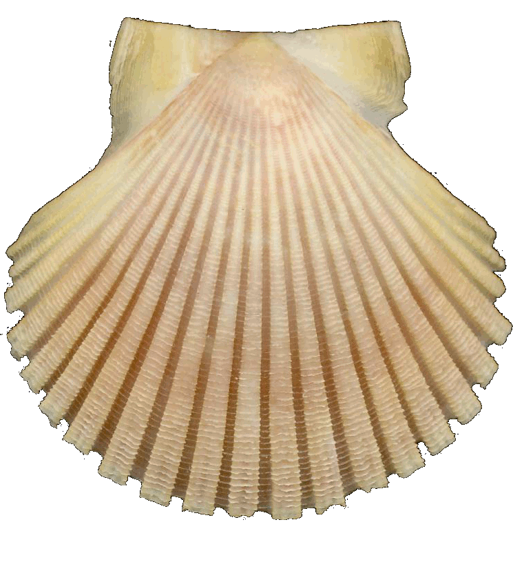
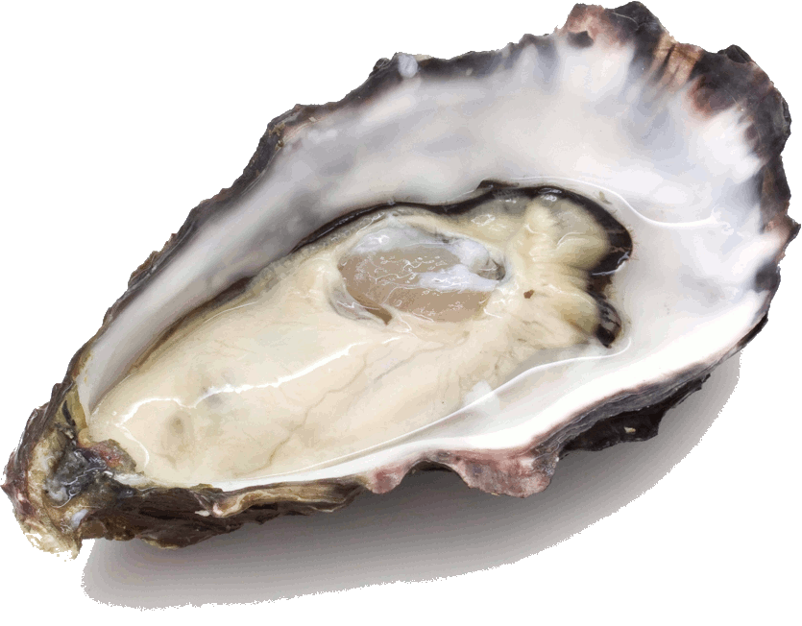
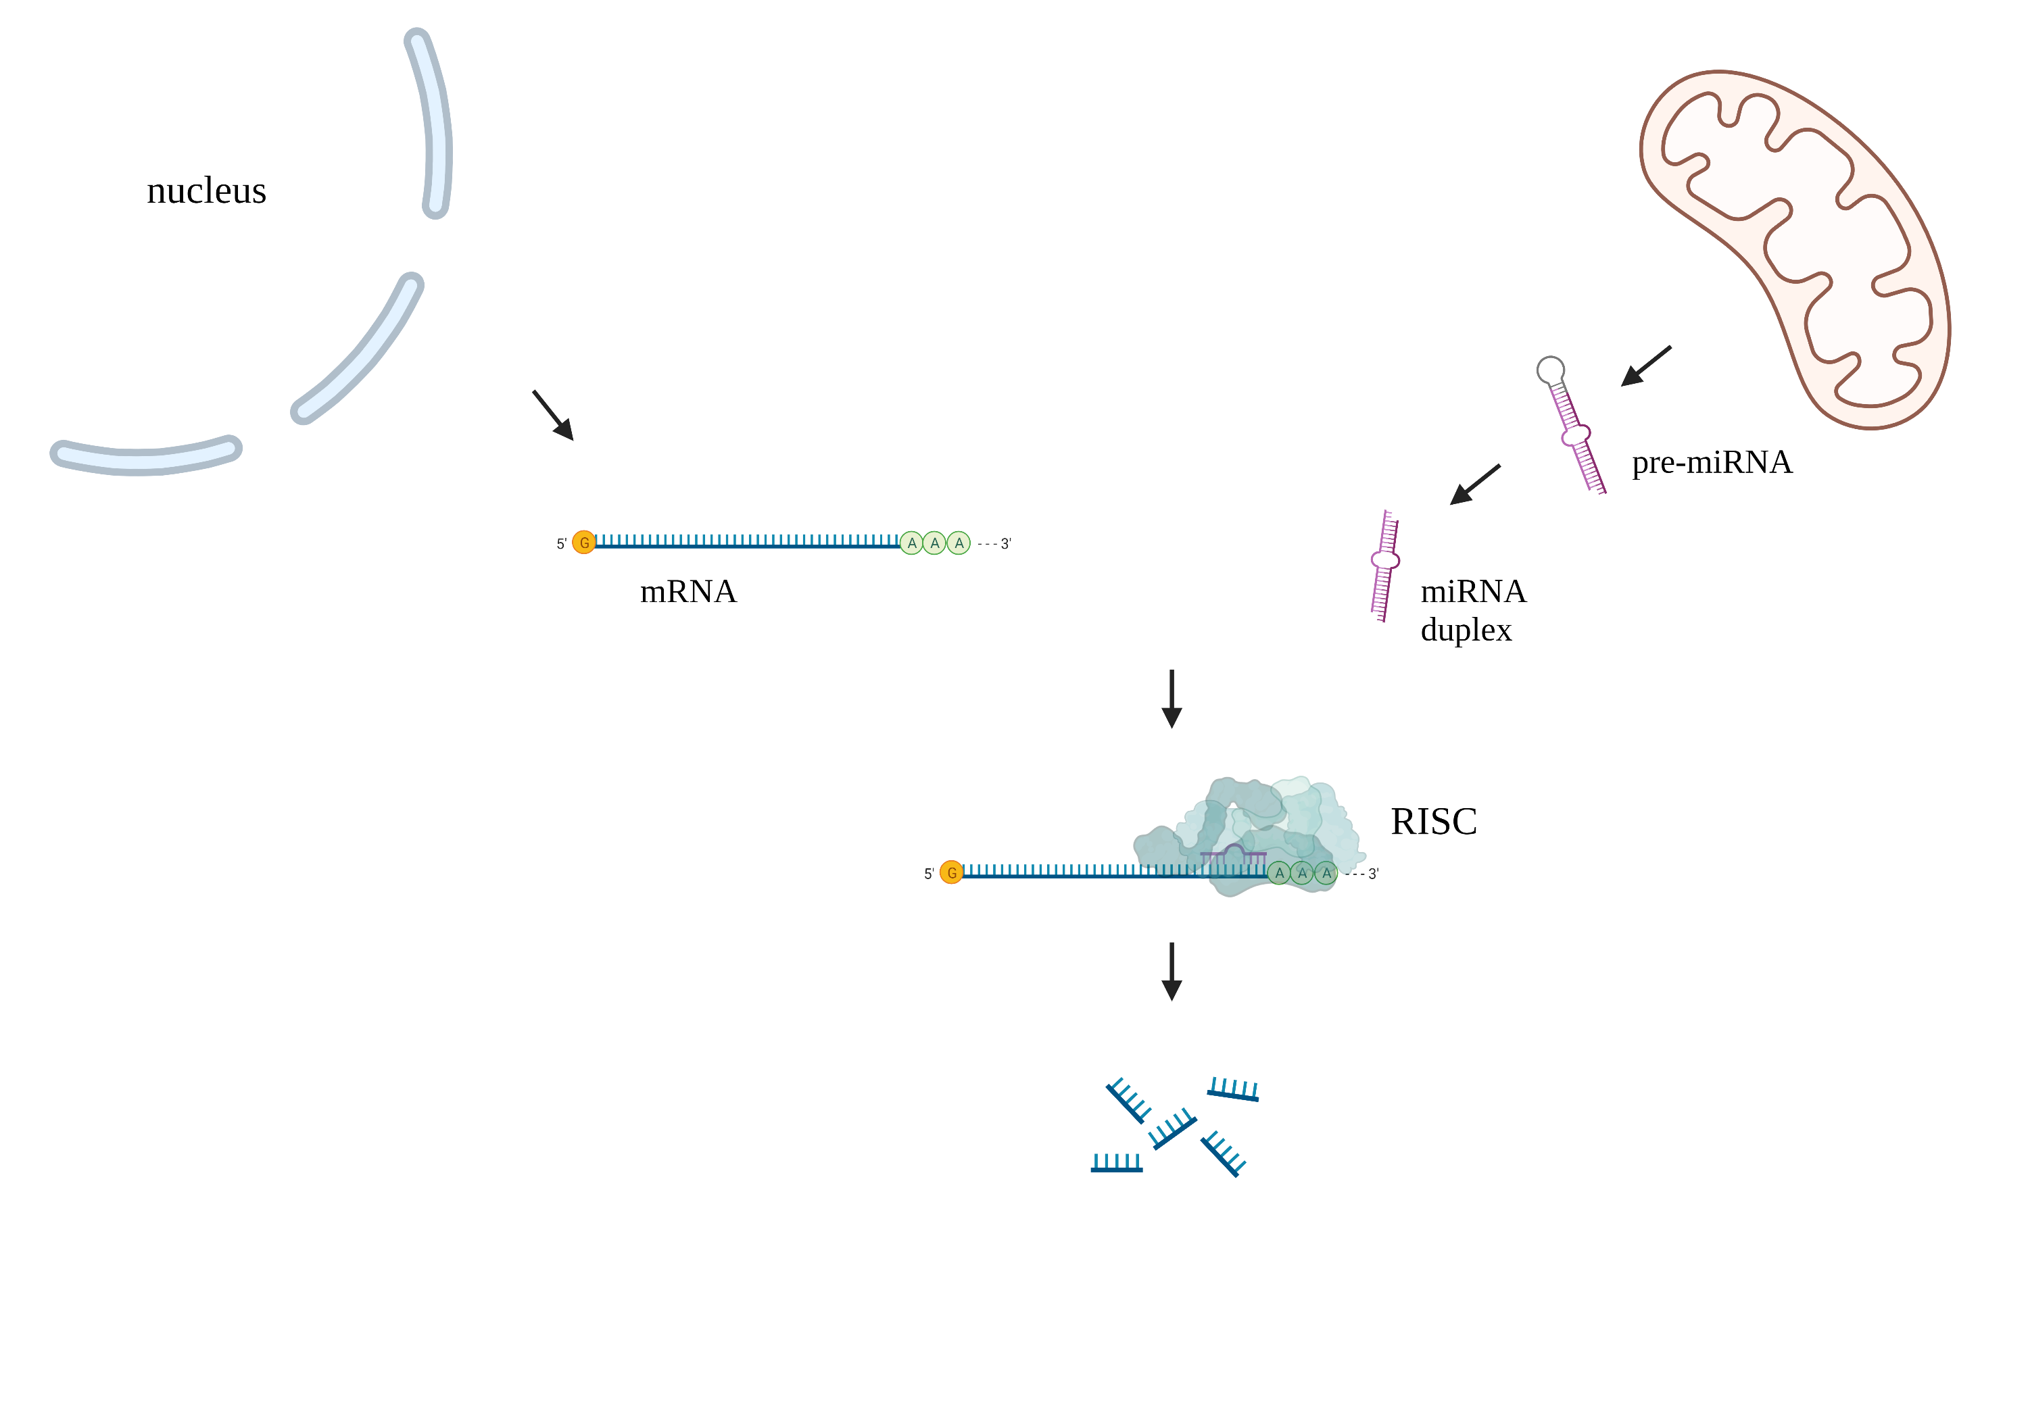
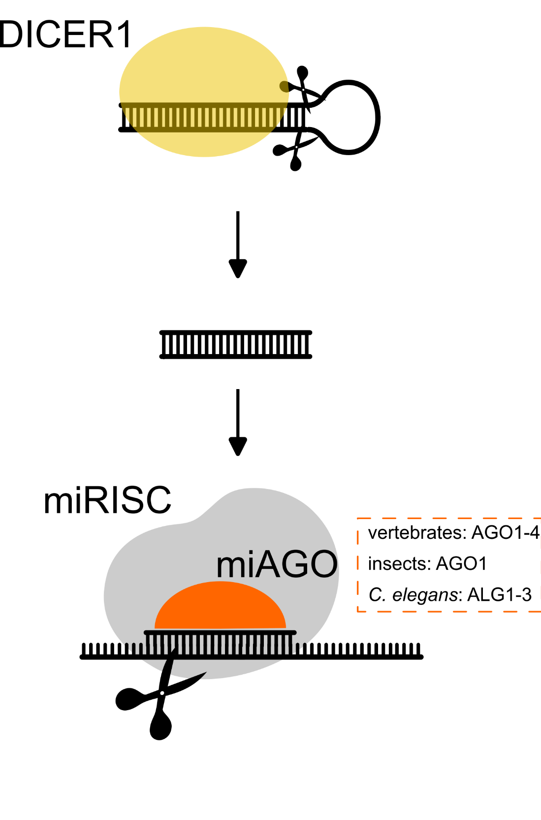
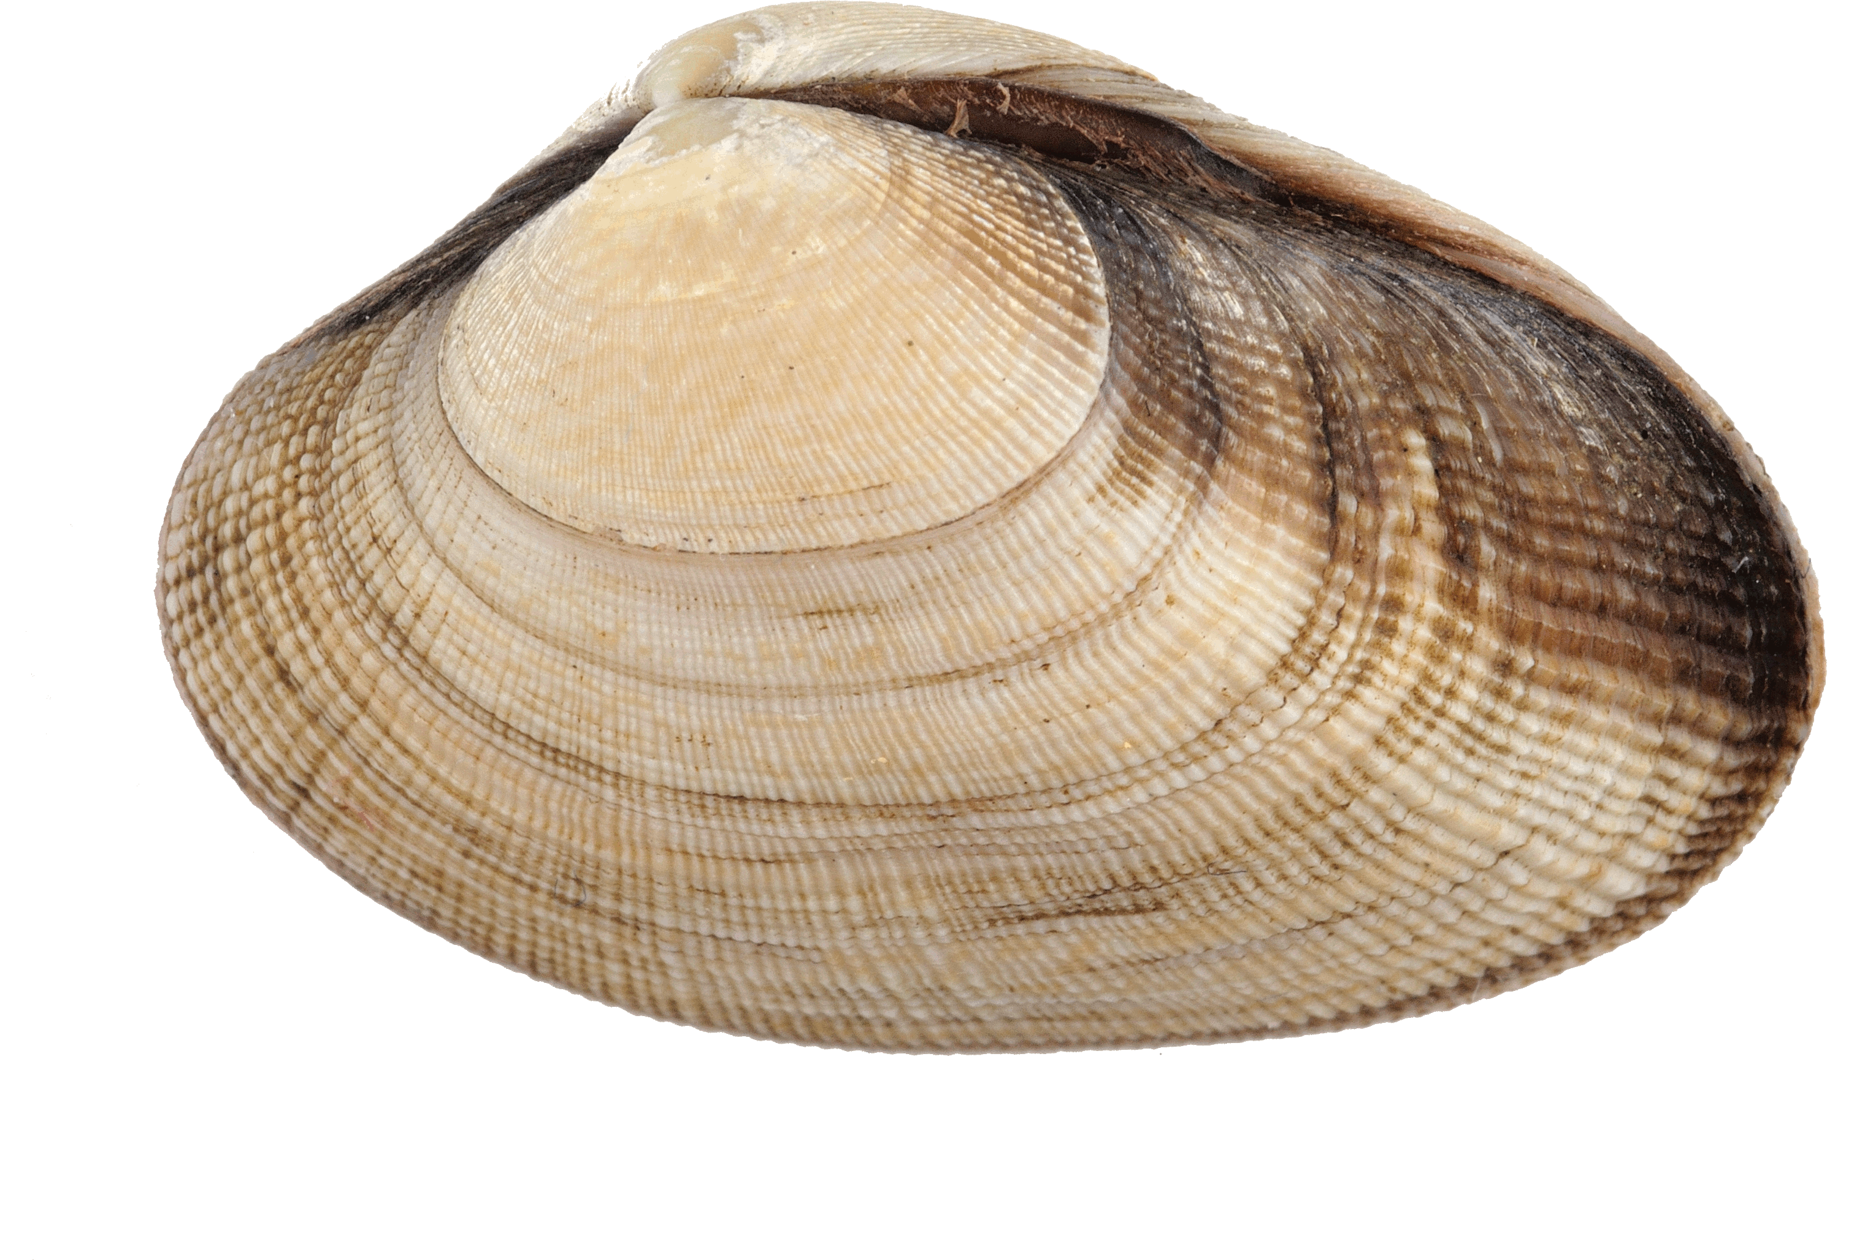
Alessandro Formaggioni Prof. Marco Passamonti
PhD student at the University of Bologna Dott. Federico Plazzi
Which are my research topics?
I am an evolutionary biologist and I mainly work on Bivalvia
Characterization of RNA interference pathways among Lophotrochozoa
Mito-nuclear co-evolution and cross-communications
Why am I here?
1. Current projects: phylogenetic analysis of proteins related to RNAi pathways
2. Future projects: first genome assembly of an Archiheterodonta species
3. Meet new people with shared research interests

