Slide 1

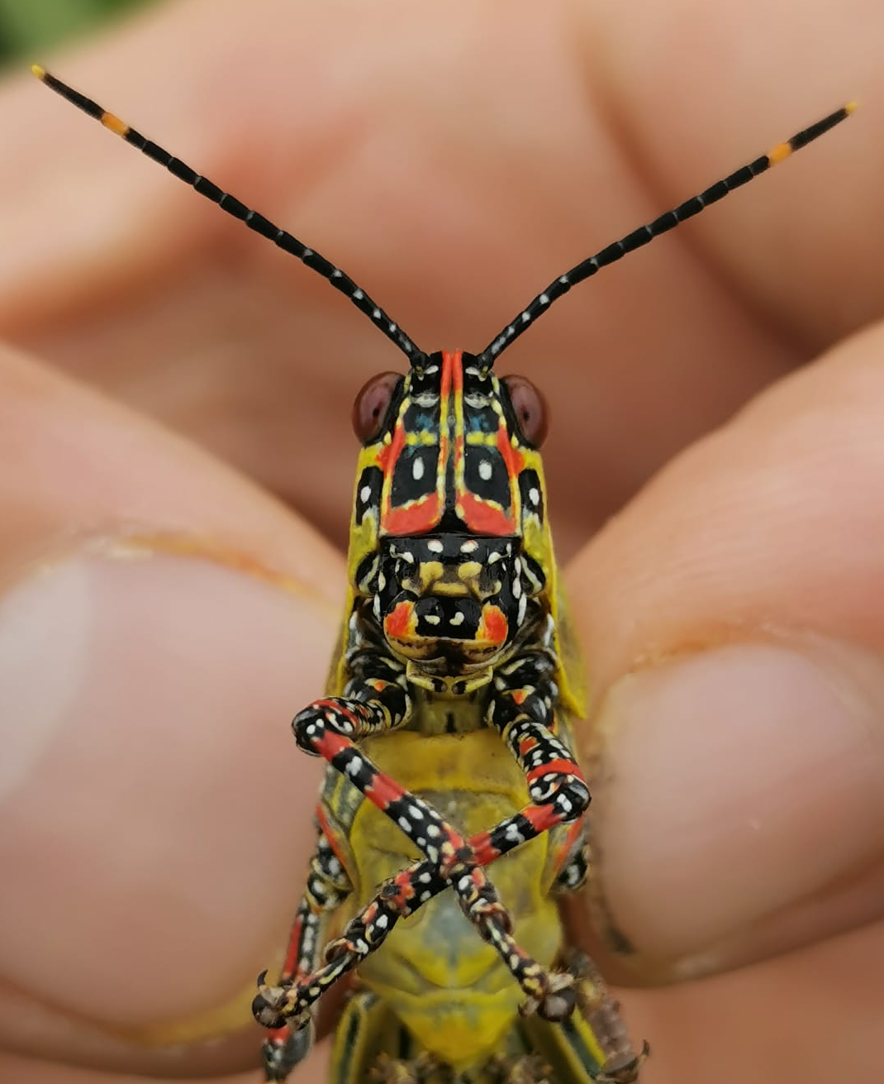
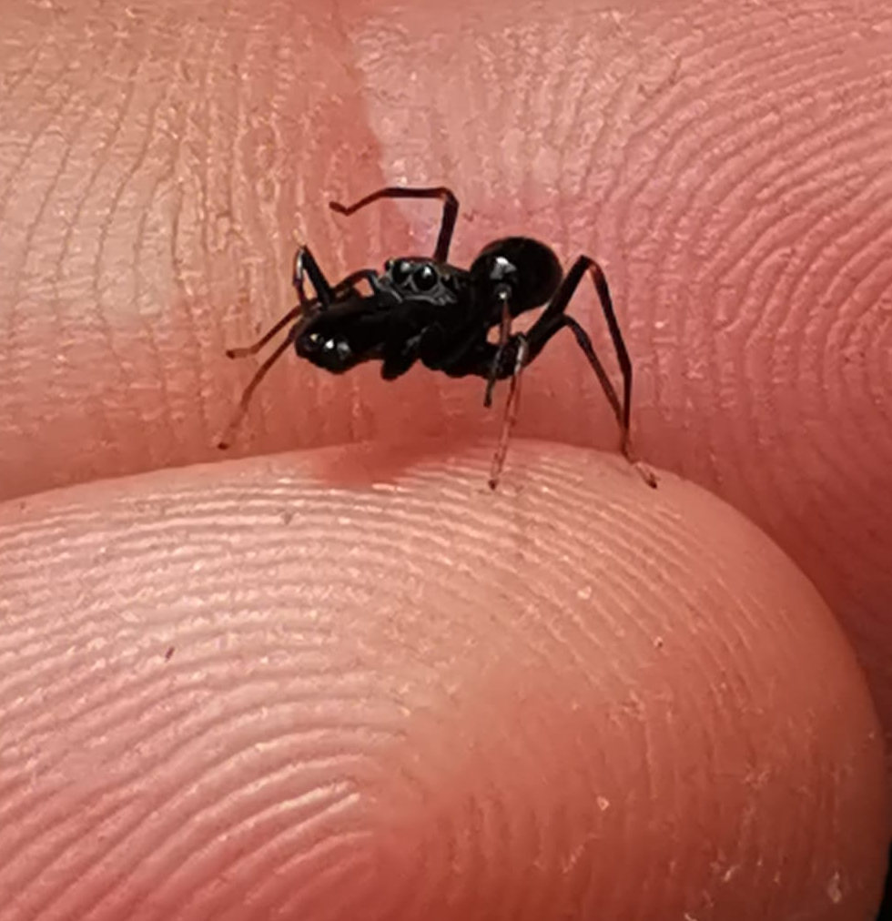
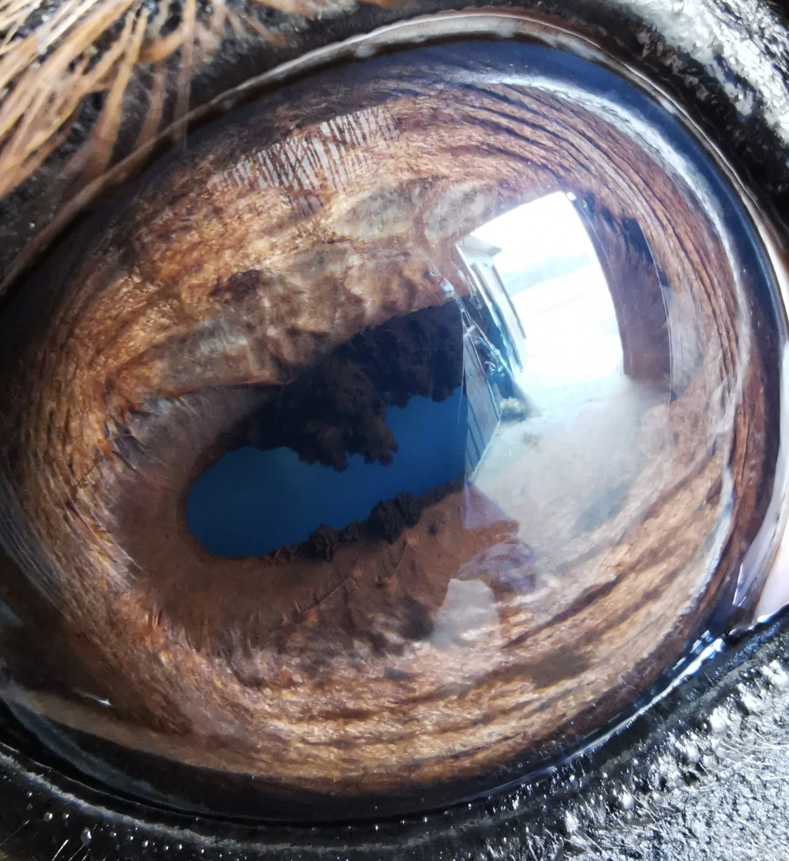
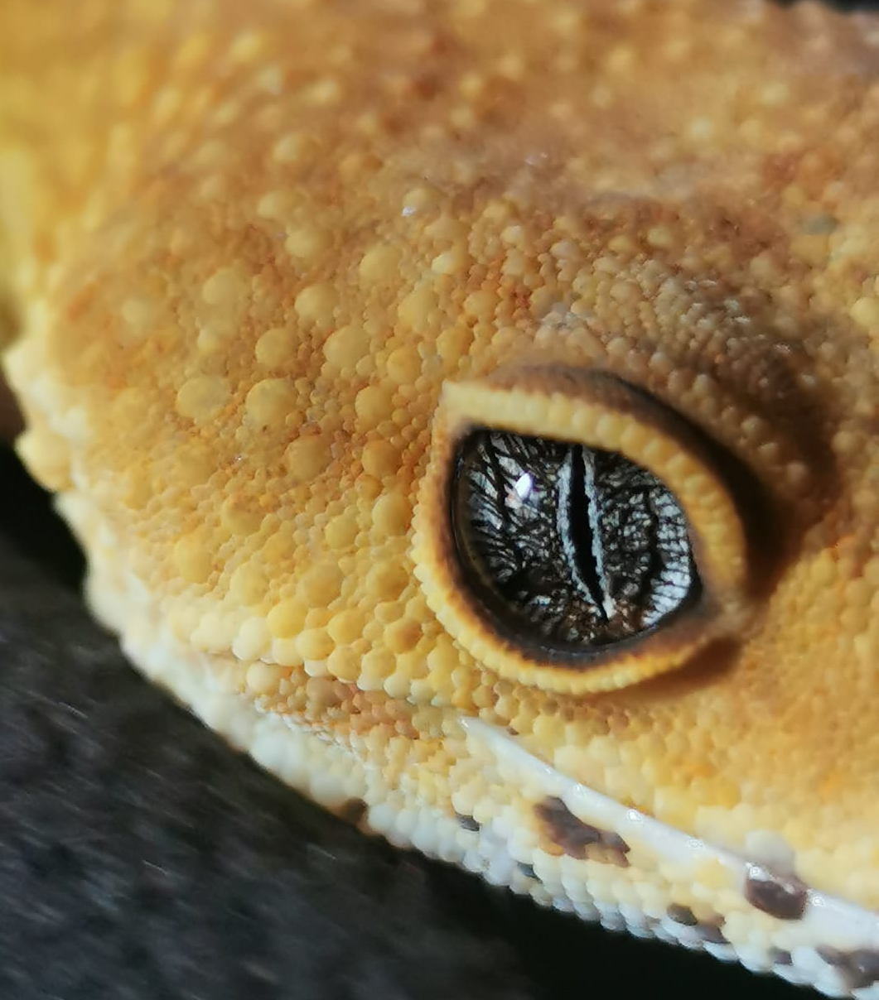
GIACOMO FRISO
WHO AM I ?
25 y.o. from Padova
Degree in Natural Science
Master’s student in Evolutionary Biology UNIPD
Fascinated by Evolution
In loved with desolate landscapes and travels
WHY AM I HERE?
To know more about Phylogeny
To understand how to face amount of sequencing data
To know scientists (you)
«THE POSSIBLE IS VASTER THAN THE REAL»
«EVOLUTION IS THE TRANSFORMATION OF THE POSSIBLE»

