Slide 1

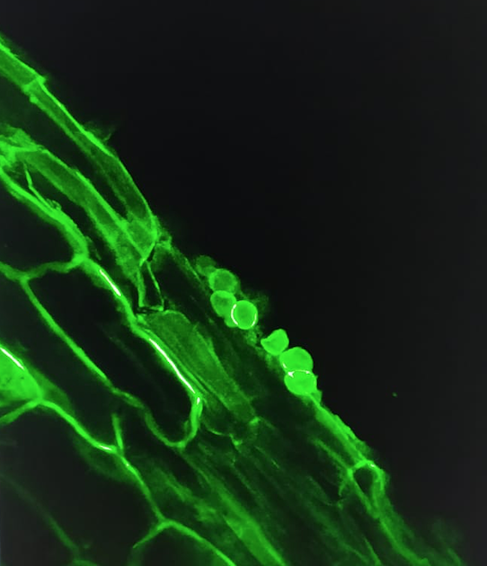
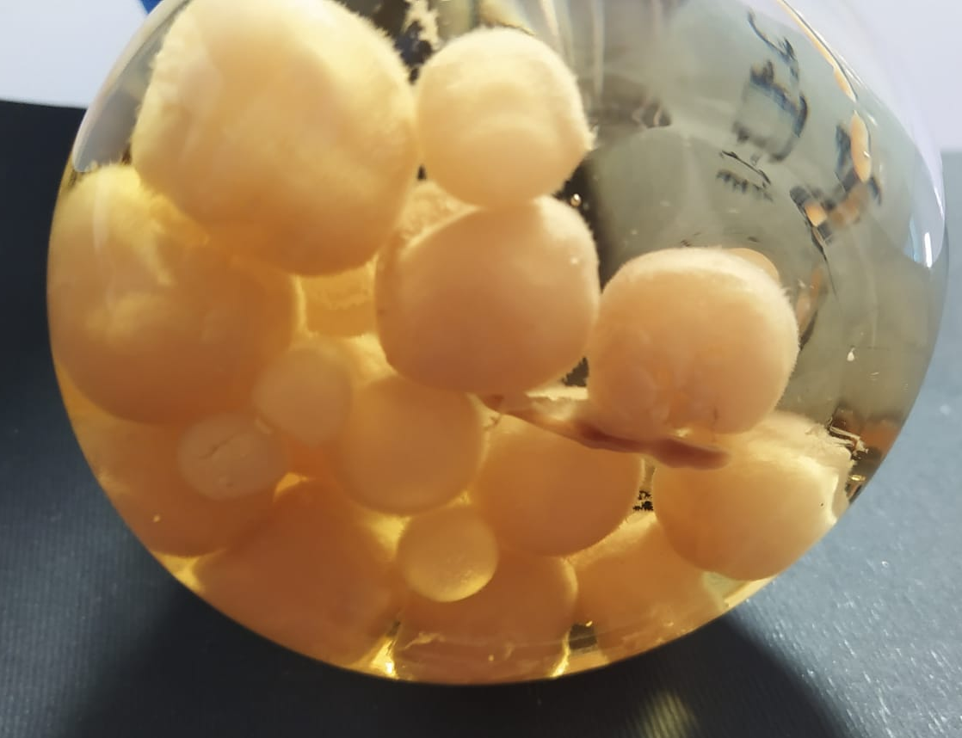
Valentina Lazazzara
Research fellow
Crop Science Research Group, Scuola Superiore Sant’Anna Pisa
Scientific interests
Molecular and physiological interactions between plants and beneficial/phytopathogenic microorganisms
Study of the impact of Serendipita indica on drought stress tolerance of tomato
Analysis of big data (i.e., bioinformatics, amplicon seq.)
Analysis of different genomes of S. indica
“I used MEGA once…”

