Slide 1


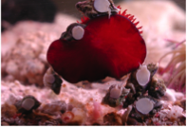
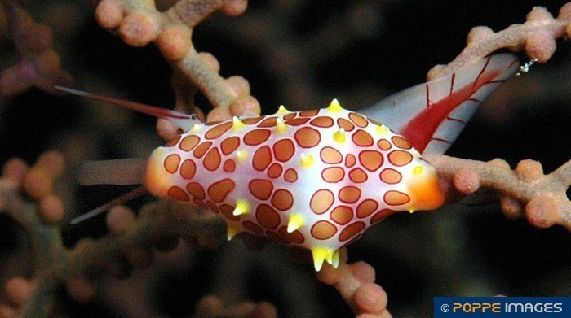
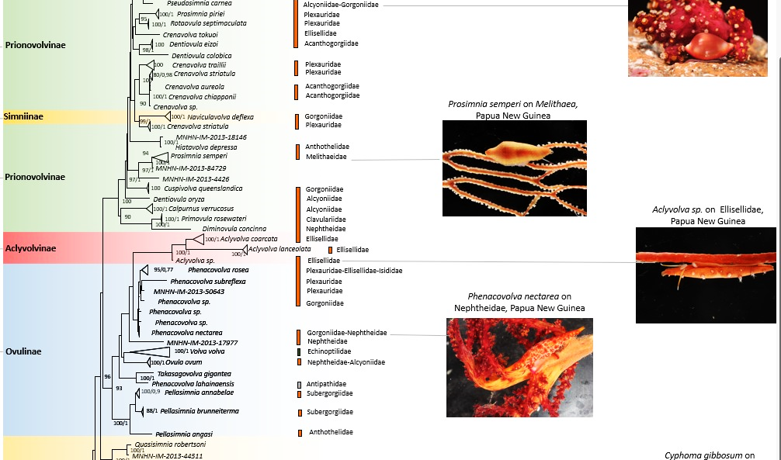
Elisa Nocella
PhD student in Environmental and Evolutionary Biology
Researching interests: molecular macroevolutionary pattern of different families of marine corallivorous gastropods

