Slide 1
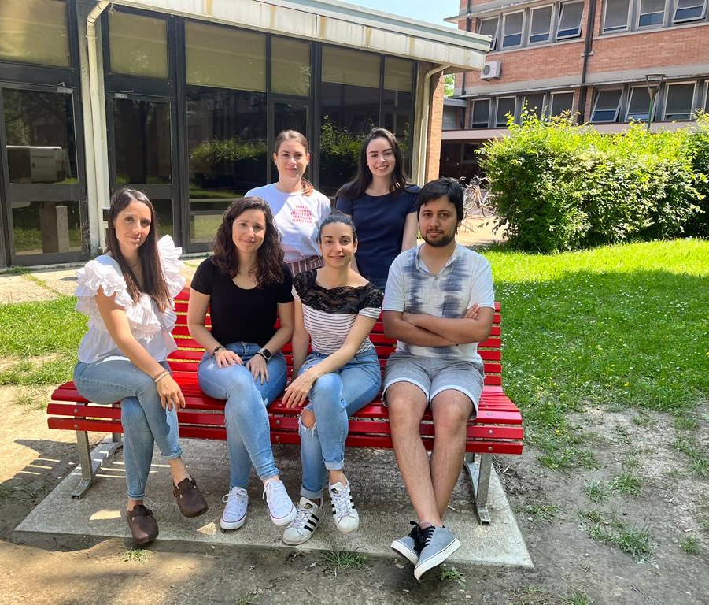
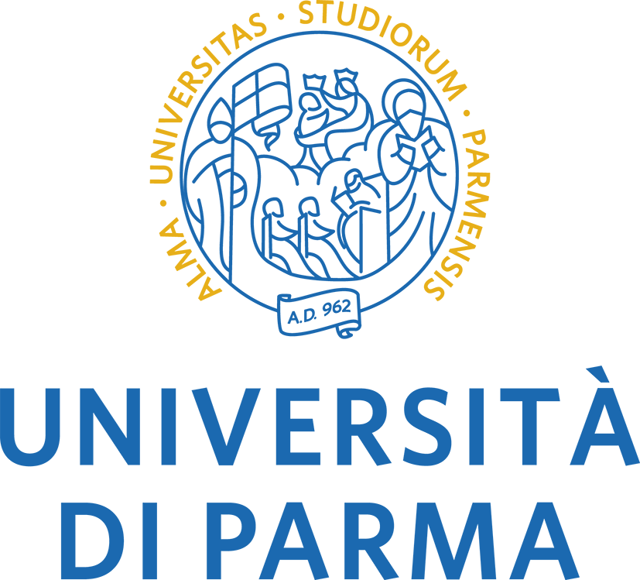
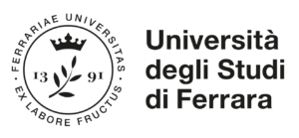

SILVIA PERRETTI
Prof.ssa Silvia Ghirotto PaleoLab
PhD student in Evolutionary Biology and Ecology
Curriculum Genetics and Evolution
XXXVI Cycle
The main field of my research is Human Population Genetics, on ancient and modern genomes, using a combination of Genomics and Bioinformatics.
Now I’m currently working on:
Inference of phenotypic traits from low coverage and ancient genomes.
Inference of human neutral genetic variation from craniodental phenotypes.
Comparison of genomic evolution and linguistic diversification.
I’m honestly not so confident with phylogenetic approaches, but I’d like to improve my skills, by learning practical tools and how to use them properly.

