Slide 1



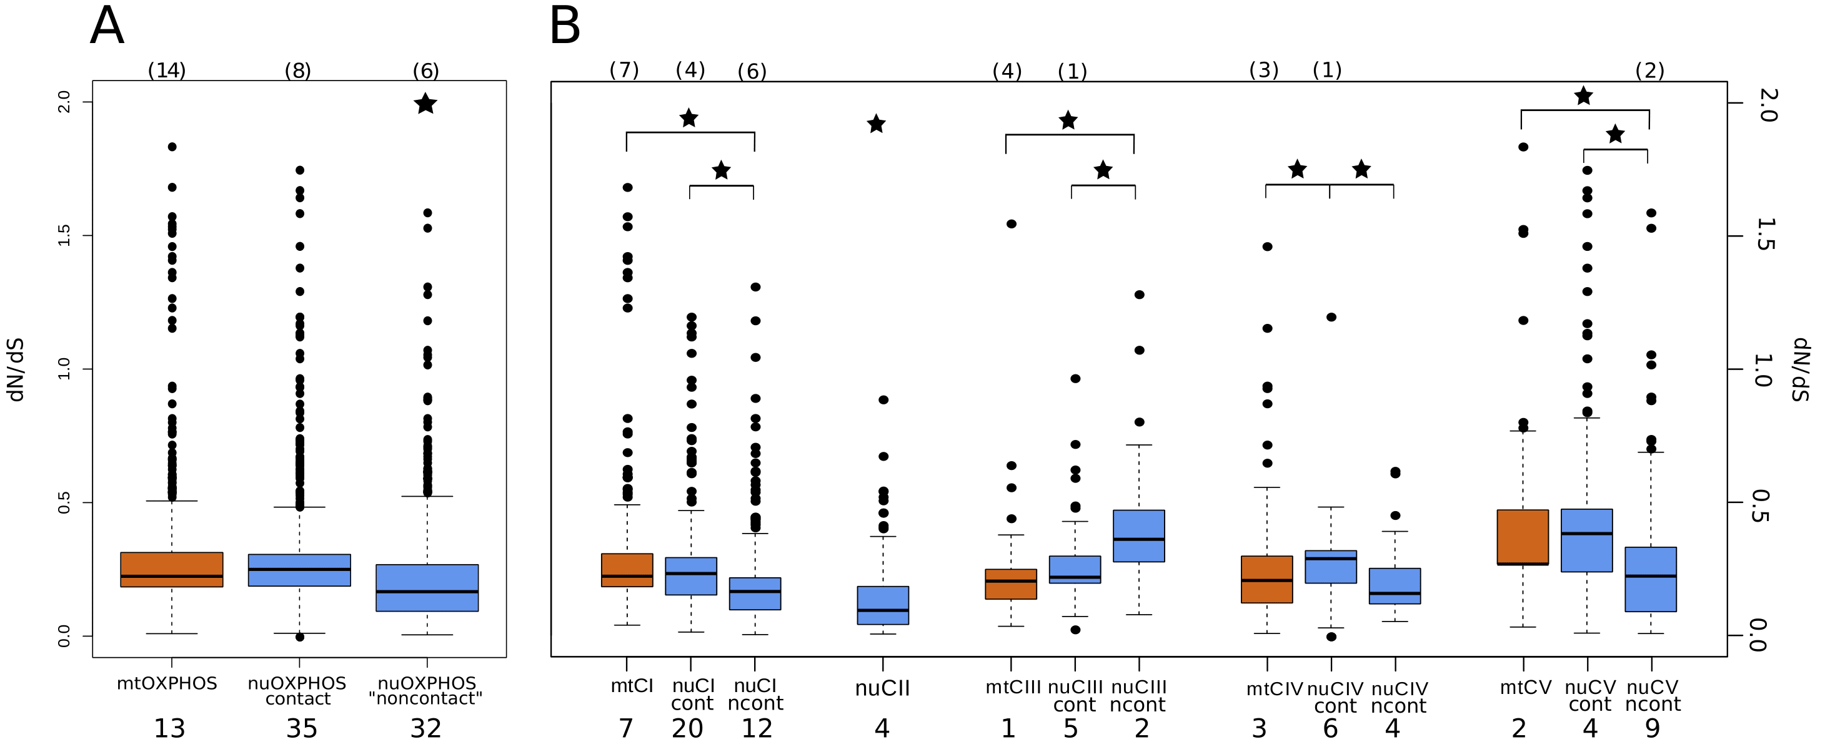
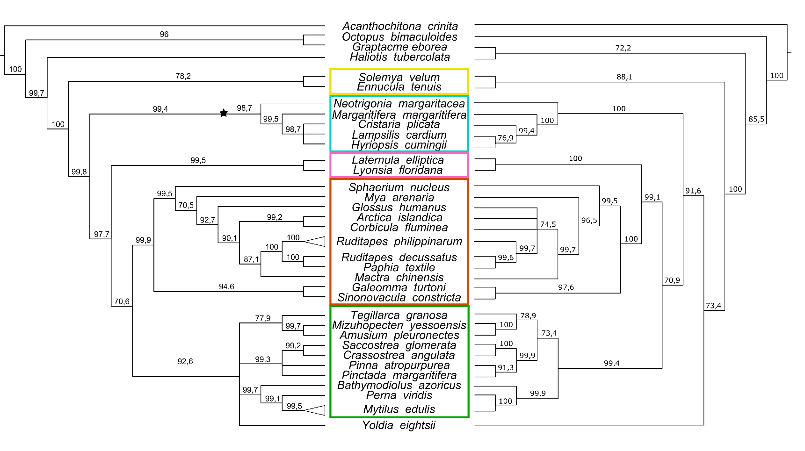
ITA*PHY Workshop
Trento 6-9/6/2023
Giovanni Piccinini
Postdoc at the University of Bologna
Department of Biological, Geological, and Environmental Sciences
Mitonuclear coevolution
dN/dS
Convergent evolution
Germline-related genes
Gene family evolution and deep domain homology

