Slide 1
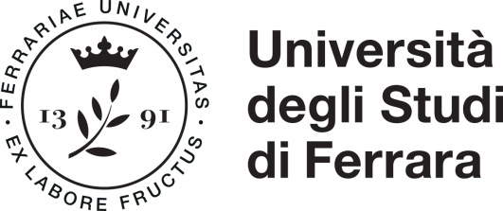
Patrícia Santos Post-doc researcher
My research interests focus on how genomic data are influenced by the demographic history of populations and on the methods used to improve our understanding of the evolutionary history of species.
I am currently working on:
Neolithic transition: ancient genomic data and personal ornaments ; metagenomics.
Conservation genomics: Apennine bear.
Understand the different methods of phylogenetic analysis and which method can be better for the study of species diversification and gene evolution.

