Slide 1
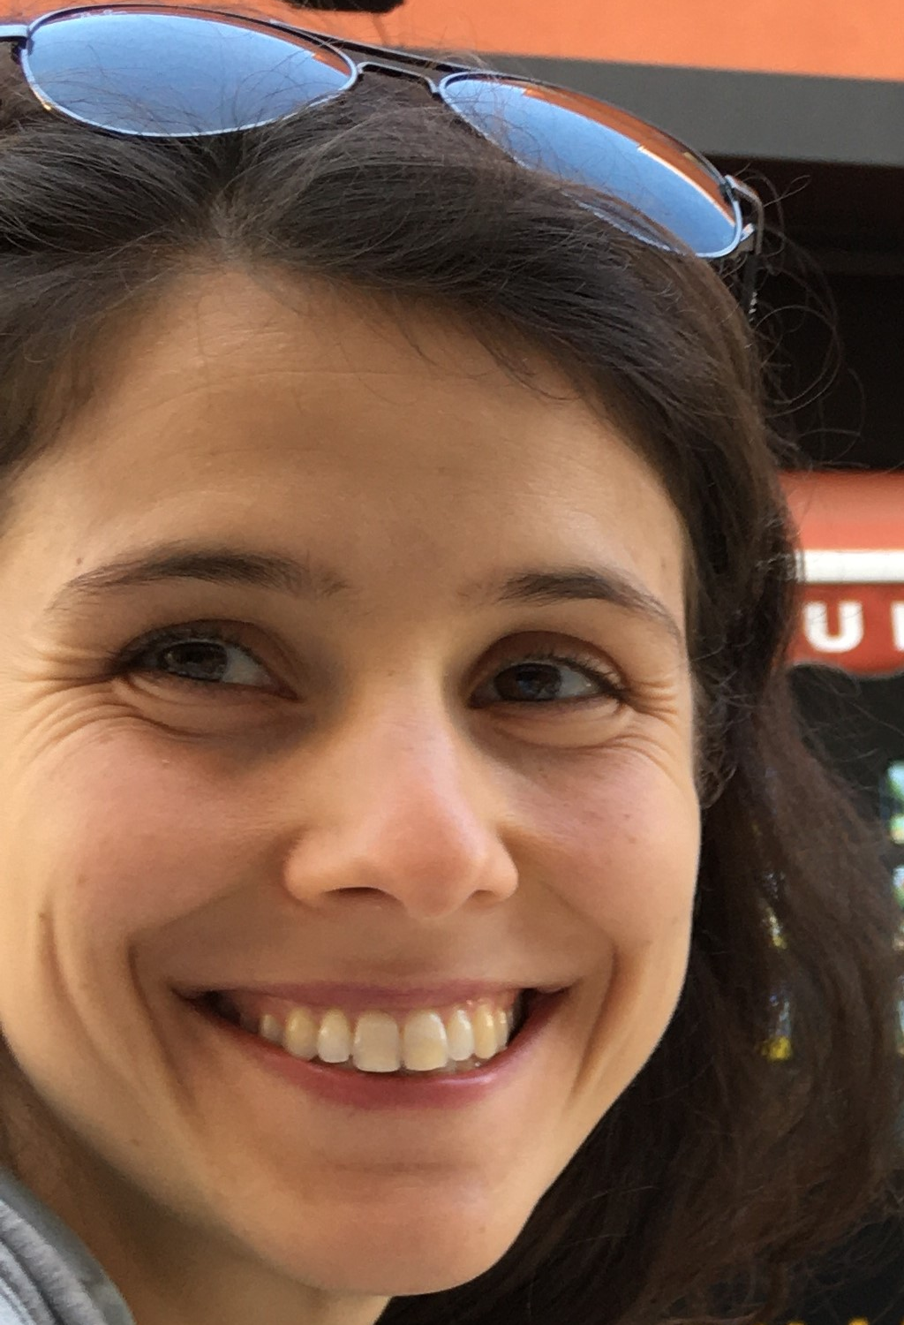
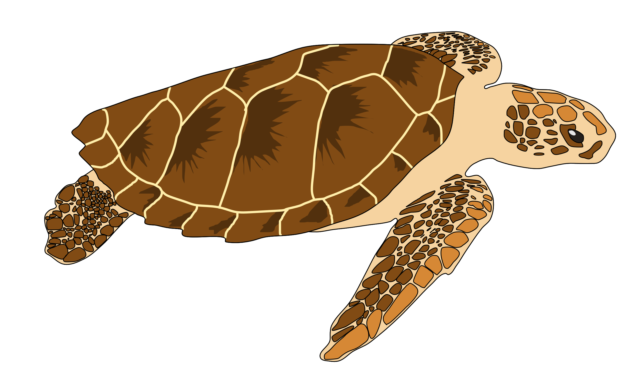

Livia Tolve
1st year
PhD Student,
Evolutionary Biology and Ecology
Research interest: conservation genetics/genomics
Actually working on: population genetics
and phylogeography of sea turtles
Under review: Tolve & Iannucci et al.
Whole mitochondrial genome sequencing provides new insights into the phylogeography of loggerhead sea turtles (Caretta caretta) in the Mediterranean
Why I joined ITA*PHY…:
To improve my basic, theoretical knowledge of phylogenetic inference
To improve my basic, practical knowledge of phylogenetic reconstruction and interpretation
To learn phylogenetic methods I am not used to (Maximum Likelihood)
To better understand differences, pros and cons of phylogenetic inference methods
To learn how to choose the best phylogenetic method for the aim of my study and depending on the samples available
To become aware of the limits of the methods and how to handle them

