Slide 1

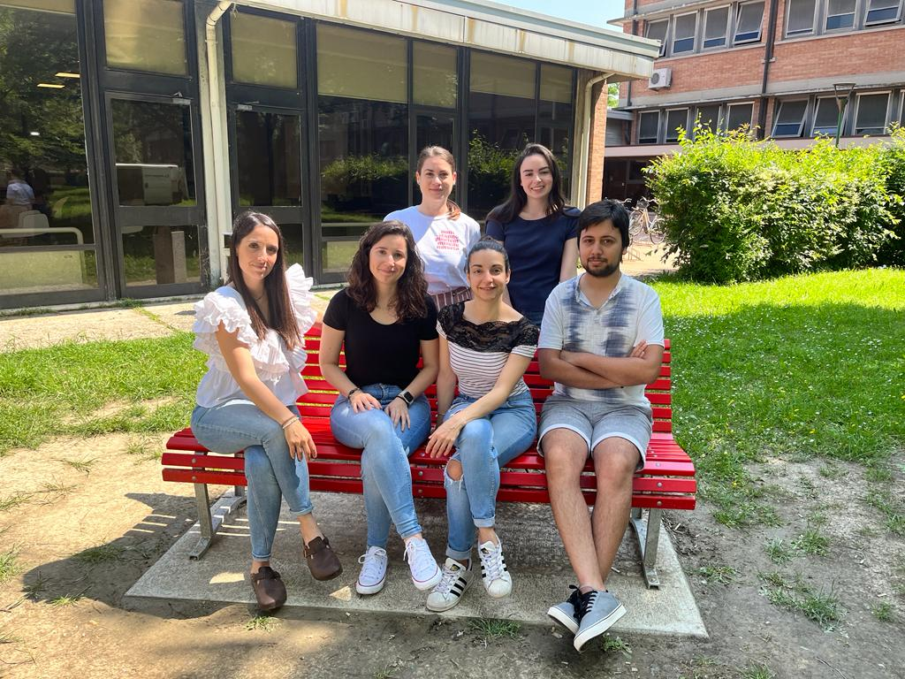
Maria Teresa Vizzari
Postdoctoral Researcher in Population Genomics
My research focuses mainly on the development of new methods to investigate the demographic and evolutionary history of species from modern and ancient genomes.
I am currently working on:
The development of a new inferential framework that allow the analysis of low-coverage genomes.
The reconstruction of past human population dynamics during the Mesolithic in Eurasia.
The evolutionary relationships among different species of sea turtles.
Learning more about phylogenomics will certainly be useful to broaden my population genetics background and improve both my theoretical and practical expertise.
Ghirotto Lab

