Slide 1
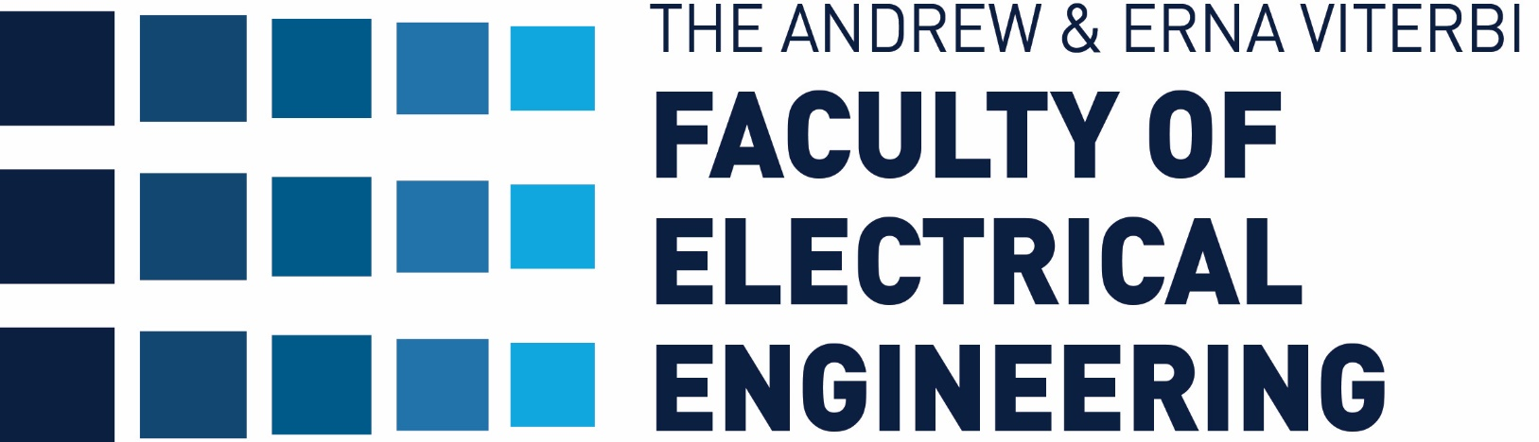


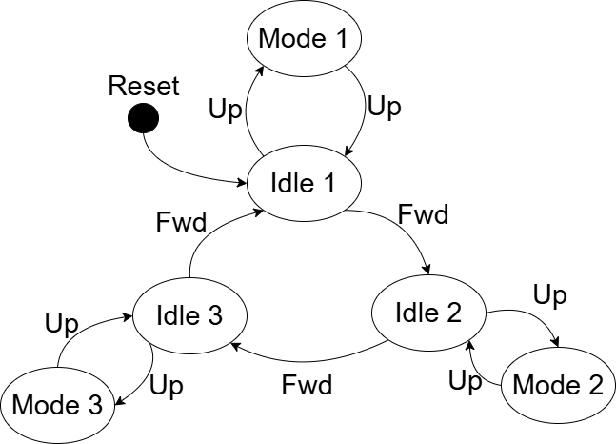
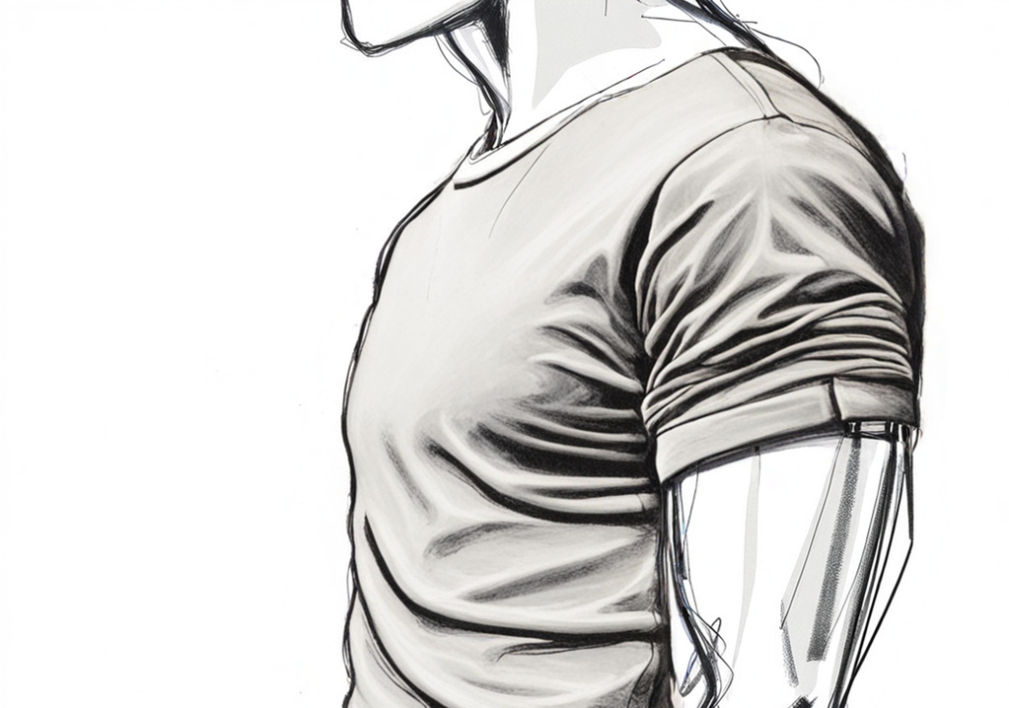


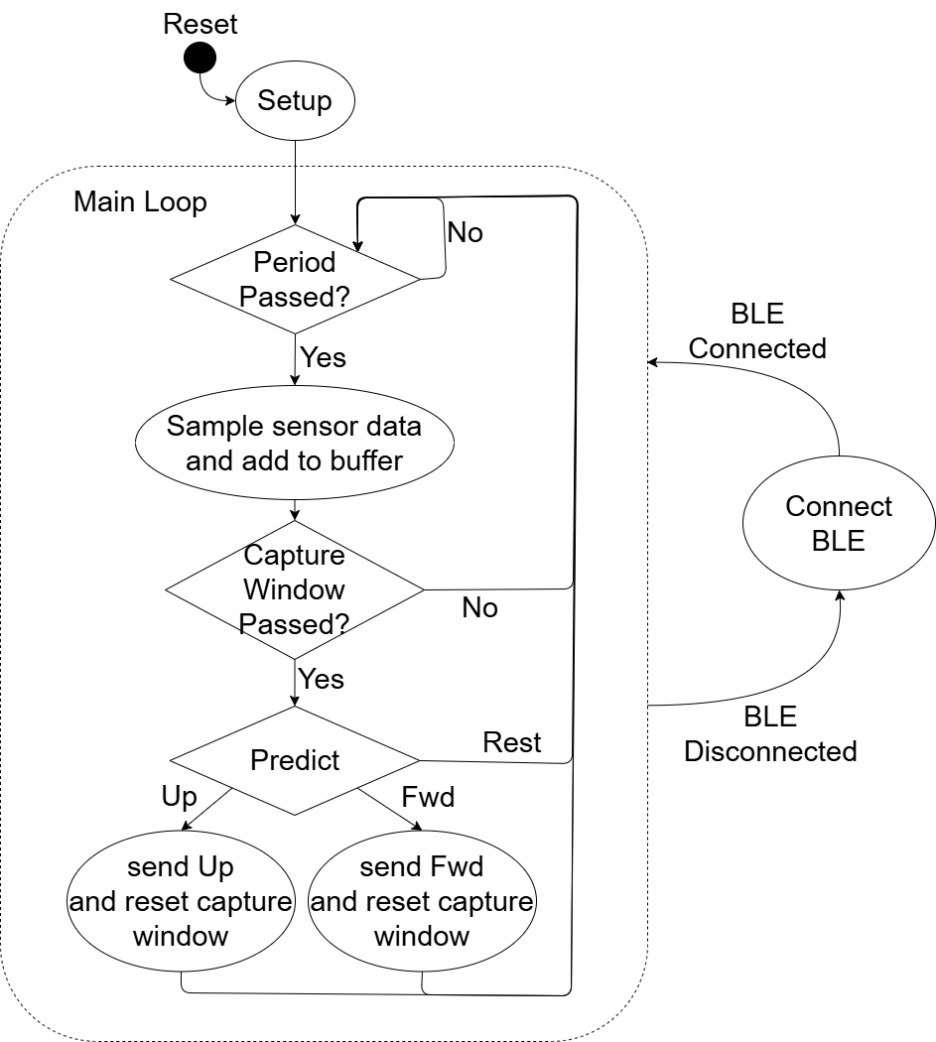

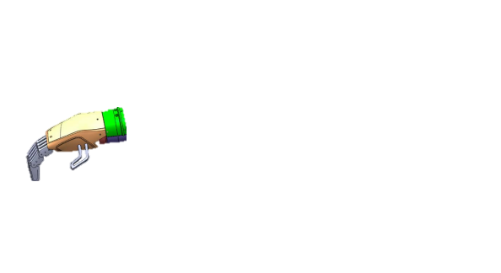

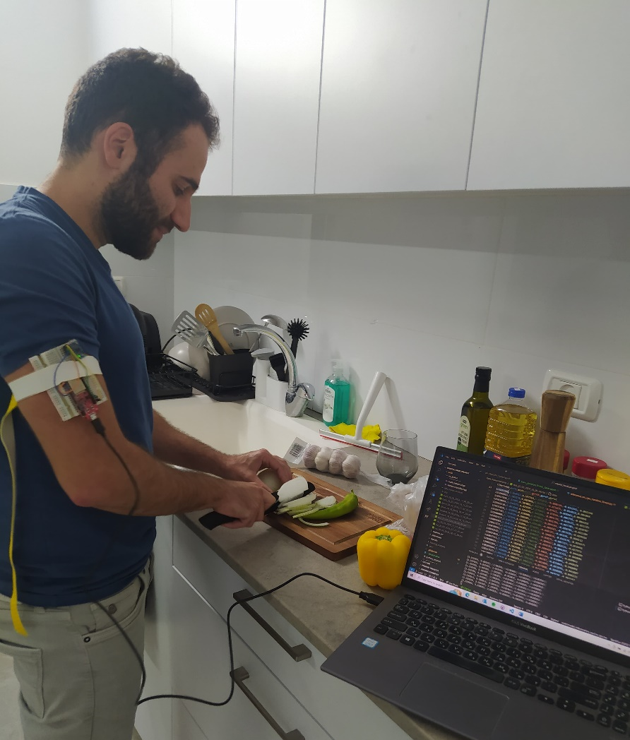

Prosthetic Hand Control via Shoulder Movement
Itay Mal and Nitay Ozer, Supervised by Kobi Kohai
Introduction
mode selection
Mode Navigation
The project is being carried out in collaboration with the 'Haifa3D' organization, which offers a service of a robotic prosthetic hand that is 3D-printed.
The hand is provided at no cost to any hand amputee who approaches the organization, customized to their measurements and personal needs.
In the current state, the hand is controlled by a phone app – the other hand needs to be occupied using the app.
We chose this approach for cycling between modes:
Pros:
Easy movement identification.
Few actions to remember.
Cons:
Less immediate operation.
Need to remember state sequence.
On/Off
Next Mode
Number of modes and their associated actions are configurable by software.
For safety and reliability - can cycle through modes only when idle.
Program Flow
Sample in $80 [Hz]$ frequency.
Add sample to buffer – contains last 100 samples.
Check if enough time have passed from last prediction to avoid multiple predictions from the same movement.
Make prediction.
Haifa 3D logo
Classification Algorithm
Goals
Wirelessly controlling Haifa 3D robotic prosthetic hand.
Using user’s shoulder movements to activate preset modes instead of using the app.
Our System
Shoulder Movement
IMU Sensors
ESP32
Block diagram
Pros:
Easy and fast training.
Highly fitted to classification tasks.
Explainable.
Fitted to microcontroller easily.
Cons:
Not designed for temporal data.
Challenges
Conclusions
Establishing a stable BLE connection between the hand and the controller.
Choosing the best configuration of IMU’s in order to get the best shoulder movement samples:
Number of sensors.
Locations on the shoulder and body.
Deciding the best approach for mode selection.
Finding the right classification algorithm for our task that can fit a microcontroller:
Need to be Computationally light.
Need to take little memory.
Need to be easily implemented on microcontroller.
No previous data set exists.
Managed to successfully achieve project goals:
Reliably classify target gestures.
Low false positive rate.
Stable wireless connection.
More research need to be done in order to make a final product:
Improve classification accuracy.
Battery life testing and optimization.
Detect more gestures.
Improve physical product.
User feedback.
Data Acquisition
ESP connected to computer to collect sample traces to CSV files.
Traces include target gestures as well as miscellaneous activities.
September 2016

