Slide 1
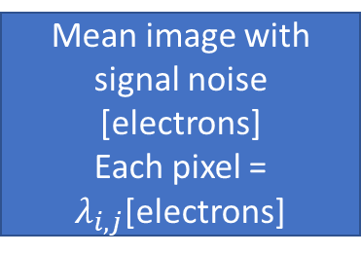
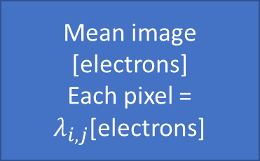
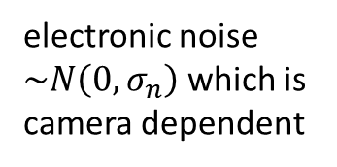
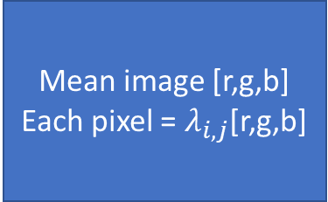
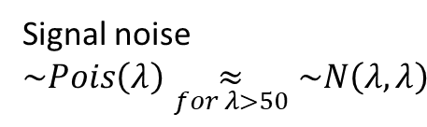
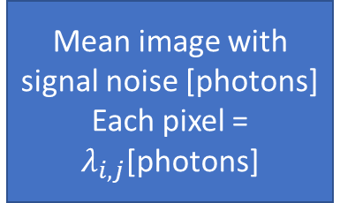
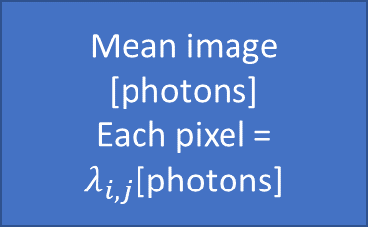
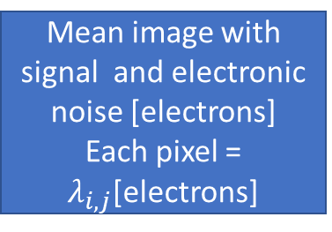
Realistic Image [r,g,b]
Mean image with signal and electronic noise [electrons]
Each pixel = $λ_{i,j}$[electrons]
/ n_well
Simulation images
Simulation images
Simulation images
Simulation images [r,g,b]
electronic noise $\sim N\left(0,σ_{n}\right)$ which is camera dependent
+
average
Mean image with signal noise [electrons]
Each pixel = $λ_{i,j}$[electrons]
Mean image [r,g,b]
Each pixel = $λ_{i,j}$[r,g,b]
Signal noise $\sim Pois\left(λ\right)\underset{for λ>50}{≈}\sim N\left(λ,λ\right)$
X quantum
efficiency
X n_well
Mean image [electrons]
Each pixel = $λ_{i,j}$[electrons]
Mean image [photons]
Each pixel = $λ_{i,j}$[photons]
Mean image with signal noise [photons]
Each pixel = $λ_{i,j}$[photons]
/ quantum efficiency
+

