Slide 1
Project Status – report 1
11/9/2022

Slide 2
TUTORIALS
Rendering
Editing a scene – creating and manipulating objects.
Sensors – rendering the scene from multiple viewpoints
Inverse Rendering
Integrating ML with mitsuba to optimize scene objects

Slide 3
Key parameters to create reliable simulation
Replicating true water physical properties
Turbidity
Sigma parameters
Caustics
Color effects
Replicating natural light
Time of day
Geographic considerations
Defining physical properties of reflective calibration targets
BSDF
texture

Slide 4
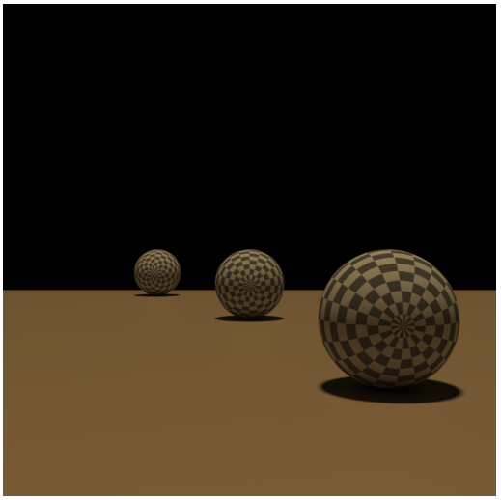
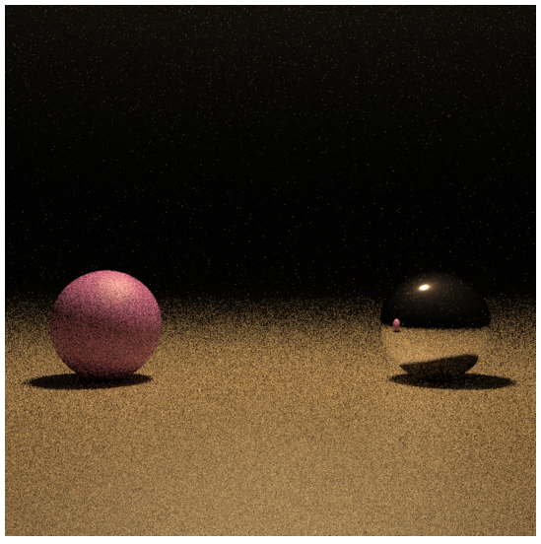
Where we stand
How to define global water properties including the features we mentioned
Directional light is not supported when combining volume objects

