Slide 1
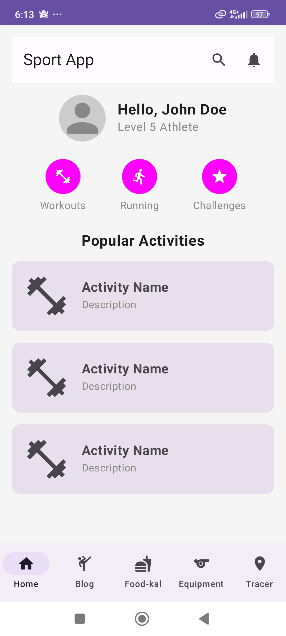



Home page- #challengeges for exercises

Slide 2
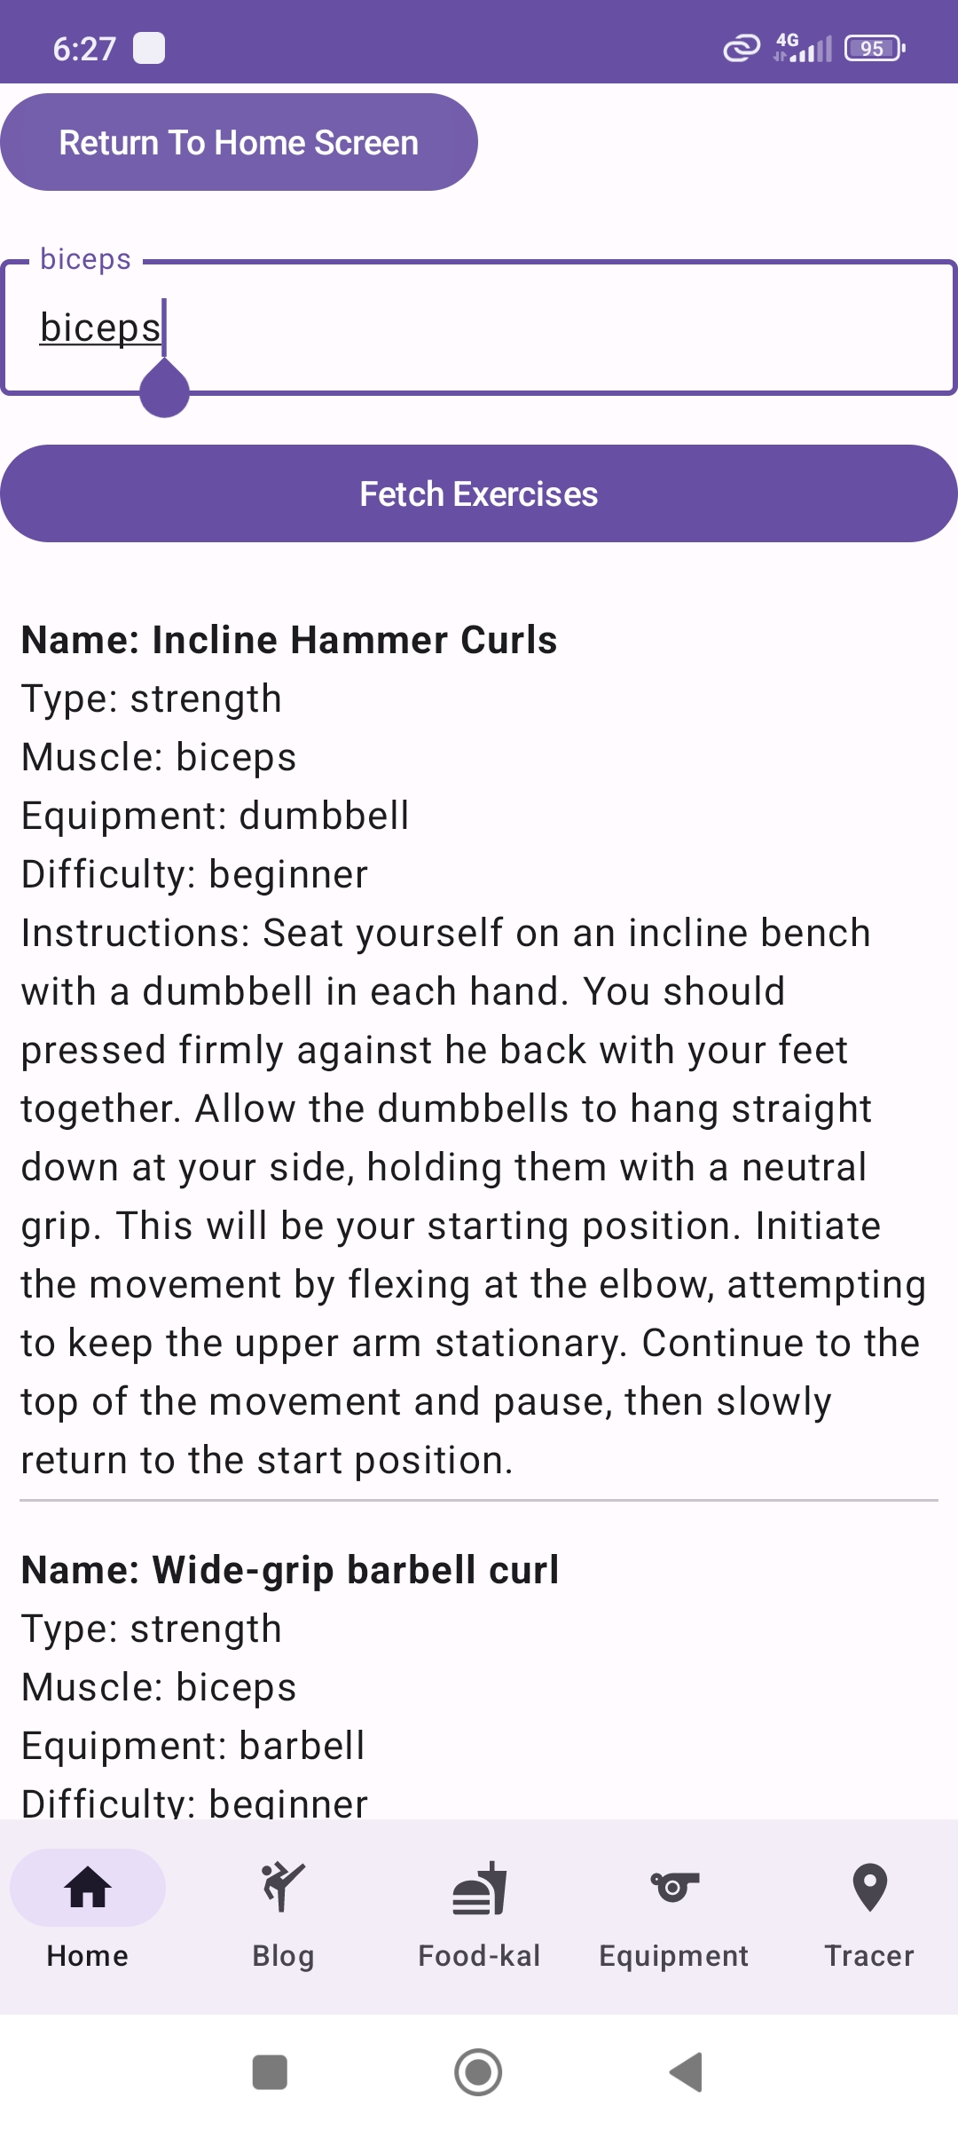
Choose from selection bar muscle and get a lot of exercises..

Slide 3
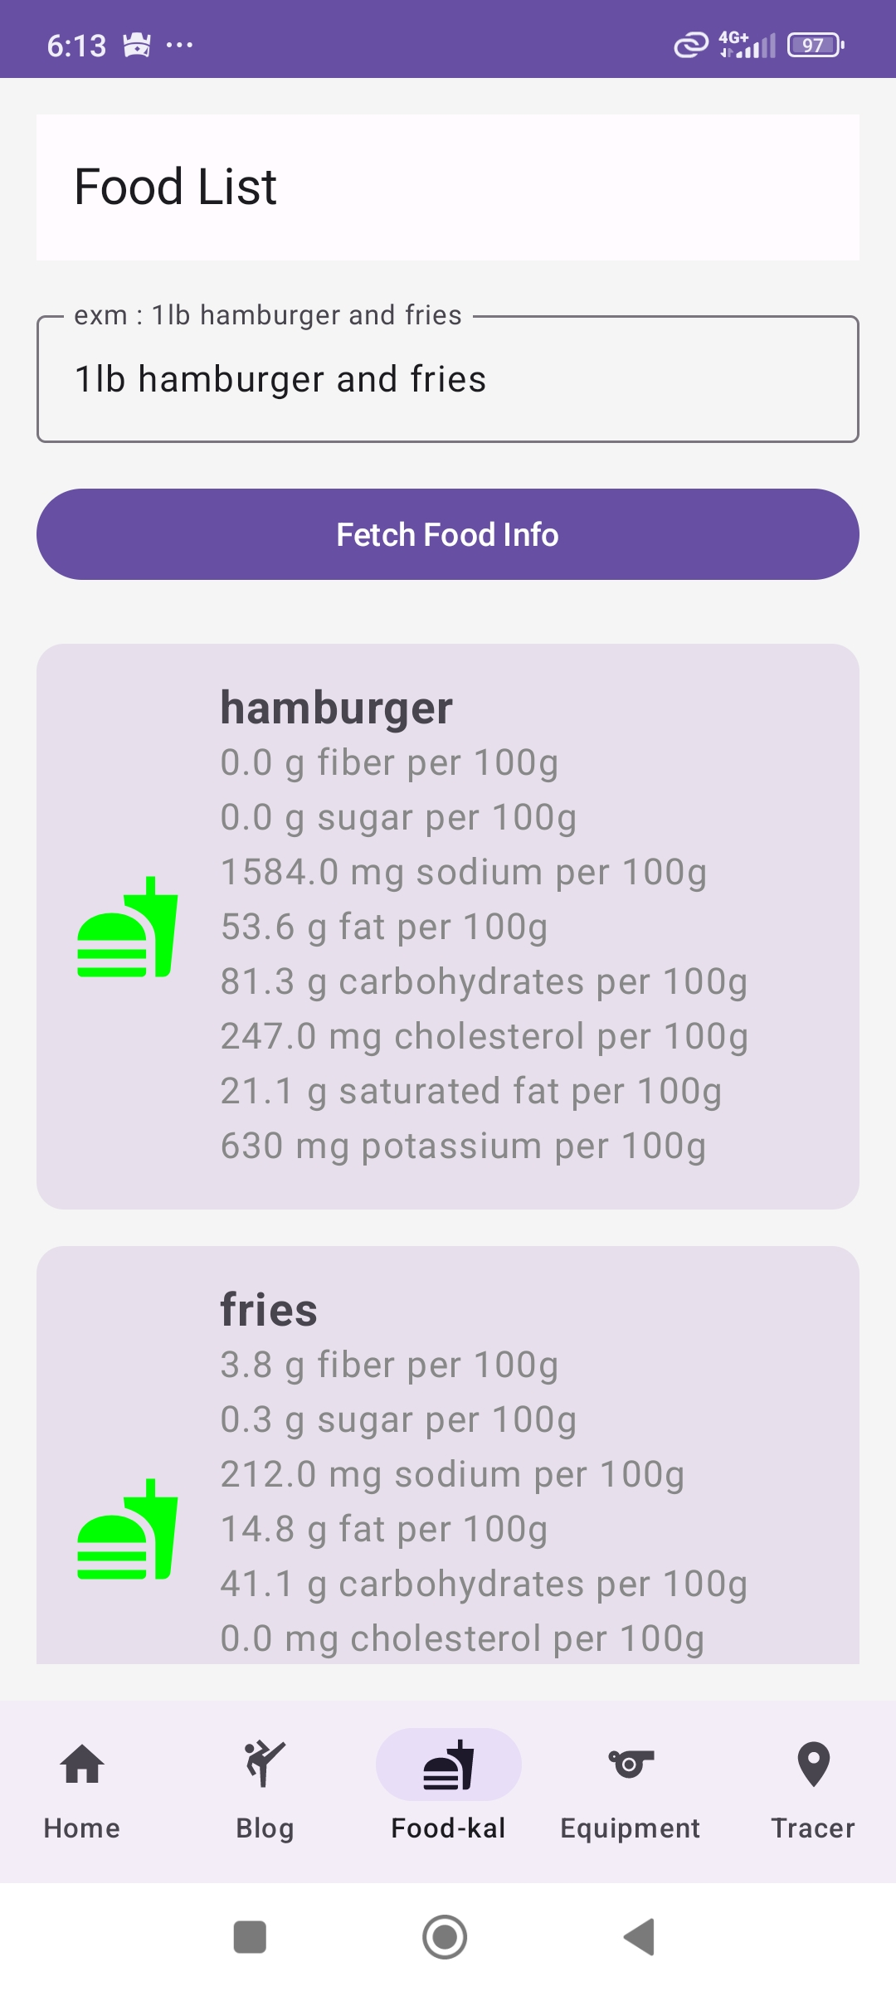



Write a kind of food meal and see the nutrition

Slide 4
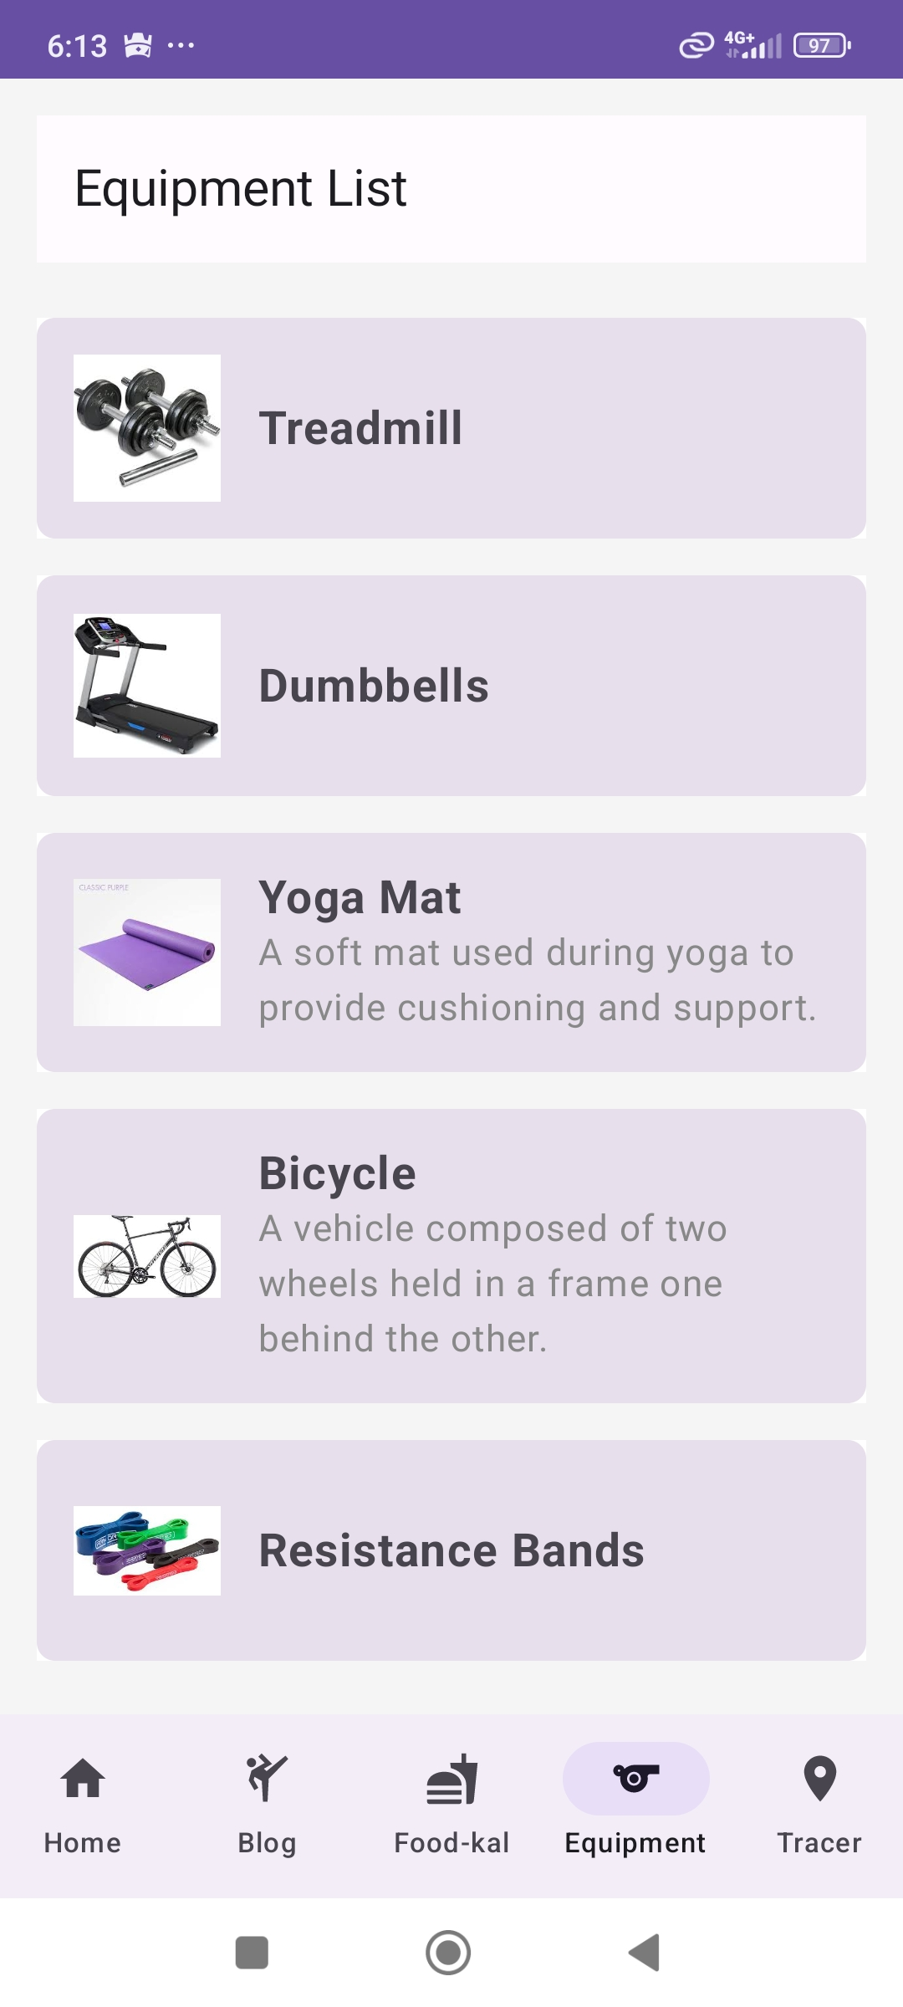
Equipment List – click to see description.

Slide 5
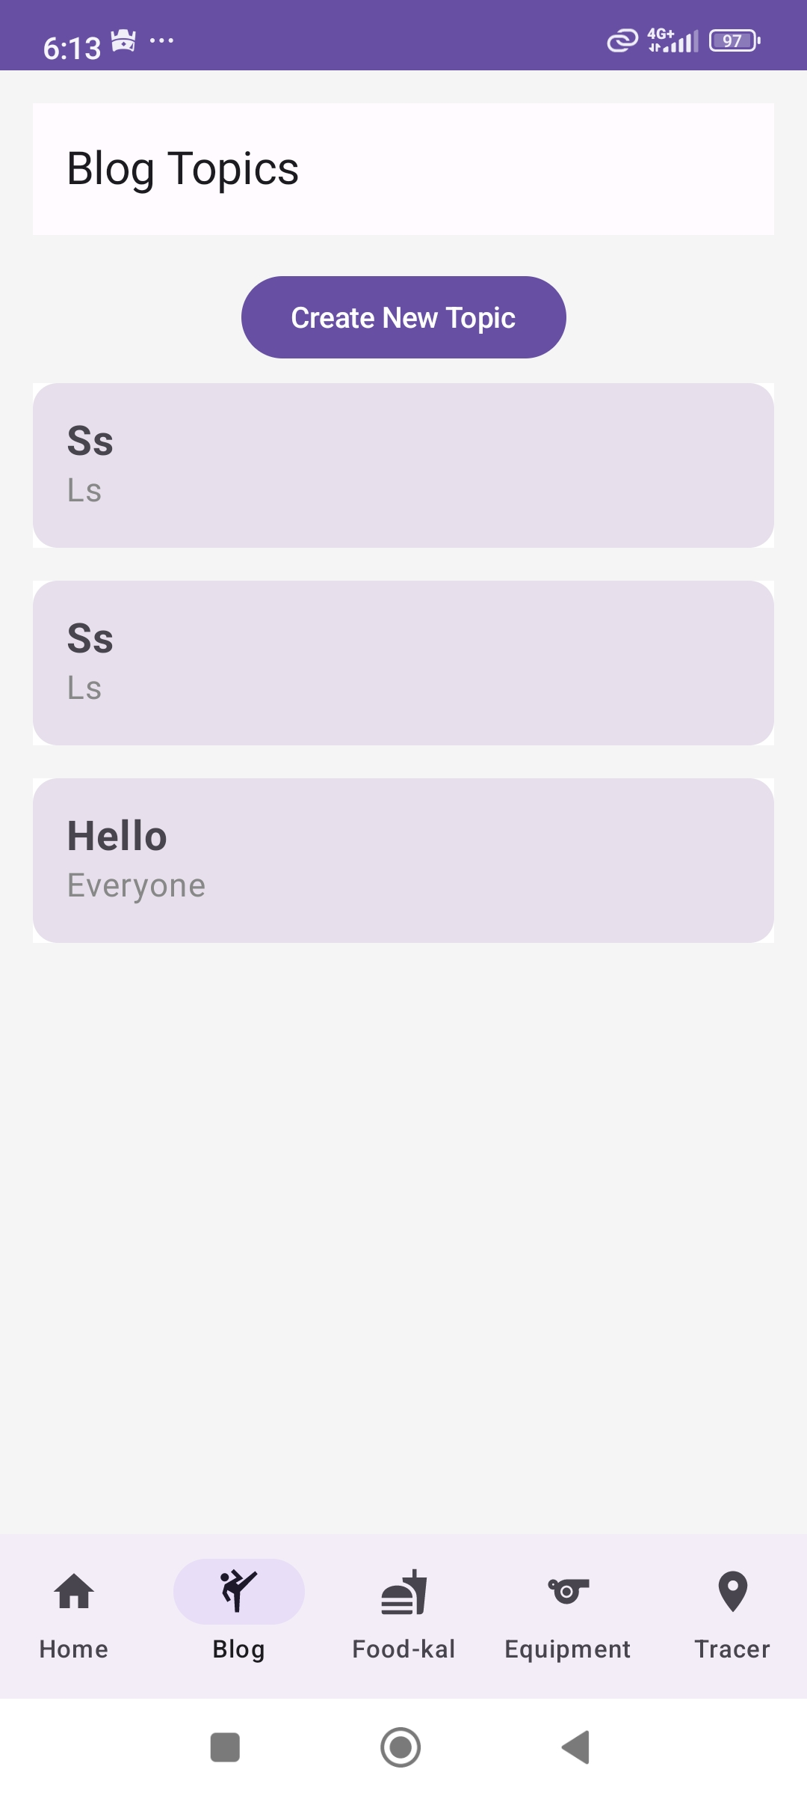
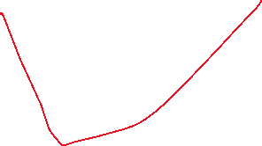

Add subject you want unswer to , and add comments

Slide 6
