Slide 1
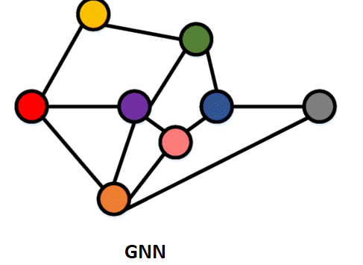

[Poster Describe Research or Software Development Project] GNN – Net classification Itay Yosef, Omer Rabin, Yoel Hartman, Itamar Almog Supervised by Dr. Amit Dvir, Dr. Ran Dubin, Dr. Chen Hajaj
Logo
49
The main goal of our research is to show if there is any advantage to using GNN to classify encrypted traffic over other deep learning methods.
2. In the last two decades the Internet has grown very much, and so is the amount of traffic in it. Today around 90% of the traffic is classified, which is a good thing for privacy of the users.
The need for traffic classification rises from the need to filter and control traffic,
even though it's encrypted.
3. There are 4 main models that we do the testing on, two of them use GNN, and the other two are some other aspects of deep learning.
4. Using 3 different data sets, BOA, MappGraph, Flowprint, we tested the implementations of the 4 models of the 3 datasets and gathered the results.
5. Solution Description (Algorithms, Modulation, Patterns, Infrastructure, UI, Functionality)
Visit Us
Scan QRCode for full Instructions(github)

