Slide 1

Inbal Ben David Dana Yehezkely Itay Roll

Slide 2
About DressCode
Crowd based platform that enables users to get feedback about their looks and outfits for special occasions and day to day wear.
Users can ask for the crowds opinion, review other people looks and be inspired by top rated looks.

Slide 3
What makes DressCode special
Objective feedback for users looks
Get the reviews that actually interest you
Varied opinions using large scale crowd
The consumption culture has changed – buying online increases the need for online consulting

Slide 4
Challenges
Rate more = Gain more
Predefined options and filters
Spammers handling - recognize minority opinion and verify clothing items

Slide 5
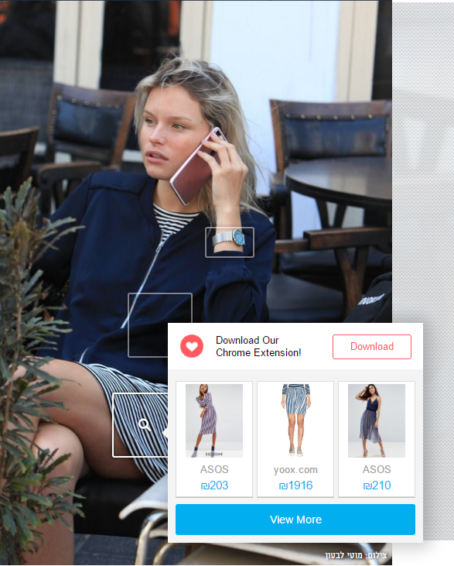
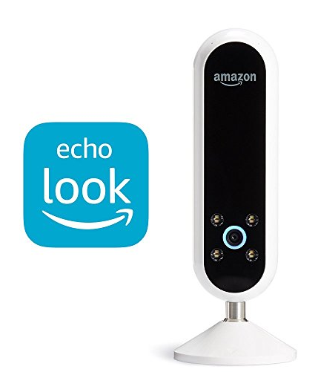
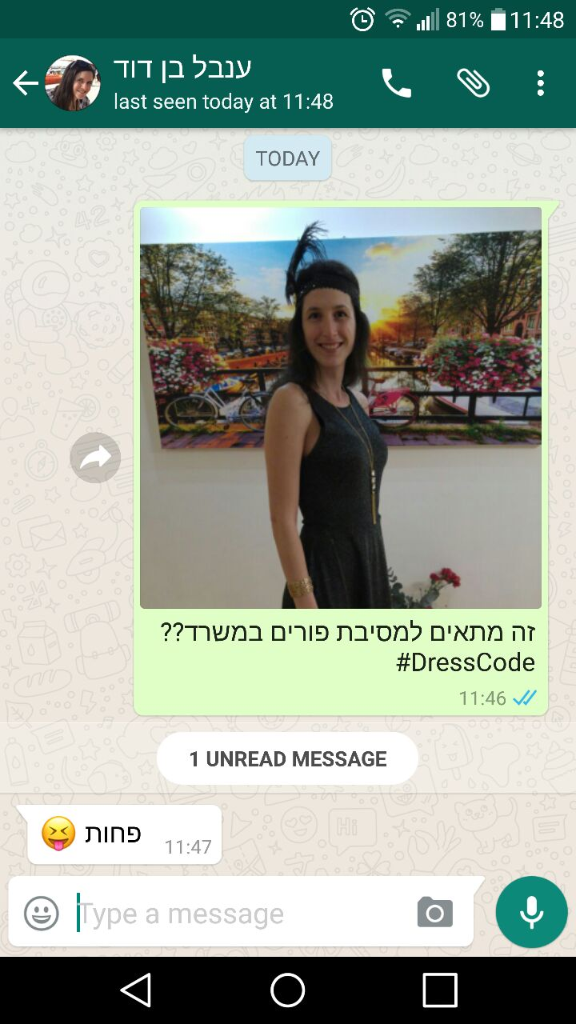
Similar products

Slide 6
Technologies
Web application written in Python using Django web framework
SQLite DB
Client side written in HTML, CSS, Bootstrap and JS

Slide 7


Architecture
questions
questions
DB
Spam detector
feedback
feedback
reviews
User interface
feedback
reviews
questions
questions
filter
reviews
feedback
questions
questions

Slide 8
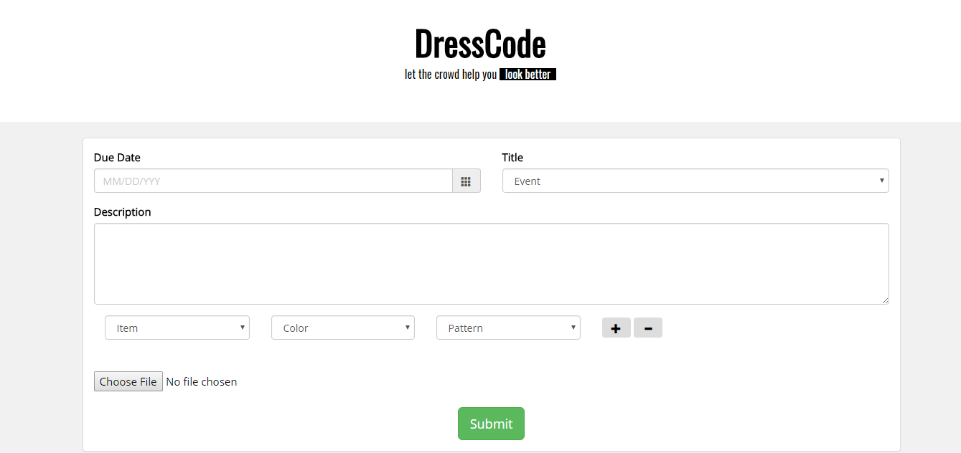
Mockups

Slide 9
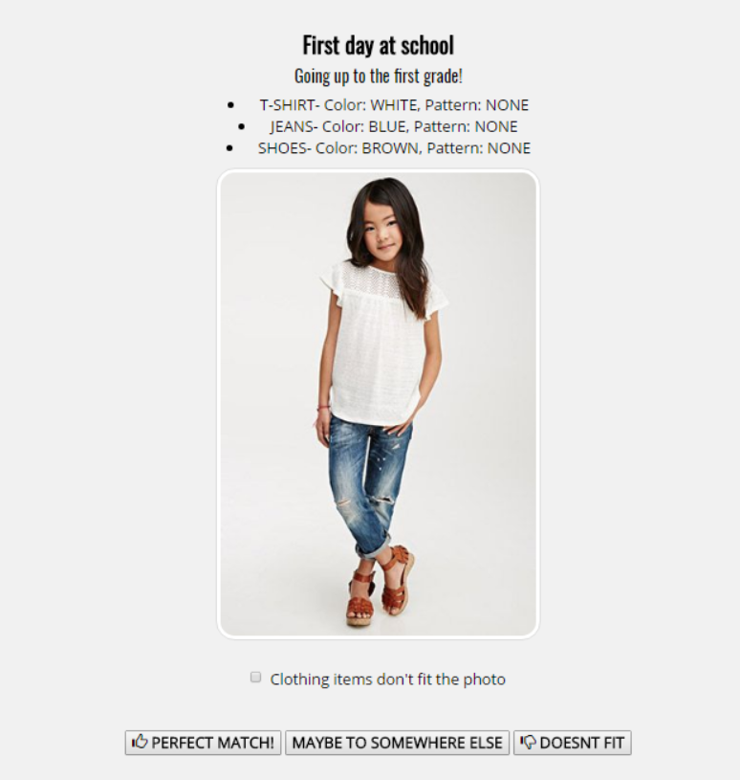
Mockups

Slide 10
Work plan
Inbal – Front End design
Itay – DB and django Back End
Dana - Feed and spam detector logic

