Slide 1

Inbal Ben David Dana Yehezkely Itay Roll

Slide 2
About DressCode
Crowd based platform that enables users to get feedback about their looks and outfits for special occasions and day to day wear.
Users can ask for the crowds opinion, review other people looks and be inspired by top rated looks.

Slide 3
Main features
Ask question
Allows you to ask the crowd questions about specific event and relevant clothing items
Answer questions
Rate other users look
By doing that you gain:
Points that allow you to post more questions
You will be positioned higher on other users feed
Better results for “similar taste” feature

Slide 4
Main features
Filter top looks
Allows you to get the top looks based on specific clothing items and gender
Review your questions
Get the general opinion of the crowd
Get the opinion of users with similar taste
Filter results based on your own preferences

Slide 5
Special features
Spam detector
Clothing don’t match to the picture
Inappropriate content
Too many answers in short time
Minority opinion
Similar taste
Results based on users that answer similar to you
Initial questions
Shared questions

Slide 6
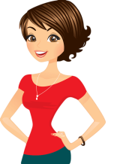
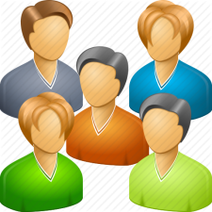
Architecture
questions
questions
DB
Spam detector
feedback
feedback
reviews
User interface
feedback
reviews
questions
questions
filter
reviews
feedback
questions
questions

