Slide 1

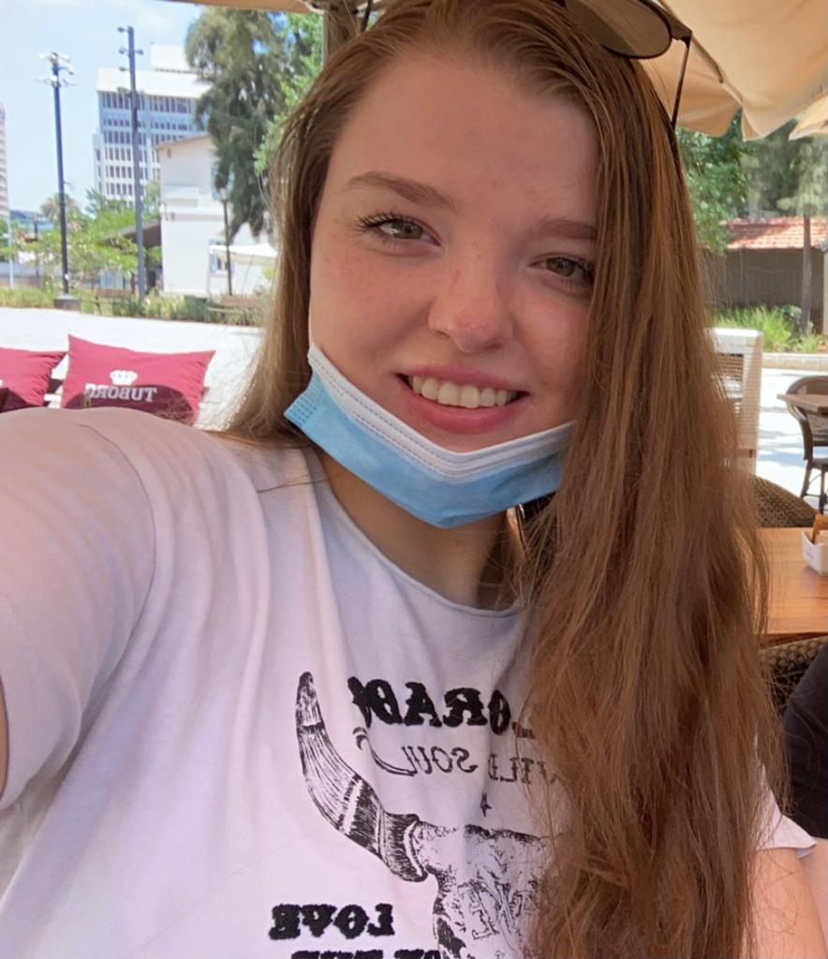

Flight Control Android Application
Submitted by:
Yana Sidanych Itay Yaakov

Slide 2
About The Project
We created a joystick app that can control a plane inside the flight gear simulator.
The app was written for android devices using Kotlin.
The app was created as a part of our Advanced Programming course:
Course number:89211
Lecturer: Eliyahu Khalastchi

Slide 3
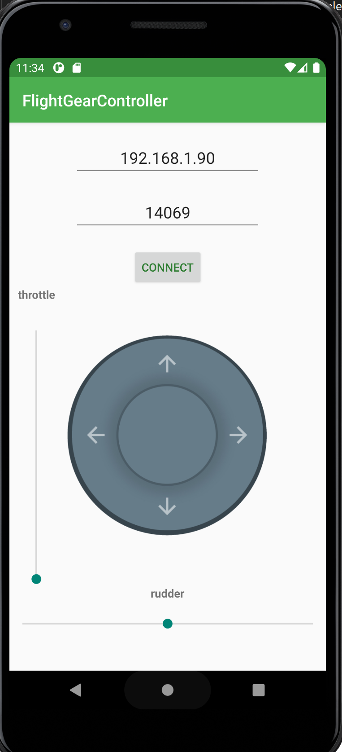
Our User Interface
The app has one screen, which contains the two main parts of the app.
First, we have the connection section, that allows the user to connect to the flight gear simulator.
Second, we have the joystick itself that allows the user to control the plane, from takeoff to the landing.

Slide 4
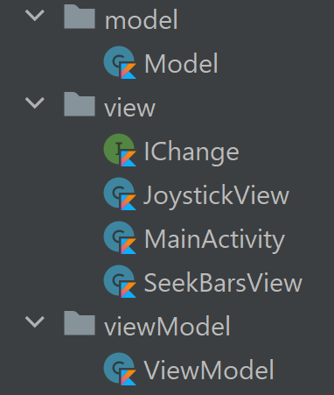
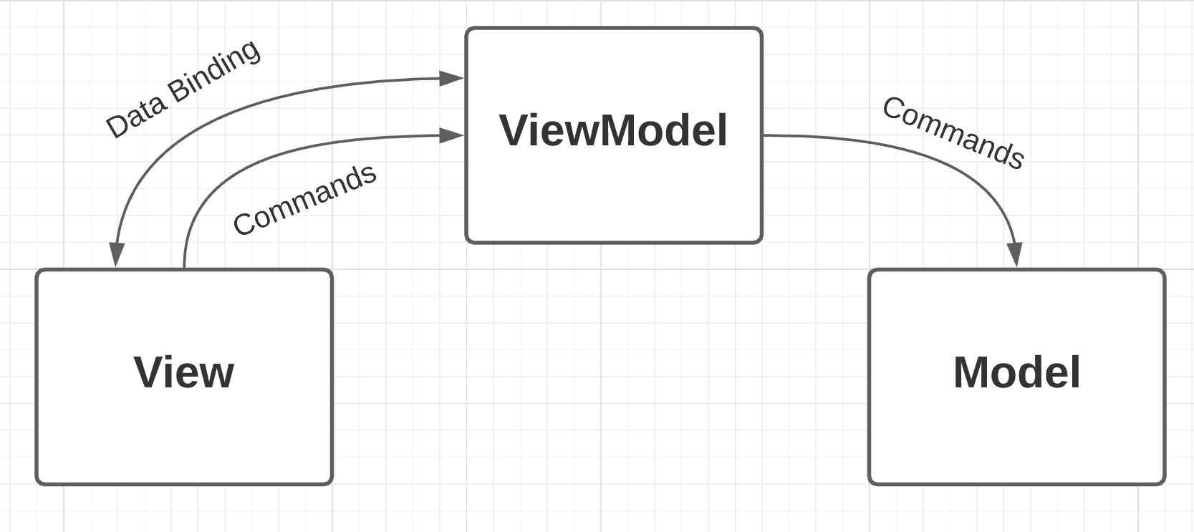
The MVVM Architecture
As the title says, in our app we used the MVVM architecture.
The code was organized in three packages, model, view and viewModel.
The view package containes the three main views, the joystick, the throttle and rudder bars and the mainActivity. They are responsible for showing and managing all the GUI componnents.
The model is responsible for connecting to the simulator and sending the flight commands
When a bound variable is notified as changed by the view, the viewModel is responsible of senings the corresponding command to the model.

Slide 5
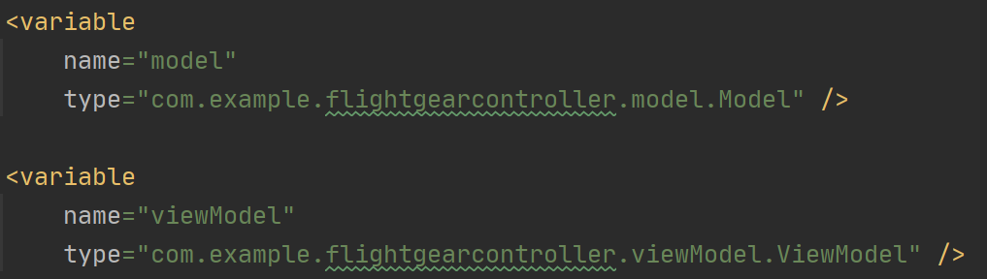
The MVVM Architecture – Code Examples
Lets demonstrate the data binding between the ip and port GUI EditText elements in the view, to the ip and port variables in the viewModel:
From: activity_main.xml
In these two lines of code you can see how the text atrribute of the GUI EditText elements is bound to the ip and port variables that exists in the viewModel.kt file.
You can see that the viewModel variable is defiend in these code lines from activity_main.xml:
The model variable is also defined here and in a similar way the isConnected variable from the model.kt file is bound to the connect button text and color attributes:

Slide 6
The MVVM Architecture – Code Examples

Slide 7
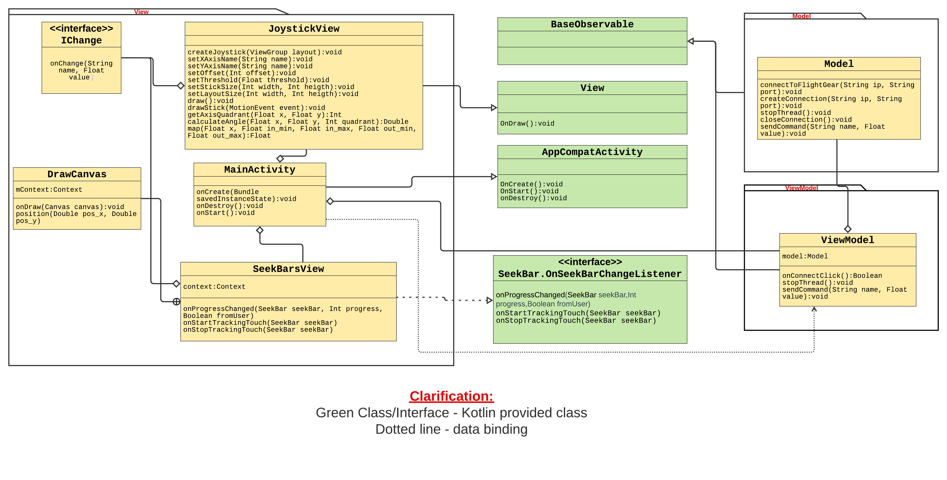
UML Class Diagram

