Slide 1
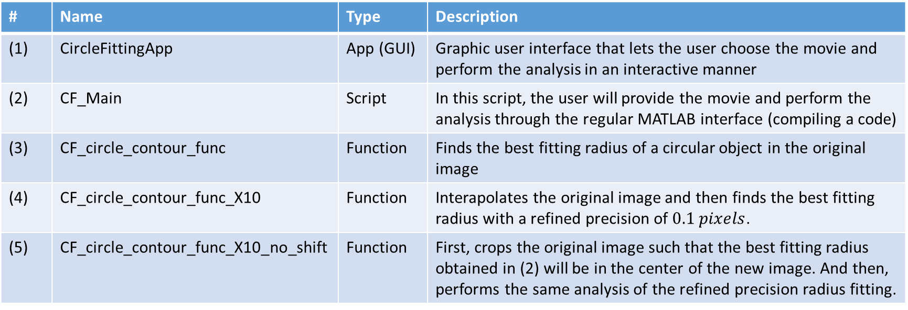
List of scripts and functions in MATLAB
# | Name | Type | Description
(1) | CircleFittingApp | App (GUI) | Graphic user interface that lets the user choose the movie and perform the analysis in an interactive manner
(2) | CF_Main | Script | In this script, the user will provide the movie and perform the analysis through the regular MATLAB interface (compiling a code)
(3) | CF_circle_contour_func | Function | Finds the best fitting radius of a circular object in the original image
(4) | CF_circle_contour_func_X10 | Function | Interapolates the original image and then finds the best fitting radius with a refined precision of $0.1 pixels$.
(5) | CF_circle_contour_func_X10_no_shift | Function | First, crops the original image such that the best fitting radius obtained in (2) will be in the center of the new image. And then, performs the same analysis of the refined precision radius fitting.

