Slide 1
Websocket-Protocol

Slide 2
Background
Websocket is a communication protocol, using the Internet.
It provides a persistent connection between a client and server.
Most browsers support the protocol, including Google Chrome, Microsoft Edge, Internet Explorer, FireFox, Safari…
We use this protocol for realtime applications like:
                Notifications
                Online games
                Live maps
                Chat

Slide 3
Life before websocket…
Let say we develop a chat application, with a server and few users, clients. When clientA sends a message to clientB, it sends it to the server, and the server should send it to client.
How can the server send a message to clientB if as we know, when using HTTP protocol, the server cannot be the initiator of transactions?
Without using websocket, we used Long Polling, but it is not so efficient…

Slide 4
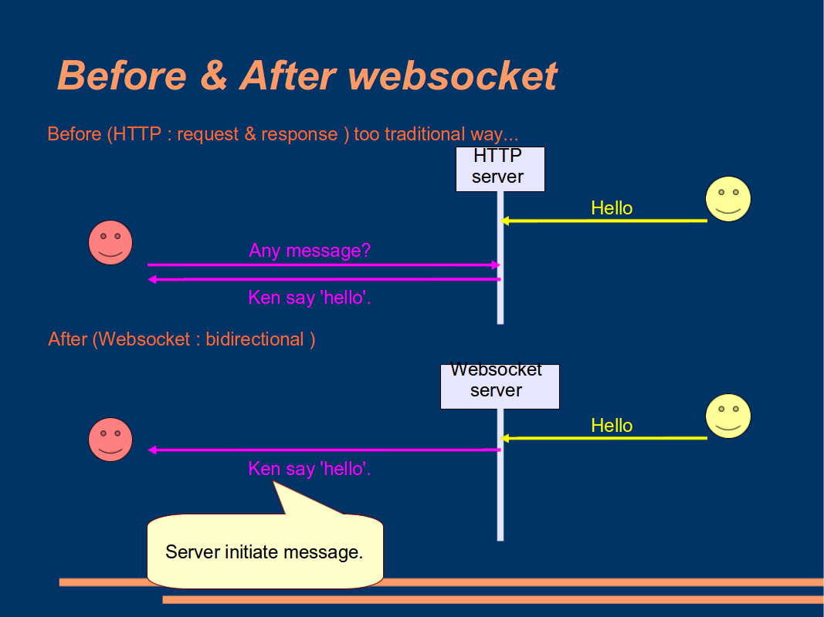
What is more efficient?

Slide 5
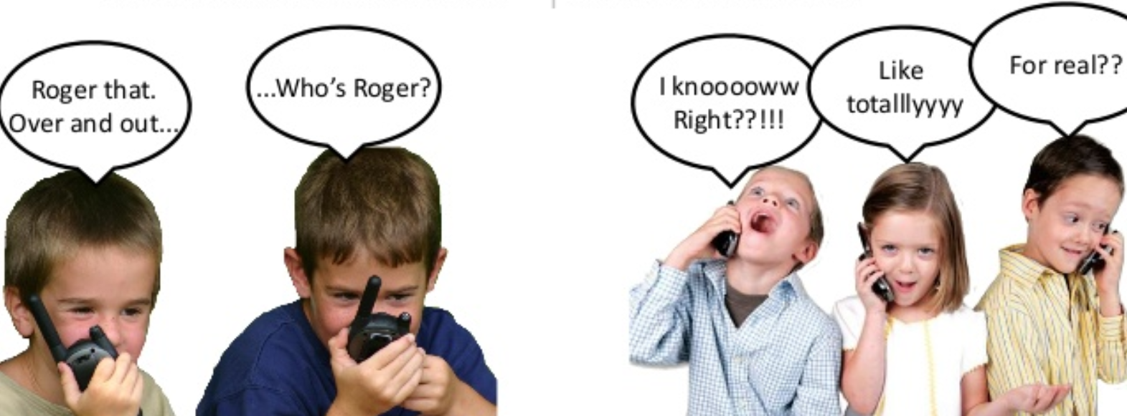
HTTPS Vs Websocket
HTTPS | Websocket
Half duplex communication | Full duplex communication
Unidirectional traffic flow | Bi-directional traffic flow
Notes:
Half-Duplexתקשורת דו כיוונית או דו-סיטרית למחצה המאפשרת לשני צדדים להעביר מידע אך לא בו-זמנית.
Full-Duplex – תקשורת דו כיוונית או דו-סיטרית מלאה המאפשרת לשני הצדדים להעביר מידע בו-זמנית.
Bidirectional means data flows in both directions, whereas Unidirectional means data flows in only one direction

Slide 6
HTTPS Vs Websocket
HTTPS | Websocket
Half duplex communication | Full duplex communication
Unidirectional traffic flow | Bi-directional traffic flow
Uses Headers (thousands of bytes) | Uses Frames (just 2 bytes)
Constantly sending messages to check if there is new one | Sends messages only when there is new data to send.

Slide 7

How does it start
First, the client sends the server a request for a websocket connection using Upgrade header:
        GET ws://websocket.bla.com/HTTP/1.1
        Origin: https://bla.com
        Connection: upgrade
        Host: websocket..bla.com
        Upgrade: websocket
If the server supports this protocol, it replies with the same Upgrade headers:
        …
        Connection: upgrade
        Upgrade: websocket
then the handshake is completed successfully, data transfer begins!

Slide 8
Navigating to a new URL address
When navigating to a new URL address, we lose the websocket connection.
Why?
the context a websocket lives in is limited to the page being displayed.
When we refresh the page or navigate to another page, the context is destroyed, and as part of the context, our websocket connection is destroyed.
How can we deal with it?

Slide 9
The solution
The first solution is to create a Single page Application.
  This kind of applications hold all the required code -> we do not need to reload the Internet page, but the new content (for example the new URL address) would be loaded into the existing page.
The second one, is to put our websocket connection in a hidden frame, where the user navigate only in the frame.
  Now, we can save our websocket connection in the topmost window, and if everything works fine, it should not be changed and just navigate using another frame.
Notes:
Single page applications:
ביישומים אלו, כל הקוד הדרוש
מגיע אל הדפדפן בטעינת דף אחת, ומשאבים נוספים נטענים בצורה דינמית, בדרך כלל כתגובה לפעולות המשתמש. דף האינטרנט לא מבצע טעינה מחדש בשום שלב, אולם כתובת האינטרנט עשויה להשתנות מעט, על מנת לתת למשתמש הבנה יותר טובה של הניווט בדף.

Slide 10
Dealing with the OSI
The OSI model allowing a one-way communication transition between the layers. Each layer transmits the information processed by it, only to the layer below. There is no communication between a layer with the one above it.
However websockets make a bi-directional communication between a client (the presentation layer) and the server (the application layer) possible!
How can we solve this conflict with the layers model?

Slide 11

The solution
We will hold a global object, an object the presentation layer (a client) and the application layer (a server) will have access to.
The changing of this object will be a “red-light” to the client: “server wants to send a message to you!”
Then the client knows to set up a conversation with the server.

