Slide 1



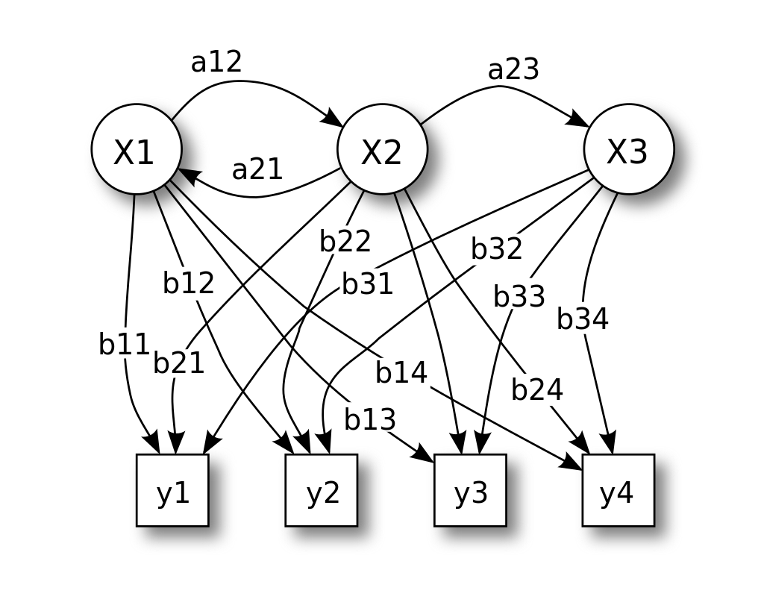
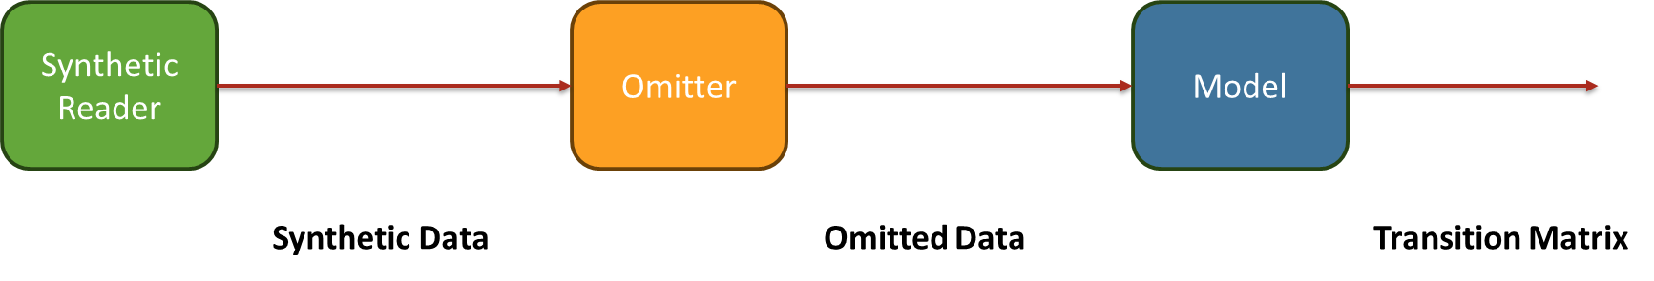
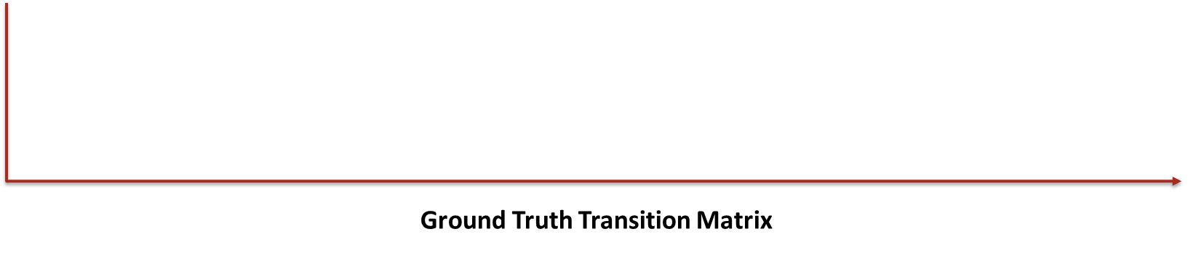

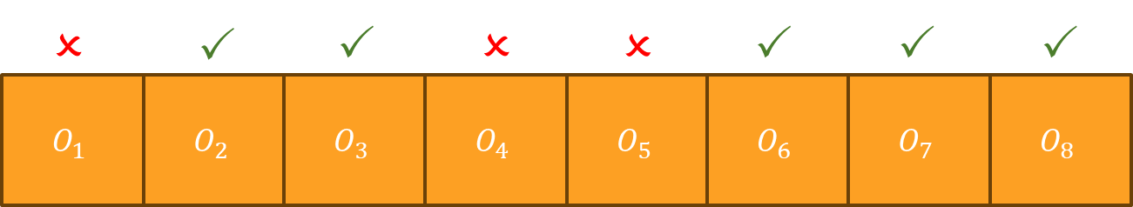
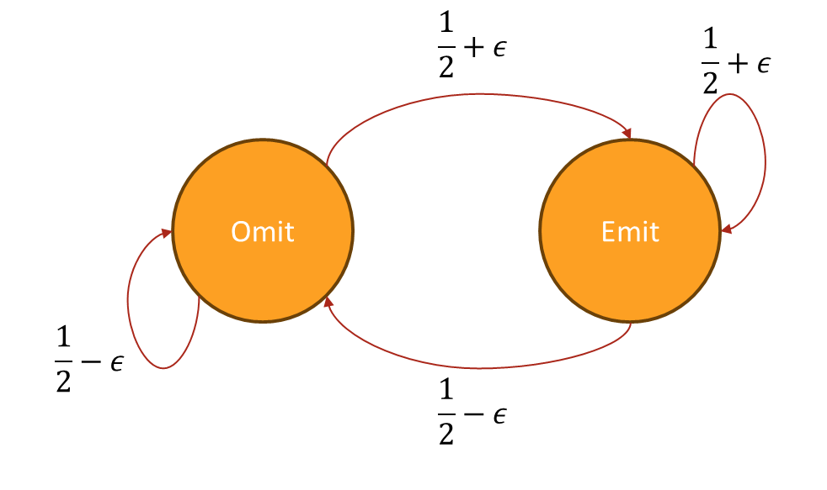
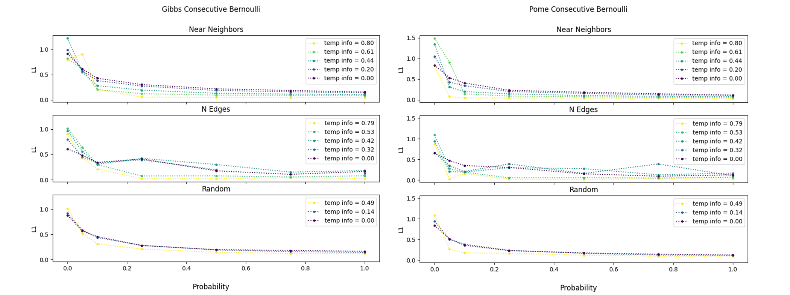
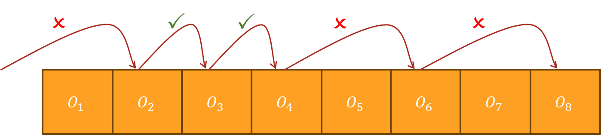
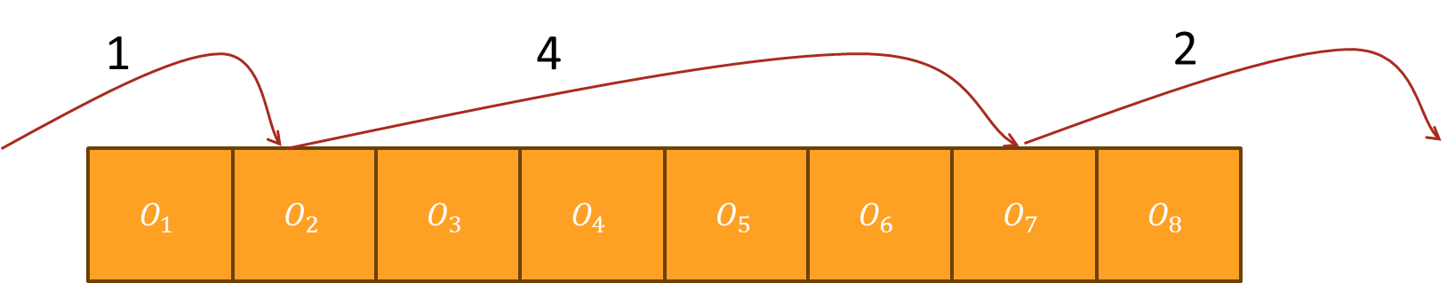
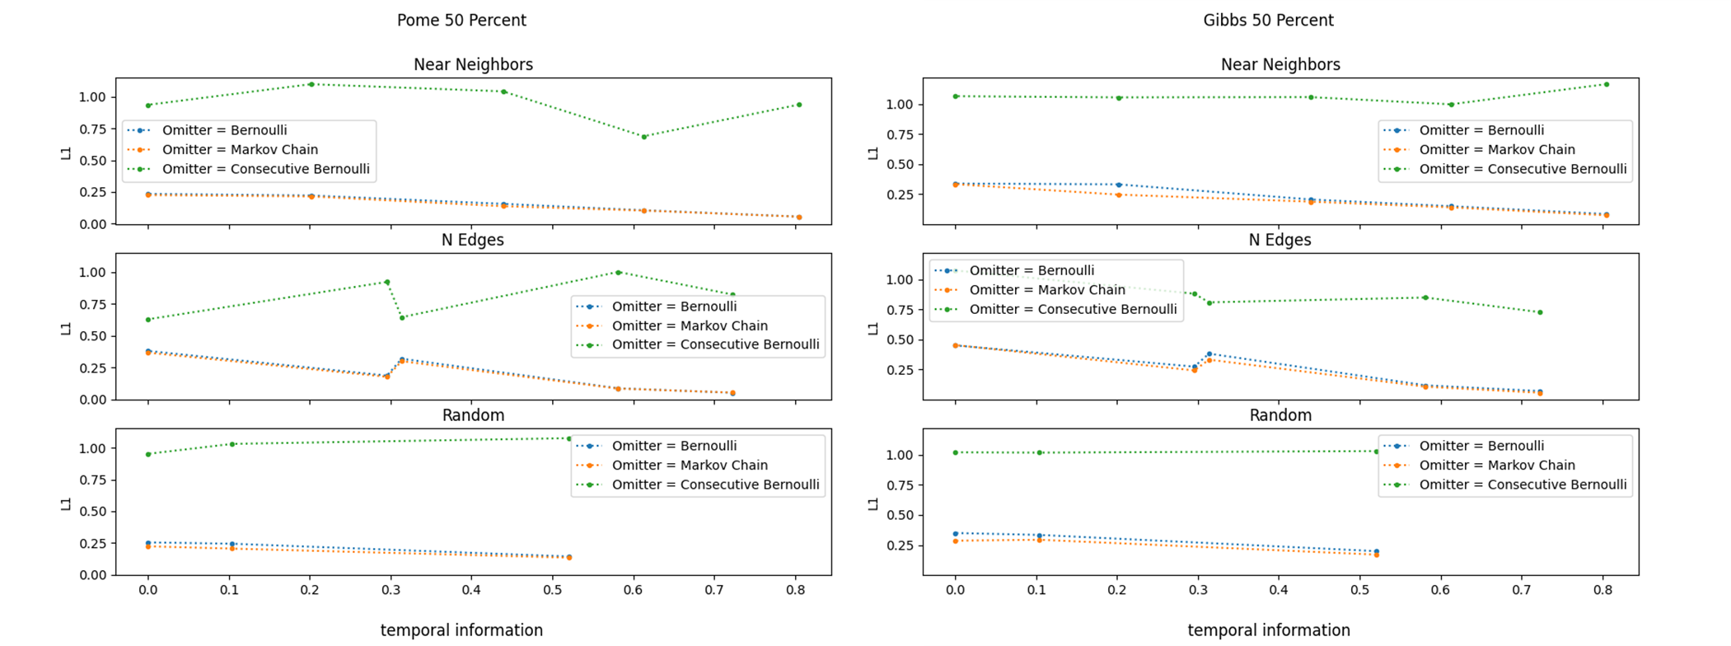
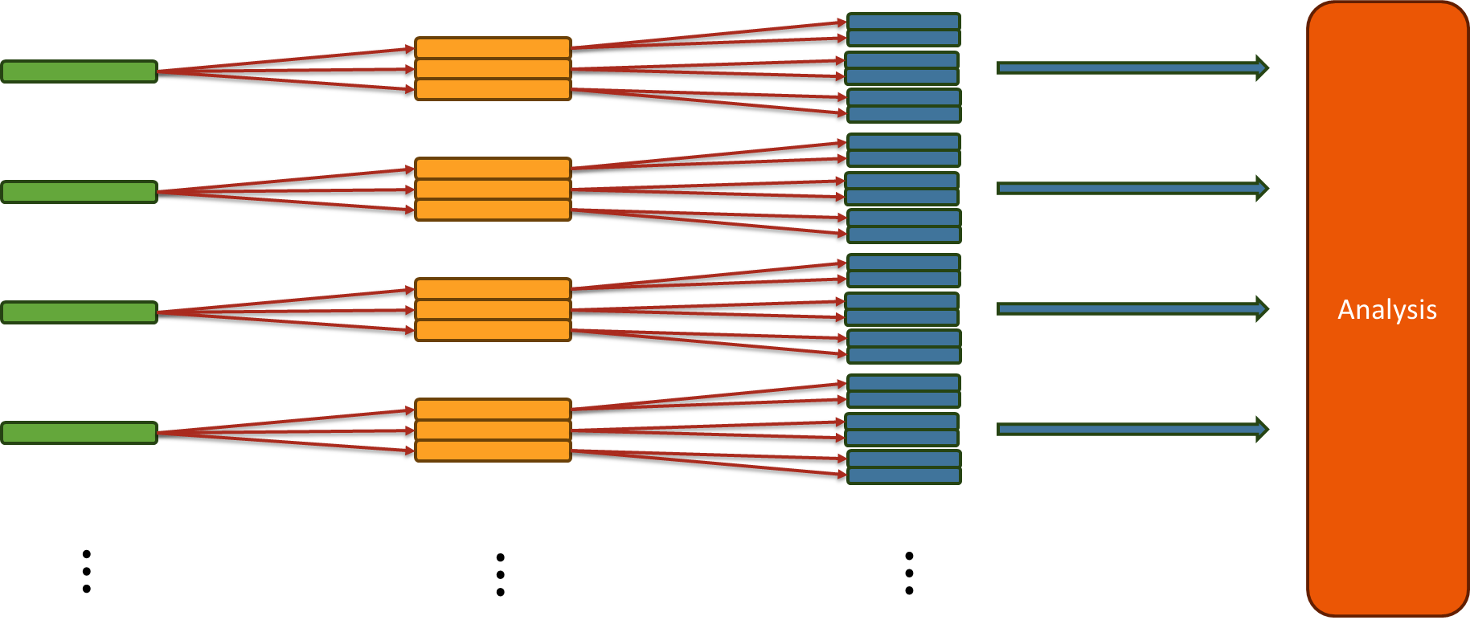
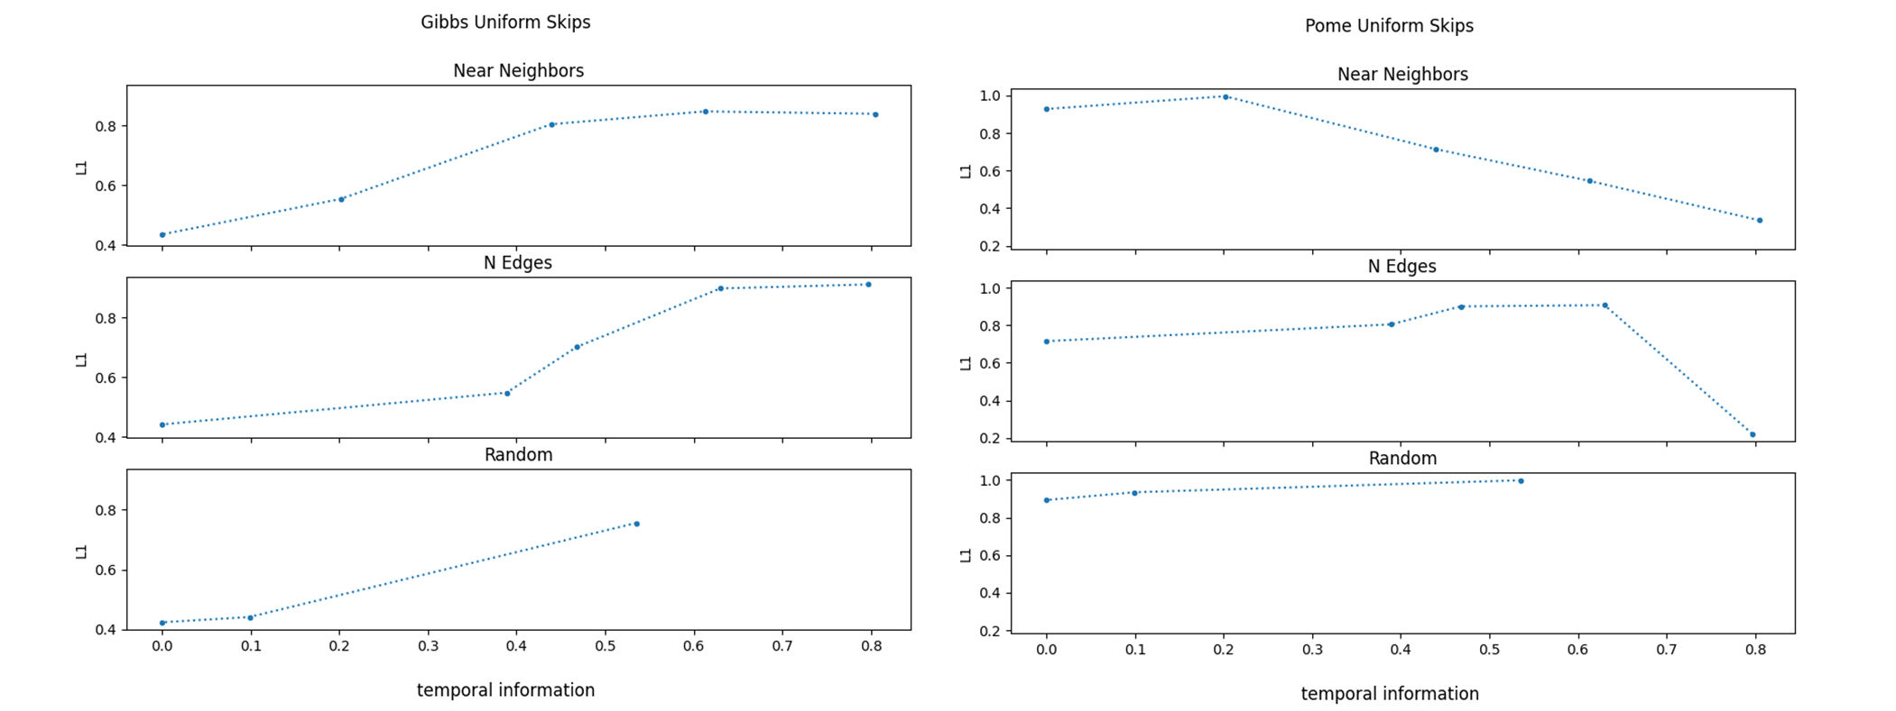
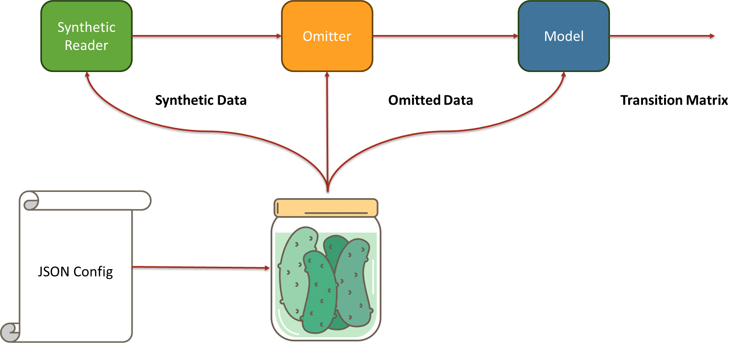



The Surprising Brittleness of Hidden Markov Model to Time Dependent Omitting Processes
Liad Ben Shachar and Itay Geva, Supervised by Binyamin Peretz
Introduction
A Single Pipeline
Data Analysis
HMM are a common model for Time Series Data
Missing Observations (or Omissions) are common in biological and medical data.
Current algorithms assume omissions to be i.i.d, and if this assumption holds, the problem remains convex, thus the algorithms converge to the solution.
For a single test, the pipeline is:
Where we can control each parameter in the pipeline.
For example, here are a few omission processes (OP) we used:
Bernoulli (i.i.d)
Markov
Consecutive Bernoulli
Uniform Skips (no consecutive observations)
We used known omission locations
Reconstruction only for T, known E
Wellness metric:
$$L_{1}=\frac{{\left\|T_{reconstructed}−T_{GT}\right\|}_{1}}{{\left\|T_{random}−T_{GT}\right\|}_{1}}$$
Thus, when $L_{1}=1$ the algorithm is as bad as a random choice
The HMM Model
Results
Omissions in Time Series Data
$p$ of Consecutive Bernoulli can be used as a measure of how many concurrent observation are left in the data:
We can see for no consecutive observations – worse than random.
For $p=0$ we get $50\%$ of the data, we can compare it to different OPs:
In Pome – worse than random, in Gibbs- can be explained by TI.
Goals
Analyze current algorithms’ performance under different omission processes.
Expose a failure of The algorithms for omission processes where there are no concurrent observations remain.
Analyze the performance in relation to the temporal information in the model.
Results on Consecutive Bernoulli Omissions
Project Framework
Challenges
Given we have many dimension of freedom, such as:
Model Used (Gibbs/EM)
Omission Process (type and parameter p)
Transition Matrix (Type and temporal information)
The number of pipelines we need is vast:
The framework needs the ability to add and change single pipelines without re-calculation of known pipeline results in order to save time.
The solution: pickle, a python library that allows for saving of variables and models.
A robust framework is required to perform the analysis, it needs to allow for:
Integration of different algorithms
Flexible experiments comprised of old and new tests
Computationally efficient
Results on 50% of the data in different OPs
Breaking is not due to lack of data, but rather of lack of consecutive observations.
For uniform skips:
Hypotheses
Algorithms Are trying to infer the transition matrix $T$ from the observations and known locations of omissions.
When There are no concurrent observations, there is no explicit effect of $T$ but only its powers $T^{j}$ where $j$ is the jumps between observations.
For a subset of these problem, extracting $T$ from its powers is intractable.
If the model has little temporal information (TI) , $T$ and its powers are similar, thus the naïve solution for $T$ might be good.
Thus our hypotheses are:
Lack of concurrent observations will break the reconstruction algorithms
The larger the TI the worse the reconstruction
Multiple Pipelines illustration
Results on Uniform Skips Omissions
Conclusions
No concurrent Observations indeed breaks current reconstruction algorithms.
Temporal information helps reconstruction for data with few omissions, while the opposite is true (for Gibbs algorithm) for data with few to no consecutive observations
Chosen Architecture for the project
April 2023

