Slide 1

Analysis and Modelling of Vehicles
Course: Data Mining
Lecturer: Chen Hajaj
Team Members: Gal Ben Lulu,Itay Habsha

Slide 2
The problem
Missing Values: Required careful imputation to maintain data integrity.
Outliers: Needed robust handling to prevent distortion.
Supervised Learning:
Class Imbalance: Challenged fair model training across pollution levels.
Feature Overload: Too many features post-encoding complicated identifying key predictors.
Unsupervised Learning:
Hidden Patterns: Focused on uncovering valuable insights in vehicle data.
High Dimensionality: Required handling complex, non-linear relationships.
Clustering: Challenged by identifying coherent and meaningful groups.
Unexpected Findings: Needed interpretation of surprising data trends.

Slide 3
Research Goals
Supervised learning:
For the supervised learning task, the focus is on predicting the pollution level of vehicles.
Pollution Level Categories:
Low Pollution Level (1): Environmentally friendly vehicles
Medium Pollution Level (2): Vehicles with moderate emissions
High Pollution Level (3): Vehicles with significant environmental impact
Unsupervised Learning:
This process helps to identify relationships and trends that may not be immediately obvious, offering additional insights into vehicle pollution trends.

Slide 4
Methods used to problem’s domain
Missing Values: Imputed missing data using statistical methods (median/mode) and logical mappings based on feature relationships.
Outliers: Addressed using the IQR method and category-specific thresholds, clipping extreme values to maintain consistency.
Supervised Learning:
Class Imbalance (Supervised Learning): Applied SMOTE to generate synthetic samples and balance the class distribution.
Feature Overload (Supervised Learning): Used feature importance analysis (Random Forest) to select the most impactful predictors and reduce dimensionality.

Slide 5
Methods used to problem’s domain
Unsupervised Learning:
High Dimensionality (Unsupervised Learning): Utilized dimensionality reduction techniques such as PCA and Kernel PCA to simplify the dataset while retaining key information.
Hidden Patterns (Unsupervised Learning): Applied clustering algorithms like K-Means and hierarchical clustering to uncover latent trends.
Clustering: Validated clustering results using Silhouette Score and the Elbow Method to ensure coherence and reliability.
Unexpected Findings: Analysed the impact of external factors, such as regulatory changes, to contextualize and explain surprising trends in the data.

Slide 6
Dataset and Features
Api:
The dataset was obtained through an open API available on Data.gov.il.
Features:
The dataset contains information about vehicles in Israel, including vehicle ID, vehicle type, fuel type, pollution level, manufacturing year, and other relevant details. The dataset contains approximately 25,000 records with 26 columns.
Examples of features:
kvutzat_zihum: Numeric identifier for the pollution group to which the vehicle belongs.
moed_aliya_lakvish: Text column indicating the date the vehicle was imported.
kinuy_mishari: A textual field providing the commercial designation of the vehicle.
mishkal_kolel: A numerical value indicating the vehicle's total weight.

Slide 7
Methodology- Supervised Learning
Logistic Regression: Baseline model for simplicity and interpretability.
SVM: Handles non-linear boundaries, ideal for complex pollution prediction.
Random Forest: Captures feature interactions, strong predictive performance.
KNN: Simple proximity-based model for non-linear relationships.
Gradient Boosting: Improves accuracy, effective for imbalanced and complex datasets.

Slide 8
Methodology- Supervised Learning
Evaluation Metrics:
F1 Score: Prioritized to balance precision and recall, ensuring a reliable evaluation for class imbalance handled by SMOTE.
Accuracy and ROC-AUC: Used for a comprehensive evaluation of the model's general performance.
Precision and Recall: Ensured the models were correctly detecting pollution levels without false positives or false negatives, especially for the critical categories.

Slide 9
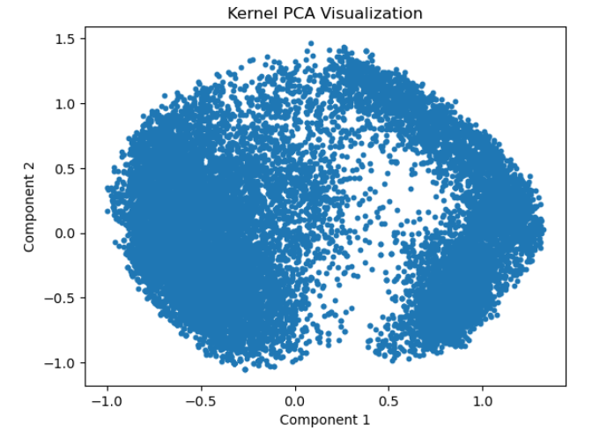
Methodology- Unsupervised Learning Kernel PCA
Kernel PCA Visualization
Kernel PCA with a sigmoid kernel was applied to reduce the data to 2 dimensions, capturing non-linear patterns. The scatter plot shows the transformed data, revealing underlying structures or clusters that may not be visible in the original feature space.

Slide 10
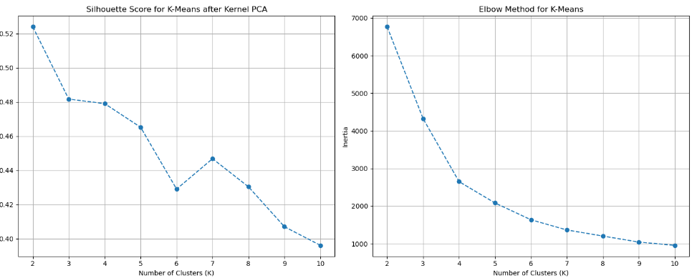
Silhouette Score VS Elbow Method
Silhouette Score: Measures how well clusters are defined by comparing the cohesion within clusters to the separation between them. The highest score (0.524) was achieved for K=2, indicating well-defined and distinct clusters.
Elbow Method: Evaluates the optimal number of clusters by identifying the "elbow point" where the improvement in within-cluster inertia slows down. The method suggested K=4, but the clustering results showed less meaningful separation.
Conclusion: After testing both K=2 and K=4, K=2 was chosen as the optimal number of clusters due to its clearer partitioning and better Silhouette Score. This provided more distinct and interpretable clusters.

Slide 11
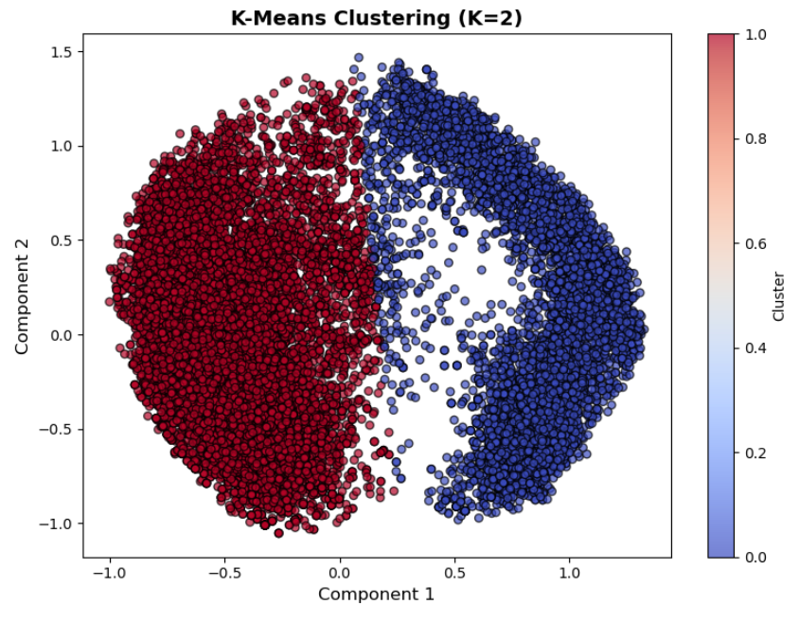
K-means Clustering
K-Means Clustering Visualization (K=2)
This code applies K-Means clustering with 2 clusters (K=2) on the Kernel PCA-transformed data. The scatter plot visualizes the clustering results, with each data point color based on its assigned cluster. This helps to assess how well the data is grouped into clusters, showcasing the separability of the two groups in the reduced feature space.

Slide 12
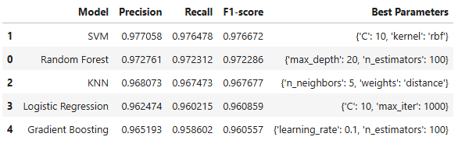
Results & Discussion
Supervised Learning:
Best Model: Random Forest and SVM emerged as top performers with F1-scores of 0.975 and 0.973, respectively. Random Forest was ultimately selected due to its robust performance across all pollution categories, minimal overtting, and better generalization abilities compared to SVM.

Slide 13
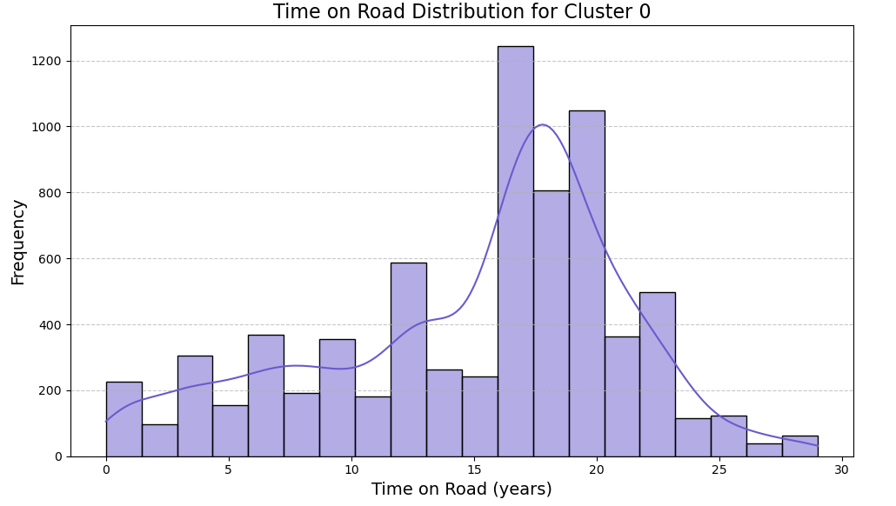
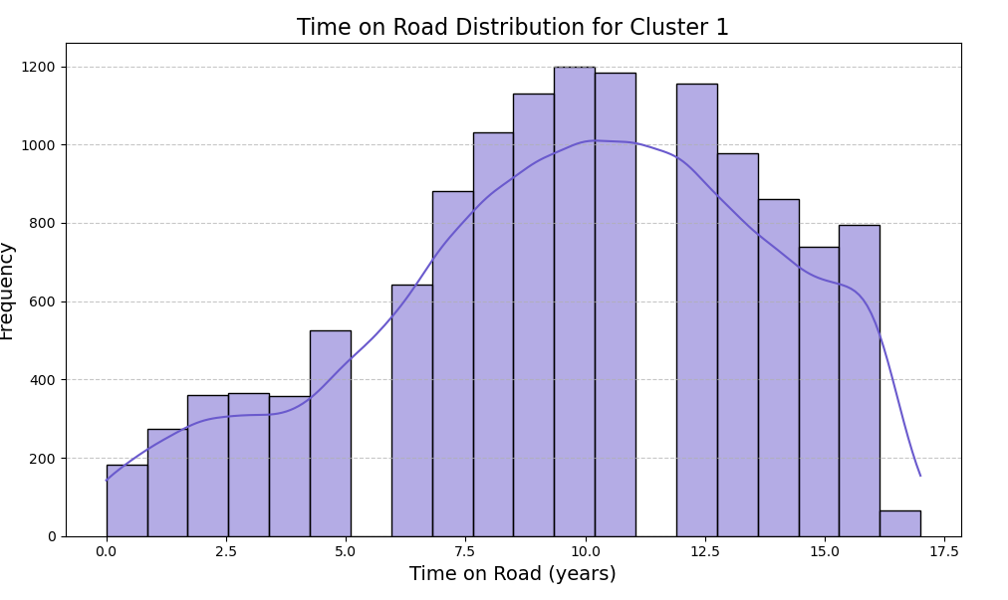
Results & Discussion
Unsupervised Learning:
Cluster 0 included older, heavier vehicles with a diverse range of weights and an average road usage of approximately 15 to 20 years. Cluster 1 consisted of newer, lighter vehicles, typically manufactured around 2014, with a shorter road usage period of approximately 5 to 10 years.

Slide 14
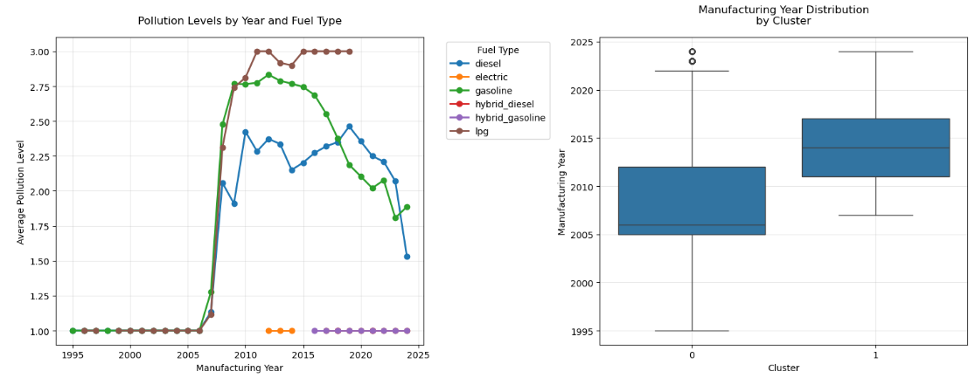
Unexpected Outcomes
Cluster 1, with newer private vehicles (average manufacturing year 2014), shows higher pollution levels compared to older vehicles in Cluster 0.
The increase in emissions for newer vehicles is linked to regulatory changes affecting cars manufactured after 2008.
These findings highlight the significant impact of the 2008 regulations on pollution levels in newer vehicles.

Slide 15
Conclusion
Supervised Learning:
Achieved 97.5% accuracy in predicting vehicle pollution levels using Random Forest.
Unsupervised Analysis:
-Discovered Cluster 0 represents older, heavier vehicles with an average road usage of 15 years, while Cluster 1 includes newer, lighter vehicles averaging 9.7 years.
-Our analysis revealed that pollution levels are primarily influenced by regulatory changes, with stricter standards implemented in 2008 having a greater impact than vehicle age or weight.

Slide 16

Thank you for listening!

