Slide 1
Data Science Project
Roi Shricki
Itay Itzhak
Holon institute of technology

Slide 2
Research question
Can we predict the price of the new real estate?
In our project, we will be focusing on the Israeli market for real estate
The Israeli real estate market is known for its high prices
We looked at what the real estate price affects as part of our project

Slide 3
Project Overview
Step 6: Conclusions
Step 1: Identify Data Group
6
1
The data we use are taken from the yad2.co.il website, which has a lot of information that helps us analyze the Israeli real estate market.
Conclusions drawn from the project
Step 5: Machine Learning
Step 2: Data Extraction
5
2
Using supervised methods, dividing the data set into training and test sets.
Created a dataset by using the crawling (using Selenium) method on yad2.co.il website.
Step 4: EDA & Visualization
Step 3: Data Processing
Analyzing the dataset, visualization, and normalization
4
3
reorganize our data by cleaning missing values, removing duplicates and finding out our outliers.

Slide 4
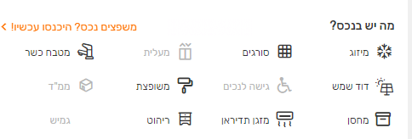
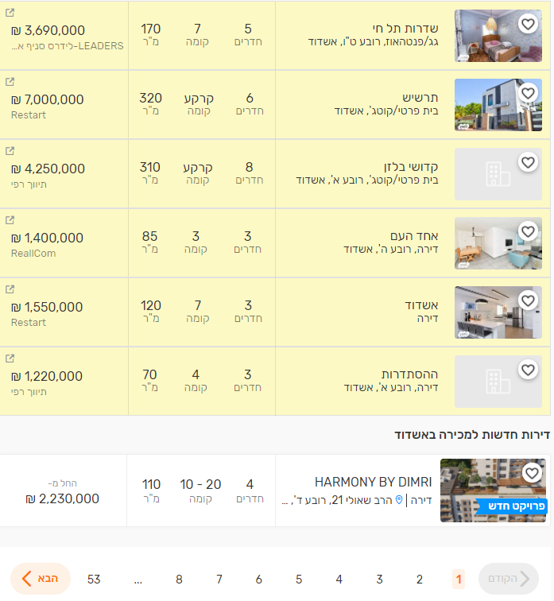
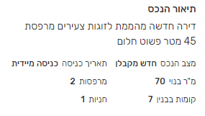
Identify Data Group
There is a lot of information about real estate for sale on yad2.co.il.
The information include prices, balconies, air-conditions, and even if there is Kosher kitchen in the house.

Slide 5

Data Extraction
We encountered a problem that we can not download the entire page
cause all the important information is inside the ad, so you need to click on it to access all the information
So, how we did it?
helps us to click each ad and to extract data automatically
Using
Selenium
The program repeat the process for every single page until we had enough data
Repeat
Process
Once we had enough data we’re exported all data to CSV file
Export
To CSV

Slide 6
Data Processing
We had a lot of data but before we're going to analyze this data we need to clean it first.
Our first step was to change the names of the columns to English
Hebrew -> English
Understanding data and separating into binary and non-binary columns
Separate Data
Dealing with missing values and "None" values as a string like "לא צוין מחיר"
Missed Values
Deleting rows without values in “SM” (Square Meter) and “Price” columns
Clean Dataframe

Slide 7
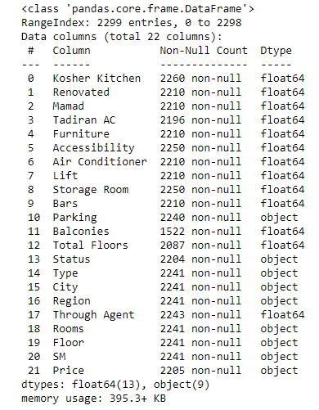
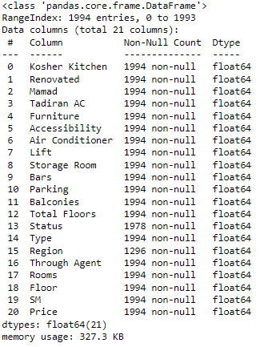
Comparing before and after data
Before
After

Slide 8
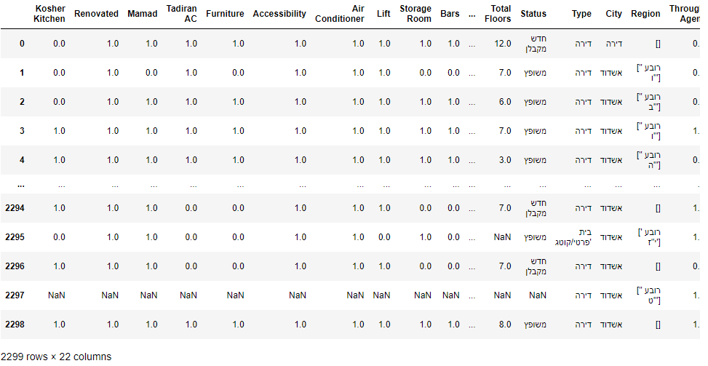
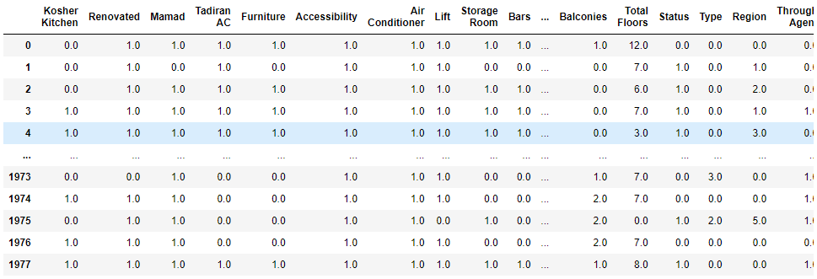
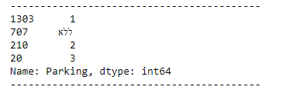
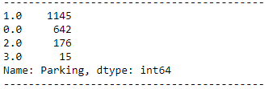
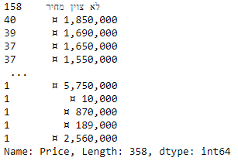
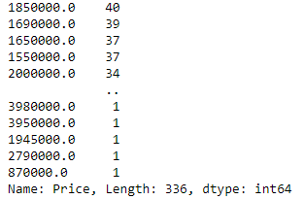
Comparing before and after data
Before
After
Before
After
Before
After

Slide 9
What we did to clean our Dataset?
Devide columns
Delete wrong data
Dividing columns by a concept like Binary, Value and Categorical
Deleting data that isn’t from Ashdod city,
In addition, we deleted rows with "nan“ and ”-” in “Rooms” column.
Fix values
Convert types
On binary columns we assigned 0.0 to “nan” values.
On Value columns we assigned wrong values like “ללא“ to nan
By converting our data from string to float type, we can manipulate it in the next step
Remove strings signs
Drop duplicates
Our data was pretty good cause drop_duplicates() function didn’t delete any row
Our “Price” column present with some signs that make convert type difficult, so we clean it from sign and prepare the strings to convert

Slide 10
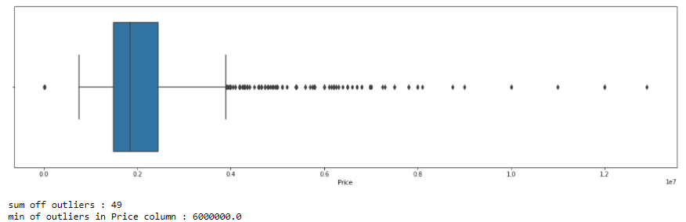
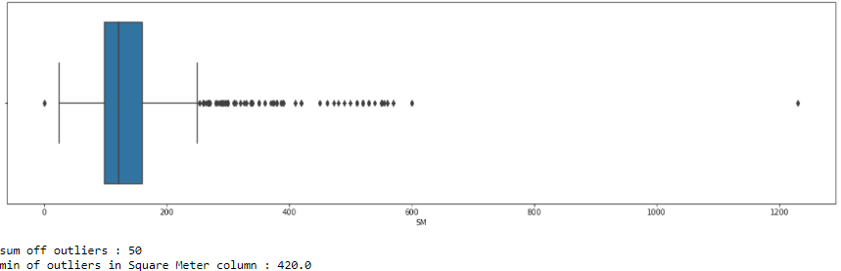
Exploratory Data Analysis
Using “matplotlib” library to display some bar graphs and pie graph.
In addition to visualization we trying to figure out if we have some outliers data.

Slide 11
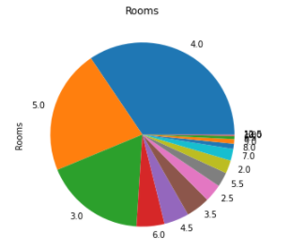
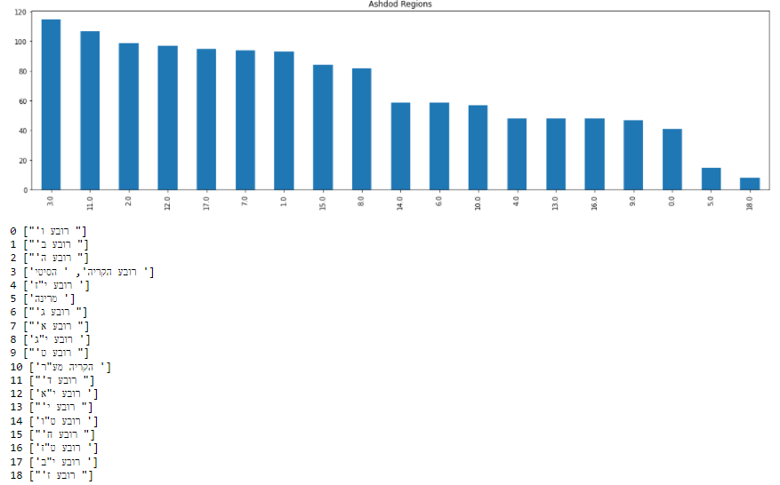
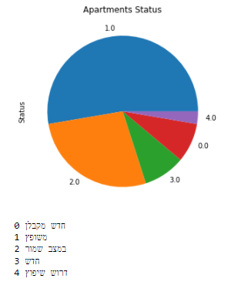
Visualization Graphs
18 is characterized as a religious region so we can see it is the reason that we have little data on that region
As we can see most apartments has 4 rooms!

Slide 12
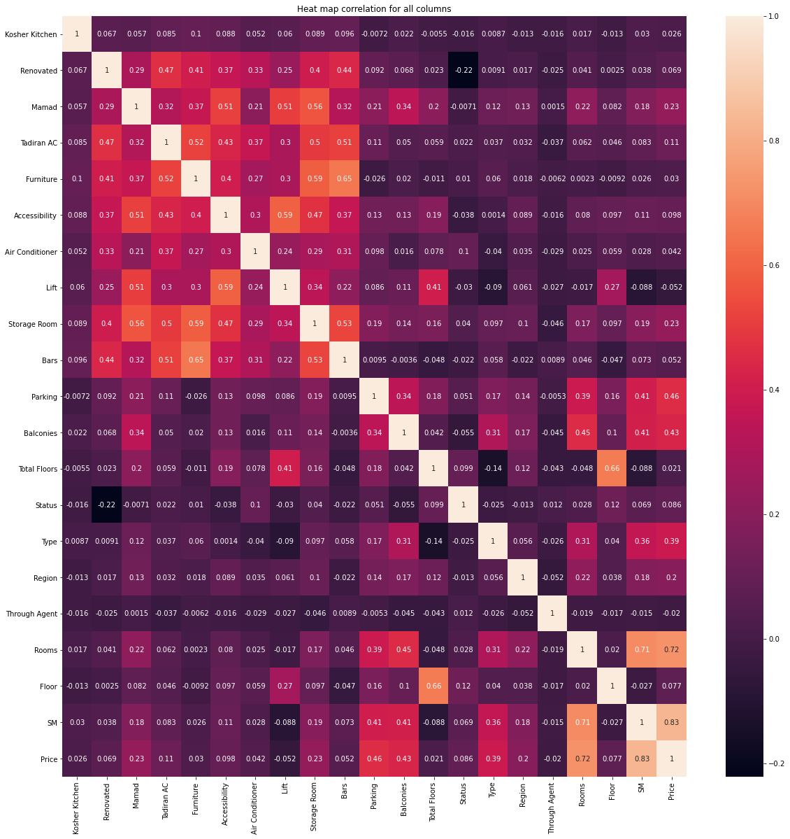
Heat Map
Heat map helps us know better about correlation between our columns

Slide 13
Merge Columns
After we had the heat map we know better which columns are important to predict price.
According to that we created three new columns to our Dataset
Extra Areas Score
Consists from:
Balconies
Parking
Storage
Total Rooms Score
<= 3.5 rooms = 1
> 3.5 and < 5 rooms = 2
<= 5 rooms = 3
These columns have high value with the “Price” column in our heat map

Slide 14
According to the heat map we want to delete some columns and handle outliers in the “Price” and “SM” columns
95%
Remove rows with price higher than 6,000,000 and lower than 800,000
80%
Price
60%
Remove rows with Square Meter greater than 500 and lower than 20
SM
50%
30%
Delete
Delete “Region”, “Status” ,” Kosher Kitchen” and “Through Agent” columns

Slide 15
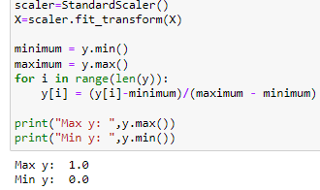
Machine Learning
In this step we had the final data set, but we need to take care of a few things before going to predict.
Split “Price” column from all other columns
dividing the dataset to train and test groups
Use scaler for X and normalize y
Search for the fittest model to our data

Slide 16

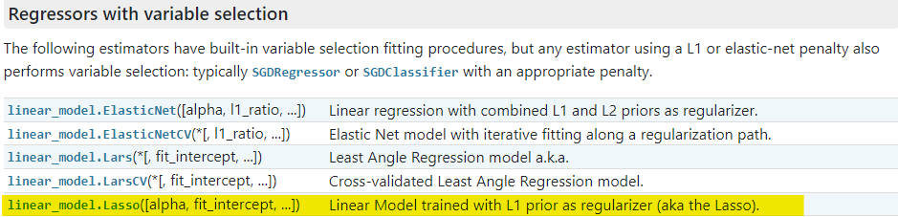
Machine Learning
To know what model to choose, you need first to understand what do you want to predict
In our case: we want to predict the price
Now we know that linear regression is the model that we want to check.
however, we want to try another model to compare between.
After searching on the internet we found another linear model

Slide 17
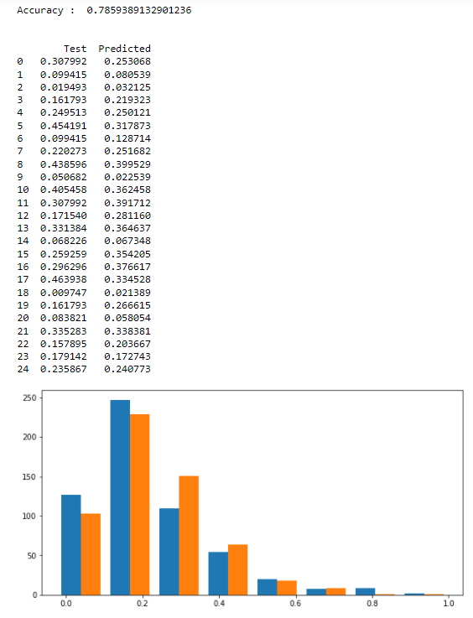
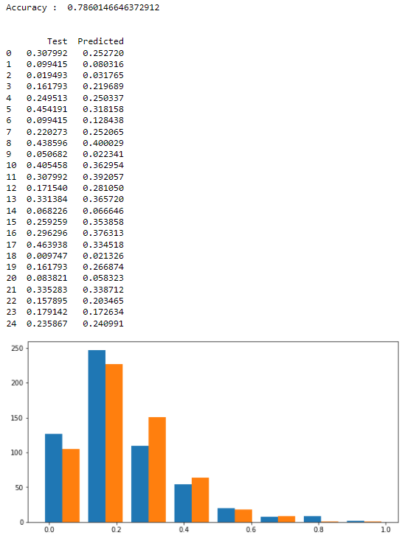
Comparing between Linear Regression and Lasso
Linear Regression
Lasso

Slide 18
Conclusions
We chose the model with the best accuracy
Linear Regression was the model with the better predicted accuracy
Linear Regression Accuracy : 0.786

Slide 19
Thank You !

