Slide 1


Final Presentation
Stock Direction Prediction
Team 003: Itay Mutzafi | Moran Zaks | Shaked Schnarch
Workshop in Data Science |Fall 2025

Slide 2
Agenda
Reminder
Project Rodemap
Recent Progress And Main Challenges
Project Status - Finished Missions
Data & feature engineering (block-based)
Phase 1: Regression (insight: noise dominates)
Phase 2: Pivot to direction classification
Classification results (binary direction) vs baselines
What improved: controlled comparisons via feature blocks
What’s Next
Conclusions & next steps
Evaluation: the “no cheating” zone (walk-forward)
Current Results
Tasks & metrics (ML + finance-aware)
Benchmarks and Expectations

Slide 3
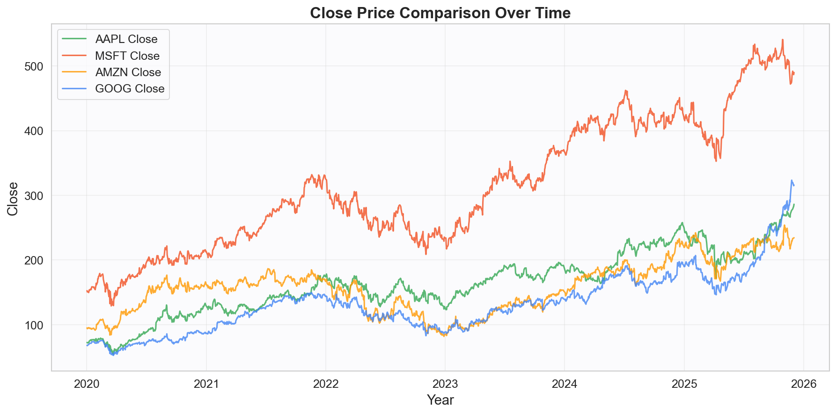
Reminder
The Task
Binary Classification based on the past data, predict if A Stock stock will increase or decrease in the future
Main dataset
Yahoo Finance’s API
Additional dataset
News

Slide 4

Project Roadmap
Evaluation
16.12 - 19.1
26.10 - 24.11
24.11 - 8.12
9.12 - 15.12
19.1 – 15.3
Business Understanding
Data Preparation
Model Selection
Finishers

Slide 5
Progress and Technical Milestones (1)
Foundations & Baseline (Pre-Checkpoint)
Problem Formulation: Defined Multi-Task objectives (Regression & Classification) and KPIs.
Core Infrastructure: Initialized repository and modular code architecture (src).
EDA and Profiling: Exploratory Data Analysis and statistical profiling of returns.
Resource Refinement: Optimized news scraping and FinBERT preprocessing pipelines.
Baseline Engineering: Constructed primary OHLCV lags and technical indicators.

Slide 6
Progress and Technical Milestones (2)
Advanced Engineering & Optimization (Post-Checkpoint)
Specialized Estimators: Developed dedicated model architectures for continuous and discrete prediction.
Intelligent Feature Selection: Implemented Forward Selection to isolate signal from market noise.
Smart Pipelines: Built automated, leakage-free processing for time-series cleaning and modeling.
Advanced Engineering: Integrated full feature blocks and refined sentiment feature alignment.
"Model Zoo" Benchmarking: Evaluated Linear, Tree-based ensembles, and Boosting algorithms.
Model Deep-Dives: Granular hyperparameter tuning and error analysis to maximize predictive accuracy.

Slide 7
Progress
Stage I: Foundations (Pre-Checkpoint)
Scope Definition: Focused on major Tech indices (AAPL, MSFT, AMZN, GOOG).
Data Infrastructure: Built automated pipelines for fetching OHLCV market data & Google News headlines.
Initial Analysis: Conducted EDA (Exploratory Data Analysis) on price distributions and volatility.
Stage II: Advanced Engineering (Post-Checkpoint)
Feature Architecture: Developed modular "Feature Blocks" (Momentum, Volatility) & integrated FinBERT for Sentiment.
Leakage-Free Pipelines: Engineered custom transformers for time-series cleaning and scaling without look-ahead bias.
Rigorous Validation: Implemented strict Walk-Forward Validation (Expanding Window) to mimic real trading.
Optimization: Executed Feature Selection experiments and tuned ML models (Random Forest vs. Baselines).

Slide 8
Benchmarks and Success Criteria

Slide 9
Tasks and Metrics
Task A: Regression
Task B: Classification
Predict next-day log return
Predict direction: Up vs Down
RMSE (primary)
R² (diagnostic)
Directional Accuracy (sign correctness)
Accuracy / Precision / Recall
Strategy Sharpe Ratio (risk-adjusted utility)
Sharpe helps translate predictions into practical signal quality.

Slide 10
Data & feature engineering (block-based)
Feature blocks
Trend
moving averages, slopes
Targets
Momentum
lagged returns, momentum
Regression: next-day log return
Classification: direction (up/down)
Volatility
rolling std, risk regime
Block design enables controlled comparisons (ablation-style).
Macro
VIX, market index
Sentiment
FinBERT headline tone

Slide 11
Evaluation: the “no cheating” zone (walk-forward)
Why?
Random splits leak future information in time-series.
Fold 1
Train
Test
Future
Fold 2 (expands)
Train
Test
This mimics real deployment: train on past → predict immediate future.
We aggregate results across folds (mean ± std) to assess stability.

Slide 12
Phase 1: Regression (insight: noise dominates)
Example (AAPL): RMSE by fold
Model | Feature set | Fold | RMSE
Ridge | B_1_Tren_Prop_Vola_Mome | 0 | 0.023488
Ridge | B_1_Tren_Prop_Vola_Mome | 1 | 0.030017
RandomForest | B_1_Tren_Prop_Vola_Mome | 0 | 0.034502
RandomForest | B_1_Tren_Prop_Vola_Mome | 1 | 0.035713
XGB_Aggressive | B_1_Tren_Prop_Vola_Mome | 0 | 0.032245
Takeaway: even simple models (Ridge) can match or beat complex ones at a 1-day horizon, suggesting a very weak and unstable signal.
This motivated our pivot to direction classification.

Slide 13
Phase 2: Pivot to direction classification
From magnitude to direction
Regression (log-return)
Classification (up/down)
Direction is often more robust than magnitude under heavy noise
Better aligned with trading decisions (enter/exit)
We still evaluate vs strong baselines under walk-forward splits

Slide 14
Classification results (binary direction) vs baselines
Accuracy (mean ± std) under strict temporal evaluation
Model | Best FeatureSet | Accuracy (mean ± std)
ClassificationBaselineMajor | B_11_Sent_Vola_Macr_Mome | 0.528 ± 0.040
ClassificationBaselineOne | B_11_Sent_Vola_Macr_Mome | 0.528 ± 0.040
ClassificationBaselineRandom | B_5_Tren_Mome | 0.521 ± 0.026
LogisticRegression | B_16_Tren_Even_Vola | 0.503 ± 0.045
XGBClassifier | B_13_Tren_Sent | 0.501 ± 0.055
RandomForestClassifier | B_4_Tren_Even_Sent_Prop | 0.492 ± 0.040
ClassificationBaselineZero | B_10_Prop_Tren_Mome | 0.474 ± 0.037
Observation: strong baselines reach ~0.52–0.53 accuracy; our first-round ML models did not yet beat them consistently.

Slide 15
What Improved: Feature & Model Insights

Slide 16
Project Status - What’s Next

Slide 17
Conclusions & next steps
What we built
End-to-end pipeline (data → features → models)
Strict walk-forward evaluation (no leakage)
Leaderboard-style comparisons across models/feature blocks
Thank you- Questions?
What we learned
1-day return magnitude is extremely noisy
Baselines are strong and hard to beat honestly
Data coverage shifts matter (sentiment stability)
Next steps
Try longer horizons / “flat” class to reduce noise
Confidence-based decisions (predict only when confident)
Richer news sources + better time alignment to market hours

